Slide 1
Madeline Leininger: Transcultural Nursing
Presented By: Danielle Dill, Lacy Halley, Chelsea Infante, Jerome & Jessica Key

Slide 2
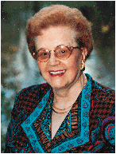
Who is Madeline Leininger?
Born: July 13, 1925
Died: August 10, 2012
Education: University of Washington

Slide 3
Transcultural Nursing
She developed the concept of Transcultural Nursing.
In 1850 Madeleine Leininger experienced what she describes as culture shock
This experience led her to become the first professional nurse in the world to earn a doctorate in anthropology and led to the development of Transcultural Nursing as a subfield of nursing.

Slide 4
Theory of Culture Care Diversity and Universality- basic concepts
Ethno nursing methodology
To assist the career in discovery of data
Patient perception vs. Nurse perception
Perceptions of caring varies with cultural background

Slide 5
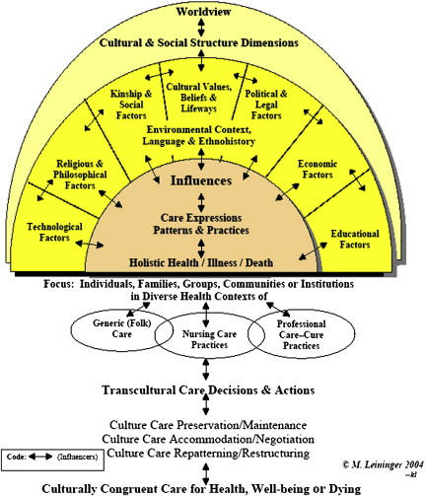
Sunrise Model
Nursing Care
Involves generic (emic) and professional (etic) care systems

Slide 6
Transcultural Nursing and Patient Care
Goal of Leininger’s theory- harmonious care measures.
Addresses the cultural differences that influence the nurse-client relationship.
Wholistic and understanding approach.
Notes:
Goal of Leininger’s theory- IS TO PROVIDE CARE MEASURES THAT ARE IN HARMONY WITH AN INDIVIDUAL’S CULTURAL BELIEFS, PRACTICES AND VALUES.
Addresses the cultural dynamics the influence the nurse-client relationship. WHEN A NURSE THAKES THE TIME TO LEARN ABOUT A PATIENTS CULTURE, BELIEFS AND VALUES, THIS STRENGTHENS THE NURSE-CLIENT RELATIONSHIP.
Wholistic and comprehensive (understanding) approach. THIS APPROACHALLOWS ONE TO LOOKS AT THE “WHOLE OR BIGGER PICTURE”. WHICH HAS LED TO BROADER NURSING PRACTICE APPLICATIONS.

Slide 7
What does this mean for nursing?
Incorporated into care plans = Better care.
Nurses can influence positive changes.
Notes:
Incorporated into care plans. – CULTURALLY COMPETENT NURSING CARE CAN ONLY OCCUR WHEN CLIENT BELIEFS AND AND VALUES ARE THOUGHTFULLY incorporated into NURSING care plans.
Nurses can influence positive changes- NURSES WHO VALUE AND UNDERSTAND CULTURALLY COMPETENT CARE can influence positive changes IN HEALTHCARE PRACTICES.

