Slide 1
Madeline Leininger: Transcultural Nursing
Presented By: Danielle Dill, Lacy Halley, Chelsea Infante, Jerome & Jessica Key

Slide 2
Who is Madeline Leininger?

Slide 3
Theory of Culture Care Diversity and Universality- basic concepts
Ethno nursing methodology
  To assist the career in discovery of data
  Patient perception vs. Nurse perception
    Perceptions of caring varies with cultural background

Slide 4
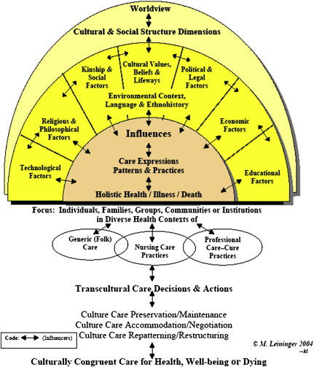
Sunrise Model
Nursing Care
Involves generic (emic) and professional (etic) care systems

Slide 5
Transcultural Nursing and Patient Care
Goal of Leininger’s theory- harmonious care measures.
Addresses the cultural differences that influence the nurse-client relationship.
Wholistic and understanding approach.
Notes:
Goal of Leininger’s theory- IS TO PROVIDE CARE MEASURES THAT ARE IN HARMONY WITH AN INDIVIDUAL’S CULTURAL BELIEFS, PRACTICES AND VALUES.
Addresses the cultural dynamics the influence the nurse-client relationship. WHEN A NURSE THAKES THE TIME TO LEARN ABOUT A PATIENTS CULTURE, BELIEFS AND VALUES, THIS STRENGTHENS THE NURSE-CLIENT RELATIONSHIP.
Wholistic and comprehensive (understanding) approach. THIS APPROACHALLOWS ONE TO LOOKS AT THE “WHOLE OR BIGGER PICTURE”. WHICH HAS LED TO BROADER NURSING PRACTICE APPLICATIONS.

Slide 6
What does this mean for nursing?
Incorporated into care plans = Better care.
Nurses can influence positive changes.
Notes:
Incorporated into care plans. – CULTURALLY COMPETENT NURSING CARE CAN ONLY OCCUR WHEN CLIENT BELIEFS AND AND VALUES ARE THOUGHTFULLY incorporated into NURSING care plans.
Nurses can influence positive changes- NURSES WHO VALUE AND UNDERSTAND CULTURALLY COMPETENT CARE can influence positive changes IN HEALTHCARE PRACTICES.

