Slide 1
Nursing Theorist
By Aj Imparato, Audrea Flowers and Jada Perkins
Lakeview College of Nursing
Myra Estrin Levine

Slide 2
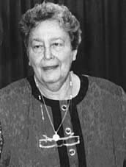
Myra Levine
"Ethical behaviour is not the display of one's moral rectitude in times of crisis, it is the day-to-day expression of one's commitment to other persons and the ways in which human beings relate to one another in their daily interactions."

Slide 3
Myra Levine
Born Chicago, IL
Died 1996
Conservation Model
BS(University of Chicago), MS (Wayne University), Ph.D (Loyola University)
Nursing Jobs
  Private Duty, Civilian(Army), Surgical Nursing Supervisor, Administration

Slide 4
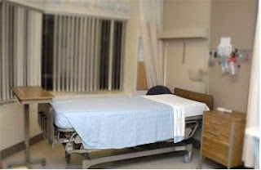

Conservation of Personal Integrity

Slide 5
Conservation of Personal Integrity
Recognizes the individual as one who strives for recognition respect self awareness selfhood self determination
  Ex. Recognize and protect patient’s space needs

Slide 6
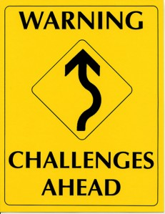
LIMITATIONS

Slide 7
LIMITATIONS
Conservation model
  No Health prevention – prevent illness before it starts.
  Only present and short term focus
  Patient has to rely on nurse more

Slide 8
LIMITATIONS
Conservation of energy
  Manic patients, ADHD in children
  Pts with limited movements (paralyzed).

Slide 9
LIMITATIONS
Conservation of structural integrity
  Damage is done due to patient request seeking beauty
    Ex. plastic surgeries, breast enhancements and liposuctions

Slide 10
LIMITATIONS
Conservation of personal integrity
  Pts psychologically impaired and incapacitated
  Cannot comprehend and absorb knowledge (comatose patients, suicidal individuals or clients)

Slide 11
LIMITATIONS
Conservation of social integrity
  When pt has no significant others like family members.
  Abandoned children, psychiatric patients who are unable to interact, unresponsive clients (unconscious individual)- pt no longer focus

