Slide 1
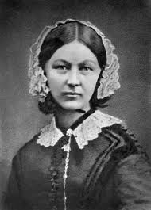
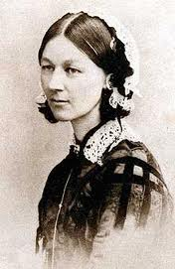
Florence Nightingale
(1820-1910)
Jenna Kreke, Lindsay Rhodes, Nichole Spencer, Amanda Harrison

Slide 2
Florence Nightingale
Born in 1820 in Florence, Italy
Born into a wealthy family
At age 17 she had a calling from God
Studied Nursing when she was 31 years old

Slide 3
What does this mean for us today?
Official records show that by February 1855, the mortality rate had fallen from 60% to 42.7% and then, once a fresh water supply was introduced, it dropped further to 2.2%.
Between 5 and 10 percent of the patients who are admitted to U.S. acute-care hospitals acquire one or more infections there, and the risks have steadily increased in recent decades, according to a February 2003 article in The New England Journal of Medicine.

Slide 4
Hand washing and Infections
99,000 associated deaths each year
32% are UTI infections
22% are surgical infections
15% lung infections
14% are blood infection

Slide 5
Fun Facts about hand washing
Around two-ten million bacteria can be found on your hands
If your hands are wet or damp germs can spread thousands times more than dry.
Millions of germs can accumulate under bracelets, watches and rings.
People who are right handed wash their hands thorghly than left handed people.
CDC quotes 80% of all infections get transmitted by hands

Slide 6
References
http://www.buzzle.com/articles/hand-washing-facts.html
http://www.spartacus.schoolnet.co.uk/REnightingale.htm
http://www.patientsafetyfocus.com/patient-safety-current-st.html

