Slide 1
Biography of Madeleine Leininger
Is the founder and leader of the academic field of transcultural nursing with focus on comparative human care, theory, and research.
She is Professor Emeritus, College of Nursing, Wayne State University, Detroit, Michigan, and Adjunct Professor, College of Nursing, University of Nebraska Medical Center, Omaha Nebraska.
Internationally known transcultural nursing lecturer, educator, author, theorist, administrator, researcher, and consultant in nursing and anthropology.
Living legend of the American Academy of Nursing and an Emeritus Member of the American association of Colleges of Nursing.
She was one of the first to graduate professional nurses prepared with a PhD in cultural anthropology.
Notes:
According to Leininger and McFarland (2002), Dr. Leininger is the founder and leader of the academic field of transcultural nursing with a comparative human care, theory, and research. Dr. Leininger is Professor Emeritus, College of Nursing, Wayne State University, Detroit, Michigan, and Adjunct Professor, College of Nursing, University of Nebraska, University of Nebraska Medical Center, Omaha, Nebraska. She is an internationally known transcultural nursing lecturer, educator, author, theorist, administrator, researcher, and consultant in nursing and anthropology. Known as a living legend of the American Academy of Nursing and an Emeritus Member of the American Association of Colleges of Nursing. Dr. Leininger is also one of the first to graduate professional nurses prepared with a PhD in cultural anthropology. (p. V)

Slide 2
Biography Continued
She initiated the Nurse Scientist and several transcultural nursing programs in the 1970s and 1980s.
Editor of the Journal of Transcultural Nursing and started the Transcultural Nursing Society.
She is a distinguished professor and lecturer in over 90 universities and has given over 1200 public addresses in the USA and overseas.
Author and editor of 28 books and has published over 220 articles
She published the first qualitative nursing research book (1985), an early psychiatric nursing book (1960) and the first Culture Care Diversity and Universality Theory book.
Leininger resides in Omaha, Nebraska and is active as a worldwide transcultural nursing consultant, educator, lecturer, and writer.
Notes:
According to Leininger and McFarland (2002), Dr. Leininger initiated the Nurse Scientist and several transcultural nursing programs in the 1970s and 1980s. She was also the editor of the Journal of Transcultural Nursing and started the Transcultural Nursing Society. Also known as being a distinguished professor and lecturer on over 90 universities and has given over 1200 public addresses in the USA and overseas. Dr. Leininger is also the author and editor of 28 books and has published over 220 articles. She published the first qualitative nursing research book (1985), an early psychiatric nursing book (1960) and the first Culture Care Diversity and Universality theory book. Dr. Leininger resides in Omaha, Nebraska and is active as a worldwide transcultural nursing consultant, educator, lecturer, and writer. (p.V)

Slide 3
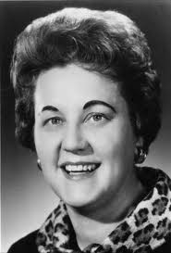

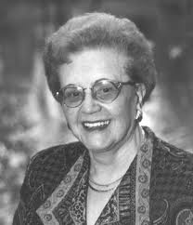
Madeleine Leininger
Rides in Omaha, Nebraska and is 86 years old
Notes:
Pictures retrieved from http://www.google.com/imghp?hl=en&tab=wi.

Slide 4
Development Of Theory
Developed -from clinical experience
Evolved- over 3 decades
Recognized- Culture was missing a link in nursing knowledge and practice
Concept f of culture>>> anthropology (enthonursing)
Concept of care>>>nursing practice

Slide 5
Culture and Caring
Theory developed through 2 concepts:
1. Caring
2. Culture
1. 40s-Worked as a student nurse & a hospital staff nurse and gained a lot of experience here.
50s-Was a psychiatric nurse for children of different backgrounds. Realized there was missing link and experienced culture shock.
2. Caring in some form was universally present in all cultures but some practices of care were different. Ethnonursing was a tool used to explore the transcultural concept (understands the diversity and universality of care). As a result, her theory came to be called The Culture Care Theory.

Slide 6
Transcultural Nursing
Many nurses have limited knowledge about culture
Demand for transcultural nursing knowledge will continue to increase, Leininger wants nurses to have a willingness to learn about cultural differences
Notes:
Leininger recognized the fact that nurses had a lack of knowledge about the variety of cultures that they could possibley be encountering.
She understood that the cultures would continue to change. Leininger wanted nurses to be passionate and willing to learn about different cultural backgrounds.
Transcultural nursing: essential for excellence... Madeleine Leininger. (1996). Nursing, 26(1), 76. Retrieved from EBSCOhost.

Slide 7
Cultural Beliefs
When handing Saudi Arabian patients medications, do not use left hand as it is seen as unclean
Using high-tech equipment may be seen as a cultural taboo to the Amish
Patient may refuse help if we do not respect their beliefs
Notes:
When teaching her followers, she wanted to make clear that not all cultures were the same. Different cultures have different beliefs. For example, Saudi Arabian patients will not accept medication from the left hand of a nurse, they view that hand as unclean. Another example has to do with the Amish, and their belief of not using technology.
Leininger wanted to make it clear that understanding cultural differences is a neccesity. Without the proper knowledge, patient interactions may be unsuccessful.
Transcultural nursing: essential for excellence... Madeleine Leininger. (1996). Nursing, 26(1), 76. Retrieved from EBSCOhost.

Slide 8
Cultural Practices
The use of folk healers is now widely accepted in the hospital setting, as long as it does not harm or interfere
Herble medicines and teas are now used in conjuction with western medicine as long as it does not interact
Nurses who are aware of Madeleines teachings about cultural practices are looked highly upon as hospitals are looking for those who are culturally aware
Notes:
Those who are aware of Madeleine’s teaching about the need for understanding different cultures are looked highly upon. Our society is constantly changing & Leininger recognized that it was becoming a necessity to incorporate culture beliefs into nursing. For example, folk healers and herble medicines are now accepted in hospital settings, as long as it does not interfere with treatment. Nurses who followed the transcultural theory would be aware of these beliefs and how to successfully incorporate them with treatment.

Slide 9
How It Helps
Makes nursing easier and more acceptable
Makes it more rewarding to patient
  Builds trust faster if nurse is aware of their beliefs
Makes it easier for nurse
  Knowledge base for different cultural beliefs towards pain and death
  Easier to make nursing diagnoses towards pain and healing
Notes:
Leinenger believed that when her theory was learned and incorporated with everyday patient interactions, the nurse will benefit. Understanding a patients culture and respecting their beliefs can allow the patient to gain trust.
Transcultural nursing: essential for excellence... Madeleine Leininger. (1996). Nursing, 26(1), 76. Retrieved from EBSCOhost.

Slide 10
Implementations
Nurses strive to discover insights about our own cultural background
Nurses discover the clients cultural beliefs
Nurses will gain an appreciation for cultural commonalties and differences
Notes:
Madeline believed that we as nurses need to discover our own beliefs about our cultural backgrounds before we can begin to understand anyone elses. After we have discovered our own beliefs, we can then work towards understanding and accepting other cultures. With this discovery and understanding, she then believed that we as nurses will gain an appreciation for different cultures. With this understanding we will also explore differences and commonalities among different cultures.
Leininger, M., & McFarland, M. R. (2002). Transcultural nursing: Concepts, theories, research, & practice. New York, NY: McGraw-Hill.

Slide 11
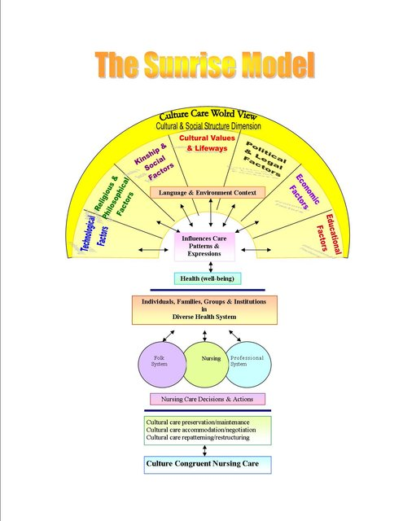
Notes:
Leininger produced a sunrise modle as a step by step guide for nurses to provide culture care on the world view.
Leininger, M., & McFarland, M. R. (2002). Transcultural nursing: Concepts, theories, research, & practice. New York, NY: McGraw-Hill.

Slide 12
Main Concepts
“Care is (or should be) the essence and central domain of nursing.”
Madeleine Leininger also stated that caring is the moral of nursing.
She wanted to develop a plan care that was universal and fit for all cultures around the world.
Care is a basic essential for human needs, growth, development, and survival.

Slide 13
Predictive Tents Essentials
Commonalities
Worldview and Social Structure
Professional and Generic Care
Modalities

Slide 14
Assumptions
Care is essential for growth, development, and survival
Care is essential in curing and healing
Forms, expressions, and patterns will vary
Every culture has both types of care
Culture care, values, and beliefs are embedded with in the culture

Slide 15
Assumptions cont.
Therapeutic nursing can only occur under certain circumstances
Differences within must be understood
Culturally congruency, specific, or universal care are essential
Nursing is an essential

Slide 16
References
Leininger, M., & McFarland, M. R. (2002). Transcultural nursing: Concepts, theories, research, & practice. New York, NY: McGraw-Hill.
Transcultural nursing: essential for excellence... Madeleine Leininger. (1996). Nursing, 26(1), 76. Retrieved from EBSCOhost.

