Slide 1
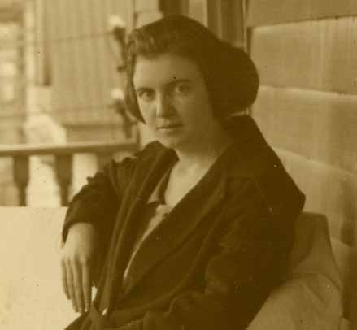
The Life and Theory of Virginia Henderson
By: Leslie Williams, Danielle Stafford, & Cynthia Quagrainie

Slide 2
Personal Life
Virginia Henderson was born November 30, 1897 in Kansas City, Missouri.
She was the fifth of eight children, her parents were Daniel B. and Lucy A. Henderson .
She died March 19, 1996 in Branford, Connecticut.

Slide 3
Nursing Education
Began her nursing education in the U. S. Army School of Nursing during World War I and graduated in 1921.
She worked for two years in the Henry Street Visiting Nurse Service after graduation.
In 1923 she accepted the position of teaching at the Norfolk Protestant Hospital in Virginia, where she remained for several years.
Received her Bachelors in the Science of Nursing in 1932.

Slide 4
Nursing Education Continued
She got her Master’s in 1934 from Teacher’s College, Columbia University.
After she got her Master’s at Columbia College, she joined the faculty and remained there till 1948.
Since 1953, she has been a research associate at the Yale University.
She has received honorary Doctoral degrees from the Catholic University of America, Pace University, University of Rochester, University of Western Ontario, and Yale University.

Slide 5
Honors
Virginia has been called the Nightingale of Modern Nursing and the “First Lady of Nursing”.
She was the first international nurse and her research and theories have changed the world of nursing and care-giving as we know it.
In 1988, the Virginia Historical Nurse Leadership Award was presented to her by the Virginia Nurses Association.
She has been recognized as one of 51 Pioneer Nurses in Virginia by the Virginia Nurses Association in 2000.
The Sigma Theta Tau International Library was named in her honor by the American Nurses Association Hall of Fame.

Slide 6
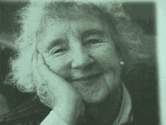
Definitions by Henderson
Nursing is: "assisting individuals to gain independence in relation to the performance of activities contributing to health or its recovery“.
Nurses do not just follow Physician’s orders; "The unique function of the nurse is to assist the individual, sick or well, in the performance of those activities contributing to health or its recovery (or to peaceful death) that he would perform unaided if he had the necessary strength, will or knowledge. And to do this in such a way as to help him gain independence as rapidly as possible".

Slide 7
Nurse's roles: Substitutive (doing for the person), supplementary (helping the person), or complementary (working with the person) 14 Fundamental Needs:
1. Breathing normally
2. Eating and drinking adequately
3. Eliminating body wastes
4. Moving and maintaining a desirable position
5. Sleeping and resting
6. Selecting suitable clothes
7. Maintaining body temperature…by adjusting clothing and modifying the environment
8. Keeping the body clean and well-groomed…
9. Avoiding dangers in the environment and avoiding injuring others
10. Communicating with others in expressing emotions, needs, fears, or opinions
11. Worshipping according to one’s faith
12. Working in such a way that one feels a sense of accomplishment
13. Playing or participating in various forms of recreation
14. Learning, discovering, or satisfying the curiosity that leads to normal development and health, and using available health

Slide 8

Impact on Patient Care
Henderson left behind a large amount of work that has become the soul of modern nursing.
Henderson’s definition of nursing has become the internationally adopted statement of who nurses are.
Her book Principles and Practice of Nursing elaborated on the knowledge nurses should possess and act upon.
She did not just study nurses but studied the differences that nurses can make in peoples lives.

Slide 9
Meaning for Nursing
Henderson describes nursing roles in relation to patient needs instead of a general theory of nursing
Because Henderson’s work is practical and based on her own nursing experience, it is useful in all different nations and cultures.
Nurses are the primary health care, diagnosing and treating when a doctor is not available.
Nurses are the general practitioners of tomorrow.

Slide 10
References
Chitty, K. K. & Black, B. P. (2007). Nursing Theory: The Basis of Professional Theory. Professional Nursing Concepts and Challenges, Fifth Edition, St. Louis, MO: Saunders, Elsevier Inc.
Henderson, V (1966), The Nature of Nursing; A Definition and Its Implications, Practice, Research, an d Education. New York, Macmillan Company.
Novelguide-Henderson Theory of Nursing (n.d.). Novel Guide-Henderson Theory of Nursing. Retrieved October 10, 2010, from http://www.novelguide.com/a/discover/genh_0002_0002_0/genh_0002_0002_0_00412.html

Slide 11
References Continued
NurseScribe - Lifelong Learning Resources for Nursing Students, Staff Nurses, Nurse Educators, and Nurse Authors. (n.d.). NurseScribe - Lifelong Learning Resources for Nursing Students, Staff Nurses, Nurse Educators, and Nurse Authors. Retrieved October 29, 2010, from http://www.enursescribe.com/Henderson
The American Heritage Dictionary of the English Language, 4th Edition, 2009 Houghton Mifflin Company.
Virginia Avernal Henderson. (2009). Retrieved from http://www.library.vcu.edu/tml/speccoll/vnfame/hendersonbio.html
Virginia Avernal Henderson. (n.d.). Nurses.info. Retrieved October 29, 2010, from http://www.nurses.info/nursing_theory

