Slide 1
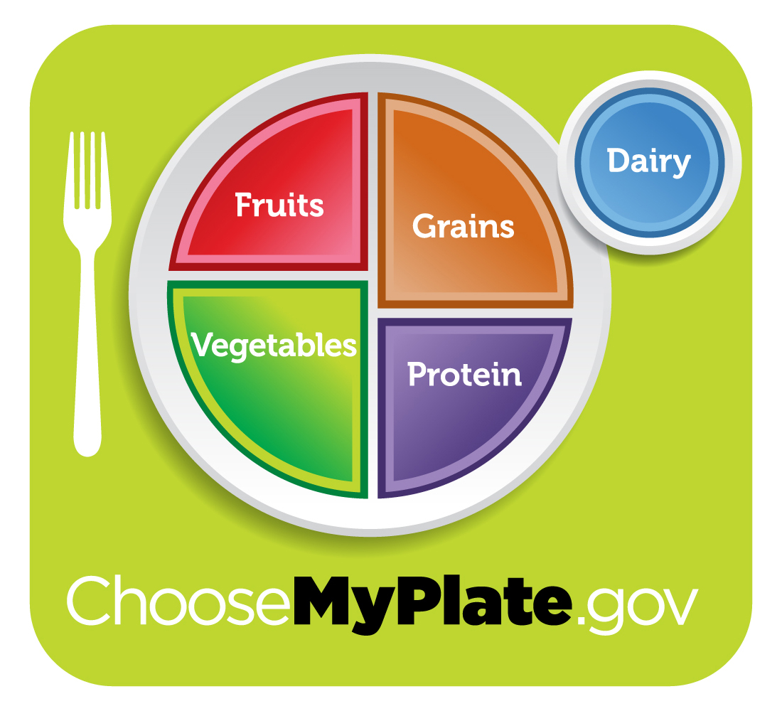
http://www.choosemyplate.gov/index.html

Slide 2
Why is good nutrition important ?
Vitamins
Minerals
Energy
Not too much
Not too little
Exercise !!
DeBruyne, L. K., Pinna, K., & Whitney, E. (2008). Nutrition & Diet Therapy (7 ed.). Belmont, CA: Wadsworth/Thomson Learning.

Slide 3
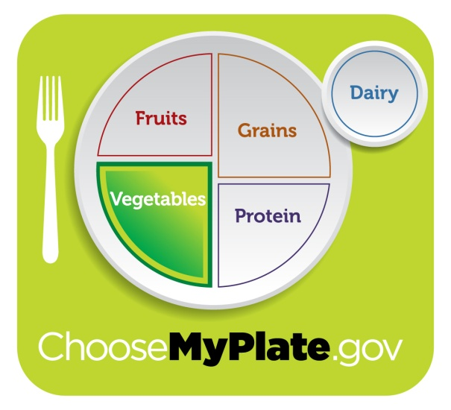
Vegetables
2 to 2and a half cups a day
http://www.choosemyplate.gov/index.html

Slide 4
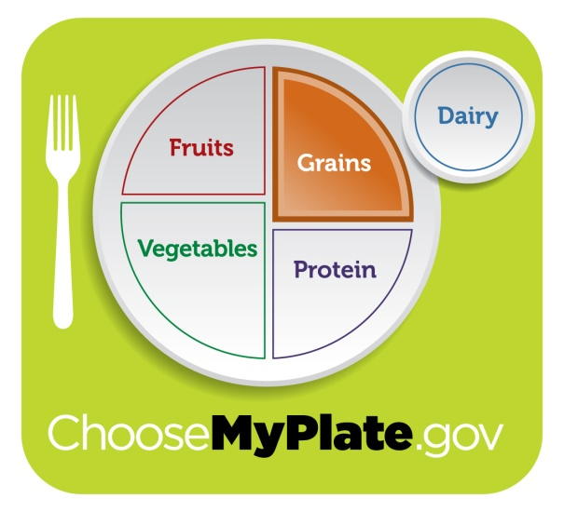
Grains
5-6 ounce equivalents a day
http://www.choosemyplate.gov/index.html

Slide 5
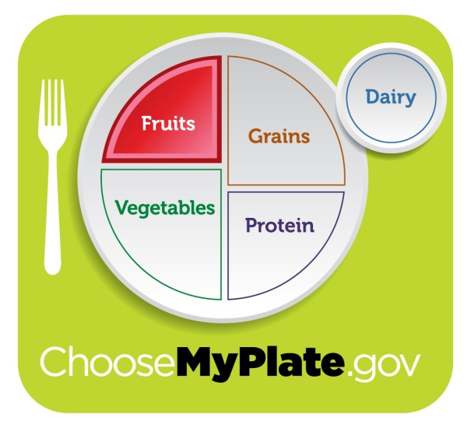
Fruits
1and1/2 cups a day
http://www.choosemyplate.gov/index.html

Slide 6
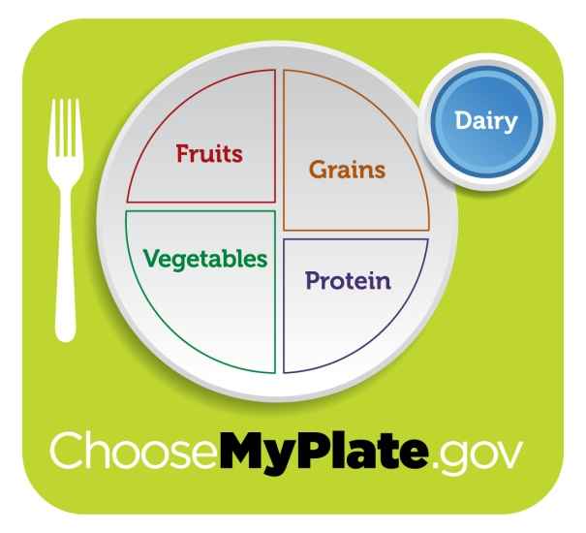
Dairy
3 cups a day
http://www.choosemyplate.gov/index.html

Slide 7
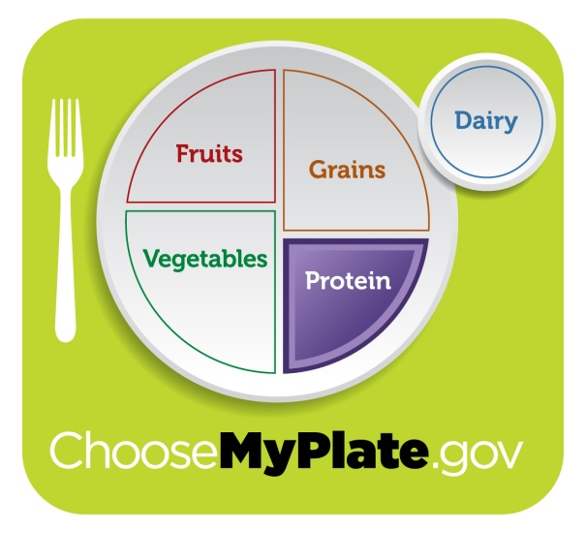
Protein
5 ounce equivalents per day
http://www.choosemyplate.gov/index.html

Slide 8
Tips for when you fill your plate
Balance your calories
Enjoy your food, but eat less
Avoid big portions
Eat more veggies, fruits and whole grains
Make half your plate fruits and veggies
Drink fat-free or 1% milk
Make half your grains Whole Grains
Cutback on sugary, salty and fatty foods
Drink water instead of sugary drinks
Kyle, T., Ricci, S.S. (2009). Maternity and Pediatric Nursing. Philadelphia, PA: Lippincott Williams & Wilkins.
http://www.choosemyplate.gov/index.html

Slide 9

http://www.choosemyplate.gov/index.html

