Slide 1
Spiritual Care in Dying Patients
An overview of care
By: Nicole Steele

Slide 2
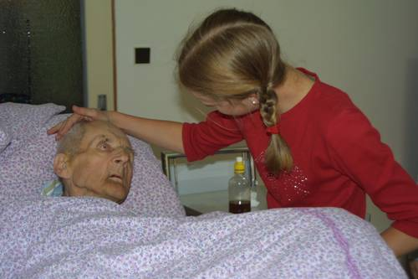
Common End of Life Fears
What has my life been about?
What will it be like now?
Who will take care of my family?
Fear of the unknown
What do I believe in?
How have I treated
people?
Where am I going?

Slide 3

Purpose of Spiritual Care
Helps with feelings of isolation felt by a dying patient and their loved ones
To bring the patient and family comfort, strength, and balance
“Spirituality is about a relationship between ourselves and the greater world” (Emanuel & Librach, p. 527)

Slide 4
Reasons Spiritual Care is Needed
Religious beliefs are common among patients, and oftentimes they want them to be addressed
Beliefs influence medical decisions
There is a relationship between spirituality and health
Supporting spirituality can enhance provider-patient relationship

Slide 5
Spiritual Assessment
Strengths
Vulnerabilities
Well-being
Emotional Struggles
Connection to spirituality
Education
Beliefs
Needs

Slide 6

SPIRIT MODEL
S= spiritual belief system
P= personal spirituality
I= involvement in a spiritual community
R= ritualized practices
I= implications for medical care
T= terminal events planned

Slide 7

HOPE MODEL
H= source of hope
O= organized religion
P= personal spiritual practice
E= end-of-life issues

Slide 8
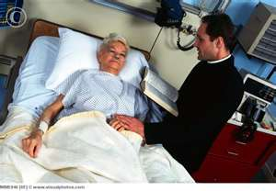
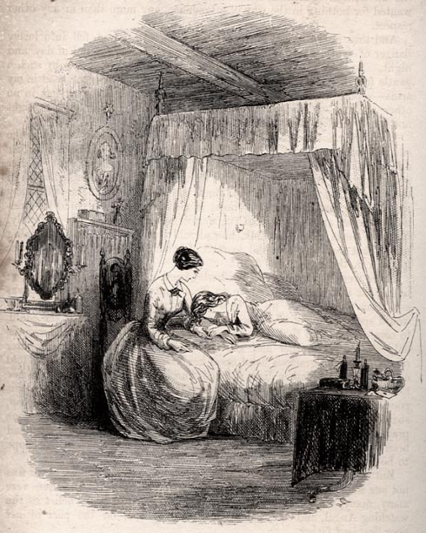
Providers of Care
Chaplains
Pastoral counselors
Spiritual counselors
Palliative team
Physician
Nurse
Aide

Slide 9
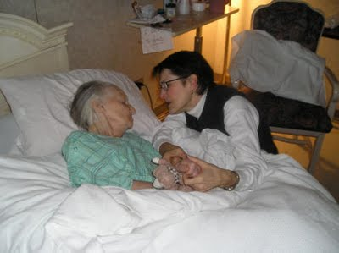
Presence
Be a quiet, supportive presence
Hold their hand
Sing
Talk
Meditate
Pray

Slide 10
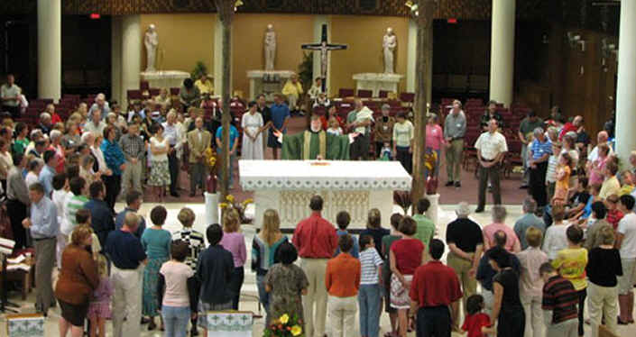
Tradition
Connect patient to their religious tradition
Offer to contact their own clergy
A link to heritage and rituals
Bring patient into the connection of a larger faith community
Buddhism, Hinduism, Islam, Jehovah’s Witness, Judaism, Christianity, Roman Catholic

Slide 11

Reflection
Patient discusses joys and concerns
Goal is to discover strengths and stressors
Counselors explore patient’s understanding

Slide 12

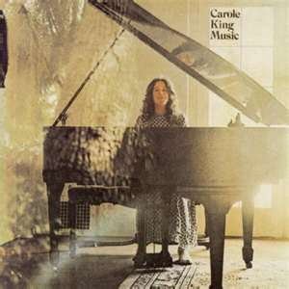
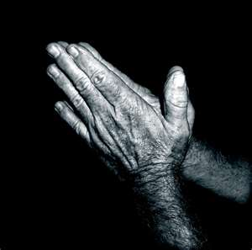
Paths to Spirituality
Location
Nature
Art
Music
Writing
Meditation
Prayer
Reading

Slide 13
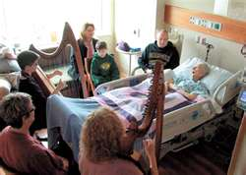
Things to Remember
Realize your own feelings on religion/spirituality
People may still be developing spiritually
Accompany patient’s through their illness
Practice with humility
Dismiss all prejudices

Slide 14
Works Cited
Emanuel, L. & Librach, S. (2007) Palliative care: core skills and clinical competencies. Saunders Elsevier: Philadelphia, PA
Mauk, K. (2010) Gerontological nursing: competencies for care. Jones and Bartlett: Sudbury, MA.

