Slide 1
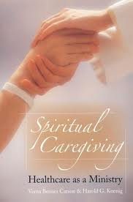
Spiritual Care
Understanding of spirituality.

Slide 2

Spirituality versus Religion The two are not synonymous

Slide 3
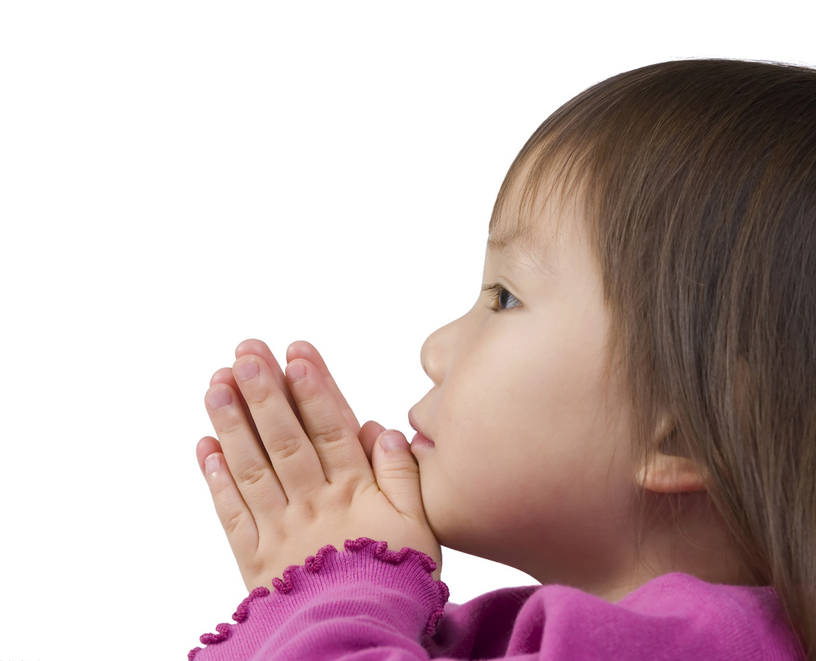
Spirituality defined
Relationship between ourselves and the greater world
One part of spirituality is religion
Addresses both universal and the particular
The interior awareness of our connection to the world
Influences some or all of a person’s daily life
The ability to fine solace

Slide 4
Spirituality defined cont’d
It is the quality of being concerned with deep feeling and beliefs(which are often religious), rather than physical parts of life
Not solely confined to organized religion
People can be spiritual without being religious

Slide 5
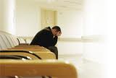
Concept of Spirituality
Finding meaning
Connecting with self, others, or a higher being
Congruence of values and beliefs
Love
Hope
Strength

Slide 6
Religion Defined
It is an expression of Spirituality by a particular group
It is the belief in and worship of a God or Gods

Slide 7
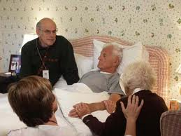
Holistic care includes spiritual care
Spiritual care must be a priority
Spiritual belief can affect clinical outcomes
Studies show spiritual beliefs can be a significant factor in the quality of life of people recovering from illness

Slide 8
What is Spiritual care?
It is the way in which you behave, talk, care , guide or treat a person.
It is given in a one to one relationship.
Makes no assumptions about personal convictions or life orientation.
Can be given by anybody to anyone regardless of beliefs, faith, or organization.

Slide 9

Three Primary Roles for Spiritual Care Professionals
Presence: Be with the patient in the experience of transition and hope to alleviate some of the patient’s isolation.
Tradition and Community: Connect the patient with clergy if that is what the patient desires
Reflection: Be present for the patient’s exploration of spiritual concerns and reflections

Slide 10
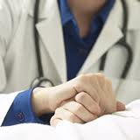
Presence
Offer humane, compassionate presence
Provide a quiet, supportive presence
Accompany patient on a path they may never have walked before
Sit at the bedside to talk, meditate, sing or hold a hand. The sound of a human voice or touch of the human hand will make a patient feel less alone.

Slide 11
Tradition and Community
Facilitate connection between patients, caregivers and their religious tradition.
Offer to contact clergy and congregations from the individual’s faith tradition
Offer to arrange for clergy to visit
Offer the patient to be placed on a prayer list

Slide 12

Reflections
Invite individuals and families to share their spiritual joys and concerns
Facilitate the patient to explore their inner experiences of meaning and faith

Slide 13


Other Ways to Provide Spirituality The Five Senses
Nature: Moving patient close to a window or bringing the sights and sounds of nature to the bedside using a video or audio recordings
Aroma: Fragrances of incense and spice, flowers, food such as peeling oranges
Touch: The warmth of a gentle furry animal or stuffed animals can create a memory of their connection to love, security and comfort; light massage can help them remember they are still fully human
Music: Live music or singing
Art: A favorite picture

Slide 14

Things to remember
People may still be developing spirituality even as they decline physically and mentally
Accompany people through their life-limiting illness as it reduces the sense of isolation
Help people find their own internal sense of comfort, balance, and strength
Alert chaplains to spiritual developments during routine care
Become comfortable with your own spirituality

Slide 15
References
Emanuel, L.,& Librach, S.L. (2007). Palliative care: Core skills and
clinical competencies. Philadelphia, PA. Saunders Elsevier
Kemp, P. (2009). Spirituality in health care: What can you do? British
Journal of Health Care, 3 (7), 333-335
Nobel, A., & Jones, C. (2010). Getting it right: Oncology nurses’
understanding of spirituality. International Journal of Palliative
Nursing, 16 (11), 565-569

