Slide 1
Social Stigmas
American Sociologist Erving Goffman defined Social stigma as a severe social disapproval of personal characteristics or beliefs that are perceived to be against cultural norms.

Slide 2
Cigarette smoking was once seen in American society as a classy, even healthy pastime. Smoking was hobby that could be enjoyed by everyone. It was a celebrity pleasure that even the workingman could afford.

Slide 3
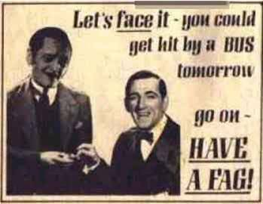

Slide 4
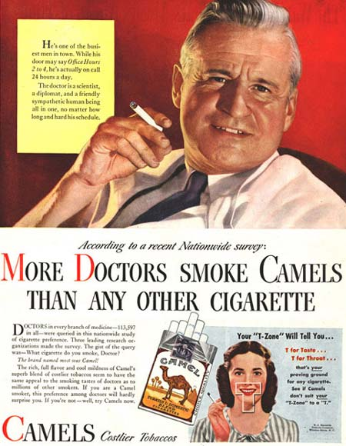

Slide 5
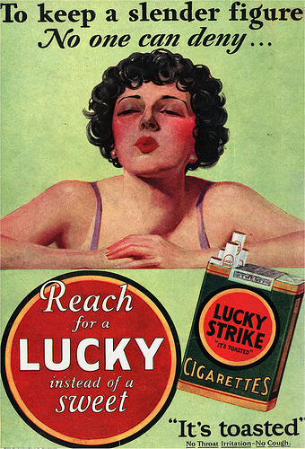

Slide 6
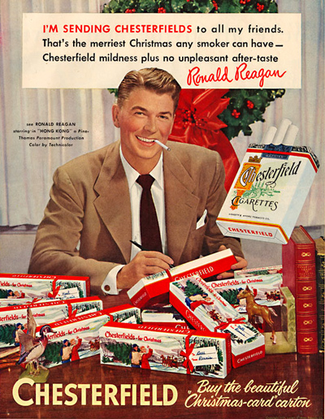

Slide 7
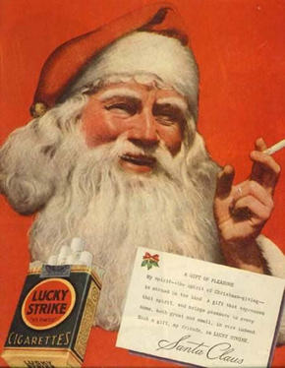

Slide 8
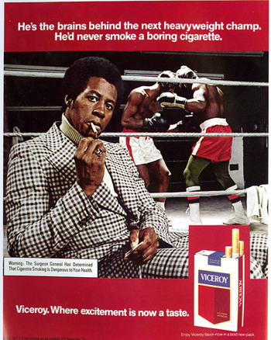

Slide 9
Times have since changed and now that research has proven that smoking leads to many health related illnesses, smoking is no longer looked at as such a glamorous luxury.

Slide 10
Modern anti-smoking campaigns are working just as hard as cigarette companies once did to promote their agenda: Tobacco companies not only lied to their consumers but that they also contributed to the deaths of millions of Americans.

Slide 11


Slide 12


Slide 13
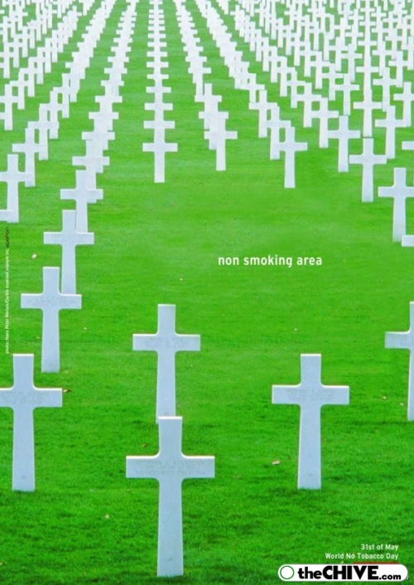

Slide 14
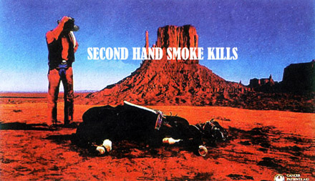

Slide 15
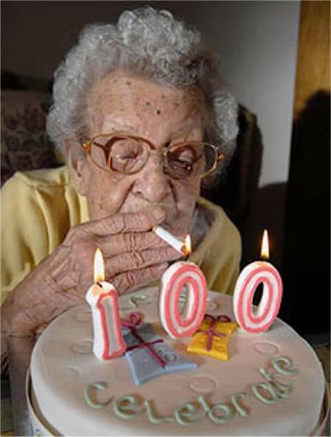

Slide 16
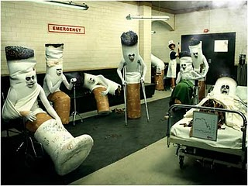

Slide 17
