Slide 1
FiTKiDS
Sydney Bailey
Lakeview College of Nursing
Nursing Informatics
July 24, 2012

Slide 2
Subject
Increasing Physical Activity and Fitness
Topics:
Importance and Benefits
Duration and Intensity
Types and Examples of Activities
Purpose:
Preventing Obesity
Maintaining Current Fitness Levels
Promoting Weight Loss

Slide 3
Target Audience
Children and Adolescents
More than 1/3 are overweight or obese (Centers for Disease Control and Prevention [CDC], 2012a).
Obesity Rates (CDC, 2012a).
6-11 year olds: 20%
12-19 year olds: 18%
Only 31% of high school students attend physical education classes on a daily basis (CDC, 2012c).

Slide 4
Technological Medium
iPod/iPhone Application
Computerized educational platforms increase student’s interest and motivation (Murray & Tenenbaum, 2010) .
A study of sixth to eighth graders concluded that interactive computerized teaching methods are more effective than written methods in increasing exercise and fitness knowledge (Murray & Tenenbaum, 2010).
Incorporating education into normal habits: Eight to 18 year olds spend an average of 3 hours per day using computers, cellphones, and video games as entertainment (CDC, 2012b).

Slide 5
Features
Video Lessons
Quizzes By Grade Level
Physical Activity Log
Weekly Fitness Tests
Monitoring By Health Care Provider
Instant Messaging Between User and Provider

Slide 6
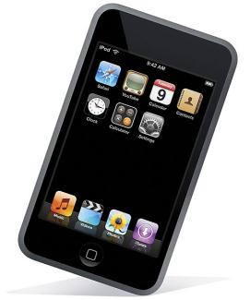
FiTKiDS Tutorial
Video Lessons
Quizzes
Physical Activity Log
Fitness Tests
Messenger
http://apcmag.com

Slide 7
Video Lessons
Lesson 1
Lesson 2
Lesson 3
Lesson 4

Slide 8
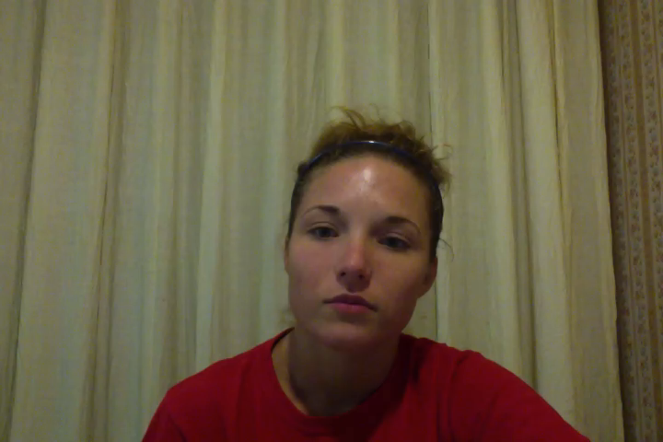
Lesson 1: Importance and Benefits (CDC, 2012c)

Slide 9
Quizzes
Select Grade Level: K-2
3-5
6-8
9-12

Slide 10
Is hopscotch muscle strengthening or bone strengthening?
Bone Strengthening

Slide 11
Is tug-of-war muscle strengthening or bone strengthening?
Muscle Strengthening

Slide 12
How many minutes of physical activity do you need each day?
60

Slide 13
Name three benefits of exercise
Any of the following:
Builds strong bones and muscles, Reduces depression and anxiety, improves academic performance, Reduces risk of obesity, Reduces risk of diabetes, colon cancer, and cardiovascular disease

Slide 14
Which of the following is NOT a vigorous activity?
Brisk Walking
Martial Arts
Running
Jumping Rope
Playing Soccer

Slide 15
Match the following:
Moderate Intensity Level
Force on bones created by impact with the ground
Muscle-Strengthening
8/10
Vigorous Intensity Level
5/10
Aerobic
Muscles working harder than usual
Bone-Strengthening
Rhythmically moving large muscles

Slide 16
Activity Log
Date | Activity & Duration | Activity & Duration | Activity & Duration | Total Minutes of Activity

Slide 17
Fitness Test
Week | Push-ups (Without Stopping) | Sit-ups (1 Minute) | Sit & Reach (Inches) | Jumping Jacks (Without Stopping)
1
2
3

Slide 18
References
Centers for Disease Control and Prevention. (2012a). Childhood obesity facts. Retrieved July24, 2012, from http://www.cdc.gov/healthyyouth/obesity/facts.htm
Centers for Disease Control and Prevention. (2012b). A growing problem. Retrieved July 23, 2012, from http://www.cdc.gov/obesity/childhood/problem.html
Centers for Disease Control and Prevention. (2012c). Physical activity facts. Retrieved July 22, 2012, from http://www.cdc.gov/healthyyouth/physicalactivity/facts.htm
Murray, M., & Tenenbaum, G. (2010). Computerized pedagogical agents as an educational means for developing physical self-efficacy and encouraging activity in youth. Journal of Educational Computer Research, 42(3), 267-283. Retrieved from EBSCOhost
U.S. Department of Health and Human Services. (2008). 2008 Physical activity guidelines for Americans (ODPHP Publication No. U0036). Washington, DC: U.S. Government Printing Office.

