Slide 1
Save the Ta-Tas
Amy Richardson, Alexis Hassler, Kristin Schomburgh, Lynette Hosier,’
& Chelsea Rosnett

Slide 2
Legacy
Legacy means:

Slide 3
Breast Cancer
We chose breast cancer awareness as our topic because it relates to nursing, it is a disease that we all should become familiar with, and it is a disease that has directly affected some of our group members’ loved ones.

Slide 4
Why Provena Cancer Center?
Susan B. Komen-
Sharon Basset Foundation-
Provena Cancer Center-

Slide 5
What we did
Bra collection
T-shirt sales
Bake sales
Jeans Days
Brochures, flyers, emails

Slide 6
Bra Donations
Researched the bra refurbishing facility.
Collected new and used bras:
Mailed used bras to the facility
Donated new bras to the WMCA

Slide 7
T-shirt Sales
Why two designs?
How did we come up with the designs?
Cost of the t-shirts and profit
Where we sold t-shirts

Slide 8
Save the Ta-Tas gear
Donated 50 t-shirts
Wrist bands
Pins

Slide 9
Budget
Income | Expenses | Profit
Cure T-shirts: $10/shirt | ($7) per shirt | $3 per shirt
$100 donation (from team) | ($105) for 15 shirts | ($5)
$50 legacy group | ($35) for shirts | $15.0
Screen fee and taxes | $27.25 | $27.25
sold 14 shirts | $0 | $140
$650 order forms (65 shirts) | ($513.00) | $137.00
47 Ta-ta shirts donated
Sold 40 | $0 | $400
DACC wrist bands | none | $40
Charter wrist bands |  | $35
Genpact Jeans Day
$3 per employee | None | $965
Goal: $200 total |  | $40 wrist bands
Toyota Dealership Jeans Day
$5 per employee | None | $115
Goal: $100 total |  | $35 wrist bands
Dr. Buranakul's Office Jeans Day |  | $35
$5 per employee
Bake Sale:
$1 per baked good | None (donated)
Goal: $40/day
Monday February 11 |  | $15
Thursday February 14 |  | $14
In Kind Donations:
Downtown Diamond and Pawn |  | $50
Money left in account from last semester |  | $15
How much we've raised | (-27.25) - (5) | $2,019
Total Goal: |  | $2,300
Donation to Presence |  | $1,719
Donation to Save the Ta-tas |  | $300

Slide 10
Bake Sales
When:
Where:
How much money did we make:

Slide 11
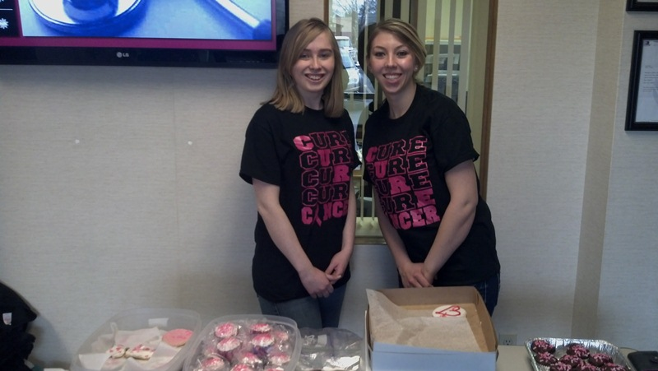
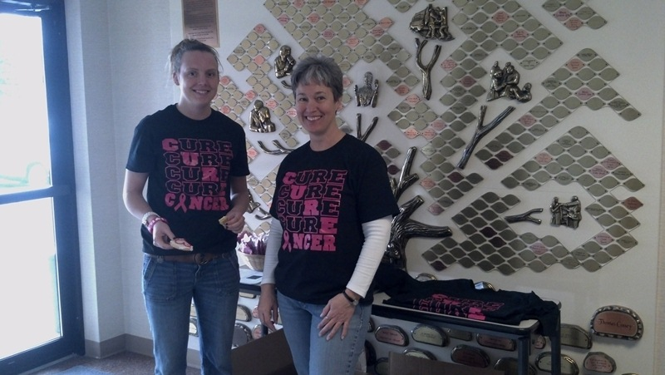
Pictures

Slide 12
Jeans Day
Toyota Dealership of Danville
Genpact

Slide 13
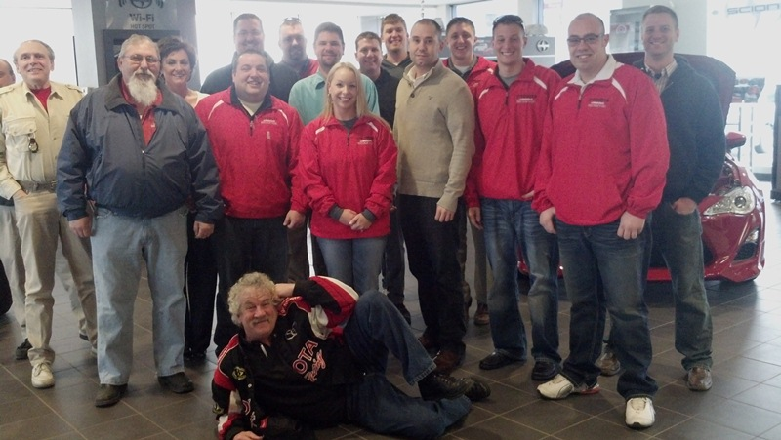
Pictures

Slide 14
What went Well
We work well together
We played to our assets
We met every week

Slide 15
What Went Wrong
Trademarked organization
Contacting Dr. offices late
Businesses unwilling or unable to participate
Shop around for t-shirts. Disorganized company led to problems with t-shirt orders

Slide 16
Recommendations
Look up tradmarks early
Contact organization early and frequently
Get more community support

Slide 17
Any Questions?

