Slide 1
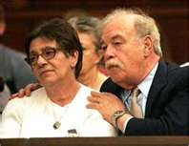
Terri Schiavo: Parent’s Perspective
Alicia Northen, Tenika McMillan, Sheila Roth, Lori Turner
Lakeview College of Nursing
RN407
November 16, 2011
www.annointed.net

Slide 2
Introduction
Theresa Marie Schiavo, commonly known as Terri
Born December 3, 1963, raised outside Philadelphia, PA
Terri struggled with childhood and adolescent obesity.
1981,Terri’s senior year, attended Catholic high school
Measured 5 feet 3 inches tall weighing 250 pounds.
After losing 100 pounds on a NutriSystem diet
Married Michael Schiavo November 3, 1984
Happily married by most court documents

Slide 3
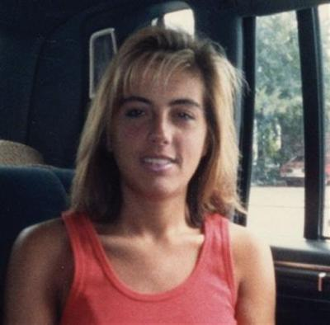
Theresa Marie Schiavo (cont’d)
Some accounts allege marital discord before her collapse.
Endured Infertility treatments.
Lost an additional 40 pounds during infertility treatments.
wizbangblog.com

Slide 4
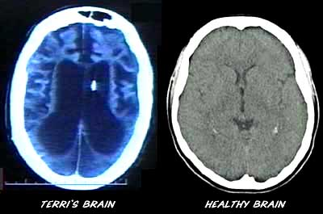
Chronological Facts
February 25, 1990, cardiac arrest, home 5:30 am
Cardiac arrhythmia caused from hypokalemia
Second possible cause: use of epinephrine during resuscitation
June 18, 1990: Michael Schiavo appointed legal guardian
By the Circuit Court Sixth Judicial Court, Florida
Determined incapacitated due to coma and anoxic encephalopathy
For 3 years, Terri received rehab in skilled nursing facilities
filsalustri.wordpress.com

Slide 5
Chronological Facts (cont’d)
Schindlers enjoyed an “amicable” relationship with Michael Schiavo
January 1993, settled malpractice case against obstetrician
Lawsuit alleged failure to diagnose eating disorder
Michael Schiavo received $750,000 in the settlement.
Settlement was placed in trust for Terri’s care
Husband received $300,000 for personal losses

Slide 6
Chronological Facts (cont’d)
1993, 3 years after the collapse, Michael Met Jodi Centonze at a dentist office.
3/1/05 The Schindlers asked the Second District Court of Appeals to grant Terri a divorce based on his alleged adultery.
1/21/06: Michael Schiavo and Jodi Centonze were married in a Catholic church in Espiritu Santo, Florida.
(Sheri & Bob Stritof,2011)

Slide 7
Chronological Facts-con’t
February 1993 post malpractice suit:
Schindlers challenged Michael’s guardianship for the first time
Court designated John H. Pecarek, attorney from Tampa
Terri’s Guardian Ad Litem
Early 1994:
Michael’s attitude toward Terri’s prognosis began to change
Terri transferred to extended care facility Largo, Florida,
Terri developed UTI, Michael changed code status: DNR

Slide 8
Chronological Facts (cont’d)
Extended care facility’s staff objected to this
Michael revoked the DNR order
Transferred Terri to a different long-term facility
March 1, 1994:
John Pecarek released Guardian Ad Litem report
Described no inappropriate actions by Michael
Two more years of litigation:
Guardianship court dismissed Schindlers’ actions: Remove Michael’s guardianship

Slide 9
Chronological Facts (cont’d)
May 1998:
Michael’s first court petition: Withdraw Terri’s life support.
On June 11, 1998:
Court appointed new Guardian Ad Litem, Richard Pearse
Three years later (7 years after her collapse):
Michael began legal plan withdraw Terri’s life support

Slide 10
Chronological Facts (cont’d)
December 29, 1998:
Pearse released report, confirmed persistent vegetative state
Pearse recommended denial of Michael’s petition for withdrawal
Unless there was more evidence of Terri’s wishes

Slide 11
Key Elements of the Terri’s condition
the diagnosis of persistent vegetative status
(PVS) has been confirmed (this must be done using the
results of expert neurological evaluation and diagnosis)
survival time of PVS patients is normally 2 to 5
years, and it is unlikely for their survival time to exceed
10 years.
PVS patients are unable to respond to their environment and require 24-hour care for feeding and maintaining personal hygiene.
(Lai,2006)

Slide 12
Schindler’s Perspective
Terri was eldest of 3 children.
Wanted to be an advocate for daughter who couldn’t defend herself.
Had different views than Michael Schiavo, regarding Terri’s care. (Shindler, 2006)
Felt it was morally wrong to end a life
Believed new evidence related to a new treatment that they believed might restore cognitive function

Slide 13
Ethical Principles
Schindler’s were devout Catholics who wished to continue to provide their daughter with medically assisted hydration and nutrition (MAHN) in accordance with Catholic teaching
Decalogue includes the traditional proscription against the taking of innocent human life and more specifically against euthanasia and suicide.
Michael Schiavo testified that Terri was a lapsed
Catholic.
(Nelson, 2005)

Slide 14
Ethical Principles
Respect for autonomy
Many argue that the moral framework is actually sanctity of life, discrimination against disabled persons, and the moral character of empowered proxies.
Sanctity of life versus quality of life
This becomes a political issue with conservatives and liberals battling
Conservatives believe in the instrinsic value of all life
Liberals are concerned with the quality of life
Notes:
According to Perry 2005), the irony is that unless one takes on the belief that sheer biological existence encompasses life, then the concerns with sanctity of life also involves the quality of life so there is no black and white issue; the issue becomes that both sides are arguing for the same thing, quality of life. The concern was also that by removing Schiavo’s feeding tube, it would set a precedence of disregard for the disabled community in general, but the author argues that there is a significant difference between persistive vegetative state and say, spinal cord injury and paralysis.

Slide 15
Courts have deemed liberty and privacy interests as a priority in past cases such as Karen Ann Quinlan-1976, Paul Brody-1986, Nancy Cruzan-1990
Medical code of ethics for end of life care focuses on autonomy, informed consent, and respect for wishes even beyond competence
Determining wishes after no longer competent is complicated and problematic
Using self determination as ethical framework in solving issues of end of life care is better than using paternalism, quality of life judgments, or sanctity of life judgments
Notes:
Before these cases, history showed protecting the liberty and autonomy of persons unable to make their own decisions was not a focus, but protecting liberties and self determination has been a foundation of our country, the United States since our Declaration of Independence was signed. Attempting to determine someone’s wishes and preferences beyond competence is complicated because the wishes are extracted from other people with feelings, emotions, and biases. Avoiding paternalism, slippery slope arguments, and quality versus sanctity of life judgments are the best approach in preserving autonomy, nonmaleficence, benficence, and justice. Self determination is the priority as a fundamental ethical principle in end of life care in protecting the rights of individuals and wide moral pluralism.

Slide 16
Ethical conflict
Michael Schiavo remained Terri’s surrogate decision maker even after he was in a relationship with another woman
Controversy regarding Terri’s religious stand point.
Prolonging life artificially
Quality of life.

Slide 17
Impact on Nursing
Advance directives
Living wills
Medical care directive
Durable power of attorney
(Butts & Rich, 2008)
Notes:
Advance directive, is “a written expression of a person’s wishes about medical care, especially care during a terminal or critical illness.
Living will, is a formal legal document that provides written directions concerning what medical care is o be provided in specific circumstances.
Medical care directive, is not a formal legal document but provides specific written instructions to the physician concerning the type for care and treatments that individuals want to receive if they become incapacitated.
Durable power of attorney, is legal written directive in which a designated person can make either general or specific health care and medical decisions for a patient.

Slide 18
Future Impact

