Slide 1
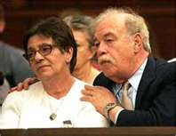
Terri Schiavo: Parent’s Perspective
Alicia Northen, Tenika McMillan, Sheila Roth, Lori Turner
Lakeview College of Nursing
RN407
November 16, 2011
www.annointed.net

Slide 2
Introduction
  Theresa Marie Schiavo, commonly known as Terri
  Born December 3, 1963, raised outside Philadelphia, PA
  Terri struggled with childhood and adolescent obesity.
  1981,Terri’s senior year, attended Catholic high school
  Measured 5 feet 3 inches tall weighing 250 pounds.
  After losing 100 pounds on a NutriSystem diet
  Married Michael Schiavo November 3, 1984
  Happily married by most court documents

Slide 3
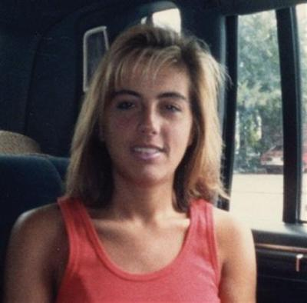
Theresa Marie Schiavo (cont’d)
  Some accounts allege marital discord before her collapse.
  Endured Infertility treatments.
  Lost an additional 40 pounds during infertility treatments.
wizbangblog.com

Slide 4
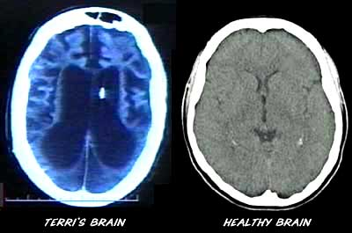
Chronological Facts
February 25, 1990, cardiac arrest, home 5:30 am
Cardiac arrhythmia caused from hypokalemia
Second possible cause: use of epinephrine during resuscitation
June 18, 1990: Michael Schiavo appointed legal guardian
    By the Circuit Court Sixth Judicial Court, Florida
Determined incapacitated due to coma and anoxic encephalopathy
For 3 years, Terri received rehab in skilled nursing facilities
filsalustri.wordpress.com

Slide 5
Chronological Facts (cont’d)
Schindlers enjoyed an “amicable” relationship with Michael Schiavo
January 1993, settled malpractice case against obstetrician
Lawsuit alleged failure to diagnose eating disorder
Michael Schiavo received $750,000 in the settlement.
Settlement was placed in trust for Terri’s care
Husband received $300,000 for personal losses

Slide 6
Chronological Facts (cont’d)
1993, 3 years after the collapse, Michael Met Jodi Centonze at a dentist office.
3/1/05 The Schindlers asked the Second District Court of Appeals to grant Terri a divorce based on his alleged adultery.
1/21/06: Michael Schiavo and Jodi Centonze were married in a Catholic church in Espiritu Santo, Florida.
(Sheri & Bob Stritof,2011)

Slide 7
Chronological Facts-con’t
February 1993 post malpractice suit:
  Schindlers challenged Michael’s guardianship for the first time
  Court designated John H. Pecarek, attorney from Tampa
    Terri’s Guardian Ad Litem
Early 1994:
  Michael’s attitude toward Terri’s prognosis began to change
  Terri transferred to extended care facility Largo, Florida,
  Terri developed UTI, Michael changed code status: DNR

Slide 8
Chronological Facts (cont’d)
  Extended care facility’s staff objected to this
  Michael revoked the DNR order
  Transferred Terri to a different long-term facility
March 1, 1994:
  John Pecarek released Guardian Ad Litem report
  Described no inappropriate actions by Michael
Two more years of litigation:
  Guardianship court dismissed Schindlers’ actions: Remove Michael’s guardianship

Slide 9
Chronological Facts (cont’d)
May 1998:
  Michael’s first court petition: Withdraw Terri’s life support.
On June 11, 1998:
  Court appointed new Guardian Ad Litem, Richard Pearse
Three years later (7 years after her collapse):
  Michael began legal plan withdraw Terri’s life support

Slide 10
Chronological Facts (cont’d)
December 29, 1998:
  Pearse released report, confirmed persistent vegetative state
  Pearse recommended denial of Michael’s petition for withdrawal
    Unless there was more evidence of Terri’s wishes

Slide 11
Key Elements of the Terri’s condition
the diagnosis of persistent vegetative status
(PVS) has been confirmed (this must be done using the
results of expert neurological evaluation and diagnosis)
survival time of PVS patients is normally 2 to 5
years, and it is unlikely for their survival time to exceed
10 years.
PVS patients are unable to respond to their environment and require 24-hour care for feeding and maintaining personal hygiene.
(Lai,2006)

Slide 12
Schindler’s Perspective
Terri was eldest of 3 children.
Wanted to be an advocate for daughter who couldn’t defend herself.
Had different views than Michael Schiavo, regarding Terri’s care. (Shindler, 2006)
Felt it was morally wrong to end a life
Believed new evidence related to a new treatment that they believed might restore cognitive function

Slide 13
Ethical Principles
Schindler’s were devout Catholics who wished to continue to provide their daughter with medically assisted hydration and nutrition (MAHN) in accordance with Catholic teaching
Decalogue includes the traditional proscription against the taking of innocent human life and more specifically against euthanasia and suicide.
Michael Schiavo testified that Terri was a lapsed
Catholic.
(Nelson, 2005)

Slide 14
Ethical conflict
Michael Schiavo remained Terri’s surrogate decision maker even after he was in a relationship with another woman

Slide 15
Impact on Nursing
Advance directives
Living wills
Medical care directive
Durable power of attorney
(Butts & Rich, 2008)
Notes:
Advance directive, is “a written expression of a person’s wishes about medical care, especially care during a terminal or critical illness.
Living will, is a formal legal document that provides written directions concerning what medical care is o be provided in specific circumstances.
Medical care directive, is not a formal legal document but provides specific written instructions to the physician concerning the type for care and treatments that individuals want to receive if they become incapacitated.
Durable power of attorney, is legal written directive in which a designated person can make either general or specific health care and medical decisions for a patient.

Slide 16
Future Impact

