Slide 1
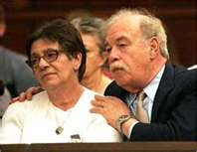
Terri Schiavo: Parent’s Perspective
Alicia Northen, Tenika McMillan, Sheila Roth, Lori Turner
Lakeview College of Nursing
RN407
November 16, 2011
www.annointed.net

Slide 2
Introduction
Theresa Marie Schiavo, commonly known as Terri
Born December 3, 1963, raised outside Philadelphia, PA
Terri struggled with childhood and adolescent obesity.
1981,Terri’s senior year, attended Catholic high school
Measured 5 feet 3 inches tall weighing 250 pounds.
After losing 100 pounds on a NutriSystem diet
Married Michael Schiavo November 3, 1984
Happily married by most court documents

Slide 3
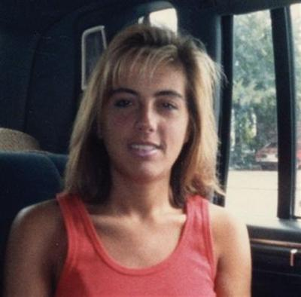
Theresa Marie Schiavo (cont’d)
Some accounts allege marital discord before her collapse.
Endured Infertility treatments.
Lost an additional 40 pounds during infertility treatments.
wizbangblog.com

Slide 4
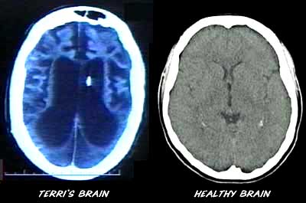
Chronological Facts
February 25, 1990, cardiac arrest, home 5:30 am
Cardiac arrhythmia caused from hypokalemia
Second possible cause: use of epinephrine during resuscitation
June 18, 1990: Michael Schiavo appointed legal guardian
By the Circuit Court Sixth Judicial Court, Florida
Determined incapacitated due to coma and anoxic encephalopathy
For 3 years, Terri received rehab in skilled nursing facilities
filsalustri.wordpress.com

Slide 5
Chronological Facts (cont’d)
Schindlers enjoyed an “amicable” relationship with Michael Schiavo
January 1993, settled malpractice case against obstetrician
Lawsuit alleged failure to diagnose eating disorder
Michael Schiavo received $750,000 in the settlement.
Settlement was placed in trust for Terri’s care
Husband received $300,000 for personal losses

Slide 6
Chronological Facts-con’t
February 1993 post malpractice suit:
Schindlers challenged Michael’s guardianship for the first time
Court designated John H. Pecarek, attorney from Tampa
Terri’s Guardian Ad Litem
Early 1994:
Michael’s attitude toward Terri’s prognosis began to change
Terri transferred to extended care facility Largo, Florida,
Terri developed UTI, Michael changed code status: DNR

Slide 7
Chronological Facts (cont’d)
Extended care facility’s staff objected to this
Michael revoked the DNR order
Transferred Terri to a different long-term facility
March 1, 1994:
John Pecarek released Guardian Ad Litem report
Described no inappropriate actions by Michael
Two more years of litigation:
Guardianship court dismissed Schindlers’ actions: Remove Michael’s guardianship

Slide 8
Chronological Facts (cont’d)
May 1998:
Michael’s first court petition: Withdraw Terri’s life support.
On June 11, 1998:
Court appointed new Guardian Ad Litem, Richard Pearse
Three years later (7 years after her collapse):
Michael began legal plan withdraw Terri’s life support

Slide 9
Chronological Facts (cont’d)
December 29, 1998:
Pearse released report, confirmed persistent vegetative state
Pearse recommended denial of Michael’s petition for withdrawal
Unless there was more evidence of Terri’s wishes

Slide 10
Key Elements of the Terri’s condition
the diagnosis of persistent vegetative status
(PVS) has been confirmed (this must be done using the
results of expert neurological evaluation and diagnosis)
survival time of PVS patients is normally 2 to 5
years, and it is unlikely for their survival time to exceed
10 years.
PVS patients are unable to respond to their environment and require 24-hour care for feeding and maintaining personal hygiene.
(Lai,2006)

Slide 11
Schindler’s Perspective
Terri was eldest of 3 children.
Wanted to be an advocate for daughter who couldn’t defend herself.
Had different views than Michael Schiavo, regarding Terri’s care. (Shindler, 2006)
Felt it was morally wrong to end a life
Believed new evidence related to a new treatment that they believed might restore cognitive function

Slide 12
Ethical Principles

Slide 13
Impact on Nursing

Slide 14
Future Impact

