Slide 1
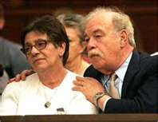
Terri Schiavo: Parent’s Perspective
Alicia Northen, Tenika McMillan, Sheila Roth, Lori Turner
Lakeview College of Nursing
RN407
November 16, 2011
www.annointed.net

Slide 2
Introduction
  Theresa Marie Schiavo, commonly known as Terri
  Born December 3, 1963, raised outside Philadelphia, PA
  Terri struggled with childhood and adolescent obesity.
  1981,Terri’s senior year, attended Catholic high school
  Measured 5 feet 3 inches tall weighing 250 pounds.
  After losing 100 pounds on a NutriSystem diet
  Married Michael Schiavo November 3, 1984
  Happily married by most court documents

Slide 3
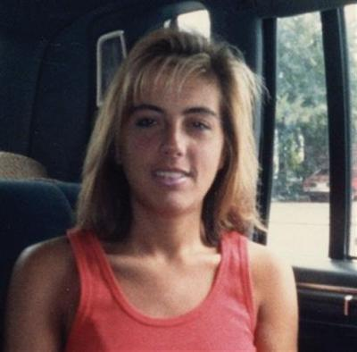
Theresa Marie Schiavo (cont’d)
  Some accounts allege marital discord before her collapse.
  Endured Infertility treatments.
  Lost an additional 40 pounds during infertility treatments.
wizbangblog.com

Slide 4
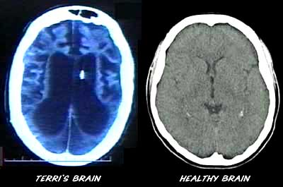
Chronological Facts
February 25, 1990, cardiac arrest, home 5:30 am
Cardiac arrhythmia caused from hypokalemia
Second possible cause: use of epinephrine during resuscitation
June 18, 1990: Michael Schiavo appointed legal guardian
    By the Circuit Court Sixth Judicial Court, Florida
Determined incapacitated due to coma and anoxic encephalopathy
For 3 years, Terri received rehab in skilled nursing facilities
filsalustri.wordpress.com

Slide 5
Chronological Facts (cont’d)
Schindlers enjoyed an “amicable” relationship with Michael Schiavo
January 1993, settled malpractice case against obstetrician
Lawsuit alleged failure to diagnose eating disorder
Michael Schiavo received $750,000 in the settlement.
Settlement was placed in trust for Terri’s care
Husband received $300,000 for personal losses

Slide 6
Chronological Facts-con’t
February 1993 post malpractice suit:
  Schindlers challenged Michael’s guardianship for the first time
  Court designated John H. Pecarek, attorney from Tampa
    Terri’s Guardian Ad Litem
Early 1994:
  Michael’s attitude toward Terri’s prognosis began to change
  Terri transferred to extended care facility Largo, Florida,
  Terri developed UTI, Michael changed code status: DNR

Slide 7
Chronological Facts (cont’d)
  Extended care facility’s staff objected to this
  Michael revoked the DNR order
  Transferred Terri to a different long-term facility
March 1, 1994:
  John Pecarek released Guardian Ad Litem report
  Described no inappropriate actions by Michael
Two more years of litigation:
  Guardianship court dismissed Schindlers’ actions: Remove Michael’s guardianship

Slide 8
Chronological Facts (cont’d)
May 1998:
  Michael’s first court petition: Withdraw Terri’s life support.
On June 11, 1998:
  Court appointed new Guardian Ad Litem, Richard Pearse
Three years later (7 years after her collapse):
  Michael began legal plan withdraw Terri’s life support

Slide 9
Chronological Facts (cont’d)
December 29, 1998:
  Pearse released report, confirmed persistent vegetative state
  Pearse recommended denial of Michael’s petition for withdrawal
    Unless there was more evidence of Terri’s wishes

Slide 10
The Schindler Family
Mary Schindler was married to Robert Schindler in January of 1963.
Daughter, Theresa Marie Schindler, was born a year later on December 3, 1963
Son, Robert or "Bobby," born in 1965
Daughter, Suzanne born in 1968.
Typical Italian Catholic family - the children attended parochial elementary and high schools and the family attended Mass weekly.
Robert Schindler died August 2009
Terri Schiavo Life & Hope Network. (n.d.). Retrieved from http://www.terrisfight.org/timeline/

Slide 11
The Schindler Family
Suzanne Schindler, the youngest daughter of Bob and Mary Schindler. is Co-Executive Director of Life & Hope Network
Moved with her family to St. Petersburg, Florida
Graduated with a Bachelor of Science in Business from the University of South Florida
Stockbroker with TD Waterhouse.
Her life drastically changed February of 1990 when sister, Terri Schiavo, collapsed
Has spoken on national television and radio programs including Hannity & Colmes, the Oprah Winfrey Show, The Glenn Beck Show, Good Morning America, The Early Show, The Today Show, Dateline NBC, the 700 Club, EWTN and many others.
Terri Schiavo Life & Hope Network. (n.d.). Retrieved from http://www.terrisfight.org/timeline/

Slide 12
The Schindler Family
Bobby Schindler is the Executive Director of the Terri Schiavo Life & Hope Network,
The only son of Bob and Mary Schindler
Born and raised just outside of Philadelphia, Pennsylvania
Graduated from LaSalle University with a Bachelor of Science degree in marketing
Obtained degree in meteorology from Florida State University.
Gave up teaching job at Tampa Catholic High School and became a full-time pro-life and disability rights advocate.
Assists families in need of legal action to prevent their loved one from threat of withdrawal of nutrition and fluids.
Terri Schiavo Life & Hope Network. (n.d.). Retrieved from http://www.terrisfight.org/timeline/
Notes:
Bobby Schindler is the Executive Director of the Terri Schiavo Life & Hope Network which works to protect the lives of the medically vulnerable and disabled from the threat of euthanasia. The Terri Schiavo Life & Hope Network was the 2009-2010 recipient of the Gerard Health Life Prizes Award. The only son of Bob and Mary Schindler, Bobby was born and raised just outside of Philadelphia, Pennsylvania with his sisters, Terri and Suzanne. After his graduation from LaSalle University with a Bachelor of Science degree in marketing, Bobby went on to obtain a degree in meteorology from Florida State University.
Bobby's life took a dramatic and unexpected turn in February of 1990 when his older sister, Terri, suddenly collapsed and was left with a profound brain injury.

Slide 13
Key Elements of the Perspective
Removing the PEG tube is abuse and neglect
Catholic Church also against the tube removal: Pope Paul John II spoke out saying that all patients must receive nutrition and hydration
Terri would choose not to “commit a sin of the gravest proportions by foregoing treatment to effect her own death in defiance of her religious faith's express and recent instructions to the contrary”
Starving Terri to death is murder
Majority view does not correspond with morality. Public opinion polls change frequently, but morality of life and death does not change
Klugman, C. (2006). Reframing Terri Schiavo: one family's story of morality, ethics, & politics. Internet Journal Of Law, Healthcare &

Slide 14
Key Elements of the Perspective
Awareness of self and of environmentis the feature that distinguishes PVS from minimally conscious state (MCS).
MCS is evident of improvement and warrants aggressive therapy
Courts are poorly equipped to understand the complex issues used to describe a continuum of awareness in neurologically devastated patients.
Huntoon, L. (2005). The perilous vegetative state. Journal of American Physicians and Surgeons 10(2), 35-36.
Notes:
Misdiagnosis is common with rates of misdiagnosis ranging from 18 to 43 percent. One of the most common errors was failure of the physician to take into account that the patient was either blind or had severe visual impairment, which impairs the patient’s tracking with their eyes (Huntoon, 2005).
Huntoon, L. (2005). The perilous vegetative state. Journal of American Physicians and Surgeons 10(2), 35-36.

Slide 15
Key Elements of the Perspective
Terri’s “in a state of “minimal consciousness” (Merrell, 2009)
George Bush told a crowd in Tucson, Arizona: “Democrats and Republicans in Congress came together last night to give Terri Schiavo’s parents another opportunity to save their daughter’s life.This is a complex case with serious issues but, in nextraordinary circumstances like this, it is always wise to err on the side of life” (Merrill, 2009)
Merrell, D. (2009). Erring on the side of life: the case of Terri Schiavo. Journal Of Medical Ethics, 35(5), 323-325. doi:10.1136/jme.2007.023002

Slide 16
How much is “awareness”?
“No one can say exactly how much awareness a patient must display in order to qualify for continued food and water.
Is a smile in response to a mother.s kind words sufficient?
Is visually tracking a balloon over a sustained period enough?
What about grimacing and turning one”s head away from an unwanted swab around the mouth?
What happens if the patient is tired from physical therapy or a bath when the doctor comes by to evaluate?
You have the right to remain silent and not respond, but if you choose not to respond or are unable to respond, your food and water may be taken away by a court of law” (Huntoon, 2005)
Huntoon, L. (2005). The perilous vegetative state. Journal of American Physicians and Surgeons 10(2), 35-36.

Slide 17
Ethical Principles

Slide 18
Impact on Nursing

Slide 19
Future Impact

