Slide 1
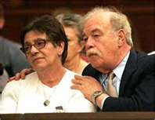
Terri Schiavo: Parent’s Perspective
Alicia Northen, Tenika McMillan, Sheila Roth, Lori Turner
Lakeview College of Nursing
RN407
November 16, 2011
www.annointed.net

Slide 2
Introduction
Theresa Marie Schiavo, commonly known as Terri
Born December 3, 1963, raised outside Philadelphia, PA
Terri struggled with childhood and adolescent obesity.
1981,Terri’s senior year, attended Catholic high school
Measured 5 feet 3 inches tall weighing 250 pounds.
After losing 100 pounds on a NutriSystem diet
Married Michael Schiavo November 3, 1984
Happily married by most court documents

Slide 3
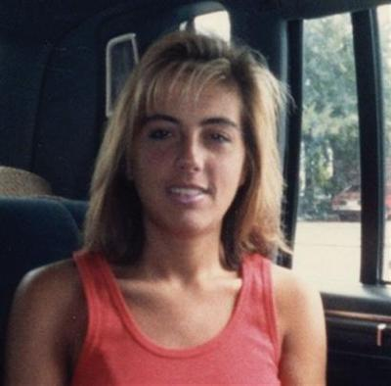
Theresa Marie Schiavo (cont’d)
Some accounts allege marital discord before her collapse.
Endured Infertility treatments.
Lost an additional 40 pounds during infertility treatments.
wizbangblog.com

Slide 4
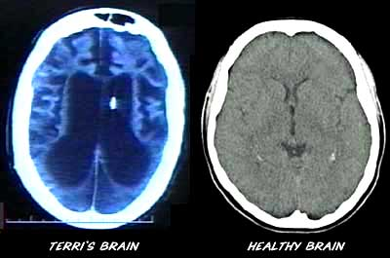
Chronological Facts
February 25, 1990, cardiac arrest, home 5:30 am
Cardiac arrhythmia caused from hypokalemia
Second possible cause: use of epinephrine during resuscitation
June 18, 1990: Michael Schiavo appointed legal guardian
By the Circuit Court Sixth Judicial Court, Florida
Determined incapacitated due to coma and anoxic encephalopathy
For 3 years, Terri received rehab in skilled nursing facilities
filsalustri.wordpress.com

Slide 5
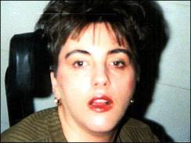
Chronological Facts (cont’d)
Schindlers enjoyed an “amicable” relationship with Michael Schiavo
January 1993, settled malpractice case against obstetrician
Lawsuit alleged failure to diagnose eating disorder
Michael Schiavo received $750,000 in the settlement.
Settlement was placed in trust for Terri’s care
Husband received $300,000 for personal losses

Slide 6
Chronological Facts (con’t)
February 1993 post malpractice suit:
Schindlers challenged Michael’s guardianship for the first time
Court designated John H. Pecarek, attorney from Tampa
Terri’s Guardian Ad Litem
Early 1994:
Michael’s attitude toward Terri’s prognosis began to change
Terri transferred to extended care facility Largo, Florida,
Terri developed UTI, Michael changed code status: DNR

Slide 7
Chronological Facts (cont’d)
Extended care facility’s staff objected to this
Michael revoked the DNR order
Transferred Terri to a different long-term facility
March 1, 1994:
John Pecarek released Guardian Ad Litem report
Described no inappropriate actions by Michael
Two more years of litigation:
Guardianship court dismissed Schindlers’ actions: Remove Michael’s guardianship

Slide 8
Chronological Facts (cont’d)
May 1998:
Michael’s first court petition: Withdraw Terri’s life support.
On June 11, 1998:
Court appointed new Guardian Ad Litem, Richard Pearse
Three years later (7 years after her collapse):
Michael began legal plan withdraw Terri’s life support

Slide 9
Chronological Facts (cont’d)
December 29, 1998:
Pearse released report, confirmed persistent vegetative state
Pearse recommended denial of Michael’s petition for withdrawal
Unless there was more evidence of Terri’s wishes

Slide 10
Chronological Facts (cont’d)
On February 24, 2005:
Governor Jeb Bush requests DCF investigate physical abuse.
March 8, 2005:
Judge Greer denied motion receive fluids and nutrition
March 19, 2005:
Supreme Court denied motion to reinsert feeding tube
March 2005:
U. S. Congress and President enter the conflict
Notes:
On February 24, 2005, at the request of Governor Jeb Bush, Florida DCF investigating allegations of physical abuse by Michael against Terri Schiavo by Schindlers
March 8, 2005, Judge Greer denied Schindlers’ motion to allow Terri to receive fluids and nutrition orally
March 19, 2005, the U. S. Supreme Court denied, the Schindler’s motion to reinsert Terri’s feeding tube
March 2005 the U. S. Congress and President enter the conflict

Slide 11
Chronological Facts (cont’d)
March 21, 2005:
George W. Bush: Signed the Protection of Incapacitated
Governor Jeb Bush:
Launched investigation of events surrounding Terri’s collapse
Investigated Michael Schiavo’s call to 911
On July 8, 2005:
Special prosecutor: No criminal wrongdoing by Michael
End of Florida’s unprecedented involvement in Schiavo case
Notes:
March 21, 2005, George W. Bush signed the Protection of Incapacitated
Governor Jeb Bush launched a special investigation events surrounding Terri’s collapse and Michael Schiavo’s call to 911
On July 8, 2005, the special prosecutor announced no criminal wrongdoing by Michael related to the 911 call,
The end of the state of Florida’s unprecedented involvement in the Schiavo case

Slide 12
Key Elements of the Perspective

Slide 13
Ethical Principles

Slide 14

Impact on Nursing
Moral Distress
Sights, sounds, smells of death are emotionally draining
Nurses need to sort own feelings toward euthanasia
While still need to meet family needs
Need to deal with own feelings of loss and grief
www.dreamstime.com
Notes:
Nurses face moral conflicts and distress. Should they keep giving such things as a morphine infusion that can cause respiratory depression? Fear of hastening death.
Should they assist in withdrawal or withholding of artificial nutrition and hydration? Some may feel it is cruel and killing patients.
Allow nurses the ability to cry and express own feelings of grief with family. (Butts & Rich, 2008)

Slide 15
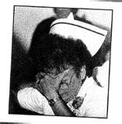
Impact on Nursing (cont’d)
Nurses: Moral distress
Regarding withholding/withdrawal of nutrition and hydration.
Removal of feeding tube
14 days later died from starvation and dehydration.
ajnoffthecharts.com
Notes:
Probably the biggest moral distress was the nurses participation in the withdrawal of artificial nutrition. Although nurses have an obligation to provide compassionate and palliative care, the nurse also has a right to withdraw from treating and caring for a dying patient as long as another nurse has assumed that patient’s care.

Slide 16

Impact on Nursing (cont’d)
Need to be honest with patient and family
Alleviate pain and suffering
Educate family on how to be supportive to loved one
Educate community on need for advanced directives
http://www.actionnurses.com/
Notes:
Death can be a positive experience with compassionate acts.

Slide 17
Future Impact
Should the courts be involved in medical decision making?
Should a consent be signed on admission regarding decisions of care if one should become incapacitated to make decisions?
Should a power of attorney be appointed on admission?
Should an advanced directive be placed in patients charts in physician’s office during routine physicals?

Slide 18
References
Kollas, C., & Boyer-Kollas, B. (2006). Closing the schiavo case: an analysis of legal reasoning. Journal Of Palliative Medicine, 9(5), 1145-1163.

