Slide 1
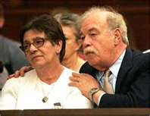
Terri Schiavo: Parent’s Perspective
Alicia Northen, Tenika McMillan, Sheila Roth, Lori Turner
Lakeview College of Nursing
RN407
November 16, 2011
www.annointed.net

Slide 2
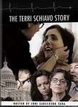
Schindler’s Perspective
Terri was the eldest of 3 children.
Wanted to be an advocate for daughter who couldn’t defend herself.
Had different views than Michael Schiavo, regarding Terri’s care.
Felt it was morally wrong to end a life
Believed new evidence related to a new treatment that they might restore cognitive function
(Schindler, 2006)
www.tvguide.com

Slide 3
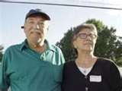
The Schindler Family
Mary married Robert Schindler in January of 1963.
Daughter, Theresa Marie Schindler, born December 3, 1963
Son, Robert or "Bobby," born in 1965
Daughter, Suzanne born in 1968.
Typical Italian Catholic family
Children attended parochial elementary and high schools
Family attended Mass weekly
Robert Schindler died August 2009
(Terri Schiavo Life & Hope Network. (n.d.))
www.sbcbaptistpress.org
Notes:
Mary Schindler was married to Robert Schindler in January of 1963. The Schindler’s daughter, Theresa Marie Schindler, was born a year later on December 3, 1963. Robert, “Bobby,” was born in 1965 and Suzanne, the baby of the family, was born in 1968. The Schindler’s are a typical Italian Catholic family. The children attended parochial elementary and high schools and the family attended Mass weekly. Sadly, Robert Schindler, Terri’s father, died in August, 2009.

Slide 4
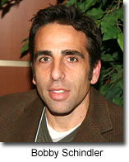
The Schindler Family
Bobby Schindler:
Executive Director : Terri Schiavo Life & Hope Network,
The only son of Bob and Mary Schindler
Born and raised outside of Philadelphia, Pennsylvania
Graduated from LaSalle University, Bachelor of Science, Marketing
Obtained degree in meteorology from Florida State University.
Relinquished teaching job at Tampa Catholic High School
Full-time pro-life and disability rights advocate.
Assists families in need of legal action
(Terri Schiavo Life & Hope Network. (n.d.))
www.lifesitenews.com
Notes:
Bobby Schindler is the Executive Director of the Terri Schiavo Life & Hope Network which works to protect the lives of the medically vulnerable and disabled from the threat of euthanasia. The Terri Schiavo Life & Hope Network was the 2009-2010 recipient of the Gerard Health Life Prizes Award. The only son of Bob and Mary Schindler, Bobby was born and raised just outside of Philadelphia, Pennsylvania with his sisters, Terri and Suzanne. After his graduation from LaSalle University with a Bachelor of Science degree in marketing, Bobby went on to obtain a degree in meteorology from Florida State University.
Bobby's life took a dramatic and unexpected turn in February of 1990 when his older sister, Terri, suddenly collapsed and was left with a profound brain injury.

Slide 5
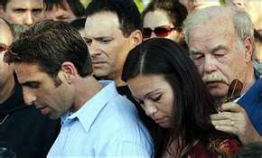
The Schindler Family
Suzanne Schindler:
Youngest daughter of Bob and Mary Schindler
Co-Executive Director of Life & Hope Network
Moved with her family to St. Petersburg, Florida
Graduated with Bachelor of Science in Business, University of South Florida
Stockbroker with TD Waterhouse
Life drastically changed when sister, Terri Schiavo, collapsed
Has spoken on national television and radio programs
(Terri Schiavo Life & Hope Network. (n.d.))
www2.ljworld.com
Notes:
Suzanne Schindler, the youngest daughter of Bob and Mary Schindler, is the Co-Executive Director of Life & Hope Network. Suzanne moved with her parents to St. Petersburg, Florida. Suzanne graduated with a Bachelor of Science Degree in Business from the University of South Florida and worked as a Stockbroker with TD Waterhouse until February of 1990 at which time Suzanne’s life drastically changed; her sister, Terri Schiavo, collapsed. Suzanne has spoken on national television and radio programs including Hannity & Colmes, the Oprah Winfrey Show, The Glenn Beck Show, Good Morning America, The Early Show, The Today Show, Dateline NBC, the 700 Club, EWTN and many others.

Slide 6
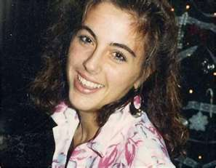
Introduction
Theresa Marie Schiavo, commonly known as Terri
Born December 3, 1963, raised outside Philadelphia, PA
Terri struggled with childhood and adolescent obesity.
1981,Terri’s senior year, attended Catholic high school
Measured 5 feet 3 inches tall weighing 250 pounds
After losing 100 pounds on a NutriSystem diet
Married Michael Schiavo November 3, 1984
Happily married by most court documents
(Terri Schiavo Life & Hope Network, n.d.)
njministries.org

Slide 7
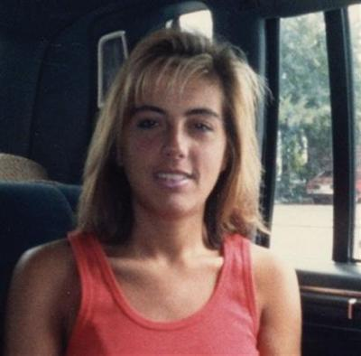
Theresa Marie Schiavo
Some accounts allege marital discord before her collapse.
Endured Infertility treatments
Lost an additional 40 pounds during infertility treatments.
(Terri Schiavo Life & Hope Network, n.d.)
wizbangblog.com

Slide 8
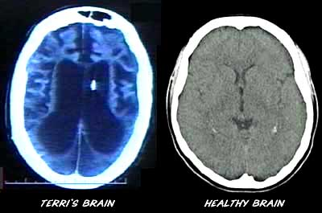
Chronological Facts
February 25, 1990, cardiac arrest, home 5:30 a.m.
Cardiac arrhythmia caused from hypokalemia
Second possible cause: Use of epinephrine during resuscitation
June 18, 1990: Michael Schiavo appointed legal guardian
Determined incapacitated due to coma and anoxic encephalopathy
For 3 years, Terri received rehab in skilled nursing facilities
(Kollas & Boyer-Kollas, 2006)
filsalustri.wordpress.com

Slide 9
Chronological Facts (cont’d)
Schindlers enjoyed an “amicable” relationship with Michael Schiavo
Lawsuit filed against obstetrician alleging failure to diagnose eating disorder
January 1993: Michael reaches settlement in malpractice case
Michael Schiavo received in excess of $1million
$750,000 of settlement was placed in a trust for Terri’s care
Michael received $300,000 for personal losses
(Kollas & Boyer-Kollas, 2006)

Slide 10
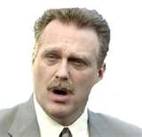
Chronological Facts (cont’d)
1993, 3 years after the collapse, Michael Met Jodi Centonze at a dentist office.
3/1/05: The Schindlers asked the Second District Court of Appeals to grant Terri a divorce based on his alleged adultery.
1/21/06: Michael Schiavo and Jodi Centonze were married in a Catholic church in Espiritu Santo, Florida.
(Sheri & Bob Stritof,2011)
www.jewishworldreview.com

Slide 11
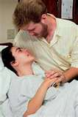
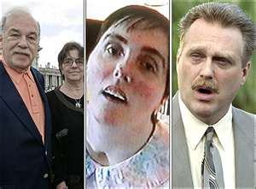
Chronological Facts (cont’d)
February 1993 (post malpractice suit):
Schindlers challenged Michael’s guardianship for the first time
Court designated John H. Pecarek, attorney from Tampa, Terri’s Guardian Ad Litem
Early 1994:
Michael’s attitude toward Terri’s prognosis began to change
Michael stopped physical therapy and rehab.
Terri transferred to extended care facility Largo, Florida,
Terri developed UTI, Michael changed code status: DNR
(Kollas & Boyer-Kollas, 2006)
www.strong4me.com
www.boston.com

Slide 12
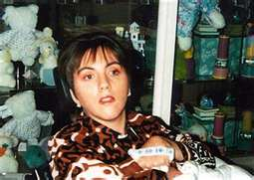
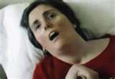
Terri: Rehab vs. No Rehab
With Rehabilitation
Rehabilitation Stopped
uaddit.com
www.rainews24.rai.it

Slide 13
Chronological Facts (cont’d)
Three years later (7 years after her collapse):
Michael began legal plan withdraw Terri’s life support
May 1998:
Michael’s first court petition: Withdraw Terri’s life support.
June 11, 1998:
Court appointed new Guardian Ad Litem, Richard Pearse
(Kollas & Boyer-Kollas, 2006)

Slide 14
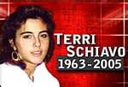
Chronological Facts (cont’d)
December 29, 1998:
Pearse released report, confirmed persistent vegetative state
Pearse recommended denial of Michael’s petition for withdrawal- unless there was more evidence of Terri’s wishes
March 18, 2005: The feeding tube was removed.
March 31, 2005: Terri died.
(Kollas & Boyer-Kollas, 2006)
www.floridaestateplanningla

Slide 15
Key Elements of the Perspective
Removing the PEG tube is abuse and neglect.
Catholic Church against tube removal:
Pope John Paul II spoke out: All patients must receive nutrition and hydration.
Terri would choose:
Not to “commit a sin of the gravest proportions by foregoing treatment to effect her own death in defiance of her religious faith's express and recent instructions to the contrary”
Starving Terri to death is murder.
Majority view does not correspond with morality
(Klugman, 2006)
Notes:
Individuals believe removing the PEG tube is abuse and neglect. The Catholic Church is also against the tube removal: Pope John Paul II spoke out saying that all patients must receive nutrition and hydration andTerri would choose not to “commit a sin of the gravest proportions by foregoing treatment to effect her own death in defiance of her religious faith's express and recent instructions to the contrary.” The Catholic Church also believes starving Terri to death is considered murder. The majority view does not correspond with morality. Public opinion polls change frequently, but morality of life and death does not change. (Klugman, 2006)

Slide 16
Key Elements of the Perspective (cont’d)
Awareness of self and environment differentiates PVS from MCS.
MCS: Evident of improvement and warrants aggressive therapy.
Courts:
Poorly equipped to understand the complex issues used to describe a continuum of awareness in neurologically devastated patients.
(Huntoon, 2005)
Notes:
Misdiagnosis is common with rates of misdiagnosis ranging from 18 to 43 percent. One of the most common errors was failure of the physician to take into account that the patient was either blind or had severe visual impairment, which impairs the patient’s tracking with their eyes (Huntoon, 2005).
Huntoon, L. (2005). The perilous vegetative state. Journal of American Physicians and Surgeons 10(2), 35-36.

Slide 17
Key Elements of the Perspective (cont’d)
Terri’s “in a state of ‘minimal consciousness’.” (Merrell, 2009)
George Bush told a crowd in Tucson, Arizona: “Democrats and Republicans in Congress came together last night to give Terri Schiavo’s parents another opportunity to save their daughter’s life. This is a complex case with serious issues but, in extraordinary circumstances like this, it is always wise to err on the side of life” (Merrill, 2009)
Notes:
Terri’s “in a state of ‘minimal consciousness’.” George W. Bush told a crowd in Tucson, Arizona: “Democrats and Republicans in Congress came together last night to give Terri Schiavo’s parents another opportunity to save their daughter’s life. This is a complex case with serious issues but, in extraordinary circumstances like this, it is always wise to err on the side of life” (Merrill, 2009)

Slide 18

Key Elements of the Perspective (cont’d)
Michael Schiavo remained Terri’s surrogate decision maker even after he was in a relationship with another woman.
Controversy regarding Terri’s religious stand point
Prolonging life artificially
Quality of life

Slide 19
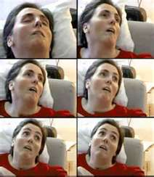
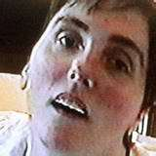
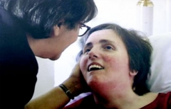
How much is “awareness”?
“No one can say exactly how much awareness…
Is a smile in response to a mother’s words sufficient?
Is visually tracking over a sustained period of time enough?
What about grimacing and turning one’s head away?
What if patient is tired from physical therapy?
What if patient is too tired after a bath for a doctor evaluation?
You have the right to remain silent…
(Huntoon, 2005)
www.lifesitenews.com
photobucket.com
www.propertyrightsresearch
Notes:
According to Hustoon (2005), “No one can say exactly how much awareness a patient must display in order to qualify for continued food and water. Is a smile in response to a mother’s kind words sufficient? Is visually tracking a balloon over a sustained period enough? What about grimacing and turning one”s head away from an unwanted swab around the mouth? What happens if the patient is tired from physical therapy or a bath when the doctor comes by to evaluate? You have the right to remain silent and not respond, but if you choose not to respond or are unable to respond, your food and water may be taken away by a court of law” (p. 35)
Huntoon, L. (2005). The perilous vegetative state. Journal of American Physicians and Surgeons 10(2), 35-36.

Slide 20
Ethical Principles
Respect for autonomy is a priority.
Many argue that the moral framework is actually sanctity of life, discrimination against disabled persons, and the moral character of empowered proxies.
Sanctity of life versus quality of life
This becomes a political issue with conservatives and liberals battling.
Conservatives believe in the instrinsic value of all life
Liberals are concerned with the quality of life
(Perry, Churchill, & Kirshner, 2005)
Notes:
According to Perry, Churchill, & Kirshner, (2005), the irony is that unless one takes on the belief that sheer biological existence encompasses life, then the concerns with sanctity of life also involves the quality of life so there is no black and white issue; the issue becomes that both sides are arguing for the same thing, quality of life. The concern was also that by removing Schiavo’s feeding tube, it would set a precedence of disregard for the disabled community in general, but the author argues that there is a significant difference between persistent vegetative state and say, spinal cord injury and paralysis.
Perry, J., Churchill, L., & Kirshner, H. (2005). The Terri Schiavo case: legal, ethical, and medical perspectives. Annals Of Internal Medicine, 143(10), 744-748.

Slide 21
Ethical Principles (cont’d)
Other ethical principles violated:
Beneficence -Terri was prevented from hydration and nutrition
Nonmaleficence
Justice -Terri did not receive diagnostic tests to discredit the PVS such as an MRI, Swallow study, and hyperbaric chamber for oxygenation.
(Butts & Rich, 2008)
Notes:
According to Butts & Rich (2008), beneficence is to benefit and promote the welfare of other people or patients, which Terri did not have the benefit of the nutrition, and hydration towards the end of her life. Nonmaleficent was also violated with Terri because she was starved to death, causing her harm. Nomaleficent is to do no harm to another person, so in this case, this ethical principle was breached. With beneficence promotes goodness, and if health care professionals cannot do good, then they are supposed to do no harm, which is what happened in Terri’s case. With the ethical principle of justice, Terri was not afforded all of the typical tests and treatments that other patients would have received. Justice is fairness, equal treatment without prejudice, and equitable distributing of treatments, which is what was violated with Schiavo.

Slide 22
Ethical Principles (cont’d)
Action versus omission
Active euthanasia versus passive euthanasia
Intentionally taking the patient’s life
Withholding or withdrawing life sustaining treatment
Is there a moral difference between actively killing a patient or letting them die?
(Butts & Rich, 2008)

Slide 23

Ethical Principles (cont’d)
Courts have deemed liberty and privacy interests as a priority in past cases such as Karen Ann Quinlan-1976, Paul Brody-1986, Nancy Cruzan-1990.
Medical code of ethics for end of life care focuses on autonomy, informed consent, and respect for wishes even beyond competence.
Determining wishes after no longer competent is complicated and problematic.
Using self determination as ethical framework in solving issues of end of life care is better than using paternalism, quality of life judgments, or sanctity of life judgments.
Notes:
Before these cases, history showed protecting the liberty and autonomy of persons unable to make their own decisions was not a focus, but protecting liberties and self determination has been a foundation of our country, the United States since our Declaration of Independence was signed. Attempting to determine someone’s wishes and preferences beyond competence is complicated because the wishes are extracted from other people with feelings, emotions, and biases. Avoiding paternalism, slippery slope arguments, and quality versus sanctity of life judgments are the best approach in preserving autonomy, nonmaleficence, beneficence, and justice. Self determination is the priority as a fundamental ethical principle in end of life care in protecting the rights of individuals and wide moral pluralism.

Slide 24

Impact on Nursing
Moral Distress
Sights, sounds, smells of death are emotionally draining.
Nurses need to sort own feelings toward euthanasia while still need to meet family needs.
Need to deal with own feelings of loss and grief
(Butts & Rich, 2008)
www.dreamstime.com
Notes:
Nurses face moral conflicts and distress. Should nurses keep giving such things as a morphine infusion that can cause respiratory depression? There is often fear of hastening death. Should nurses assist in withdrawal or withholding of artificial nutrition and hydration? Some nurses may feel it is cruel and aids in killing patients. Facilities should allow nurses the ability to cry and express own feelings of grief with family. (Butts & Rich, 2008)
Patient’s fears and needs must be addressed. Nurses must create an environment in which patients and their families can feel free to voice their feelings and concerns. (Ball, 2006)

Slide 25
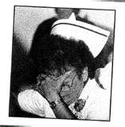
Impact on Nursing (cont’d)
Nurses: Moral distress
Regarding withholding/withdrawal of nutrition and hydration
Removal of feeding tube
Terri died 13 days later from starvation and dehydration.
(Butts & Rich, 2008)
ajnoffthecharts.com
Notes:
In all likelihood, the biggest moral distress nurses suffered was the participation in the withdrawal of artificial nutrition. Although nurses have an obligation to provide compassionate and palliative care, the nurse also has a right to withdraw from treating and caring for a dying patient as long as another nurse has assumed that patient’s care. (Butts & Rich, 2008)
Butts, J. B., & Rich, K. L. (2008). Nursing ethics: Across the curriculum and into practice (2nd ed.). Sudbury, MA: Jones and Bartlett.

Slide 26

Impact on Nursing (cont’d)
Nurses need to be honest with patients and families.
Nurses must work to alleviate pain and suffering.
Nurses must educate family how to be supportive to a loved one.
Nurses must educate communities on need for advanced directives
http://www.actionnurses.com
Notes:
Death can be a positive experience with compassionate acts.

Slide 27

Future Impact
Should the courts be involved in medical decision making?
Should a consent be signed on admission regarding decisions of care if one should become incapacitated to make decisions?
Should a power of attorney be appointed on admission?
Should an advanced directive be placed in patients charts in physician’s office during routine physicals?
Notes:
As this group of author’s discussed the future impact Terri Schiavo’s case will have, a list of questions came to mind. The discussion expanded further on the importance of educating patients regarding end-of-life decisions and the necessity of having them recorded in one’s medical file.

Slide 28
References
Ball, S. C. (2006). Nurse-patient advocacy and the right to die. Journal of Psychosocial Nursing, 44(12), 36-42.
Butts, J. B., & Rich, K. L. (2008). Nursing ethics: Across the curriculum and into practice (2nd ed.). Sudbury, MA: Jones and Bartlett.
Huntoon, L. (2005). The perilous vegetative state. Journal of American Physicians and Surgeons 10(2), 35-36.
Klugman, C. (2006). Reframing Terri Schiavo: One family's story of morality, ethics, & politics. Internet Journal Of Law, Healthcare & Ethics, 4(1).
Merrell, D. (2009). Erring on the side of life: The case of Terri Schiavo. Journal Of Medical Ethics, 35(5), 323-325. doi:10.1136/jme.2007.023002
Kollas, C., & Boyer-Kollas, B. (2006). Closing the schiavo case: an analysis of legal reasoning. Journal Of Palliative Medicine, 9(5), 1145-1163.

Slide 29
References
Nelson, L. (1997) Catholic bioethics and the case of Terri Schiavo. Professor of Law, Cumberland School of law. Samford University. Vol. 35(3)
Perry, J., Churchill, L., & Kirshner, H. (2005). The Terri Schiavo case: Legal, ethical, and medical perspectives. Annals Of Internal Medicine, 143(10), 744-748.
Stritof, Sheri & Bob (n.d.). Michael and Terri Schiavo’s Marriage Profile. Retrieved 15 November 2011 from http://marriage.about.com/od/celebritymarriages/p/schiavo.htm
Terri Schiavo Life & Hope Network. (n.d.). Retrieved from http://www.terrisfight.org/timeline/

