Slide 1
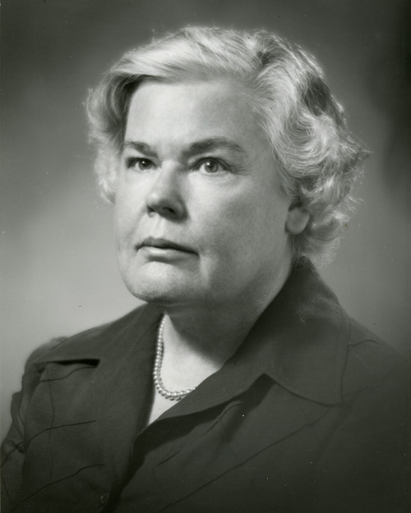
Dorothea Orem
1914-2007

Slide 2

Early in Her Life
She was born in Baltimore, MD in 1914. She lived with her mother, father and two older sisters.
Her father was a construction worker, and her mother stayed at home to take care of her and
her sisters.
They were a family that thought highly
of proper education.
Notes:
According to Blog Spot (2010) Orem was born in Baltimore, Maryland in 1914. Her family was a relatively close family, that sought out education as a very vital role in life. Orem’s parents expected extremely highly of Dorothea and her sisters. Her mother dedicated her life to them, and made sure their education was taken exceptionally serious. (Blog Spot)

Slide 3

Education
Providence School of Nursing
Georgetown University
Notes:
According to Blog Spot (2010) Orem started her nursing education in Washington D.C. at Providence School of Nursing, where she later completed her BSN and MS in nursing education. After, she received these degrees, she started working on her self-care theory. In 1976, Orem received her honorary Doctorate of Science from Georgetown University (Blog Spot).

Slide 4
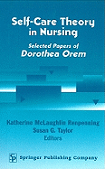
During her Life
In 1958, Orem started working on the self-care theory.
She worked in many different areas of nursing.
Notes:
According to Blog Spot (2010)the self-care theory in nursing was started after receiving her BSN and MS in nursing education. Her ultimate goal was to improve the quality of nursing, as a whole. In 1959, her theory was published for the first time. During her lifetime, she was able to work as a private nurse, staff nurse, an educator in nursing and consultant. This gave her the opportunity to see multiple vital roles within the nursing field. (Blog Spot)

Slide 5
Basic Concepts of Theory
Experience
Indiana State Board of Health and goals
Dean and Professor
Concept of Nursing
Notes:
The development of this theory took many years and experience being a nurse. Orem had many jobs relating to the nursing profession that gave her the knowledge to develop this theory.
Orem first worked for the Division of Hospital and Institutional Services of the Indiana State Board of Health from 1494-1957 (Nursing Theories, 2011).
During this time her goal was to increase the quality of nursing in general hospitals throughout the state. She also developed her definition of nursing practice (Nursing Theories, 2011).
Orem later served as acting dean of the school of Nursing and as an assistant professor of nursing education at CUA in 1959 (Nursing Theories, 2011).
She continued to develop her concept of nursing and self care during this time. Orem’s Nursing: Concept of Practice was first published in 1971 and then in 1980, 1985, 1991, 1995, and 2001(Nursing Theories, 2011).
“In her seminal work ‘Nursing: Concepts of Practice’, Dorothea Orem drew on the work of Levin, Katz and Holst (1976).and others to deﬁne the concept and construct a self-care model of nursing. This model assumes that all individuals have self-care needs, and that they have the right and ability to meet these needs themselves, except when their ability is in some way compromised” (Pearson, 2008). Before Orem made the self-deficit theory, she created the Nursing: Concerts of practice. This theory then lead into more detailed theories like theory of self care deficit.

Slide 6
Basic Concept of Theory.
Purpose
The importance of the theory
Main Goals
Continuous Process
Notes:
The purpose of Dorothea Orem’s theory of self care deficit is to allow individuals and their families to maintain control of their healthcare.
The most important part of Orem’s theory is that it shows when the nurse is needed to help take care of the patient. If there is a problem and the patient can’t fully take care of themselves, nursing care is needed to ensure the person can reach their optimal health (Guevarra, 2010).
The three main goals of this theory are to restore, promote, and maintain the patients health.
Self- Care is an ever changing process throughout life and requires constant reassessment (Guevarra, 2010).

Slide 7
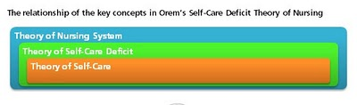
Key Concepts
Self- care theory
Self- care deficit theory
Nursing system theory
  Compensatory system
  Partial compensatory system
  Educative- developmental system
Notes:
There are three key concepts to the self care deficit theory which are the theory of self-care, theory of self-care deficit , and the theory of nursing system.
The Self -care theory states that self-care is learned behaviors that individuals initiate and perform on their own behalf to maintain life, health, and well-being.
Self-care deficit theory states that people benefit from nursing because they have health-related limitations in providing self-care.
Nursing system theory suggests that nursing systems form when nurses prescribe, design, and provide nursing that relates the individual's self-care capabilities and meets therapeutic self-care requirements. (Guevarra, 2010)
There are three main components to the Self-care nursing model, the compensatory system, the partial compensatory system and the educative-developmental system
The Compensatory system is when the nurse provides total care for the patient. This patient cannot do anything for them self. The nurse is necessary for survival of the patient because the patient is totally independent.
The second of Orem’s systems is the Partial Compensatory. The patient and patients family can help but the nurse still has to assist with the care. The patient can go back to providing their own care when they are better but need the support and instruction a nurse can provide at this time.
The third of Orem’s systems is the Educative-developmental system. The patient has total control over their health; the nurse just assists with education and promoting better health care practices. (Guevarra, 2010)

Slide 8
Theory’s implementation in nursing practice
This theory’s implementation is broken down into a progression of three steps:
  Diagnostic
  Prescriptive
  Regulatory
Notes:
This theory’s implementation is broken down into a progression of three steps: diagnostic, prescriptive and regulatory (Chitty and Black, 2011, pp.311).

Slide 9
Diagnostic
Evaluation of capacity of self-care.
Demographic factors are considered in this evaluation
Whatever tasks not able to be performed by the patient is a self-care deficit.
Notes:
First the nurse must evaluate the patient’s extent to provide their own self care. Age, gender, developmental status, socio-cultural and environmental factors are all considered in this evaluation. If any area of self-care can’t be properly performed by the patient then this is considered a self-care deficit (Chitty and Black, 2011, pp.311).

Slide 10
Prescriptive
Creating a plan:
  Considers priorities of self-care
  Consider methodologies
  Possible education
Notes:
In this stage, the nurse develops a plan of how to attend to these self-care deficits. The nurse reviews methodologies as to how these self-care deficits can be met and which one of these deficits should be met first. This may include just educating the patient in how to attend to these self-care deficits or the nurse actually attending to these self-care deficits because the patient is just simply not able. The nurse then develops a specific plan of care for these needs to be met and implements this plan (Chitty and Black, 2011, pp.311).

Slide 11
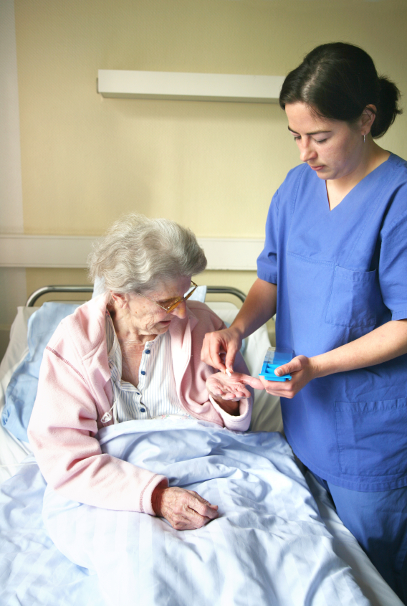
Regulatory
Implementation of plan
Method must be monitored for effectiveness
Notes:
This step is the actual implementation of the assistance with self-care. In some cases the patient would be performing their own self care correctly because of the information provided to them. As a nurse, you must constantly evaluate effectiveness of the assistance and the possiblity of one day the patient performing these health care rituals by themselves (Chitty and Black, 2011, pp.311).

Slide 12
Summary of Orem’s Theory
Orem's theory (Self-care deficient theory)
The nurses role in the theory, and when nursing is needed.
Notes:
According to Clark (1986) Orem's theory is based on the idea that all patients have the right, innate ability and responsibility to care for themselves. Human development is accompanied by self reliance, and a desire to be self directing. Self Care is a behavior learned in childhood and exhibited in adult hood. It encompasses activities that incite health, sustain life and well being. (pp 125-135)
According to Bromley (1980) the nurses role is to help the client with self care practices and maximize their self care abilities. A nurse is needed when the patient does not have the ability to maintain a amount of self care to maintain life and health, or recover from disease and injury, or to cope with their effects.(pp 245-249)

Slide 13
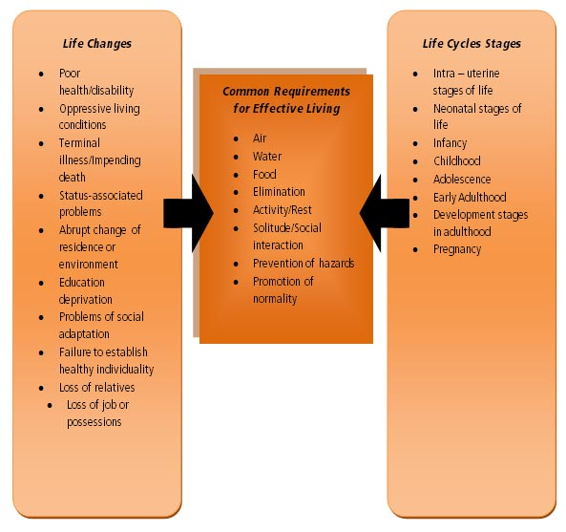
Summary Continued
Orem's 3 nursing systems.
The modern self care plans evolved from Orem’s theory.
Notes:
According to Clark (1986) wholly compensatory is when the patient has no role in self care. Examples include a incapacitated patient(mentally and physically). A patient who is unable to move, but senses environment. A patient whose psychomotor skills cannot respond to the needs of life. Partly compensatory is when both the nurse and patient perform self care measurements. The nurse compensates for the patients inability to maintain self care. Supportive education is when the patient is physically and psychologically capable of maintaining self care. The role of the nurse is to support, guide, and teach. (127-135)

Slide 14
Resources
Bromley, B. (1980).Applying Orem's self-care theory in enterostomal therapy, American journal of nursing. 80.2, 245-249. Retrieved from http://www.jstor.org.proxy.lakeland.cc.il.us:2048/stable/3470054
Clark, M.D.(1986). Application of Orem’s theory of self-care : A case study. Journal of community health nursing, 3.3, 127-135.Retreived from http://www.jstor.org.proxy.lakeland.cc.il.us:2048/stable/3427521
Chitty, K. K., & Black, B. P. (2011). Professional nursing: Concepts & challenges. (pp. 311). Maryland Heights, MO: Saunders Elsevier.
Pearson, A. (2008). Dead poets, nursing theorists and contemporary nursing practice. International journal of nursing practice. 3, 1-2. Retrieved from http://web.ebscohost.com.proxy.lakeland.cc.il.us:2048/ehost/pdfviewer/pdfviewer?vid=3&hid=15&sid=74260344-5fbb-4e5f-9985-41167f0838a9%40sessionmgr13
Dorothea Orem's self-care theory (2010). Nursing theories. Retrieved from http://currentnursing.com/nursing_theory/self_care_deficit_theory.html
Dorothea Orems: Self-care deficit theory (2010). Blog spot. Retrieved from http://oremselfcaredeficittheory.blogspot.com/p/dorothea-orem.html
Guevarra, W. (2010). Dorothea Elizabeth Orem's theory of Self Care. Retrieved October 3, 2011, from http://upoun207tfn.blogspot.com

