Slide 1
Analysis of a Quantitative Study
Megan Aprile
Catherine Morris
Holly Robson
David Walthall
Notes:
There are many components that contribute to a well-written research article. Doing a thorough research analysis of an article can help further explore these different components and their make-up. The research article by Kaper, Wagena, Willemsen, & Schayck (2006) will be broken down and examined according to the criteria outlined by Burns and Grove (2009).

Slide 2
Summary
Purpose is to determine reimbursement effects on long-term smoking cessation
Probability of occurrence framework
Experimental design
Sample size of 1320 smokers split into two separate groups
Found reimbursement to be a large motivator in smoking cessation
Notes:
The purpose of this experimental study is to determine whether reimbursement for smoking cessation treatment (SCT) plays a part in whether or not people are able to quit smoking for extended periods of time. The conceptual framework was probability of occurrence, current research was included, and the research question was created and addressed later on in the study. The sample size of 1,320 participants were split into two separate groups, control and intervention. The control group received no reimbursement for their smoking cessation efforts, while the intervention group did receive reimbursement. The researchers planned for follow-up questionnaires and interviews at 6 months and 2 years to determine the progress of smoking cessation. At both intervals, the researchers concluded that those receiving reimbursement for their SCT were about two to three times more likely to remain smoke-free at the given intervals. (Kaper, Wagena, Willemsen, & Schayc, 2006)

Slide 3
Purpose/Problem
The purpose of this study is to determine if reimbursement aids in prolonged abstinence from smoking
The purpose of this study is one that is researchable
This is relative to nursing because it could improve the overall health of our patients.
Notes:
The purpose of this study is not clearly stated, but it is easily inferred from the introduction. The problem of this study is researched by doing an experimental study with two groups involved. The topic is whether or not reimbursement plays a factor in prolonged tobacco abstinence. One of the groups is reimbursed for their smoking cessation efforts, while a second group is not reimbursed. This is relative to nursing because smoking can cause so many health problems. If there is a way to get more people to quit, then this means there may be less patients with smoking-related health concerns for providers to address. (Kaper, Wagena, Willemsen, & Schayc, 2006)

Slide 4
Literature Review
The review of literature is appropriate, thorough and organized
Current research from the last ten years is used
The literature is well critiqued
There are gaps of knowledge that are addressed
Notes:
The review of literature is appropriate and thorough. It not only includes current research, but it acknowledges the mistakes that past studies have made on this topic. In a previous study, no effect was found on reimbursement. This is likely because in this study, only 30 percent of the participants were informed that they would be reimbursed. This shows that it is necessary for all participants to be fully aware of all aspects of the study beforehand. (Kaper, Wagena, Willemsen, & Schayck, 2006)

Slide 5
Framework
Study was based on a probability of occurrence framework
The framework of this study fits the purpose of the study
The concept is if smoking cessation treatment is paid for, then it is more likely to have a prolonged abstinence from smoking
Notes:
The framework for this study was a conceptual framework. The concept this study was based on was the probability of occurrence (i.e. if A, then probably B). If the smoking cessation treatment is paid for, then the subject will probably be more likely to have a prolonged abstinence from smoking. This framework fits the purpose of this study because the purpose of the study was to see if reimbursement helps with prolonged abstinence from smoking. The concepts and relationships of the study are identified. (Kaper, Wagena, Willemsen, & Schayck, 2006)

Slide 6
Research Question/Hypothesis
The research questions are clearly stated in the beginning of the article
The primary question asked by the researchers is “whether reimbursement for smoking cessation treatment (SCT) can increase prolonged abstinence from smoking up to 2 years.” (Kaper, Wagena, Willemsen, & Schayck, 2006).
The hypothesis is also clearly stated
Notes:
The question/hypothesis are both researchable, as stated by the authors of this article. The research collection methods are thoroughly explained and all of the data used in drawing the conclusions are given and explained in a clear and organized manner.
The question/hypothesis does relate logically to the problem, discussion, literature review and framework. The conceptual framework is based on the idea that if A occurs, then B will be the result. In this instance, A would be the smoking cessation treatment and the result; B, would be that there was a greater chance for smoking abstinence in the future. (Kaper, Wagena, Willemsen, & Schayck, 2006)

Slide 7
Variables
The concepts/variables are clearly defined in this study
There are two clear groups studied in this article.
No conceptual definitions given
There are no concepts explained in abstract or theoretical terms.
Notes:
The concepts/variables are clearly defined in this study. There are two clear groups studied in this article. Both groups are former smokers who are trying to abstain from resuming smoking. One group has been offered a free smoking cessation treatment, while the other group has not. There are no conceptual definitions given, meaning that there are no concepts explained in abstract or theoretical terms. There are operational concepts throughout the article. These are more concrete ideas, such as the idea that participation in an SCT will increase the chances of abstaining from smoking. There were not many extraneous/intervening variables identified. The independent variable was the SCT and reimbursement, and this was controlled by the researchers. (Kaper, Wagena, Willemsen, & Schayck, 2006)

Slide 8
Design
Experimental design
The researchers have almost complete control over the study
The researchers either provided SCT at no cost, or did not provide SCT
Two groups of participants
Notes:
The research design that was used by the authors was an experimental design. In this type of study, the researchers try to control or manipulate the participants or variables in the study. In this case, the researchers either provided SCT at no cost or did not provide SCT to two groups of smokers working on smoking abstinence. This design was very appropriate for this type of study. By controlling the variables, the researchers were able to see clear results based on their hypothesis. Internal validity is addressed and the cause-effect relationship of SCT and successful smoking abstinence is described and thoroughly explained. (Kaper, Wagena, Willemsen, & Schayck, 2006)

Slide 9
Sample
General sample of 1320 smokers
54 participants excluded because they were ineligible
Randomly assigned to control group or intervention group
General Dutch population
Gave oral consent for participation in study
Approved by Medical Ethics Committee of the Dutch Trimbos Institute
Notes:
The sample size is described and representative of the population. Random samples of 1,320 smokers were included in this study. Of the 1,320 participants, 54 were released from the study due to ineligibility. The study included the general Dutch population and all participants were insured at the same regional health insurance company. The mean age of participants was 39.7 and 55% of participants were male. The education level of the participants varied. The sampling method is appropriate for this study. The sample size included a control group of 634 and a intervention group of 632 participants. The sample size is adequate. Protection of subjects is addressed throughout the article. All participants were required to give oral consent for participation in this study and then were randomly put into either the control or intervention group. The study was approved by the Medical Ethics Committee of the Dutch Trimbos Institute. (Kaper, Wagena, Willemsen, & Schayck, 2006)

Slide 10
Data Collection
Baseline data collected
Age, gender, nicotine dependence, education, and airway complaints
Follow up assessment at 6 months and 2 years
Self Report
Questionnaires
Notes:
The data collection approach for this study was done primarily through self report by the participants themselves. If the patient’s self report indicated that they remained smoke free, a follow up was done at 2 years. The tools and instruments were only briefly mentioned. The study states that the self reports and questionnaires were used to gather the data for this study. If the participants remained smoke free at 2 years, a follow up was conducted. Reliability and validity were addressed as limitations in this particular study. The fact that the data relied heavily on the participant’s self- report makes the validity of the data questionable. (Kaper, Wagena, Willemsen, & Schayck, 2006)

Slide 11
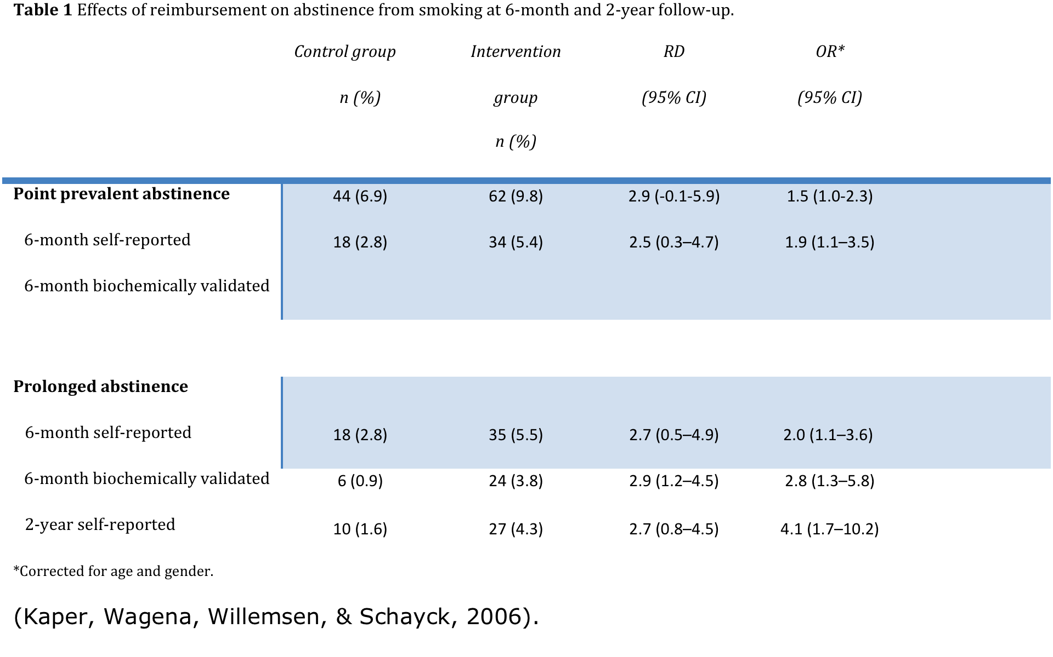
Data Analysis
Notes:
The analysis procedures are appropriate for the level of measurement. The study uses a flow sheet to depict how the participants were divided into two groups. The study then summarizes the data into two tables. The tables use descriptive statistics to describe their findings. Means and standard deviations were used as well as t-tests. The data analysis procedures answer the research question at hand. The results of this study suggest that smoking cessation therapy may be effective at increasing abstinence rates even after a 2 year time period. The results of this study are clearly presented within the two tables. At the end of the research article, the results are then summarized in a narrative format. (Kaper, Wagena, Willemsen, & Schayck, 2006)

Slide 12
Findings and Limitations
Researchers found the intervention group almost 3x more likely to remain smoke-free
Limited validity of self-report
Unreliable means of biochemical validity
No stated clinical implications or recommendations for further research
Notes:
At 6 months of reimbursement, the study found that 18 control group participants and 35 intervention group participants reported smoking cessation. At 2 years, 10 control group participants and 27 intervention group participants reported smoking cessation. Overall, the percentage of participants that actually refrained from smoking was low, ranging in 2-5% of the entire sample. When using SCT, the overall numbers increased for both the control and intervention group, ranging in the 15-22%. Limitations were found in the study as well. Even though there was no reward or punishment associated with refraining from tobacco, the researchers were unable to prove that the participants were telling the truth during the self-report portion of the follow-up. There are biochemical means to determining whether or not the patients are telling the truth, but not all 1,320 participants were tested with this due to cost, patient consent, and ethical considerations. The results are generalized to the population of people that use tobacco. There are no implications for nursing practice because this study, although effects nursing, does not directly require nursing intervention. Recommendations for further studies were also not included in the study. (Kaper, Wagena, Willemsen, & Schayck, 2006)

Slide 13
Conclusion
Study is organized and thorough
Research question answered
Hypothesis was proven correct
Sample size, method of gathering data, and data analysis were appropriate
Clearly stated results and limitations
Notes:
Overall, this study was well-designed and organized. The researchers were fairly thorough with each part of a quantitative analysis study. The research problem and question were clearly stated, and were answered later in the article. Their hypothesis that SCT reimbursement would have a positive impact on long-term smoking cessation was accurate. The sample size was large and diverse, they used several credible methods of data gathering, and the data was analyzed in a thorough and organized way. Limitations were clearly stated within the article and were both sensible and reasonable. The results were nicely stated at the end and displayed tables to organize data and results. Clinical implications and recommendations for further research were the only aspects of a proper quantitative research analysis that were not addressed. It can be tentatively concluded that patients who are receiving reimbursement for their smoking cessation efforts have a higher probability of prolonged smoking cessation than those who are not receiving reimbursement. (Kaper, Wagena, Willemsen, & Schayck, 2006)

Slide 14
References
Burns, N. & Grove, S. K. (2009). The practice of nursing research: Appraisal, synthesis, and generation of evidence (6th ed.). St. Louis, MO: Elsevier.
Kaper, J. J., Wagena, E. J., Willemsen, M. C., & van Schayck, C. P. (2006). A randomized controlled trial to assess the effects of reimbursing the costs of smoking cessation therapy on sustained abstinence. Addiction, 101(11), 1656-1661. doi:10.1111/j. 1360-0443.2006.01578.x

