Slide 1
Reproductive System Medications & Problems
Daphne Piercy RN, MSN/FNP-BC
Lakeview College of Nursing

Slide 2
Growth & Development
Dependent on sex hormones
Males—testosterone
6 to 7 weeks’ gestation, male embryos differentiate under the influence of testes-determining factor (TDF)
Females—estrogen, FSH, and LH
Gonads produce estrogen; in the absence of testosterone, there is a loss of the wolffian system, and the two gonads develop into ovaries
Gonadotropin-releasing hormone (GnRH) produced in the hypothalamus by 10 weeks’ gestation controlling the production of the gonadotropins LH and FSH
LH and FSH levels rise until 28 weeks, stimulating estrogen and progesterone production
Gonadostat-negative feedback mechanism controls GnRH

Slide 3
Reproductive Development Child
Puberty
Exact trigger unknown
Females
Dehydroepiandrosterone (DHEA) and its sulfate (DHAS)
Begins with thelarche (breast development) in females
Adrenarche
Gonadarche

Slide 4
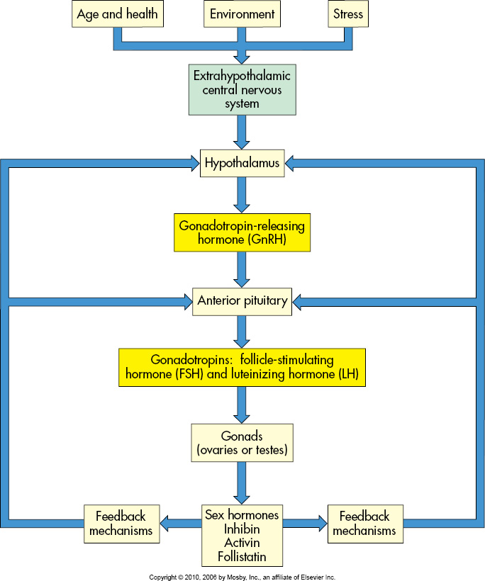
Factors for Reproductive Development

Slide 5
Female Puberty
Puberty
Accelerated growth followed by thelarche
Early puberty in girls linked to:
Obesity
Increased levels of leptin (a hormone secreted from adipose tissue); regulates appetite
Leptin levels increase until puberty, then decrease as puberty advances
Contributes to increased adipose tissue, allowing maturation to occur

Slide 6
Female Reproductive
Menarche
Menopause
Phases
Menstruation (menses)
Follicular/proliferative phase
Luteal/secretory phase

Slide 7
Menstrual Cycle
Follicular phase—first half of the cycle (days 1 to 14)
Luteal phase—second half of the cycle
Full cycle typically takes 28 days.
Coordinating ovarian and uterine events
Uterine changes are brought about under the influence of estrogens and progesterone.
Anterior pituitary hormones, follicle-stimulating hormone (FSH) and luteinizing hormone (LH) regulate the menstrual cycle.

Slide 8
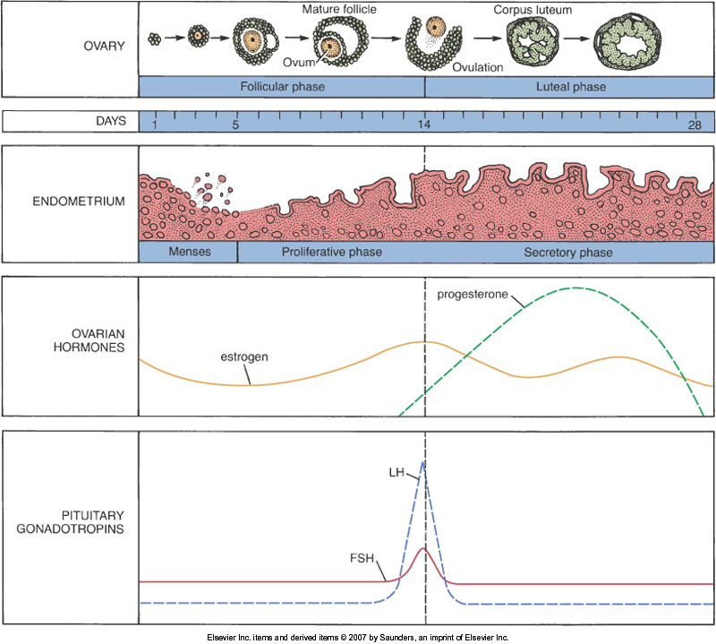

Slide 9
Male Reproductive
External genitalia
Testes
Essential organs of reproduction
Produce gametes
Produce sex hormones (androgens, testosterone)
Suspended outside the pelvic cavity
Sperm production requires an environment that is 1° or 2° C cooler than body temperature
Epididymis
Scrotum
Penis

Slide 10
Male Internal Reproductive
Internal genitalia
Seminal vesicles
Prostate gland
Bulbourethral glands

Slide 11
Hormones Male Reproductive
Androgens
Primary androgen—testosterone
Produced mainly in Leydig cells of the testes
Testosterone
Sexual differentiation
Urogenital system development
Nervous and skeletal tissue development
Sex drive

Slide 12
Pathophysiology of the Female Reproductive System
Age Related
delayed reproduction
menapause
Hormonal
Endocrine disorders
Metabolic syndrome, PCOS, Diabetes
Endometriosis
Infectious
STDs
HPV
Cancers
Breast, Prostate, Cevical, Uterine

Slide 13
Female Genitourinary Disorders
External Genitalia
Vaginal Disorders
Cervical Disorders
Uterine Disorders
Ovarian Disorders
Disorders of Menstration

Slide 14
External Genitalia
Bartholin Gland Cyst
Disorders of the Vulva
Benign
Changes in the vulvar tissue and mucosa
Lichen Sclerosis
Squamous Cell Hyperplasia
Malignant – rare 3-5% of female reproductive cancers
Squamous Cell Carcinoma (90%)
Malignant melanoma
Adenocarcinoma

Slide 15
Disorders of the Vagina
Vaginitis
Infections
Opportunistic
Sexually transmitted
Non-sexually transmitted
Inflammatory
Allergens
Irritants
Age related
Atrophic
Cancer (very rare 1%)
DES exposure
Hormonal drug to prevent pregnancy from 1940-1971
Clear Cell Adenoma
HPV and extending cervical cancer
Squamous cell carcinoma
Malignant melanoma

Slide 16
Disorders of the Cervix
Cervicitis
Cervical Lesions
Premalignant
Malignant
In 1950 cervical cancer was the leading cause of cancer death in the U.S. in women.
Cervical cancer is still a leading cause of death in developing countries.

Slide 17
Cervical Lesions
Pathogenesis
HPV (40 types infect here)
15 strains are high risk
Subtype 16 linked to 60%
Subtype 18 linked to 10%
6 & 11 cause genital condyloma
Growth starts in the transformation zone
Newest and least mature cells
Factors related to disease progression

Slide 18
Prevention of Cervical Cancer
Gardasil
Recommended for 9-26 year old patients.
Prevents 16, 18, 6, 11
3 vaccines over 6 month period
Not studied in old population or previously exposed.
Pap Smear
Should be done at least every 2 years in younger and at risk patients.
Transformation zone presence
Older low risk every 3 years.

Slide 19
Classifications of Premalignant Lesions
Squamous Cell Carcinoma
ASCUS
ASC-US
ASC – cannot exclude high grade
LSIL
Most will regress spontaneously
HSIL
Cell cycle is disrupted by HPV
Increased cell proliferation and dysplasia
Gradually progresses to Carcinoma in situ
Remains static for up to 10 years

Slide 20
Diagnosis
Pathologic Confirmation
Colposcopy
Cervicography camera
Early Disease
Vaginal bleeding, spotting, and discharge.
Repeated cervical or vaginal infections
Bleeding after intercourse.
Dysfunctional cyclic bleeding.
Late Disease
Pelvic and back pain that radiates down the leg
Hematuria
Lymphadenopathy
Inguinal, supraclavicular

Slide 21
Treatment Modalities
Biopsy
Local tissue destruction
Electrocautery, cryosurgery, laser
LEEP proceedure
Lesions extend into the endocervical canal.

Slide 22
Cervicitis
Acute –Infection
Reddened erythemic cervix with copious mucopurulent drainage.
Patient may complain of itching discharge and odor.
Sexually transmitted
Trichamoniasis
Gonorrhoeae
Chlamydia*
HSV, HPV
Non-sexually transmitted
Candidiasis
Gardnerella (BV)
Chronic
Low grade inflammation
May have increase cervical drainage, nabothian cysts, mild tenderness or aching.
Related to trauma
Untreated infections will extend into the pelvis
Cryosurgery
Culture will reveal mixture of nonspecific microbes
Streptococcal
Staphylococcal

Slide 23
Disorders of the Uterus
Endometritis
Acute infection of the endometrium.
Uncommon and related to instrumentation
Curettage is diagnostic and will likely remove infected and nectrotic tissue.
Adenomyosis
Endometrial tissues and glands are within the uterine smooth muscle
Most common in 4th-5th decade, common diagnosis in young infertile females
Heavy painful menses with clots, dypareunia.
Endometrial hyperplasia
Treat with OCs or if severe hysterectomy.
Uterine Leiomyomas (fibroid tumors)
Benign neoplasms of the uterine smooth muscle.
May cause menorrhagia, anemia, necrosis, urinary changes.
Should regress with menapause.
Myomectomy vs. Hysterectomy

Slide 24
Disorders of the Uterus Pelvic Inflammatory disease
Polymicrobial infection of the upper reproductive tract including the uterus, fallopian tubes, and/or ovaries.
Most likely to occur soon after menses
Risk Factors
Clinical Features
Treatment

Slide 25
Disorders of the Uterus Endometriosis
Endometrial tissue is found in ectopic sites usually in local tissue sites.
Common cause of infertility.
Has increased in recent decades.
More than 50% of women under 20 with chronic pelvic pain have endometriosis.
Cause “theories”
Implantation theory
Vascular lymphatic theory
Metaplastic theory

Slide 26
Disorders of Uterine Support
Cystocele
Herniation of the bladder into the vagina
Rectocele
Herniation of the rectum into the vagina
Uterine Prolapse
Bulging of the uterus into the vagina
1st, 2nd, and 3rd degree

Slide 27
Disorders of the Ovaries
Cystic Lesions
PCOS
Ovarian Tumors
Ovarian Cancer

Slide 28
Disorders of the Ovaries
Benign Tumors
Ovarian Cancer
Second most common female reproductive cancer.
Risk factors
Non-suppressed menstrual cycles.
Breast cancer due to suseptible genes.
S & Sx
Increase abdominal size, dyspepsia, bloating.
CA – 125
Cell surface antigen
Monitor therapy and evaluate recurrence.

