Slide 1
Variables
Canadian Adults 20 years and older
Independent Variables:
Prevalence of diagnosed hypertension
Incidence of diagnosed hypertension
Dependent Variables:
Mortality among people with and without diagnosed hypertension
Notes:
Demographic Variables include Canadian adults 20 years and older excluding women aged 20-54 years who were suspected to have pregnancy induced hypertension.
Prevalence and incidence of diagnosed hypertension are independent variables for this study. A diagnosis of hypertension was conceptually defined as either having two or more physician claims for hypertension within two years or one recording of hypertension in the hospital discharge abstract. Prevalence of diagnosed hypertension is operationally defined as the number of people diagnosed with hypertension divided by the insured population. Incidence of diagnosed hypertension can also be operationally defined as the total number of people with newly diagnosed hypertension divided by the total number of people at risk for hypertension. The mortality rate among people with and without diagnosed hypertension is the dependent variable in this study. Conceptually defined, the mortality rate was figured by dividing all-cause mortality among people with diagnosed hypertension by the number of people without diagnosed hypertension.
Extraneous variables identified in this study include but aren’t limited to individuals who don’t report having been diagnosed with hypertension as well as those who don’t follow their prescribed medication regimen. Intervening variables in this situation were out of researchers control.

Slide 2
Design
Retrospective Population-based Cohort Study
Appropriately addresses the research problem
Notes:
The retrospective design collects data from past events, in this study the past events are medical diagnosis’ of hypertension from 1997 until 2008. Because the study was also a population-based cohort study the entire Canadian population, whom had health insurance, were followed over ten years.
The internal validity of this study could not be compromised. All information related to diagnosis of hypertension and mortality causes was gathered from national health records.

Slide 3
Sample
Inclusion Criteria:
Adults 20 years or older
Health Insurance
Notes:
More than 26 million adults in Canada were studied to find the prevalence and incidence of diagnosed hypertension. The sample includes the majority of the country therefor can be described as representative of the population. The sampling method used, reviewing combined medical records from the national records, is the best fit for collecting such a vast amount of information. Protection of the subjects involved in this study was not addressed.

Slide 4
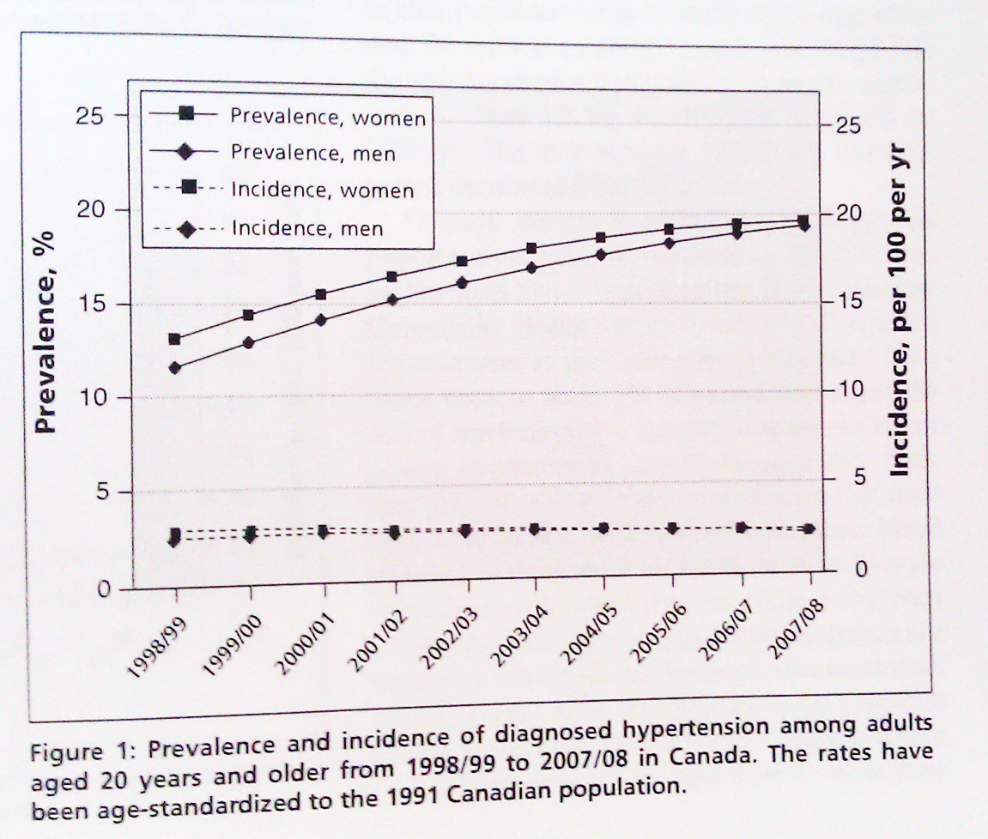
Data Analysis
Table 4: All-cause mortality and rate ratios among adults aged 20 years and older with and without diagnosed hypertension in Canada in 2007/08
All-cause mortality, per 1000 people
Age, yr | No hypertension | Hypertension | Rate ratio
20-24 | 0.5 | 2.2 | 4.2
25-29 | 0.5 | 2.0 | 4.0
30-34 | 0.5 | 1.5 | 2.7
35-39 | 0.7 | 1.8 | 2.4
40-44 | 1.1 | 2.6 | 2.4
45-49 | 1.8 | 3.5 | 1.9
50-54 | 2.7 | 4.9 | 1.8
55-59 | 4.2 | 6.7 | 1.6
60-64 | 6.4 | 9.8 | 1.5
65-69 | 10.3 | 14.9 | 1.5
70-74 | 16.5 | 22.7 | 1.4
75-79 | 28.5 | 35.5 | 1.2
80-84 | 49.2 | 57.4 | 1.2
>85 | 105.1 | 120.4 | 1.1
Notes:
Researchers analyzed prevalence and incidence of diagnosed hypertension by age, location and sex. The procedure chosen to analyze the data appropriately measures all information collected while still answering the research question. Results are presented in narrative form as well as charts and tables.

