Slide 1
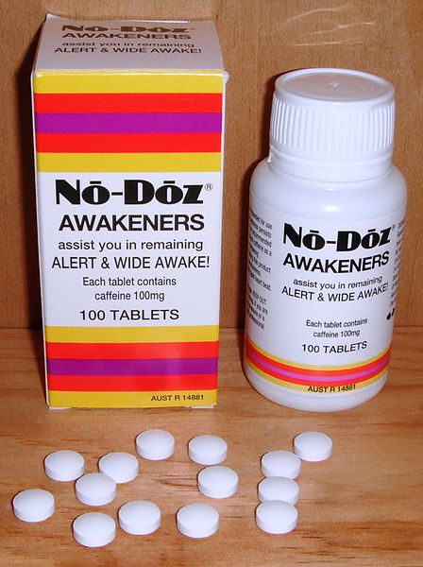
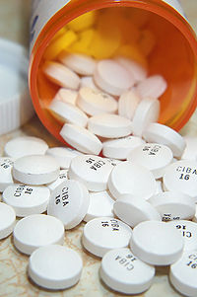
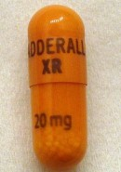
Psychostimulants
Caffeine
Ritalin
sympathomimetics

Slide 2
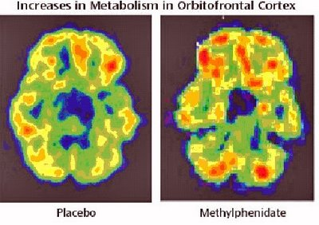
How They Work
Stimulates dopamine release from presynaptic neurons and inhibition of reuptake
Several brain regions are stimulated including the reticular activating system

Slide 3

Therapeutic Goal
Increases attention and concentration, decreases distractibility, hyperactivity, and impulsivity

Slide 4
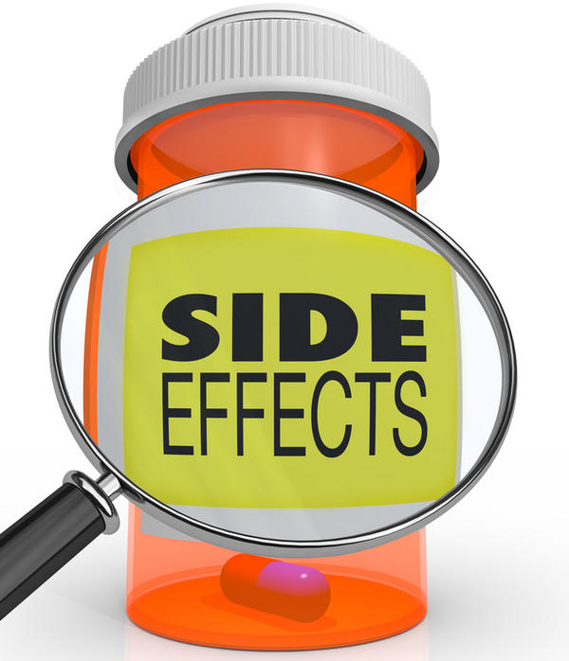
General Side Effects
Hypertension
Palpitations
Tachyarrhythmias
Uticaria
Constipation
Diarrhea
Dizziness
Excitement
Insomnia
Tremor
Restlessness

Slide 5
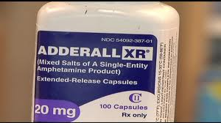
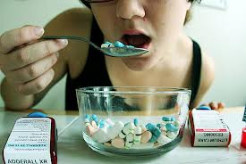
ADDERALL
Adderall contains a combination of amphetamine and dextroamphetamine.
Both these medicines are central nervous system stimulants that affect chemicals in the brain and nerves that contribute to hyperactivity and impulse control.
Adderall is used to treat narcolepsy and attention deficit hyperactivity disorder (ADHD).

Slide 6
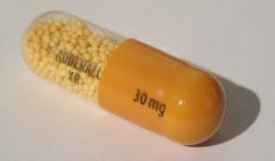
ADDERALL
It is a dopamine releasing agent, a norepinephrine releasing agent, and can be mildly serotonergic
It is available in two formulations: IR (Instant Release) and XR (Extended Release)
The immediate release formulation is indicated for use in attention deficit hyperactivity disorder (ADHD) and narcolepsy, while the XR formulation is approved for use only with attention deficit hyperactivity disorder (ADHD)

Slide 7
ADDERALL (SIDE EFFECTS)
Important side effects of therapeutic dextroamphetamine includes:
stunted growth in young people
occasionally a psychosis can occur at therapeutic doses during chronic therapy as a treatment emergent side effect.
When abused at high doses, the risk of experiencing side effects and the severity of side effects increases.
Sweating or shaking.
headache, weakness, dizziness, blurred vision;
feeling restless, irritable, or agitated,
sleep problems (insomnia);
dry mouth or an unpleasant taste in your mouth;
diarrhea, constipation, stomach pain, nausea, vomiting;
fever;
hair loss, loss of appetite, weight loss; or
loss of interest in sex, impotence, or difficulty having an orgasm.

Slide 8
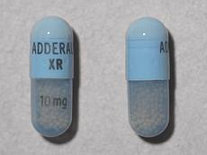
ADDERALL ADVERSE EFFECTS
fast, pounding, or uneven heartbeats;
pain or burning when you urinate;
talking more than usual, feelings of extreme happiness or sadness;
tremors, hallucinations, unusual behavior, or motor tics (muscle twitches); or dangerously high blood pressure
chest pain, shortness of breath, uneven heartbeats, seizure.

Slide 9
CONTRAINDICATIONS, PRECAUTIONS, AND INTERACTIONS
Taking a CYP2D6-inhibiting drug along with amphetamine will lead to an elevated level of amphetamine in the system, resulting in the drug's remaining in the body for a longer period, which can lead to undesirable and possibly serious side effects
MAOIs (monoamine oxidase inhibitors, e.g., phenelzine, selegiline, iproniazid, etc.) —There is a high risk of a hypertensive crisis if amphetamine is administered within two weeks after last use of an MAOI type drug.
NRIs (norepinephrine reuptake inhibitors, e.g., atomoxetine, etc.) — NRI medications and amphetamine both enhance noradrenergic activity. Possible augmentation/potentiation of effects.
The combination of tricyclic and amphetamine compounds/other direct-acting sympathomimetics has been associated with increased sympathetic action
Antihypertensives
Diuretics
Lithium
Phenytoin
Ascorbic Acid (Vit-C)

Slide 10

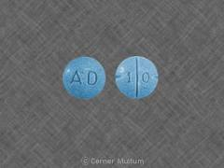
Heart disease or moderate to severe high blood pressure (hypertension)
Arteriosclerosis
Overactive thyroid
Glaucoma;
Severe anxiety, tension, or agitation; or
Hx of drug or alcohol addiction
Congenital heart defect;
Heart failure, heart rhythm disorder, or recent heart attack;
A personal or family history of mental illness, psychotic disorder, bipolar illness, depression, or suicide attempt;
Epilepsy or other seizure disorder; or
Tics (muscle twitches) or Tourette's syndrome

Slide 11
SAFETY INFORMATION
Take the missed dose as soon as you remember.
Skip the missed dose if it is almost time for your next scheduled dose, or if it is already evening.
Taking this medicine late in the day can cause sleep problems.
Do not take extra medicine to make up the missed dose.
Seek emergency medical attention or call the Poison Help line at 1-800-222-1222.
An overdose of Adderall can be FATAL.
Overdose symptoms may include severe forms of some of the side effects listed in the previous Slide
Avoid drinking fruit juices or taking vitamin C at the same time you take Adderall. These can make your body absorb less of the medicine.

Slide 12
Methylphenidate
Common names: Ritalin, Concerta
Functional class: Cerebral stimulant
Action: increases the release of norepinephrine and dopamine in the cerebral cortex to the reticular activating system, but exact action is not known.
Onset 0.5-1 hour, duration 4-6 hours, half life 3-4 hours

Slide 13
Methylphenidate Uses
Attention deficit disorder (ADD)
Attention deficit hyperactivity disorder (ADHD)
Post-stroke depression and major depression (These are unlabeled uses)
Offered in extended-release once-daily capsules or tablets, chewable tablets, oral suspension, transdermal patch (Daytrana)

Slide 14
Methylphenidate Side Effects
CNS hyperactivity
Insomnia
Restlessness
Headache
Seizure
Dysrhythmias and tachycardia
Nausea
Anorexia
Anemia
Dermatits
Fever
Scalp hair loss

Slide 15
Methylpheidate
Contraindicated for children under six years of age, hypersensitive patients, anxiety patients, and patients with glaucoma or anorexia nervousa
Precautions for women who are pregnant or breastfeeding
This medications has a black box warning for substance abuse

Slide 16
Methylphenidate
Hypertensive crisis can occur with use of MAOI’s or within 14 days of taking MAOI’s
Caffeine should be avoided
Assess vitals, obtain a CBC and blood glucose
Height and growth rate of children may be decreased with this medication
Stop medication if changes in mental status occur or signs of withdrawal when lowering dose

Slide 17
Methylphenidate
Teach patient to decrease caffeine amount and avoid OTC medications
Patients need adequate rest of this medication, take a regular tablet at least six hours prior to sleep

Slide 18
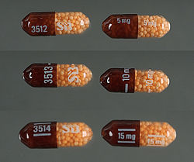
Dextroamphetamine
Uses:
Narcolepsy
Attention Deficit Hyperactive Disorder (ADHD)
Obesity

Slide 19
Side effects
Hypersensitivity
Insomnia
Restlessness
Dizziness
Headache
Irritability
Aggressiveness
Tremor
Dependence
Addiction
Palpitations
Tachycardia
Hypertension
decrease in heart rate
Dysrhythmias
Anorexia
dry mouth
Diarrhea
weight loss
metallic taste

Slide 20
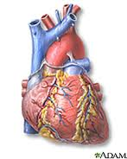
Contraindications
Hyperthyroidism
Hypertension
Glaucoma
substance abuse
Anxiety
anorexia nervosa
Black Box:
cardiovascular disease
substance abuse

Slide 21

Patient Education
Obesity= Before Meals
Decrease caffeine consumption= increased irritability
Avoid alcohol
Lots of rest

Slide 22
References
Adderall. (2013, Feburary 04). Retrieved from http://www.drugs.com/adderall.html
Porth, C. (2011). Essentials of pathophysiology. (3rd ed.) Philadelphia, PA: Lippincott, Williams, and Wilkins.
Skidmore-Roth, L. (2011). Dextroamphetamine. 2011 Mosby's nursing drug reference (24th ed., pp. 375-377). St. Louis, Mo.: Mosby.
Skidmore-Roth, L. (2012). Mosby's 2012 nursing drug reference (25th ed.). St. Louis, Mo.: Elsevier/Mosby.
Wolters, K. (2013). Nursing 2013 drug handbook. (33rd ed.) Philadelphia, PA: Lippincott, Williams, and Wilkins.

