Slide 1
Native American
Cultural Preferences
Ronnie Beathea, Melaney Coleman, Brittany Graff, Michael Kraak, & Lauren Magruder
Lakeview College of Nursing
N200- Theories and Issues in Nursing
13 April 2011

Slide 2
Introduction
America is a melting pot
Be aware and sensitive to patient needs
Practice as a culturally competent nurse
Knowledge of culture guides the nurse
Culture determines patient responses
More likely to encounter different cultures
Vital for efficient care
Notes:
America is a melting pot of different cultures and nurses should be aware and sensitive to the specific caring needs. The purpose of this presentation is to demonstrate how important it is to practice as a culturally competent nurse, specifically with the Native American population. According to Chitty and Black (2011), “knowledge of a patient’s culture guides the nurse in understanding behaviors and planning appropriate approaches to patient needs” (p. 231). Culture also plays a significant role in terms of how the patient may respond to healthcare providers. As our population increases, so does the likelihood of encountering different cultures. That’s why it is vital to have knowledge of other cultures. (Chitty & Black, 2011, pp. 231-234)

Slide 3
Demographic Representation of Culture in the US
Smallest population in America
500 federally recognized tribes
Increase in population from between 2000-2010
Notes:
Native Americans are among the smallest populations in America. They account for only 0.9 percent of the population; that is, 2.9 million people reporting that they are Native American alone. Also, of those 2.9 million people, there are 500 different federally recognized tribes. Although Native Americans represent a small percent of the population, from 2000- 2010 there was an 18 percent increase. With so many different tribes and an increase in population, there is more of a need to be a culturally competent nurse. (U.S. Census Bureau, 2010)

Slide 4
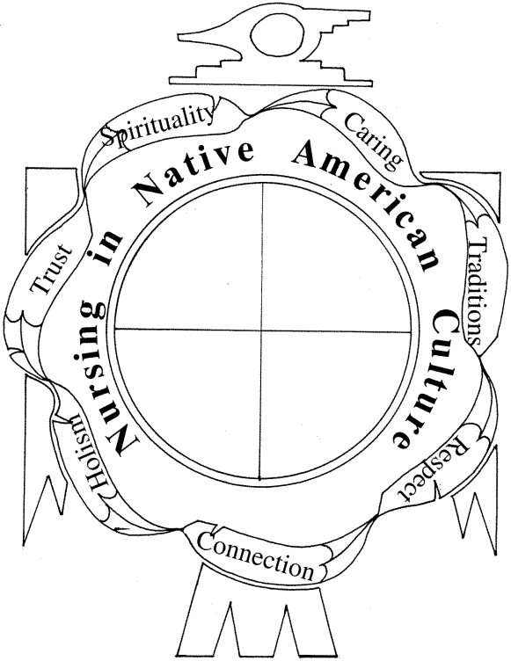
Native American Health
Preferences
Navajo culture- Keep pain and discomfort to oneself
Native American model
  Spirituality
  Caring
  Traditions
  Respect
  Connection
  Holism
  Trust
http://proxy.library.eiu.edu:2053/ehost/pdfviewer/pdfviewer?sid=108cf767-6f8e-414c-b5ee-9c24e091ef4f%40sessionmgr113&vid=21&hid=125
Notes:
Many cultures have different beliefs and values. In order to keep the nurse from misinterpreting the patient’s actions, it is important to understand exactly what those values might entail. For instance, the Navajo culture puts great emphasis on keeping pain and discomfort to oneself. They believe that expressing such emotions could be seen as weak. Because of this, the nurse may misinterpret a calm appearance as total comfort when, in reality, the patient might be in a great deal of pain. (Chitty & Black, 2011, p. 232) The native American nursing model shows the seven values that are essential to a Native American’s holistic life. These include Spirituality, caring, traditions, respect, connection, holism, and trust. (Struthers & Lowe, 2003)

Slide 5
Native American Health
Preferences
Meanings of dreams are significant
Patiently wait to speak
Traditional healing practices:
  herbs
  sweats
  Smudges
  Music
  Prayer
  Hypnosis or meditation
Notes:
Dreams and spirituality are one important aspect of their culture. They believe that the meanings of dreams directly relate to their health. In order for a patient to adhere to treatment, there must be a sense of motivation. One way to incorporate these two aspects into nursing is to use stories to help motivate Native Americans into living healthy lifestyles. (Bindler & Paul, 2004, p. 237) Another aspect of Native American’s holistic approach is respect. Native Americans do not believe in interrupting anyone while they are speaking. It is very important to patiently wait for the client to finish their thoughts in order to avoid offending them. The Native Americans believe in their traditional healing practices. These include herbs, sweats, smudges, music, and prayer. (Bindler & Paul, 2004, p. 239) They also believe that hypnosis or meditation puts them in balance with mother earth.

Slide 6
Native American Health
Preferences
Symbolism In Healing
Traditional Native Medicine Techniques
Sweating Physical and Emotional Ills.
Notes:
Natives (add Americans) believe that healing will result from sacred ceremonies that rely on having visions and using plants and objects that may be symbolic of the individual, the illness, or the treatment. Traditional medicine includes chanting, prayer, sand painting, dancing, and herbs. Many Native American tribes turn to the sweat lodge to cure a variety of physical and emotional ills. Native American’s perform ceremonies and chants to cleanse their spirit. (O'Brien, Anslow, Begay, Pereira, & Sullivan, 2002, pp. 55-56)

Slide 7
Native American Health
Preferences
Western Medicine Use
Examples
Native Medicine Use
Examples
Notes:
Natives use western medicine to treat western diseases. They do not use contemporary pharmacology unless it is absolutely necessary. For example, diabetes, cancer, and gallbladder disease are common illnesses to Native Americans and they use contemporary medicine to treat them. Furthermore, they use Native medicine to treat native problems. These types of problems include pain, disturbed family relationships resulting in physical symptoms, or sicknesses of the spirit, which may include mental illness and alcoholism. (Hendrix, n.d.).

Slide 8
Native American Health
Preferences
Surgical Preferences
Communication Preferences
Death Atmosphere Preferences
Notes:
After surgery it is not unusual for American Indian patients to request any removed body tissues be returned to them after surgery. This includes hair, nail clippings, tonsils, organs surgically removed (appendix, gallbladder, etc.), and often, amputated limbs or digits. Upon death, there is a general preference for naturalness, and home care is preferred unless there is a cultural taboo regarding death. Native Americans interact in the health care setting much differently than others. The physical distance of the conversation should be several feet to ensure a usual comfort zone. Eye Contact is not direct or only briefly direct, the gaze may be directed over the shoulder. While interviewing, the emotional expressiveness may be controlled and limited. Touch is not usually acceptable except a handshake. The conversational pace of American Indian languages have some of the longest pause times, compared to other languages, and especially English. Elders frequently complain that English speakers “talk too fast.” Silence is valued greatly. Jason’s story when he was treating clients in Alaska reinforce this type of behavior. (Hendrix, n.d)

Slide 9
Impact of Preferences on Nursing Care
Cultural competence
Conception of illness and healing
Collaboration between traditional healers and western practices
Notes:
According to Chitty and Black (2011), “cultural competence is the integration knowledge, attitudes, and skills that enhance cross-cultural communication and appropriate interactions with others” (p. 231). Integrating patients’ cultures into their nursing care is an important part of providing appropriate, individualized patient care. Native Americans believe that illness is caused by unhealthy or immoral behavior and they also believe that correcting these behaviors will bring about wellness. In their opinion, the treatment of disease and illness through western medicine impedes important life lessons that accompany illness. When providing care to a Native American, it is important for nurses to understand that many times, they will refuse western medical care because it impedes with their life course. Many Native Americans, however, practice both traditional and western medicine. Nurses providing care to this population must understand the vital role that traditional medicine still plays in the lives of American Indians. Because many Native Americans practice both types of medicine, nurses must often times collaborate care with traditional healers. Nurses must support the traditional medicine of Native Americans and instead of trying to fit the patient into their model of health, they must try to fit themselves into the patient’s model of health. This involves trying to incorporate natural remedies and the restoration of the balance between mind, body, and spirit into patient care. When providing care to Native Americans, nurses must understand their role in the traditional healing process and they must respect cultural differences and recognize the strength in the natural healing process. (Broome & Broome, 2007, pp. 162-163)

Slide 10
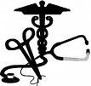
Impact of Preferences on Nursing Care
Five great values
  Generosity and sharing
  Respect for the older ones
  Getting along with nature
  Individual freedom
  Courage
http://uoprehealth.wordpress.com/
Notes:
One example of how the medical preferences of Native Americans impacts the nursing care given to them is the five great values of the Sioux tribe. The Sioux’s perspective on life is based on these five values, and it is very important for nurses to incorporate these values into their care. The first of the five values is generosity and sharing. According to Sanchez, Plawecki and Plawecki (1996), “according to this great value, when someone does something for you unasked, it is considered terribly insulting to thank him or her, as it would be perceived as payment for generosity” (p. 301). This value also incorporates the idea that no one person is better than another, and anything done must affect the whole group, whether negatively or positively. The second great value is respect for the older ones. This value holds the idea that elderly and people holding an authority position should be respected. Signs of respect in the Native American culture include avoiding eye contact except while speaking and never leaving an ill person alone. Children will also spend most to all of their time at the hospital with a sick parent. Getting along with nature is the third value. As the name suggests, this value holds the idea that every aspect of life is interrelated, and also that everything, whether animate or inanimate, has a spirit or power, also called the innermost. When a person’s innermost has been disrespected or hurt, illness results. Individual freedom, the fourth great value, involves the essence of choice. Individuals are free to makes choices as they wish, but their choices must not interfere with the freedom of another and a person cannot force anyone else’s decision. The responsibility and consequences of the choice must also be accepted by the chooser. The fifth and final great value is courage. Courage is an extremely important value and is symbolic of the interrelatedness of life. Because courage is so highly valued, Native Americans are unlikely to show fear, pain, or weakness. (Sanchez, Plawecki, & Plawecki, 1996, pp, 300-305)

Slide 11
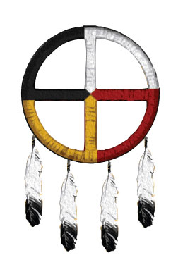
Impact of Preferences on Nursing Care
Case Study
http://www.billingsclinic.com/body.cfm?id=695
Notes:
“Mr. Wolfe is a Native American. He is 56, married, and has five children. He has been experiencing difficulty voiding and has recently been having pink-tinged urine. As you ask questions, you discover that he has also been experiencing rectal pain and some pelvic pressure. You explain that you will need to perform a more thorough examination. He consents to the examination. Following the examination and more testing, you inform Mr. Wolfe and his wife that based on the test results, he has prostatitis. You give him a prescription for antibiotics. Mr. Wolfe accepts the antibiotics and states that he will take these along with his herbal treatments. As the healthcare provider, what should you do? How will you work to educate Mr. Wolfe and his wife to integrate western and AI beliefs.” (Broome & Broome, 2007, p. 163).

Slide 12
Summary
America is melting pot
Smallest population in America
Believe in natural, holistic health
Native American Model
Traditional healing practices
Understand and respect practices
Notes:
Because America is made up of many different cultures, cultural competence is something that every nurse should have. The Native American population is the smallest population in America, accounting for 0.9 percent of the population. Native Americans believe in naturalness and the idea that everything in life is connected. The Native American Model shows the seven values that Native Americans value most. These are the values that nurses must take into consideration when providing care to a Native American patient. Native Americans use many traditional healing practices. These include things such as herbs, sweats, smudges, music, prayer, and hypnotism and meditation. A lot of the time, Native Americans will choose to only use traditional healing practices to bring about wellness. However, sometimes they will choose a combination of western medicine and traditional practices. When Native Americans choose a combination of both practices, it is very important that the nurse understands the role that traditional practices play in the health of the Native American patient. The nurse must be sure that medical care provided by him or her does not conflict with traditional practices. The nurse must also respect the practices and culture of the Native American patient. Respecting the culture of a Native American patient will be beneficial not only for the patient, but also for the nurse.

Slide 13
References
Broome, B., & Broome, R. (2007). Culture and diversity issues. Native Americans: Traditional healing. Urologic Nursing, 27(2), 161. Retrieved from EBSCOhost.
Chitty, K. K., & Black, B.P. (2011). Professional nursing: Concepts & challenges. Maryland Heights, MO: Saunders Elsevier.
Hendrix, L. (n.d.). Health and health care of American Indian and Alaska Native. Stanford University. Retrieved April 6, 2011, from http://www.stanford.edu/group/ethnoger
O'Brien, B., Anslow, R., Begay, W., Pereira, B., & Sullivan, M. (2002). 21st century rural nursing: Navajo traditional and western medicine. Nursing Administration Quarterly, 26(5), 47-57. Retrieved from EBSCOhost.
Provi-Bindler, R., Allen, C., & Paul, R. (2004). Native American learning: an integrative model. Journal of Nursing Education, 43(5), 237-240. Retrieved from EBSCOhost.
Sanchez, T., Plawecki, J., & Plawecki, H. (1996). The delivery of culturally sensitive health care to Native Americans. Journal of Holistic Nursing, 14(4), 295-307. Retrieved from EBSCOhost.
Struthers, R., & Lowe, J. (2003). Nursing in the Native American culture and historical trauma. Issues in Mental Health Nursing, 24(3), 257-272. Retrieved from EBSCOhost.
U.S. Census Bureau. (2010). United States census 2010: It's in our hands. Retrieved from www.census.gov.
Notes:
This presentation was very strong in every aspect. The colors and artwork you chose were very effective. The text of the slides appeared consistent throughout. You obtained good resources and provided good detail in your notes pages. Your presentation to the class was professional. However, more than that, it was interesting and very informative.
There are only a few minor APA issues which are noted as bold faced and underlined (or red in the references). Overall….excellent!
Content: 70/70
APA: 27/30
Grade: 97/10

