Slide 1
Callista Roy
Dominique Bell, Tara Kutz, Allison Marquardt, Julia McGraw, Megan Aprile, Catherine Deters
Notes:
My comments will be in the notes pages….bold-faced and underlined.
I recommend you add the school name, course, and date for your future reference.

Slide 2
Objectives
To inform the class on the achievements of Callista Roy
To provide Roy’s biographical information
To explain Roy’s Adaptation Theory
To explain how her adaptation theory applies to the present

Slide 3
Biography
Born in Los Angeles on October 14, 1939
BSN at Mount Saint Mary’s College
MSN at University of California – Los Angeles
Masters and Doctorate in Sociology at University of California – Los Angeles
Sister of Sisters of Saint Joseph of Carondelet
Notes:
Callista Roy was born in Los Angeles, California on October 14, 1939. She graduated from Mount Saint Mary’s College in 1963 with her Bachelors of Science in Nursing (BSN). She continued on to graduate from the University of California Los Angeles with her Masters of Science in Nursing (MSN) in 1966. After graduating with her MSN, Roy decided to continue on with her education and received both her Master’s degree and her Doctorate degree in Sociology in 1973 and 1977. Roy then decided to become a Sister at the Sisters of Saint Joseph of Carondelet. (Alligood and Tomey, 2010, p. 335)
Alligood, M.R. & Tomey, A.M. (2010). Sister Callista Roy. Nursing theorists and their work (pp. 335-336). Maryland Heights, MO: Mosby Elsevier.
The discussion in the notes pages doesn’t add anything to what is presented in the slide.

Slide 4
Biography
Professor and chairperson of the nursing department of Mount Saint Mary’s College and University of Portland
Created the position of “Nursing Theorist” at Boston College in 1987
Member of Sigma Theta Tau
Achieved dozens of awards
Notes:
In 1983, Roy was promoted to a professor of nursing education at both Mount Saint Mary’s College and the University of Portland. She was the main initiator of the summer program at the University of Portland. During the times of 1983-1985, Roy worked at the University of California as a clinical instructor in neuroscience. She did much research on the cognitive recovery from head injuries. In 1987, Roy created the position of “Nursing Theorist” at Boston College School of Nursing. She has published several books, journals, and chapters throughout her day. She is a member of Sigma Theta Tau, which is an international honor society for nursing. She has earned dozens of awards, however her most prominent one came from the American Academy of Nursing when they recognized her as a Living Legend. (Alligood and Tomey, 2010, p. 336)
Alligood, M.R. & Tomey, A.M. (2010). Sister Callista Roy. Nursing theorists and their work (pp. 335-336). Maryland Heights, MO: Mosby Elsevier.

Slide 5
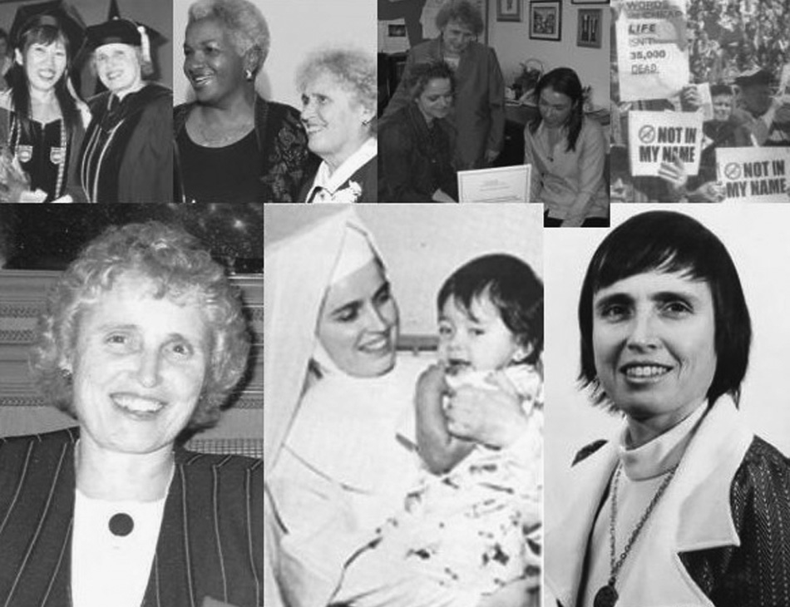
Callista Roy at Her Best
Frederickson, K. & Velasco-Whetsell, M. (2007). Tribute to the Theorists. Callista Roy over the years. Nursing Science Quarterly, 20(2). 107. Retrieved from EBSCOhost
Notes:
These are some pictures of Callista Roy’s finest moments. She was a respectable, independent woman who has influenced many individuals over the years. (Frederickson & Velasco-Whetsell, 2007, p. 107)
Frederickson, K. & Velasco-Whetsell, M. (2007). Tribute to the Theorists. Callista Roy over the years. Nursing Science Quarterly, 20(2). 107. Retrieved from EBSCOhost

Slide 6
How theory came to be developed
Dr. Callista Roy was challenged in a seminar
First presented her model as conceptual framework for nursing curriculum in 1970
Published introduction to nursing: An adaptation model
Updated all of her writing in a comprehensive text in 1999
Model is widely used for education research and nursing practice today
Notes:
While a graduate student at the University of California, Los Angles (1964-1966), sister Dr. Callista Roy was challenged in a seminar by another nurse theorist to come up with her own theory. So she first presented her model as a conceptual framework for a nursing curriculum in 1970( Chitty & Black, 2011, p.313). In 1976 she published introduction to nursing: An adaptation model and followed with a second edition in 1984. Roy updated all her writing in a comprehensive text in 1999. Her model is widely used for education research and nursing practice today. ( Chitty & Black, 2011 p.313)
Chitty, K., & Black, B. (2011). Professional nursing: Concepts and challenges. Maryland Heights, MO: Saunders Elsevier.
Notes discussion does not add anything to what is presented in the slide.

Slide 7
Model Concepts
Systems Model
Systems are open
People are adaptable
Roy Adaptation Model focuses on the person, goal, health, environment, and nursing activities
Notes:
Callista Roy’s model is a systems model that focuses on outcomes. Since systems are open, “behavior is determined by the free interplay of changing forces” (Johnson Lutjens, 1991, p. 8). People constantly adapt to their changing environments which allows for survival and growth. The Roy Adaptation Model focuses on the person, goal, health, environment, and nursing activities. According to Johnson Lutjens (1991), “Roy uses person in her model as a concept to identify the recipient of nursing care” (p. 9).
Johnson Lutjens, L.R. (1991). Callista Roy: An adaptation model. Newbury Park, CA: SAGE Publications, Inc.

Slide 8
Goal and Health
Goal of Model: to promote adaptation
Described health as “a state and a process of being and becoming an integrated and whole person” (Johnson Lutjens, 1991, p. 9).
Holism + integrating the four adaptive modes = wholeness and health
Health: a state of maximum potential whether the person is healthy or dying
Notes:
The goal of Roy’s model is to promote adaptation which is “promoted by four adaptive modes” (Johnson Lutjens, 1991, p. 9). These include physiologic, interdependence, self-concept, and role function which ultimately contributes to health of the individual. Roy and Andrews described health as “a state and a process of being and becoming an integrated and whole person” (Johnson Lutjens, 1991, p. 9). Holism as well as integrating the four adaptive modes results in wholeness and health which is a state of maximum potential whether the person is healthy or dying. (Johnson Lutjens, 1991, p. 9)
Johnson Lutjens, L.R. (1991). Callista Roy: An adaptation model. Newbury Park, CA: SAGE Publications, Inc.
Notes discussion does not add anything to what is presented in the slide.

Slide 9
Environment and Nursing Activities
Described the environment as “all conditions, circumstances, and influences that surround and affect the development and behavior of the person” (Johnson Lutjens, 1991, p. 10).
Internal and external environmental stimuli
Environment causes people to be adaptive
Nursing activities = the nursing process
Notes:
Roy and Andrews described the environment as “all conditions, circumstances, and influences that surround and affect the development and behavior of the person” (Johnson Lutjens, 1991, p. 10). There are internal and external environmental stimuli. These stimuli can be further classified as residual, focal, or contextual, according to Roy. Due do these different stimuli, the environment causes people to be adaptive. Nursing activities is ultimately the nursing process. Roy made a minor change to the nursing process, in which the process was six steps but the first two steps are assessment of behavior and then assessment of stimuli. Then she goes into diagnosing, goal setting, setting interventions, and evaluating. (Johnson Lutjens, 1991, p. 10)
Johnson Lutjens, L.R. (1991). Callista Roy: An adaptation model. Newbury Park, CA: SAGE Publications, Inc.

Slide 10
The Roy Adaptation Model In Community Health Nursing
Can make a great impact on community health nursing
Addresses the problems within the community related to health risks and how they can be reduced
Notes:
The use of the Roy Adaptation Model can make a great impact on community health nursing. When used in community health nursing, it addresses the problems within the community related to health risks and how they can be reduced. (Dixon, 1999, p. 292)
Dixon, E. (1999). Community health nursing practice and the Roy Adaptation Model. Public Health Nursing, 16(4), 290-300. Retrieved from EBSCOhost.
The notes discussion does not add to the information presented in the slide.
The font size in the slide’s title on slides 10-13 needs to be larger to correspond with the other slides.

Slide 11
The Roy Adaptation Model In Community Health Nursing
Begins with a behavioral assessment, which has four parts
Physical mode
Group identity
Role function
Interdependence
Behavioral assessments are used to make a stimuli assessment
Nursing care plan is made from the stimuli assessment
Notes:
The process begins with a behavioral assessment. This looks for behaviors that are negative or keeping the community from moving forward. There are four modes that address these behaviors. The physical mode looks at health problems and concerns within the community. Group identity looks at the variety of community groups available to its members and if the groups are serving the community members’ needs. Role function looks at the functioning and effectiveness of groups and their members serving the community. The interdependence mode looks at the relationships and support systems among the community and its members. After identifying the behavior problems, it is then time to do a stimuli assessment. The assessment looks for the origination of the behavior problems that were found. The assessment is then used to make nursing diagnoses. Goals would then be set, interventions planned, implementation given, and then an evaluation of whether the goals were met. (Dixon, 1999, p. 294)
Dixon, E. (1999). Community health nursing practice and the Roy Adaptation Model. Public Health Nursing, 16(4), 290-300. Retrieved from EBSCOhost.
See previous comment about font size of slide’s title.

Slide 12
Theories Implementation In Nursing Practice
Studies at Brook Army Medical Center and the United States Army Institute of Surgical Research
Based on Roy adaptation model
Examined quality of life of cancer patients
Notes:
Studies based on the Roy adaptation model were done at the Brook Army Medical Center and the United States Army Institute of Surgical Research. The goal of the studies was to determine if an increase in person-environment interaction would impact a cancer patient’s quality of life. (Fawcett, 2005, p. 321)
Fawcett, J. (2005). Using the Roy adaptation model to guide nursing research. Nursing science quarterly, 18 (4), 321
The discussion on the notes pages did not add anything to what was presented in the slide.

Slide 13
Theories Implementation In Nursing Practice
Significant improvements in quality of life
Greater effort by medical professionals to ask about quality of life
Roy adaptation model was seen as an excellent guide
Notes:
The studies concluded that when using the Roy adaptation model, the patients had a significant improvement in quality of life. Researchers concluded that nurses and other medical professionals should make a greater effort to use the Roy adaptation model and ask patients questions about their quality of life that they might not share if not asked. According to Linda H Yoder, “My colleagues and I have found that the Roy adaptation model has served as an excellent guide for out investigations of quality of life among patients with chronic illnesses…” (Fawcett, 2005, p. 321)
Fawcett, J. (2005). Using the Roy adaptation model to guide nursing research. Nursing science quarterly, 18 (4), 321

Slide 14
Summary
Callista Roy… RN, PhD, FAAN
Created the Roy adaptation Model which proves to still aid health care professionals in nursing today
Model contributes to “focus on its transferability to their reality and ease of crosscultural interpretation” (Fredrickson & Velasco-Whetsell, 2007, p. 107).
Roy adaptation Association has two branches; one in the Unites States and one in Japan
Notes:
Callista Roy is a Registered Nurse, has a doctorate degree, and is a member of the Fellows of the American Academy of Nursing. Roy focused on the sanctity of the individual through her Adaptation model. She is a very popular nursing theorist and has been a role model for health care professionals everywhere. Her strong and courageous attitude, and her ability to be so caring have led her to become a part of history. The Roy Adaptation Association was established in 1991, and is available for nurses who are interested in adaptation of the Roy Adaptation Model. (Fredrickson & Velasco-Whetsell, 2007, p. 107)
Frederickson, K. & Velasco-Whetsell, M. (2007). Tribute to the Theorists. Callista Roy over the years. Nursing Science Quarterly, 20(2). 107. Retrieved from EBSCOhost

Slide 15
References
Alligood, M.R. & Tomey, A.M. (2010). Sister Callista Roy. In Nursing theorists and their work (pp. 335-336). Maryland Heights, MO: Mosby Elsevier.
Chitty, K., & Black, B. (2011). Professional nursing: Concepts and challenges. Maryland Heights, MO: Saunders Elsevier.
Dixon, E. (1999). Community health nursing practice and the Roy Adaptation Model. Public Health Nursing, 16(4), 290-300. Retrieved from EBSCOhost.
Fawcett, J. (2005). Using the Roy adaptation model to guide nursing research. Nursing science quarterly, 18 (4), 321.
Frederickson, K. & Velasco-Whetsell, M. (2007). Tribute to the Theorists. Callista Roy over the years. Nursing Science Quarterly, 20(2). 107. Retrieved from EBSCOhost
Johnson Lutjens, L.R. (1991). Callista Roy: An adaptation model. Newbury Park, CA: SAGE Publications, Inc.
Notes:
Line spacing should only be double-spacing.
Do not use bullet points in the references.
There were a few formatting errors in the references. Please type them in a larger font size for the second project.

