Slide 1
Placental Abruption
Jessica Key & Stephanie Gonzalez

Slide 2
Introduction
Placental Abruption is the premature separation of the placenta from the uterus during pregnancy (Effects of intimate partner violence, 2010).
Abruption is the most common cause of serious vaginal bleeding, occurring in 1 percent of pregnancies (Late Pregnancy Bleeding, 2007).
It is a great contributor to both maternal and fetal mortality and accounts for about 12% of perinatal deaths.
Common risk factors for placental abruption include advanced maternal age, hypertension, trauma, and maternal substance abuse (Effects of intimate partner violence, 2010).

Slide 3
Etiology
To date, very little is known about the etiology of placental abruption (Effects of intimate partner violence, 2010).
Placental abruption is thought to be a consequence of Intimate Partner Violence(IPV) –however, evidence linking the two is not very sound. Studies have shown that IPV can lead to other risky behaviors in pregnancy such as drugs, stress, hypertension, etc. (Effects of intimate partner violence, 2010).
Theories have been suggested relating its occurrence to decreased blood flow to the placenta during the last trimester (Davidson, M., Ladewig, P. & London, M., 2012).
Placental abruption typically manifests as vaginal bleeding, uterine tenderness or back pain, and evidence of fetal distress (Late Pregnancy Bleeding, 2007).

Slide 4
Treatment
Tocolysis may be used with corticosteroids in mild abruption before 34 weeks but otherwise, it is contraindicated (Late Pregnancy Bleeding, 2007).
One trial demonstrated a reduction in the incidence of abruption with intrapartum treatment of preeclampsia using magnesium sulfate (Late Pregnancy Bleeding, 2007).
Managing an abruption may require rapid cesarean delivery to prevent morbidity and mortality (Late Pregnancy Bleeding, 2007).
The incidence of placental abruption may be decreased by cessation of tobacco, cocaine, or amphetamine use, and appropriate care for hypertensive disorders in pregnancy (Late Pregnancy Bleeding, 2007).

Slide 5
Consequences of Complication
Disseminated intravascular coagulation can result from the release of thromboplastin into the the mothers blood circulation when the placenta separates (Late Pregnancy Bleeding, 2007).
Placental Abruption is a major contributor to fetal and maternal mortality (Effects of intimate partner violence, 2010).
The high fetal mortality is usually caused by preterm delivery. Maternal outcomes caused by placental abruption include major blood loss, disseminated intravascular coagulopathy, and renal failure (Effects of intimate partner violence, 2010).

Slide 6
Nursing Diagnoses
The #1 nursing diagnoses that would be assigned to this patient would be Risk for Deficient Fluid Volume related to hypovolemia secondary to excessive blood loss.
The #2 nursing diagnoses that would be assigned to this patient would be Ineffective Peripheral Tissue Perfusion related to blood loss secondary to uterine atony following birth.

Slide 7
Nursing Interventions for Risk for Deficient Fluid Volume
Weigh pads and chux, this will help determine the woman's amount of blood loss.
Monitor urinary output hour and measure urine specific gravity, to assess for dehydration.
Assess mental status of patient, to ensure there is no excessive blood loss causing confusion.
Palpate bilateral peripheral pulses, skin color and temperature to help determine signs of hypovolemic shock.
(Davidson, M., Ladewig, P. & London, M., 2012)

Slide 8
Nursing Interventions for Ineffective Peripheral tissue Perfusion
Assess maternal vital signs to determine if an episode of bleeding has occurred.
Monitor fetal heart tones to detect signs of fetal hypoxia.
Assess fundal height to determine an approximate gestational age.
(Davidson, M., Ladewig, P. & London, M., 2012)

Slide 9
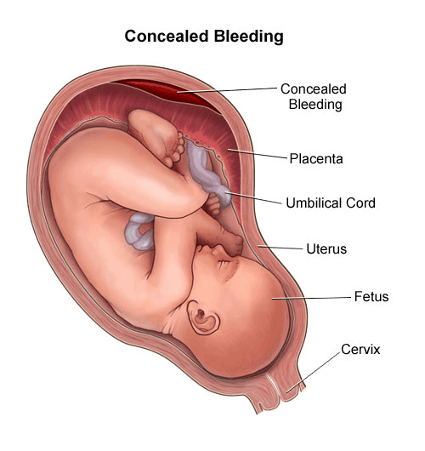
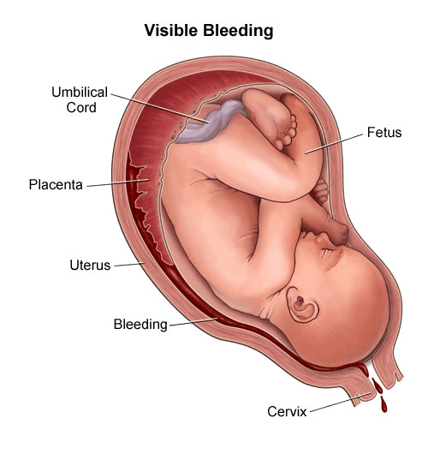
Concealed Bleeding and Visible Bleeding
http://www.chop.edu/healthinfo/bleeding-in-pregnancy-placenta-previa-placental-abruption.html

Slide 10
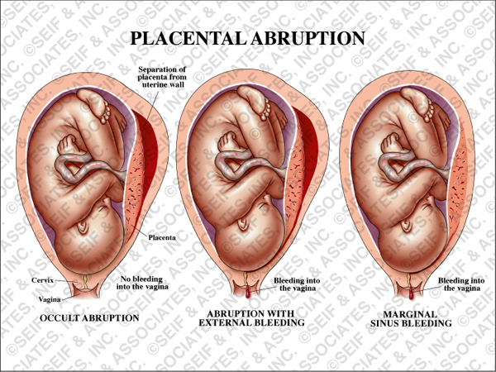
Examples of Placental Abruption- with different bleeding patterns.
http://www.seifmedgraphics.com/placental_abruption.htm

Slide 11
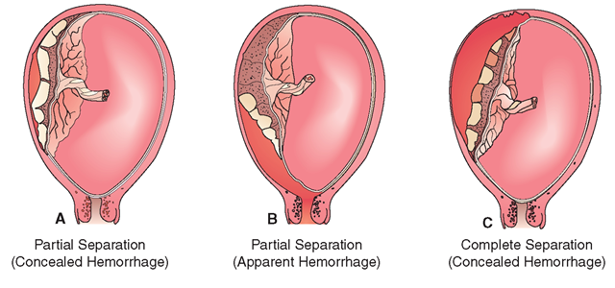
Different Levels of Separation
http://what-when-how.com/nursing/high-risk-pregnancy-and-childbirth-maternal-and-newborn-nursing-part-3/

Slide 12
Conclusion
Placental Abruption is the separation of the placenta from the uterine wall before delivery and exact cause is unknown.
Chances of Placental Abruption occurring can be lowered by participating in preventative measures.
Treatment is limited but medications focus on maintaining the mothers cardiovascular status while developing a plan to safely deliver the fetus (Davidson, M., Ladewig, P. & London, M., 2012).
Fetus can be delivered by cesarean section if moderate to severe abruption has occurred. If mild abruption occurs close to full term, vaginal delivery can be induced (Davidson, M., Ladewig, P. & London, M., 2012).

Slide 13
References

