Slide 1
Placental Abruption
Jessica Key & Stephanie Gonzalez

Slide 2
Introduction
Placental Abruption is the premature separation of the placenta from the uterus during pregnancy(Effects of intimate partner violence, 2010).
Abruption is the most common cause of serious vaginal bleeding, occurring in 1 percent of pregnancies(Late Pregnancy Bleeding, 2007).
It is a great contributor to both maternal and fetal mortality and accounts for about 12% of perinatal deaths.
Common risk factors for placental abruption include advanced maternal age, hypertension, trauma, and maternal substance use(Effects of intimate partner violence, 2010).

Slide 3
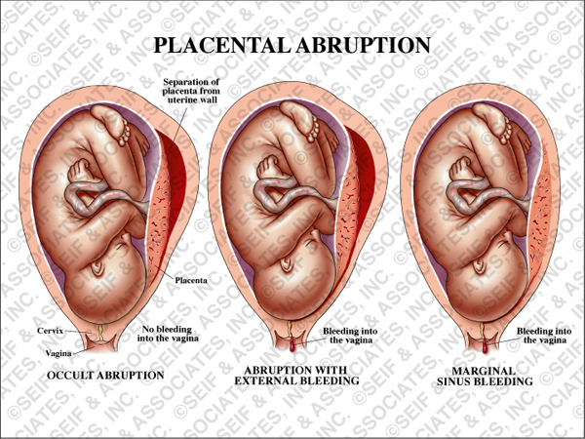
Examples of Placental Abruption- with different bleeding patterns.
http://www.seifmedgraphics.com/placental_abruption.htm

Slide 4
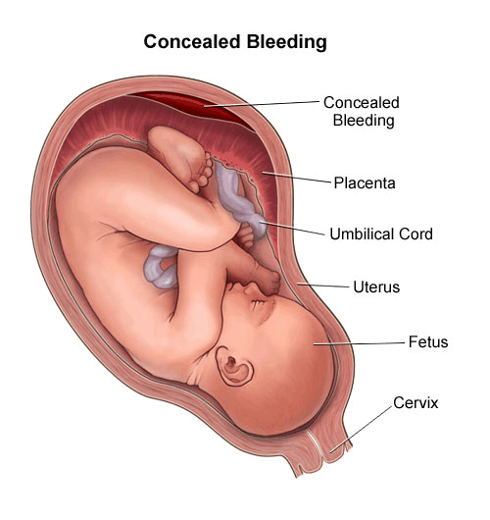
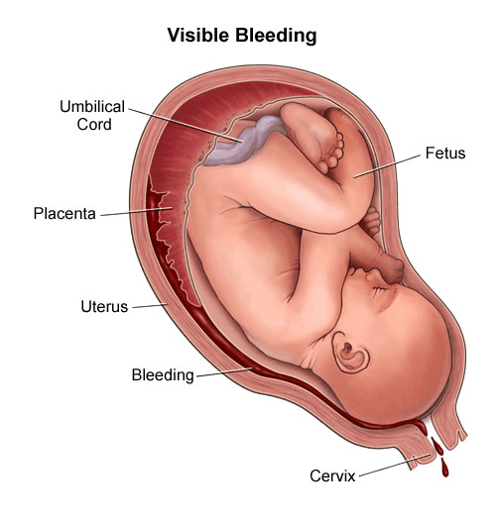
Concealed Bleeding and Visible Bleeding
http://www.chop.edu/healthinfo/bleeding-in-pregnancy-placenta-previa-placental-abruption.html

Slide 5
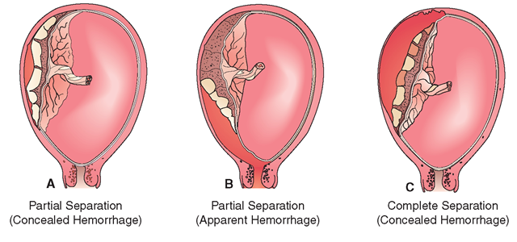
Different Levels of Separation

Slide 6
Etiology
Placental abruption is thought to be a consequence of Intimate Partner Violence -evidence linking the two is not sound(Effects of intimate partner violence, 2010).
To date, very little is known about the etiology of placental abruption. Placental abruption only occurs in about 6.5/1000 births(Effects of intimate partner violence, 2010).
Placental abruption typically manifests as vaginal bleeding, uterine tenderness or back pain, and evidence of fetal distress(Late Pregnancy Bleeding, 2007).

Slide 7
Etiology

Slide 8
Treatment

Slide 9
Consequences of Complication
Disseminated intravascular coagulation can result from the release of thromboplastin into the the mothers blood circulation when the placenta separates(Late Pregnancy Bleeding, 2007).
Placental Abruption is a major contributor to fetal and maternal mortality(Effects of intimate partner violence, 2010).
The high fetal mortality is usually caused by preterm delivery. Maternal outcomes caused by placental abruption include major blood loss, disseminated intravascular coagulopathy, and renal failure(Effects of intimate partner violence, 2010).

Slide 10
Nursing Diagnoses

Slide 11
Nursing Interventions

Slide 12
Conclusion

Slide 13
References

