Slide 1

Urbana Illinois Windshield Survey
By Gregory Cahill

Slide 2
Urbana Illinois
Located at the intersection of I-74 and I-57 right next to Champaign IL

Slide 3
Population
Total- 41,250
Male- 50.1%
Female- 49.9%
White- 57.7%
Asian- 17.7%
Black- 16.1%
Hispanic- 5.2%
Other- 0.5%

Slide 4
Places to live
Mean house price- $159,260
Median rent- $703
Median household income- $32,236
Renter occupied housing- 63.04%
Owner occupied housing- 36.96%

Slide 5
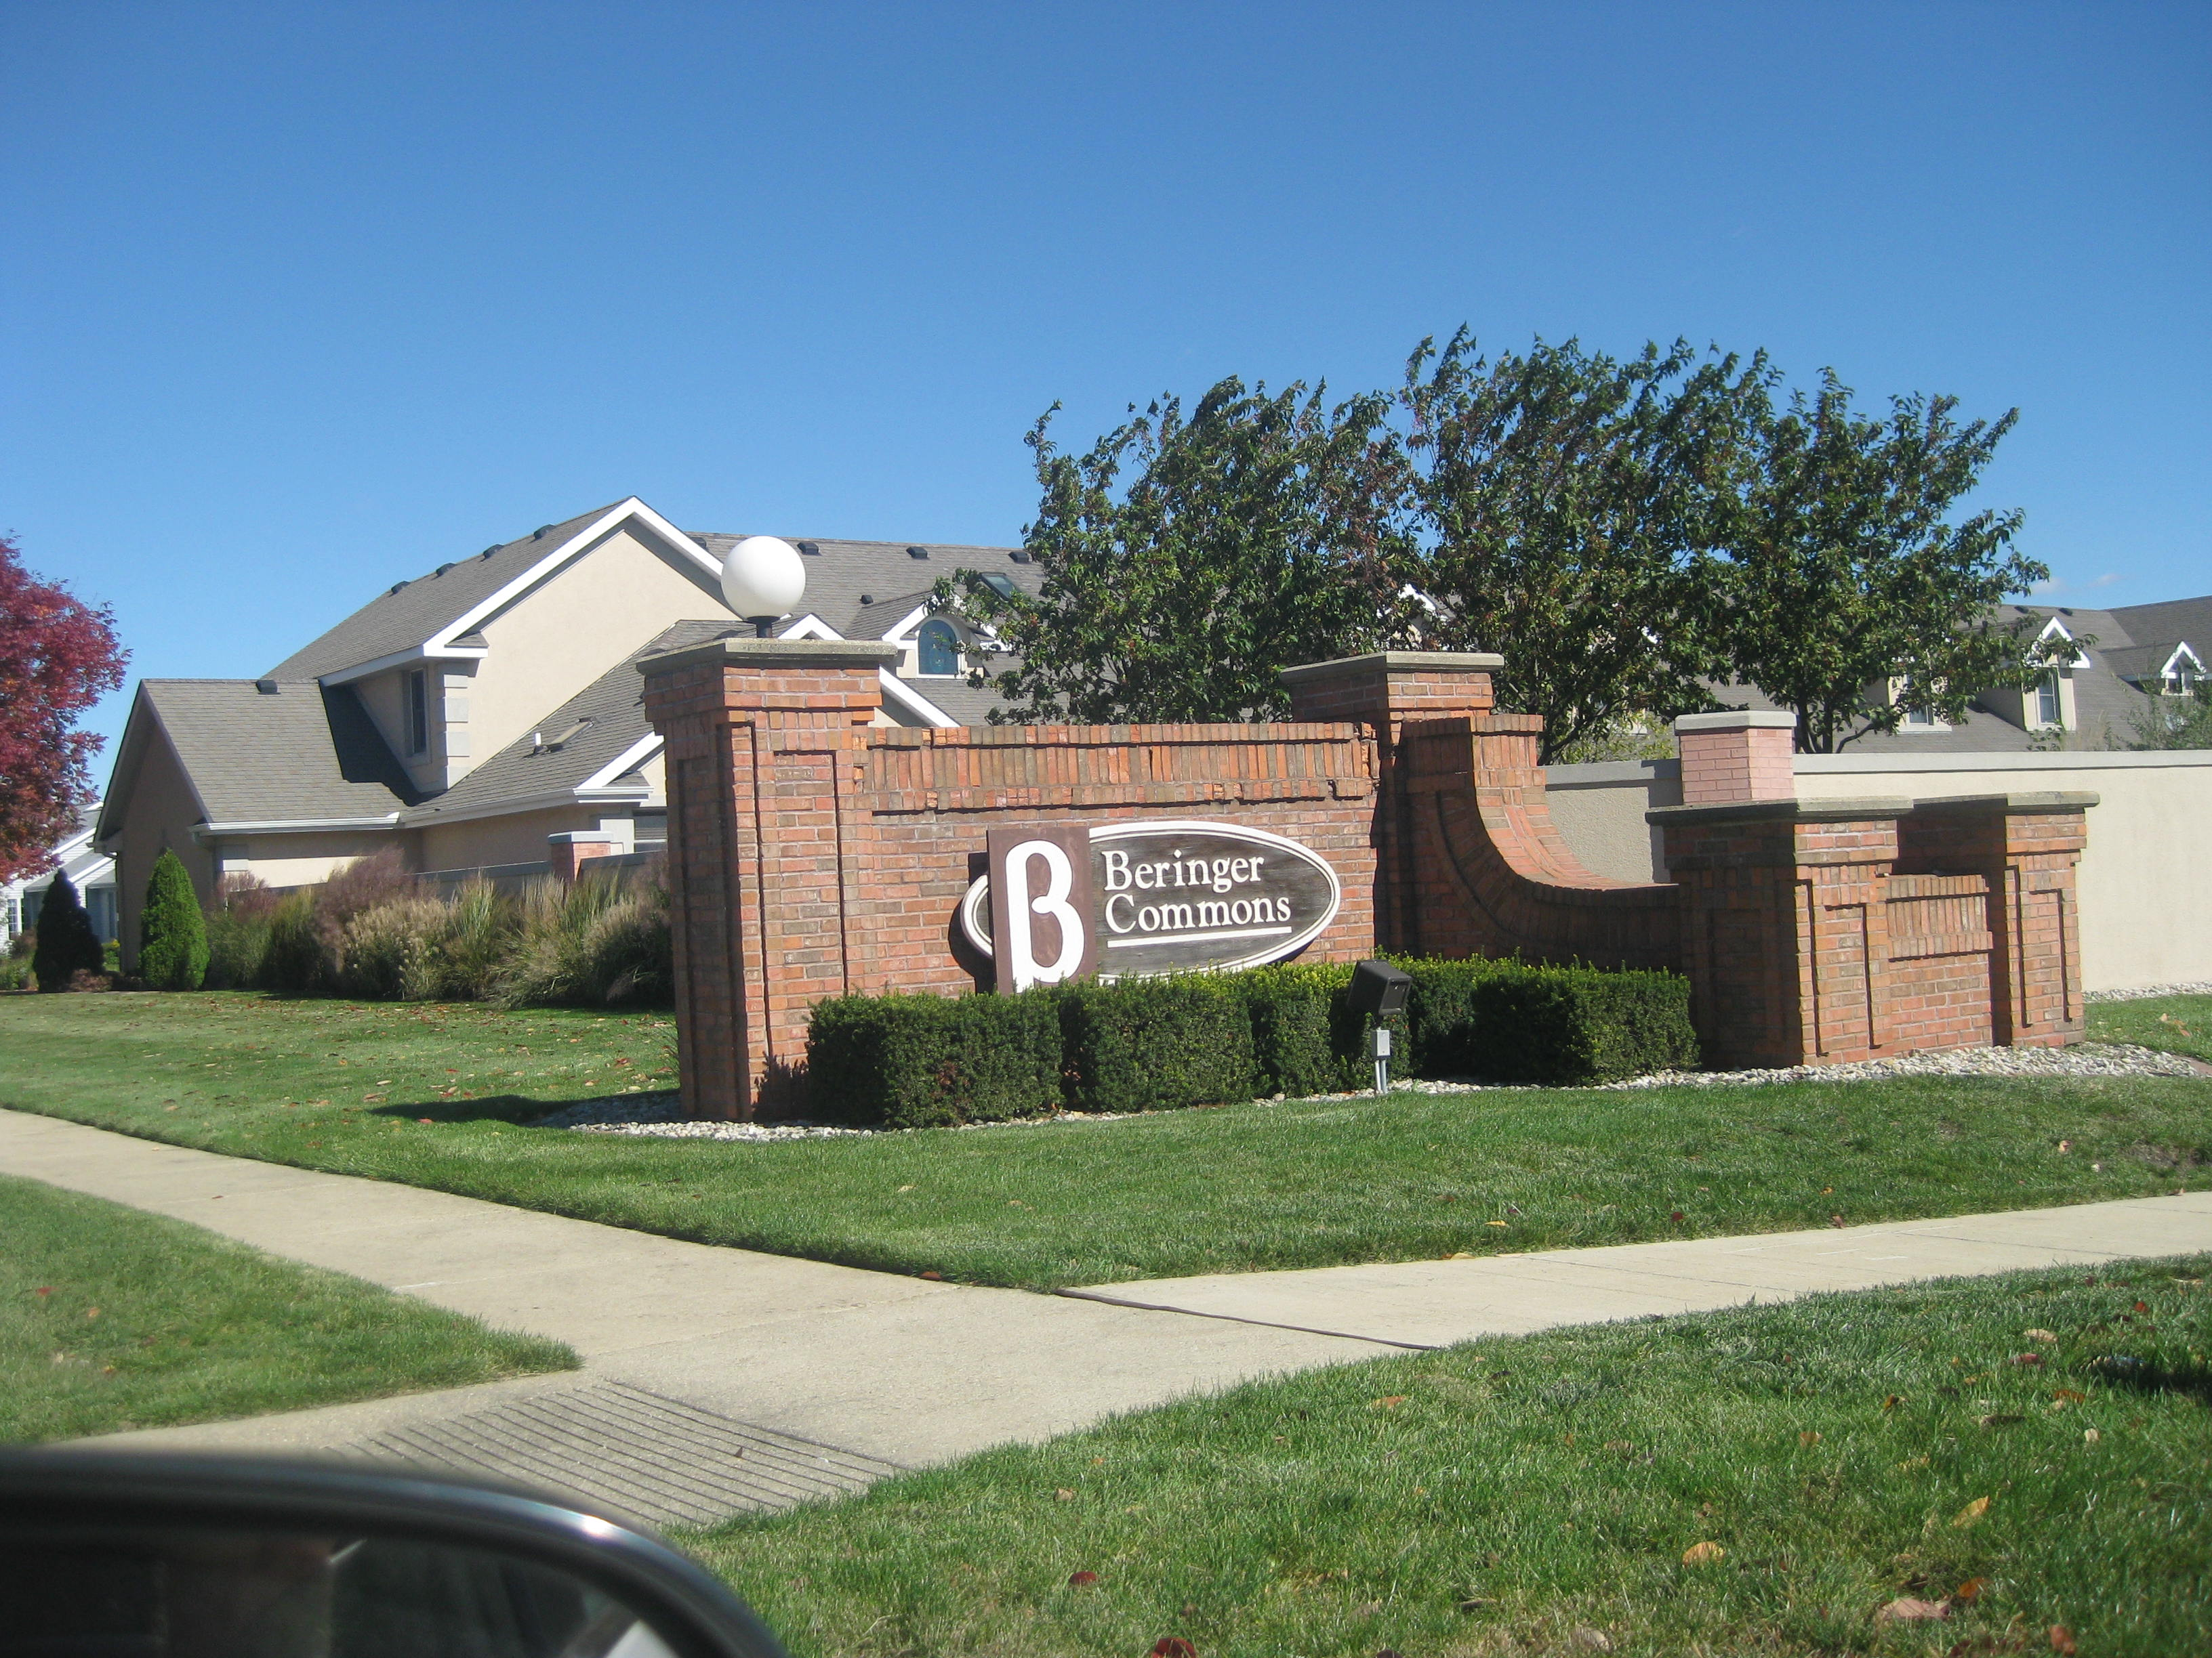
Upscale living to trailer parks and everything in between

Slide 6
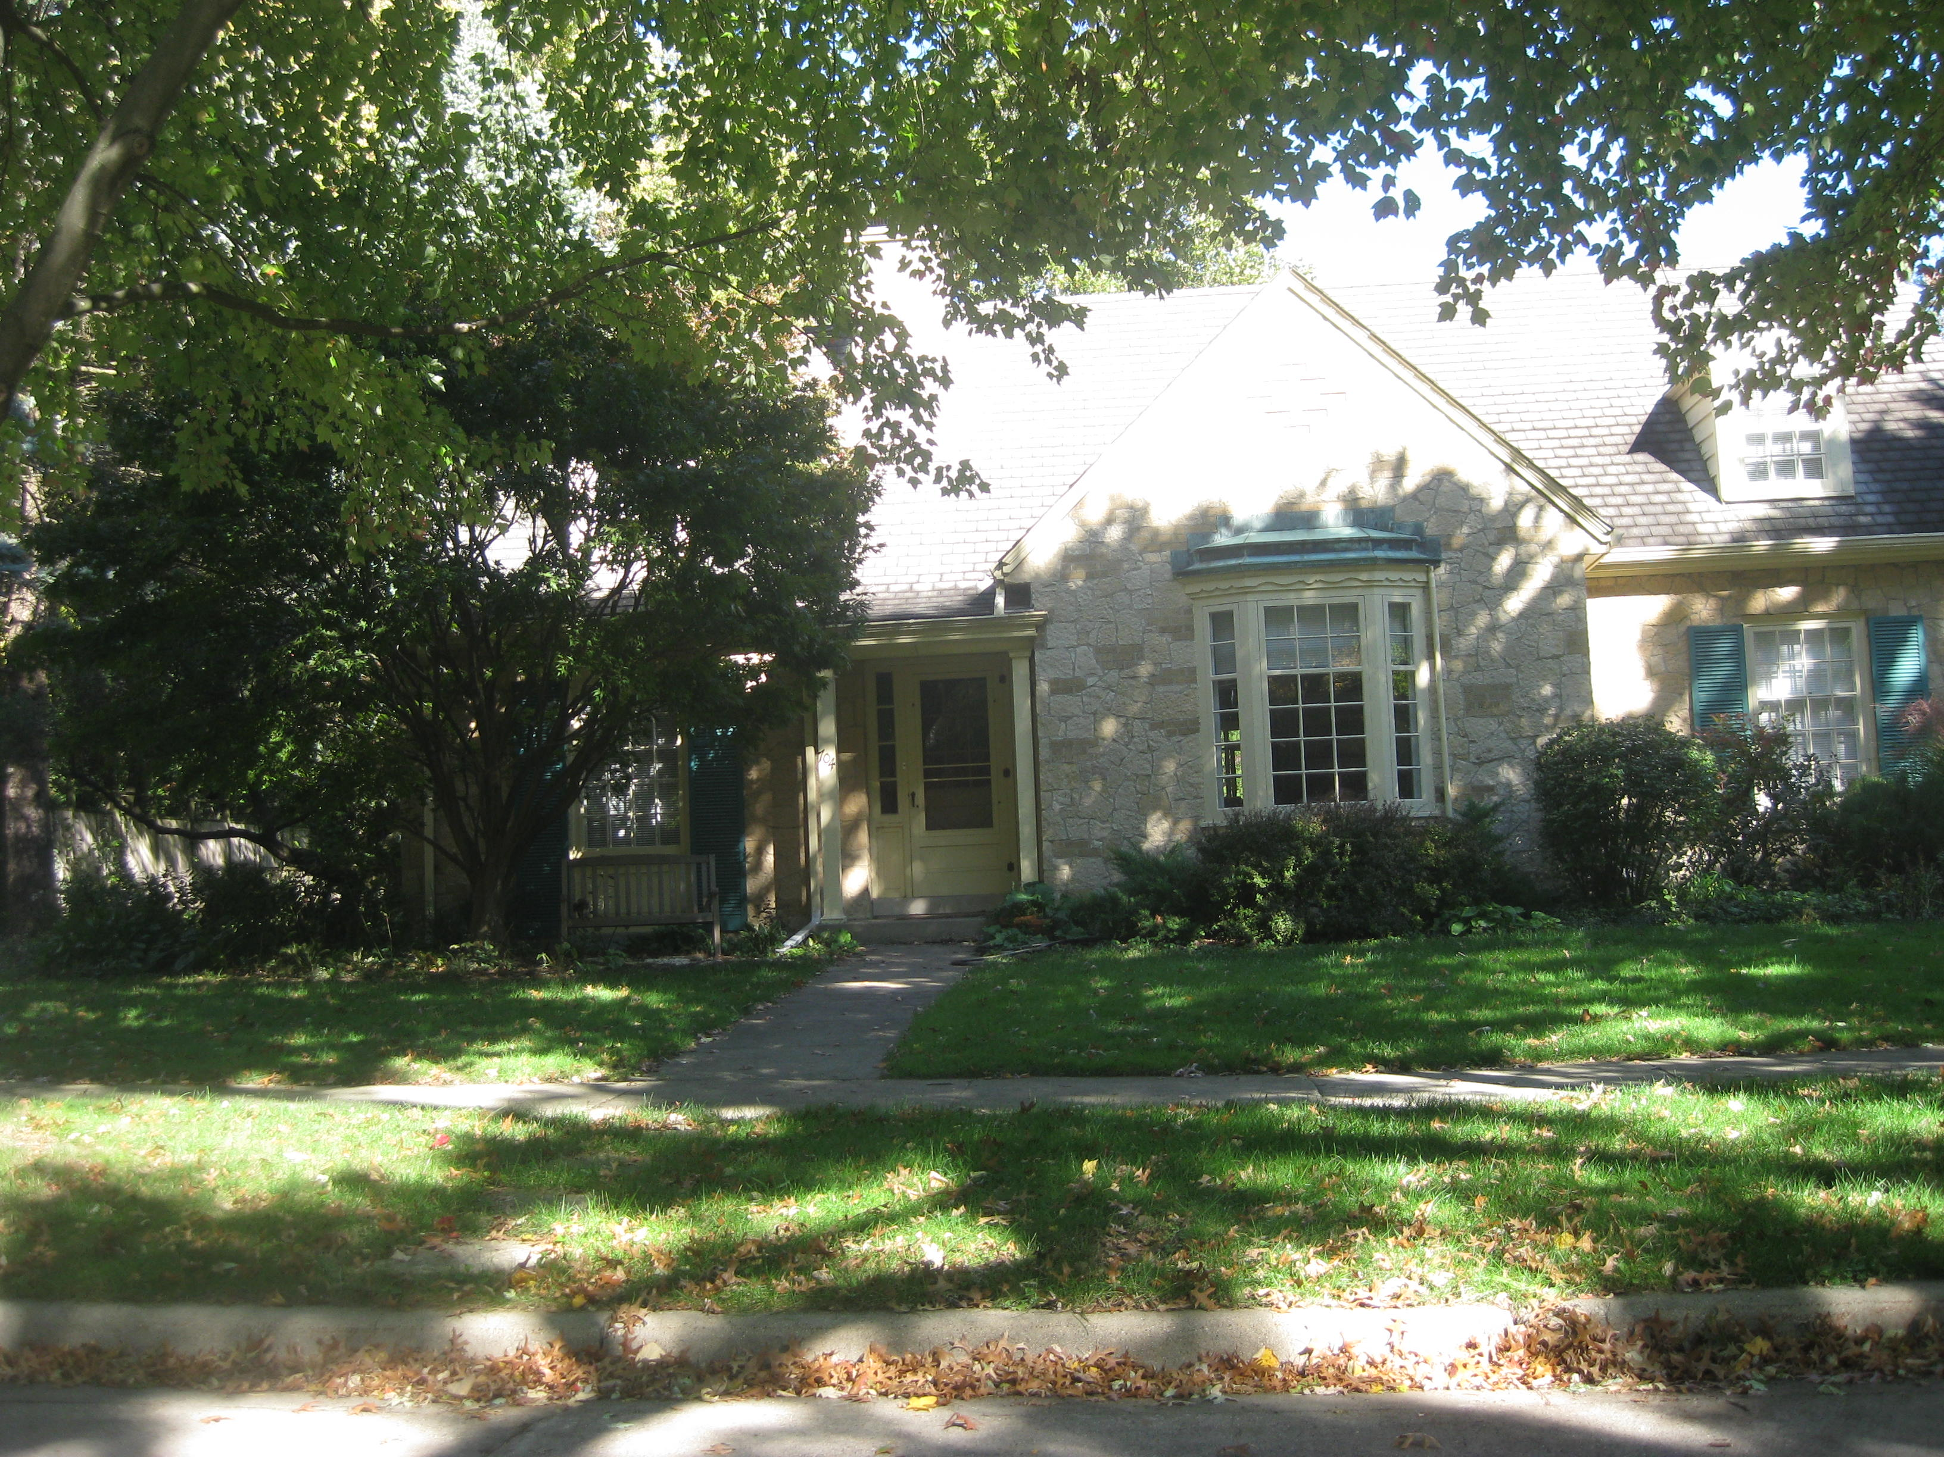

Slide 7
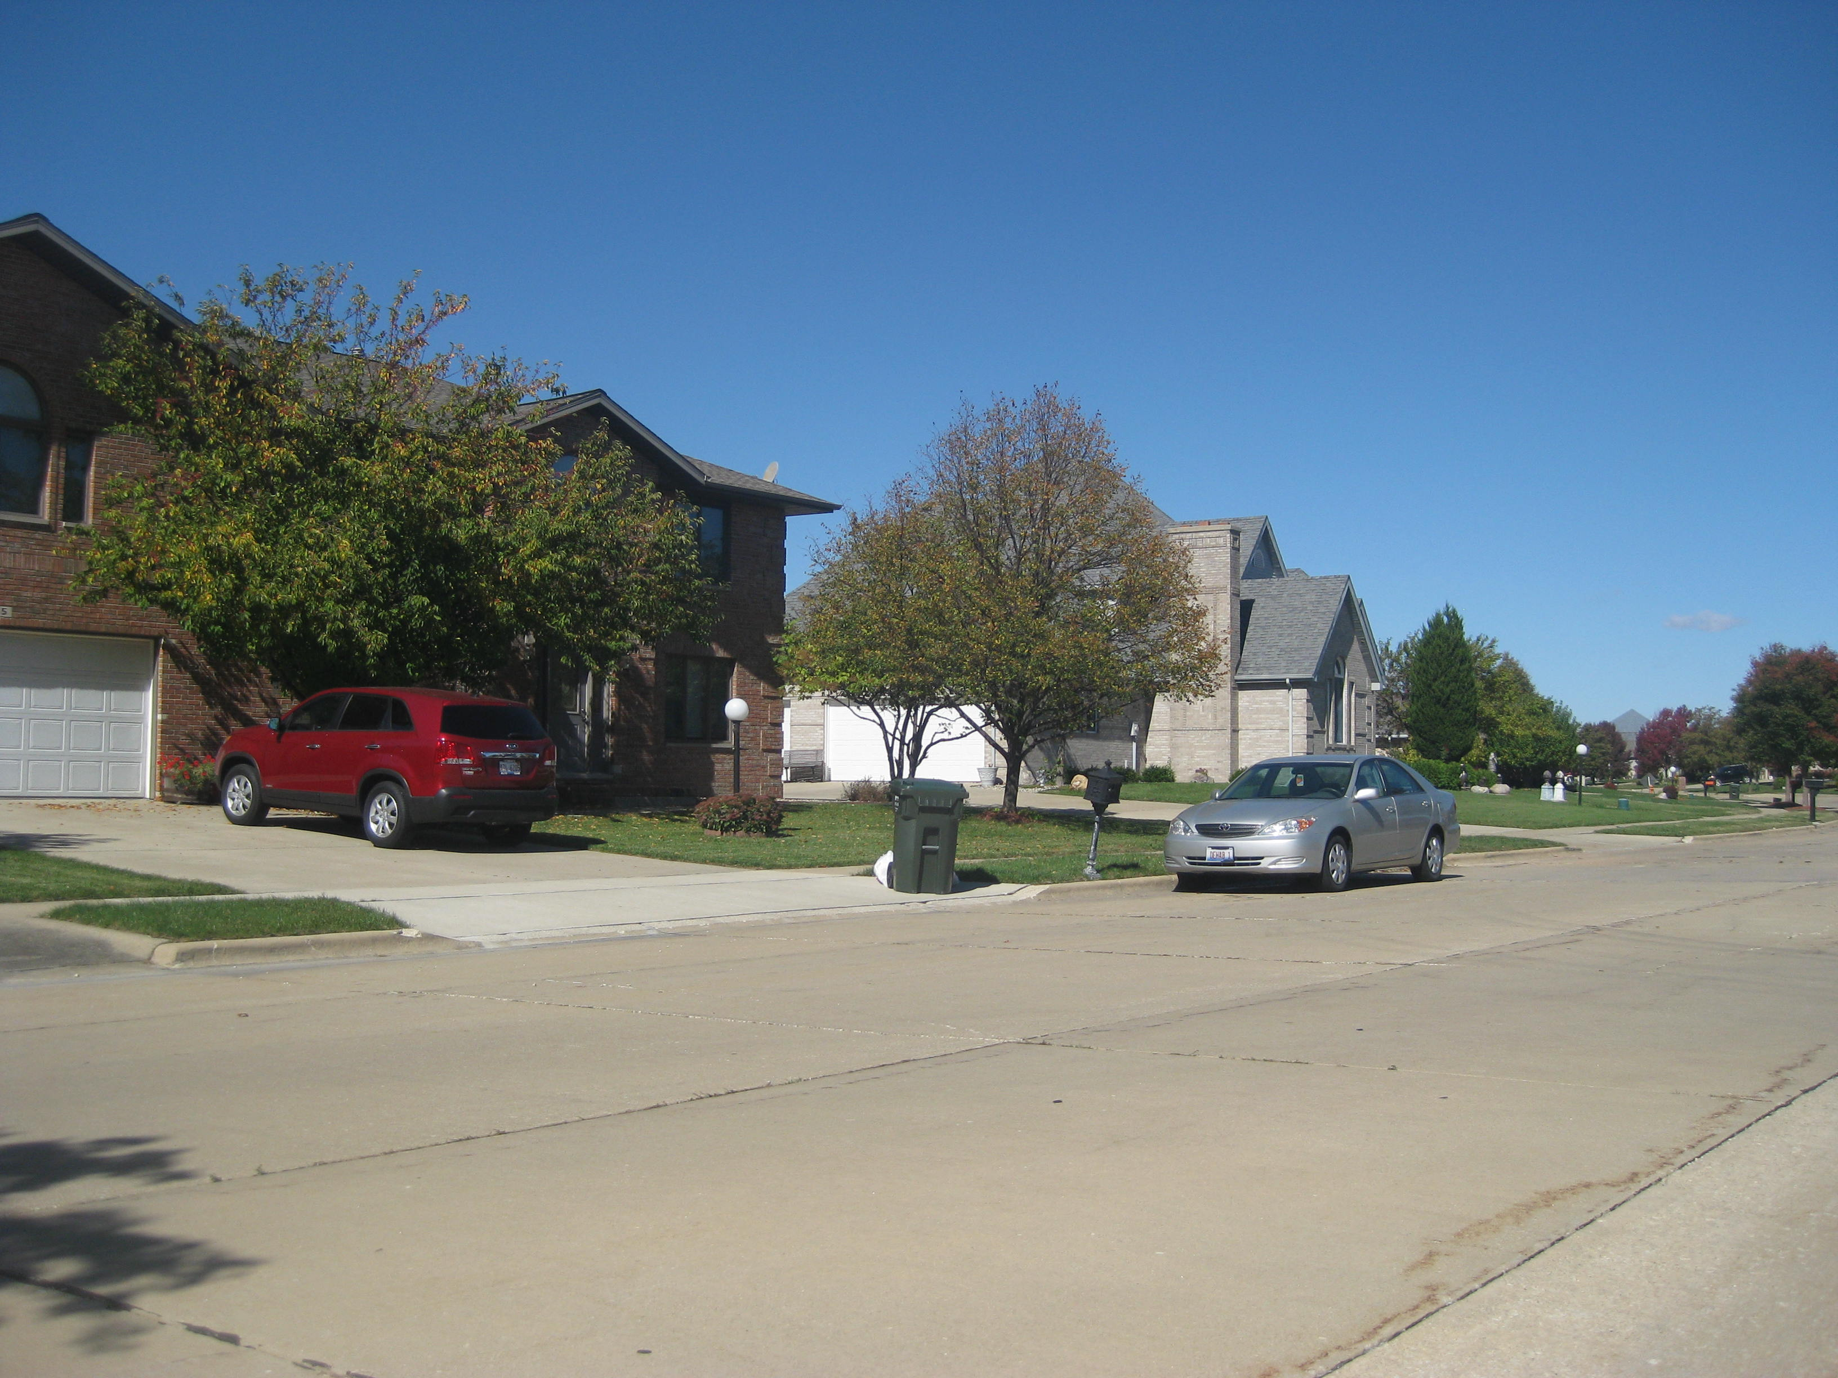

Slide 8
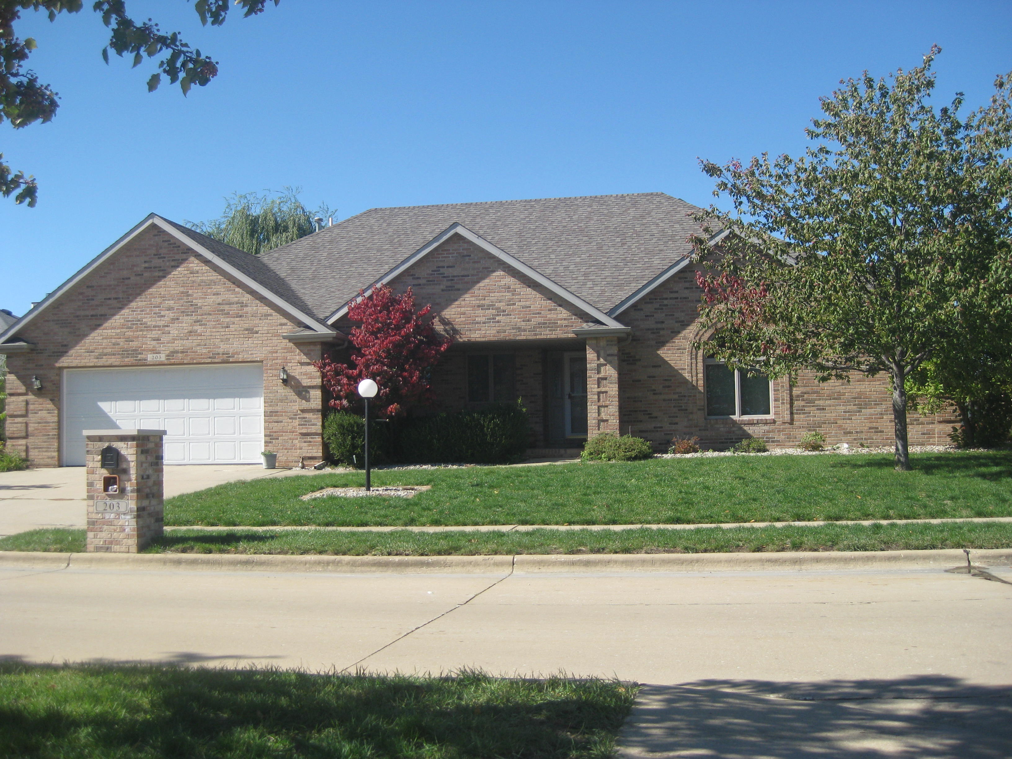

Slide 9
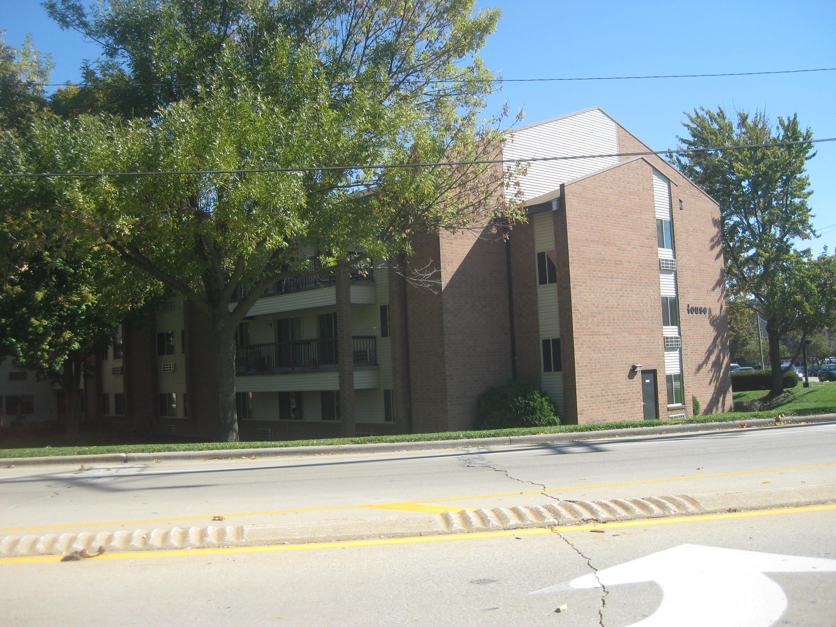

Slide 10
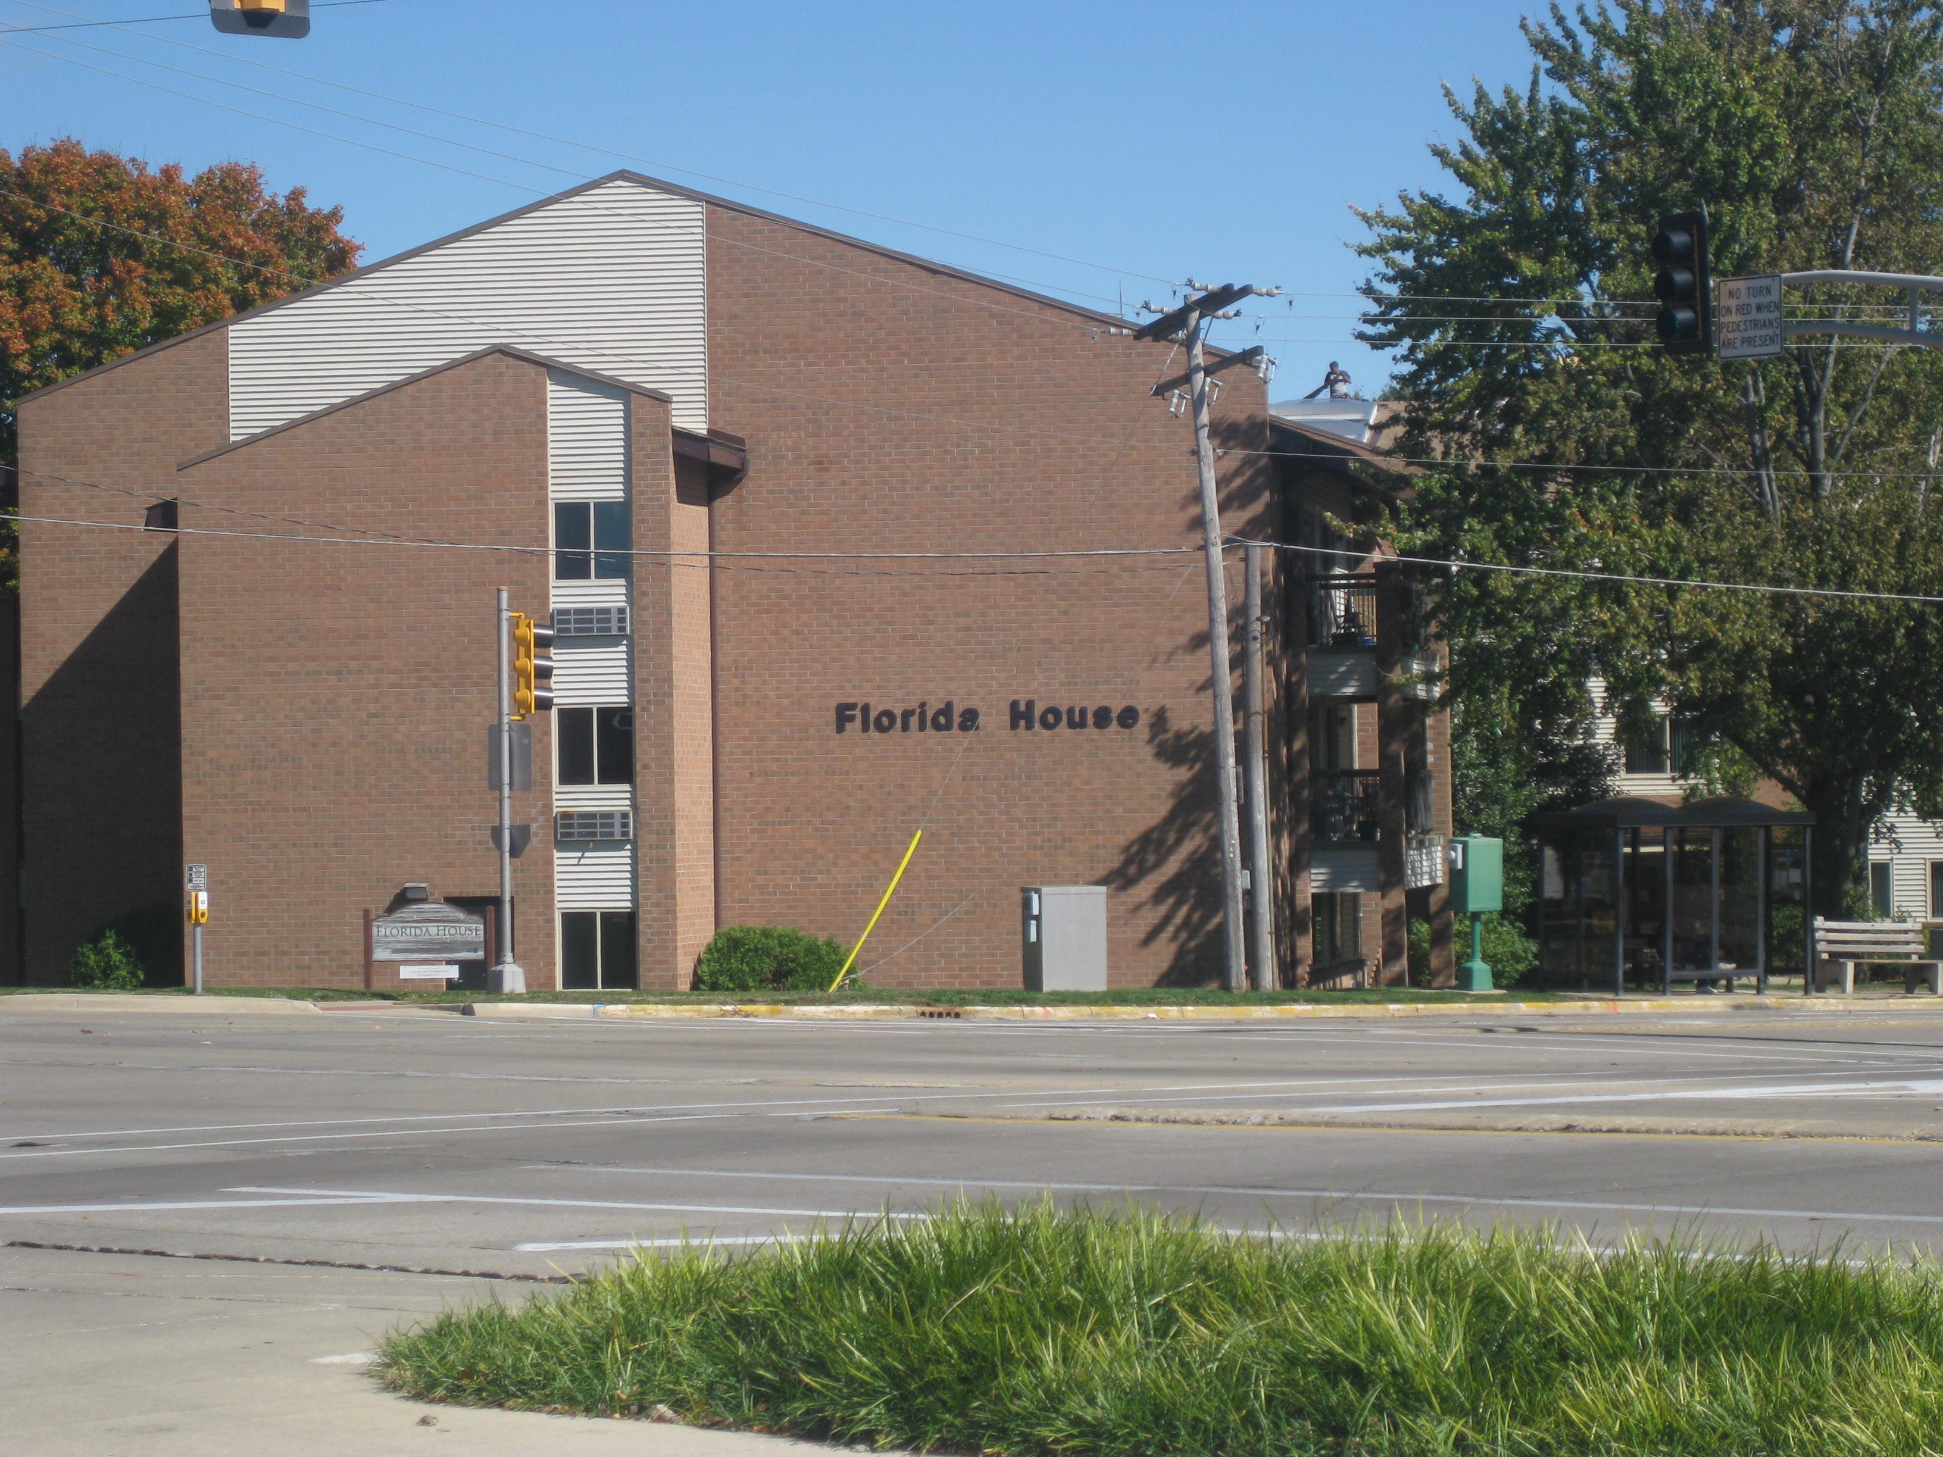

Slide 11
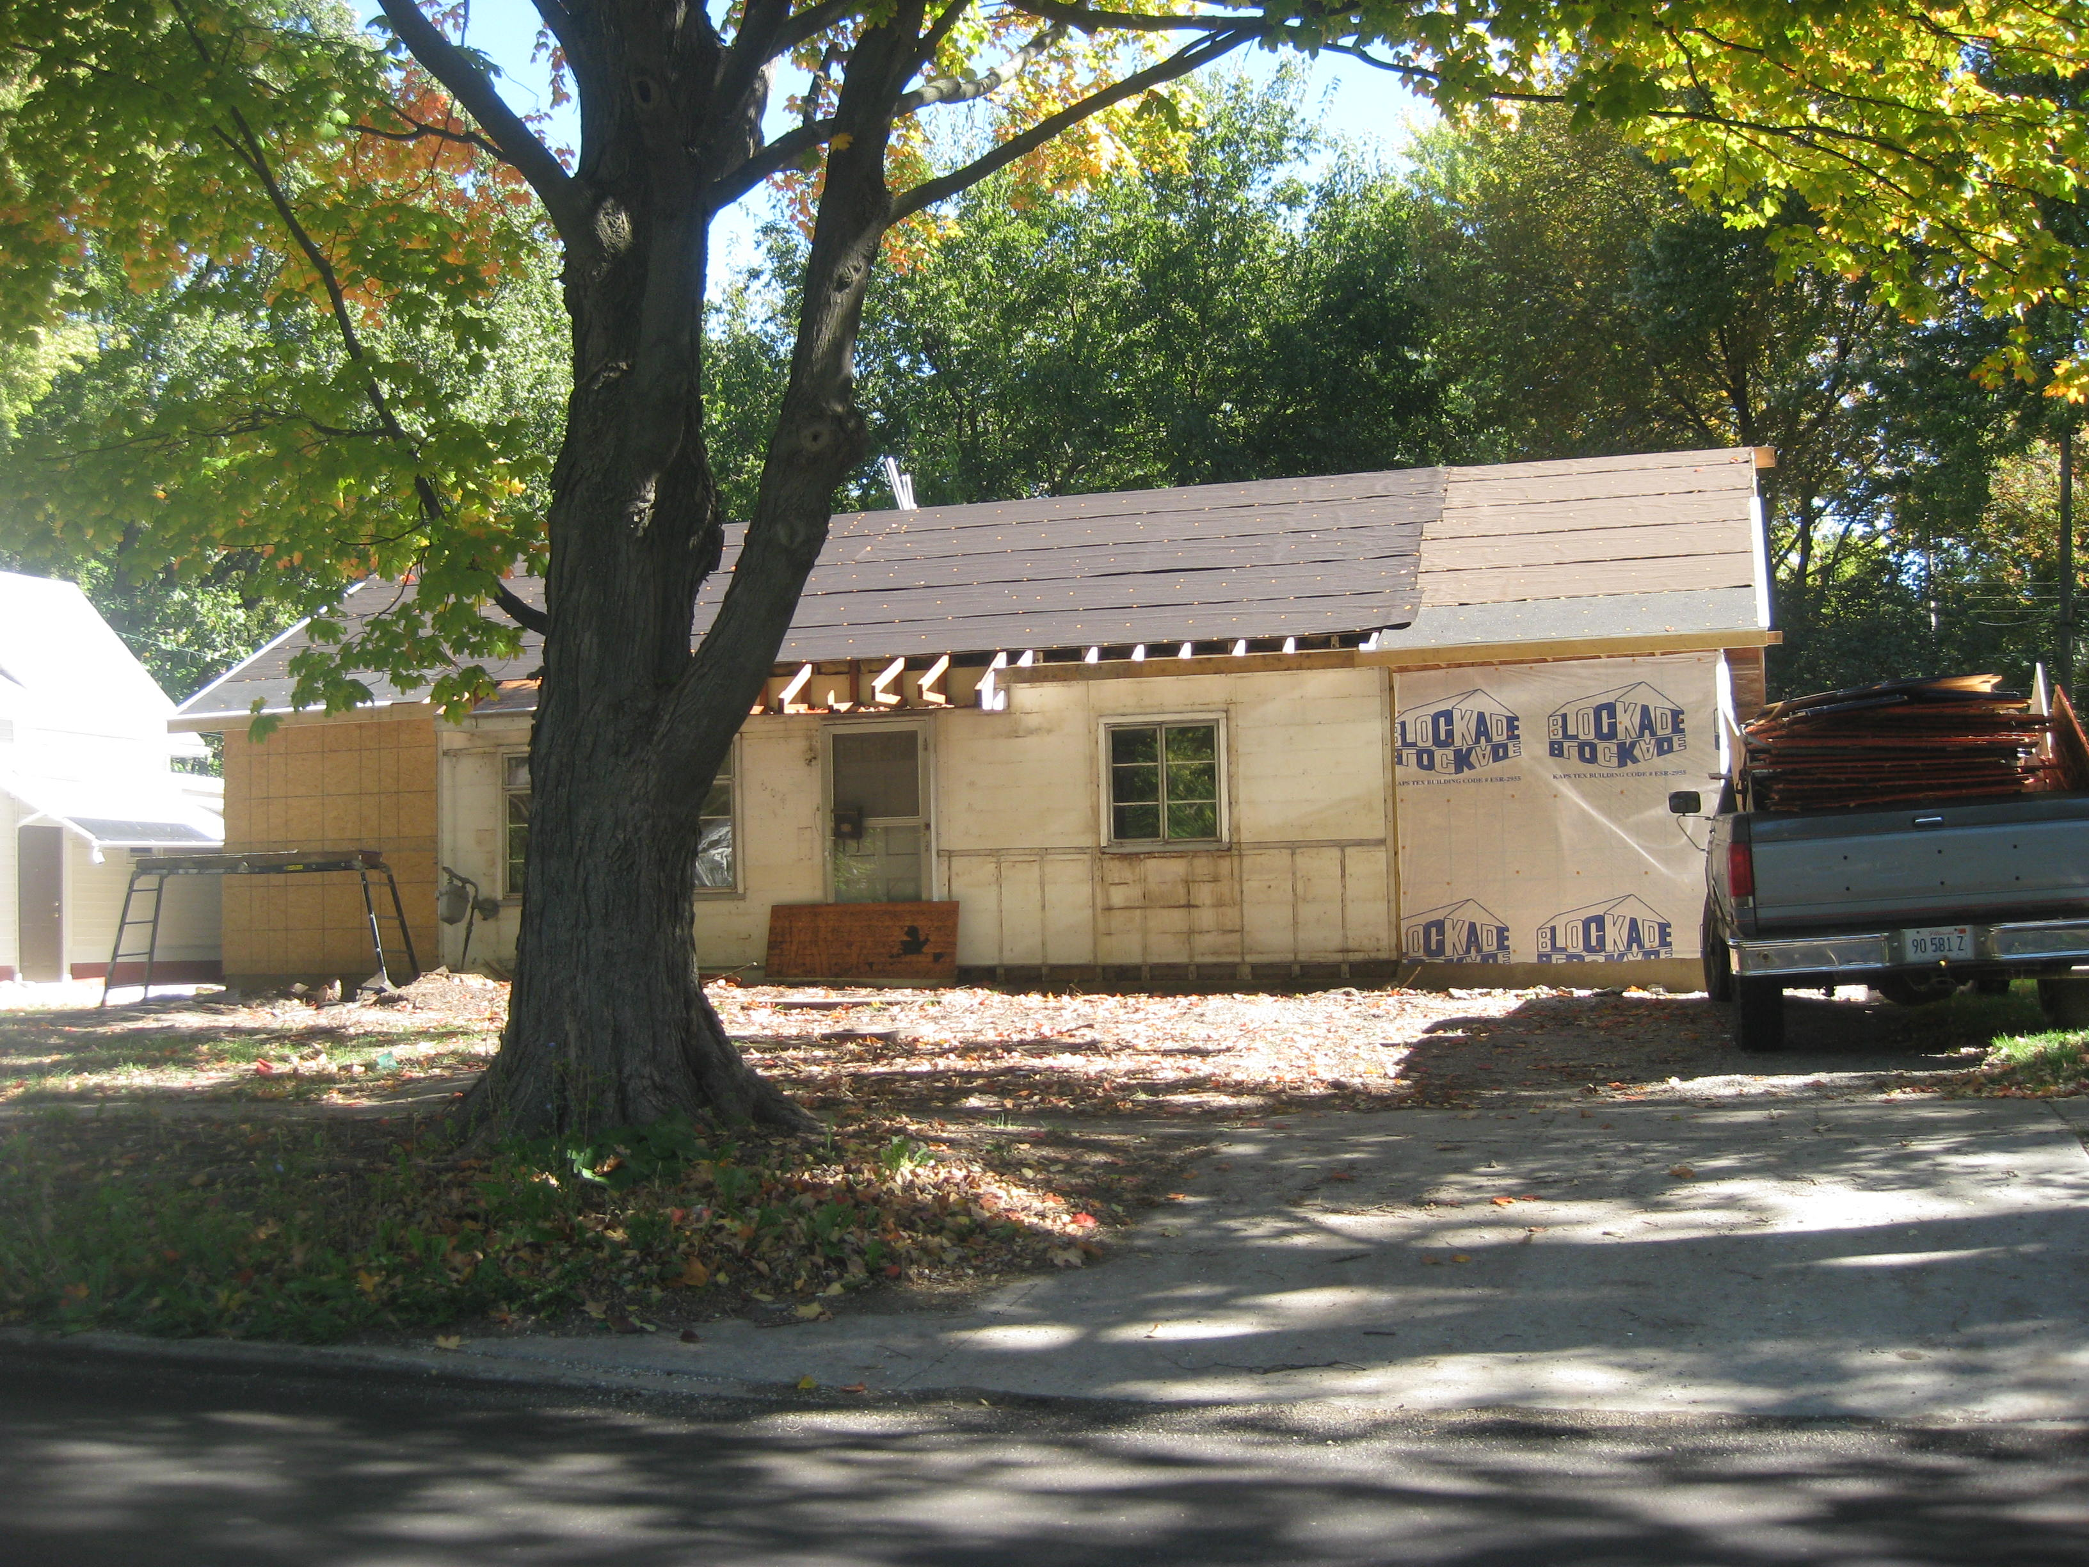

Slide 12
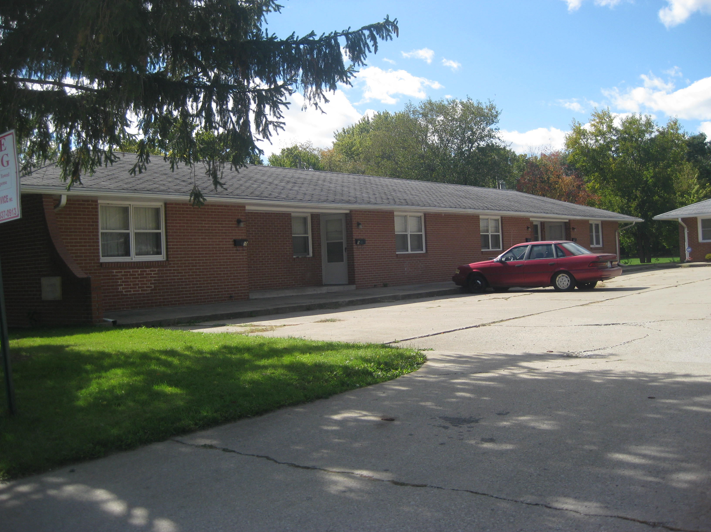

Slide 13
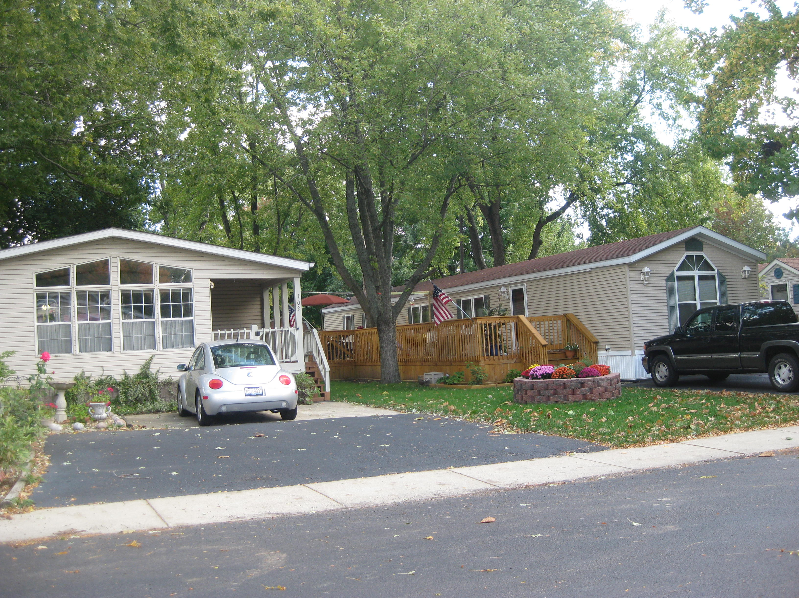

Slide 14
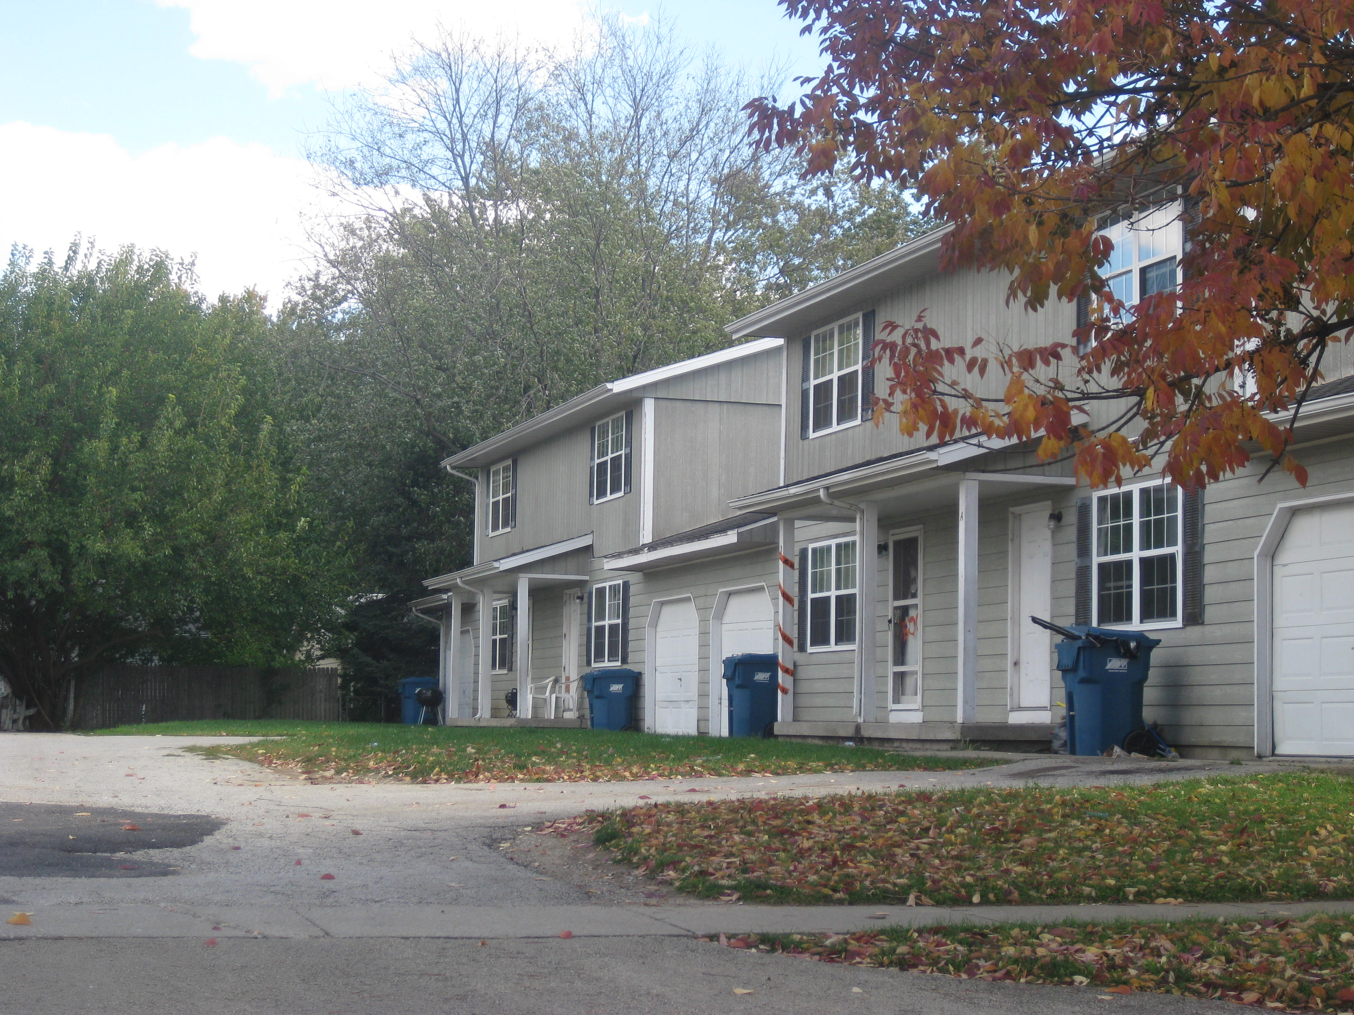

Slide 15
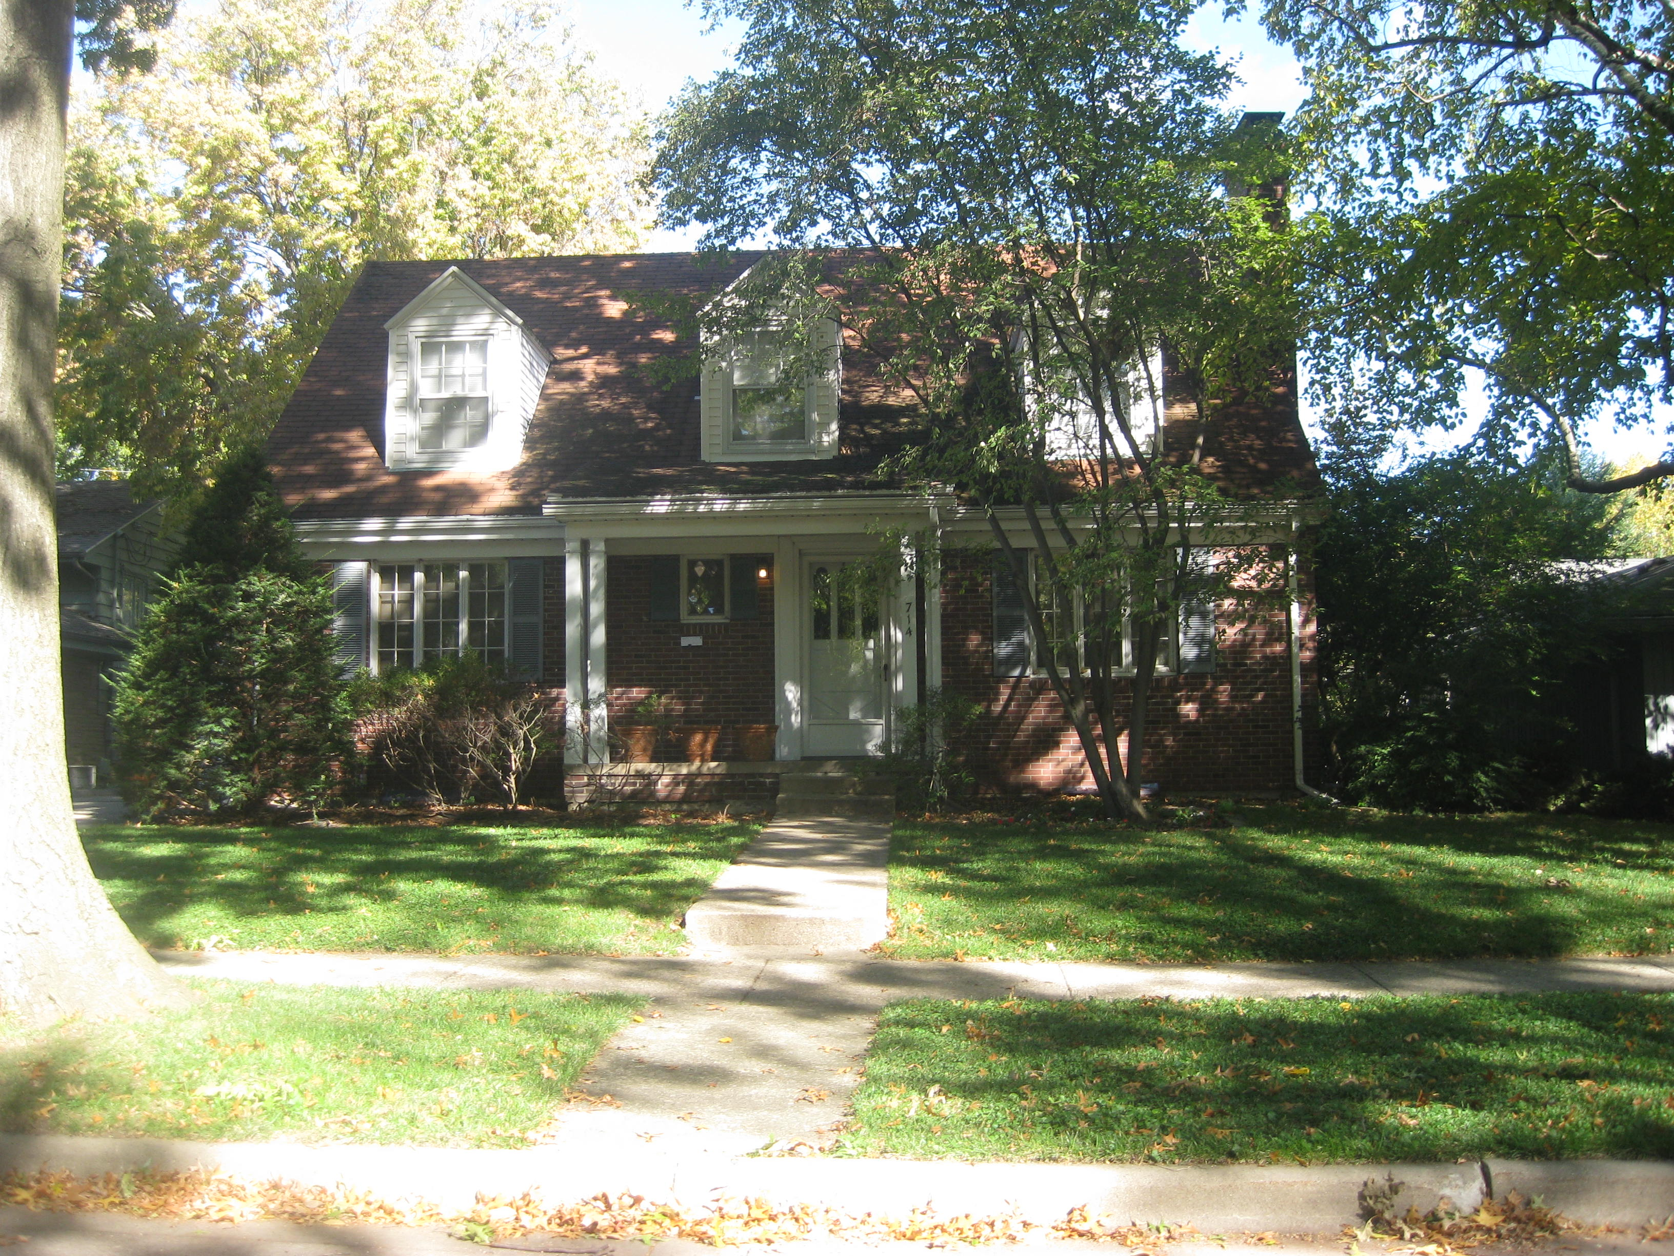

Slide 16
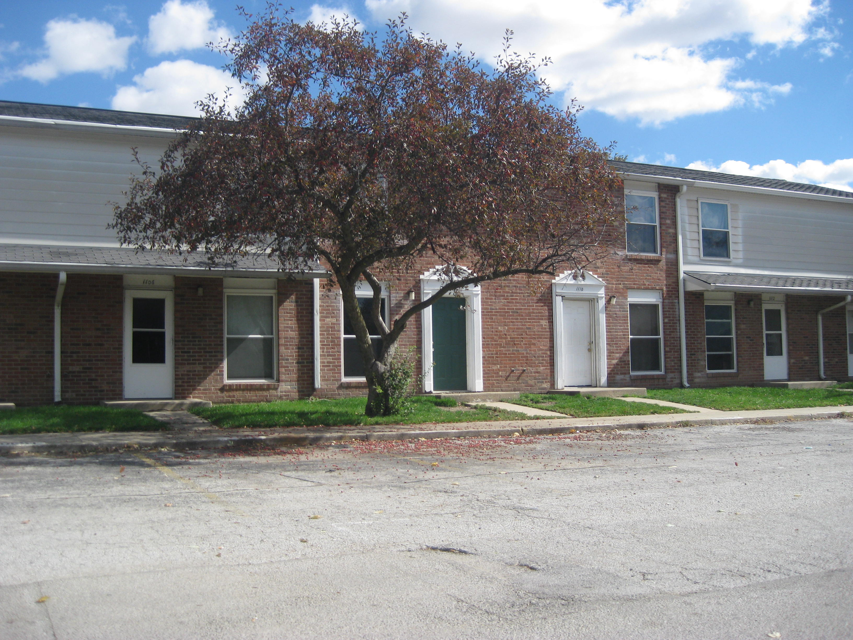

Slide 17
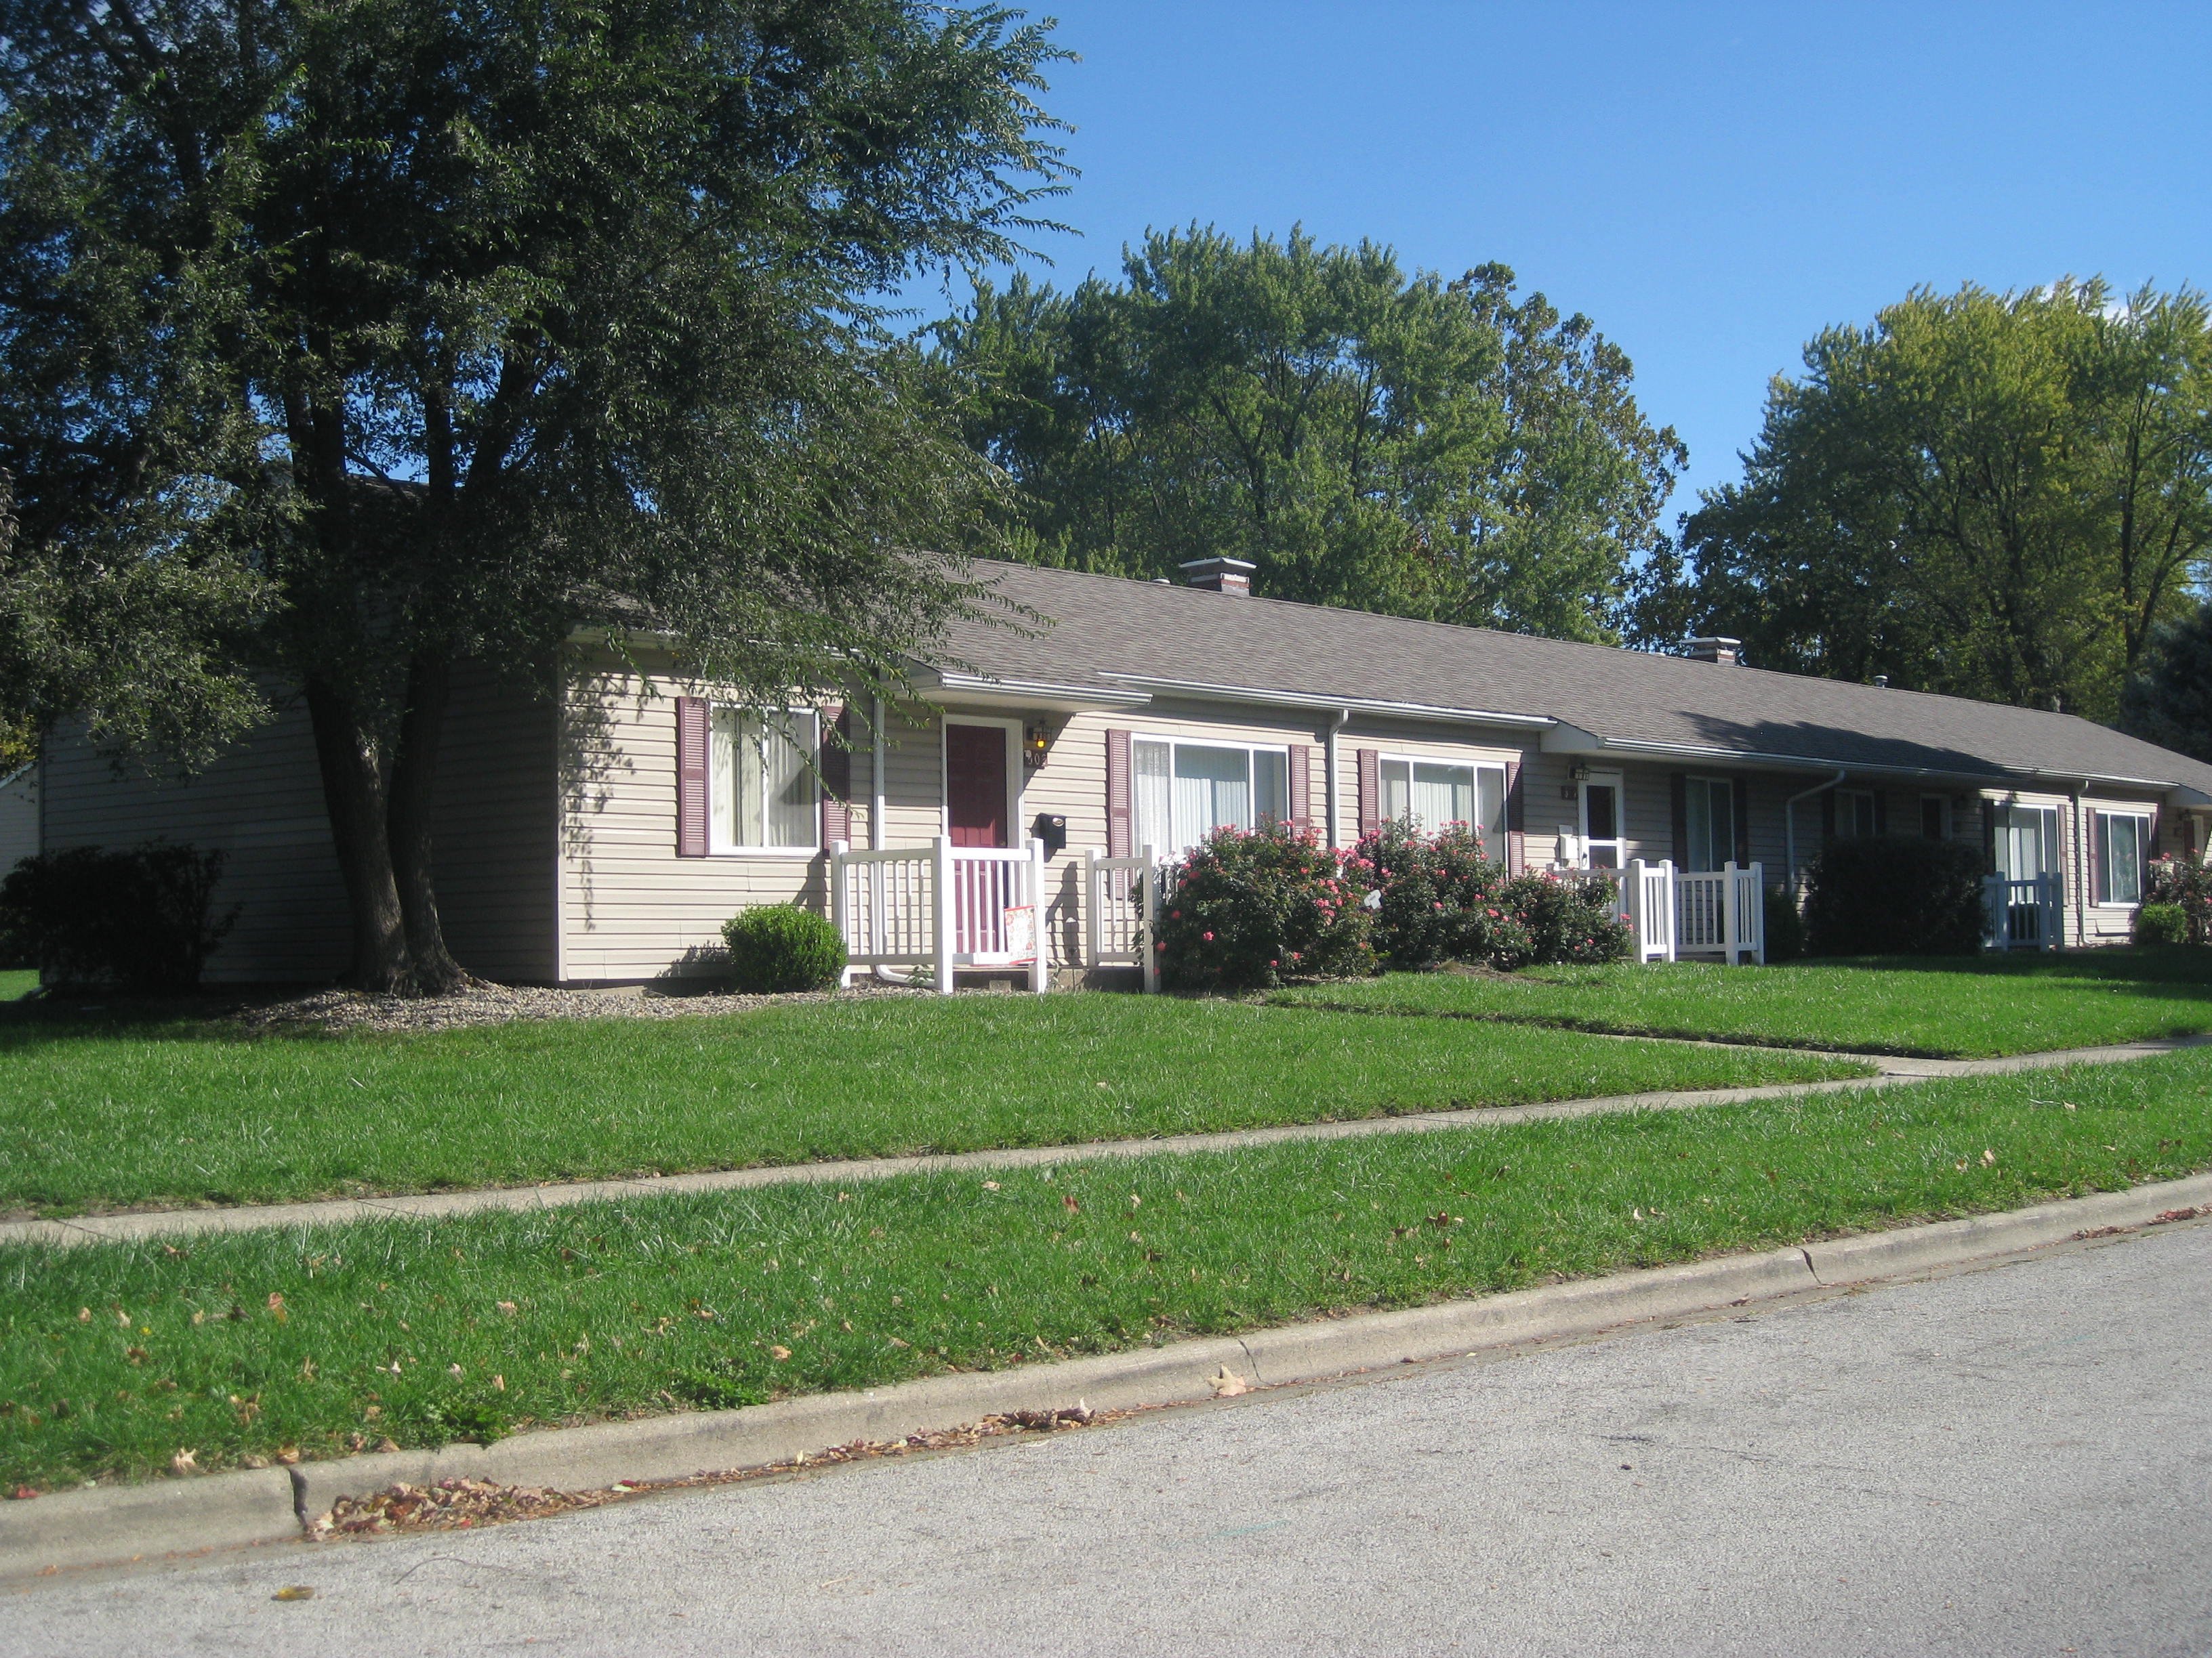

Slide 18
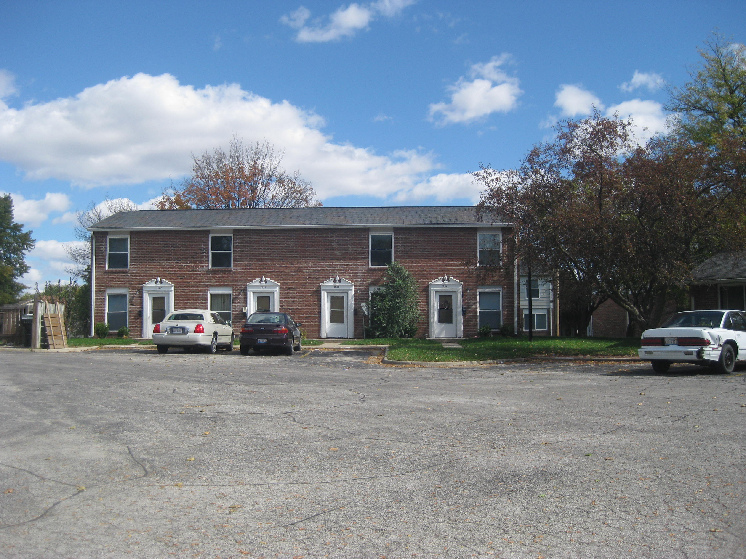

Slide 19
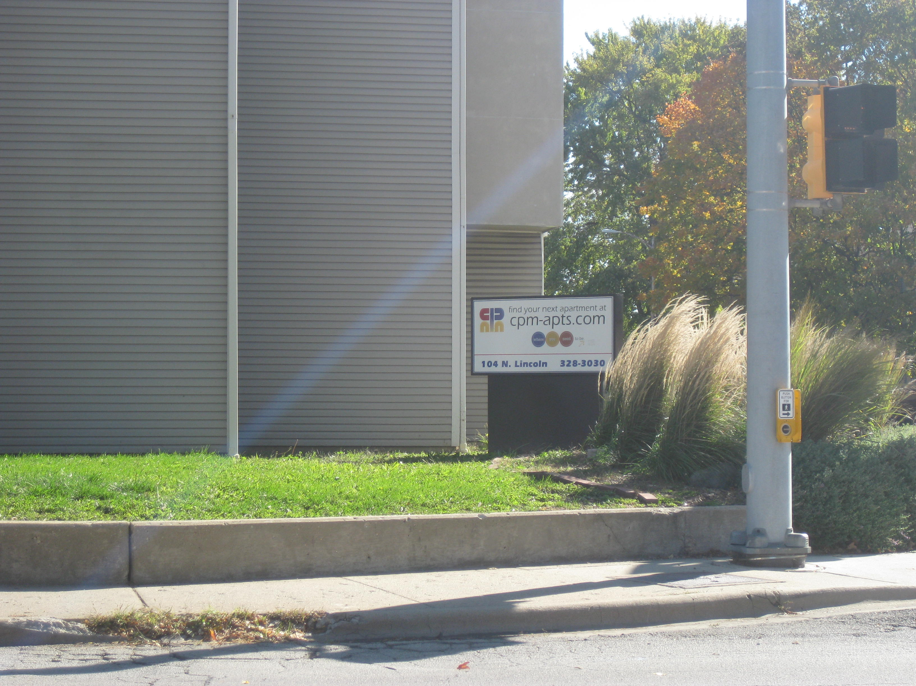

Slide 20
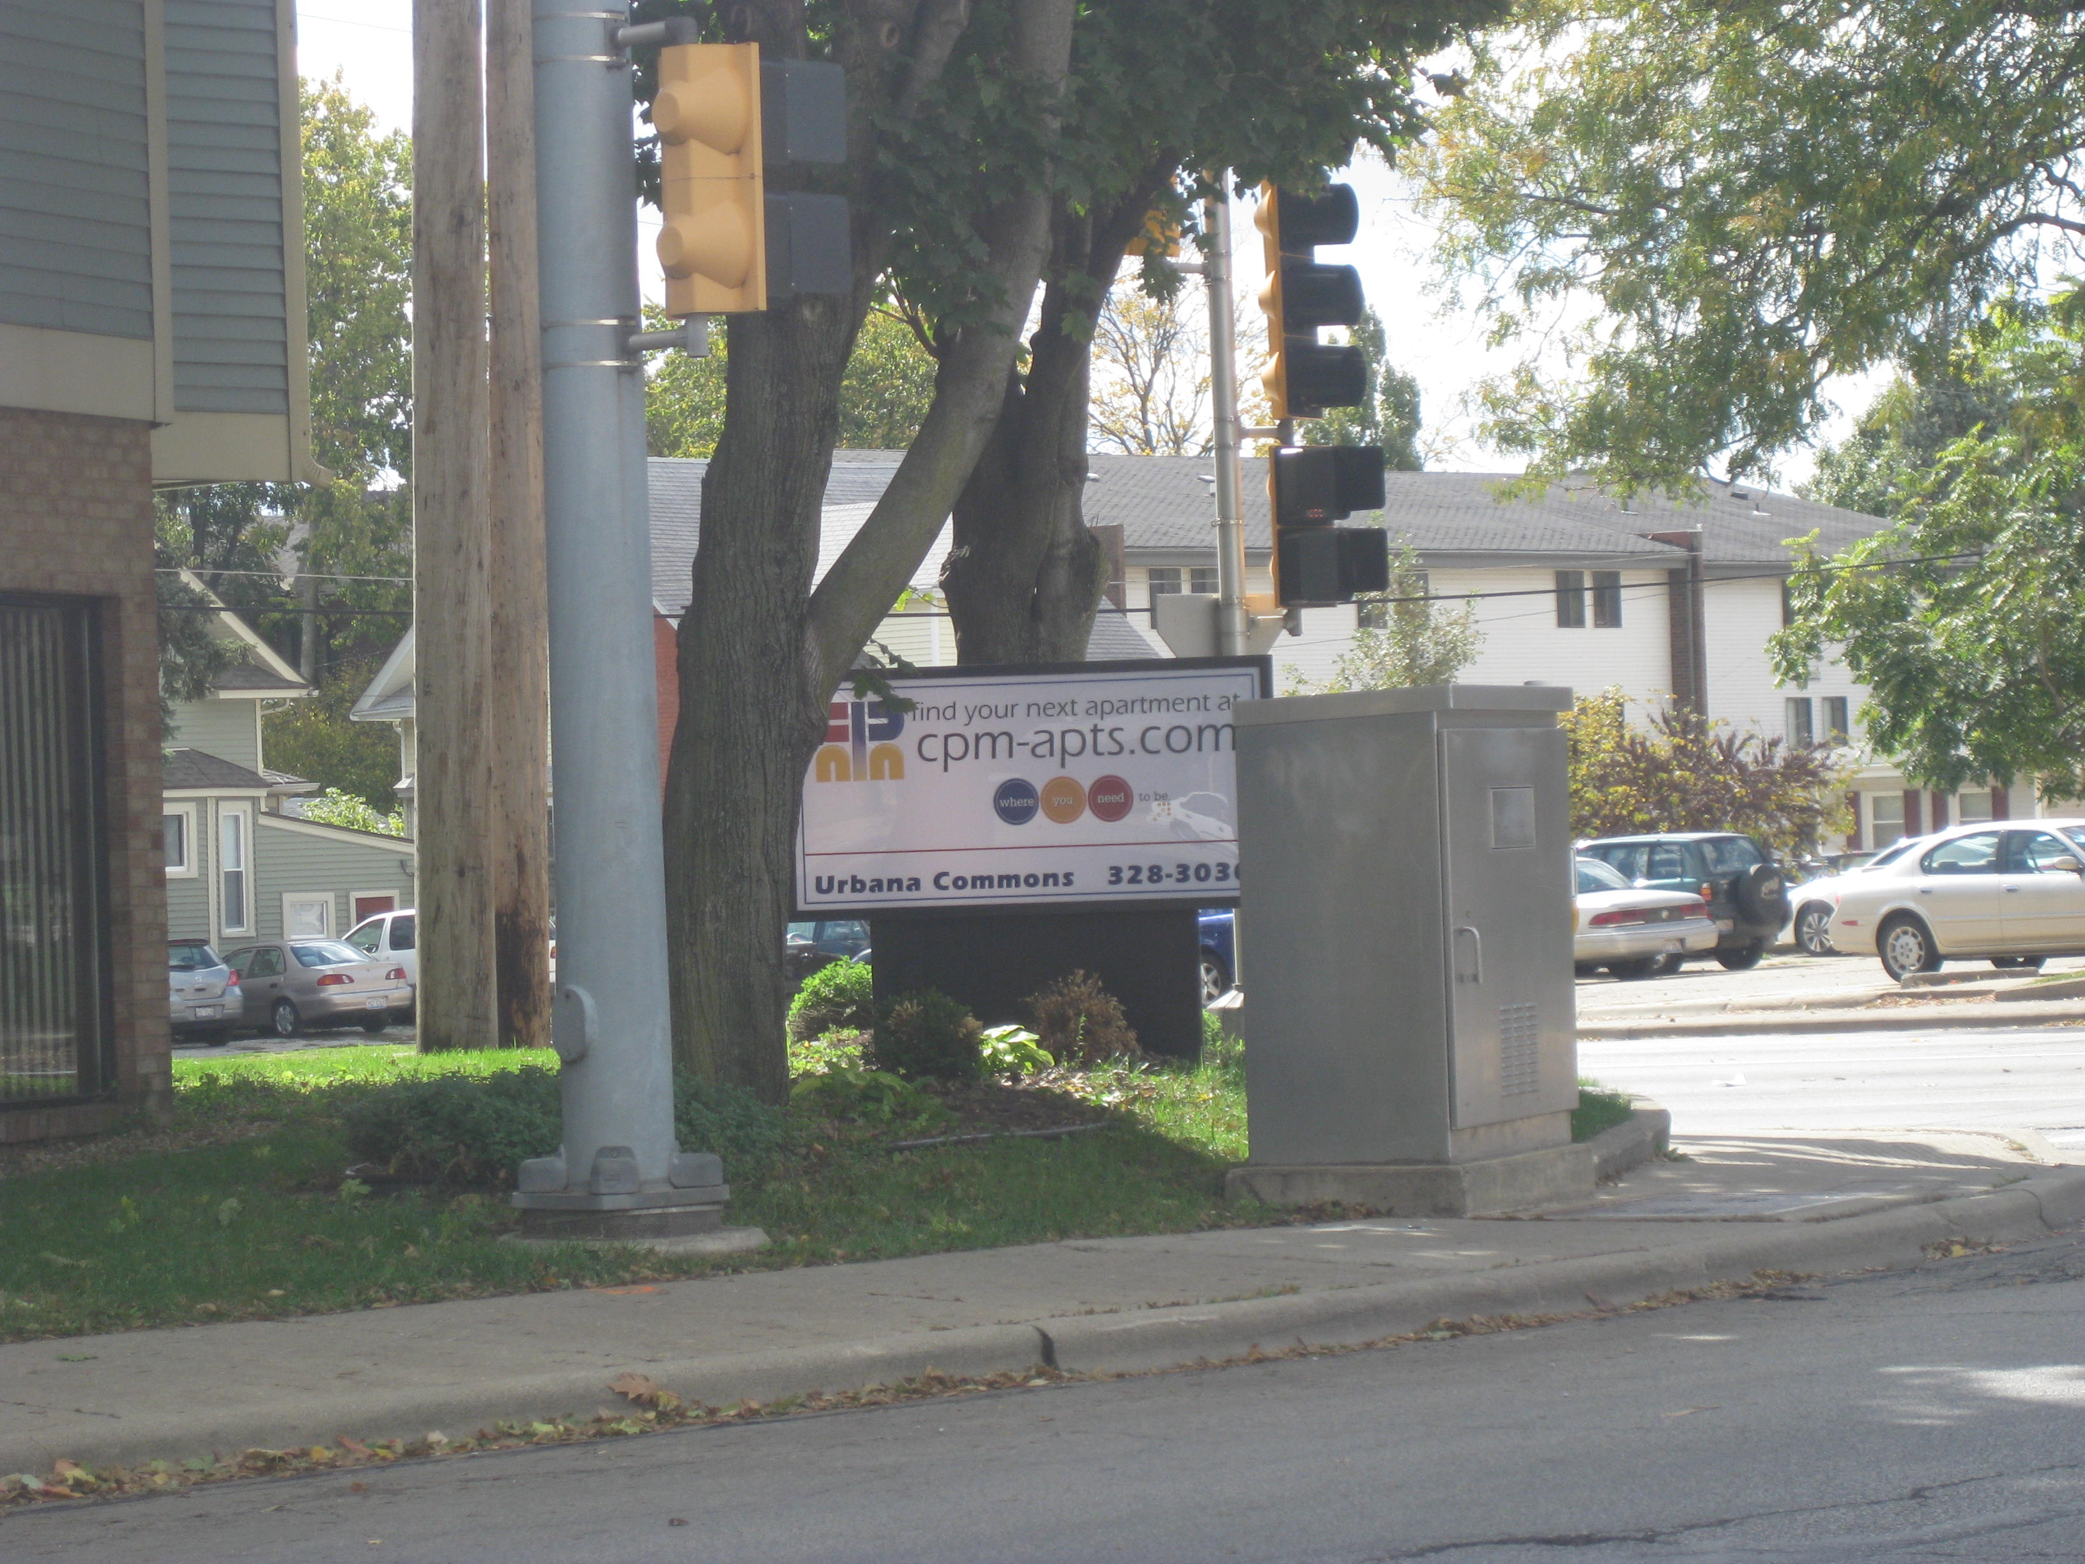

Slide 21
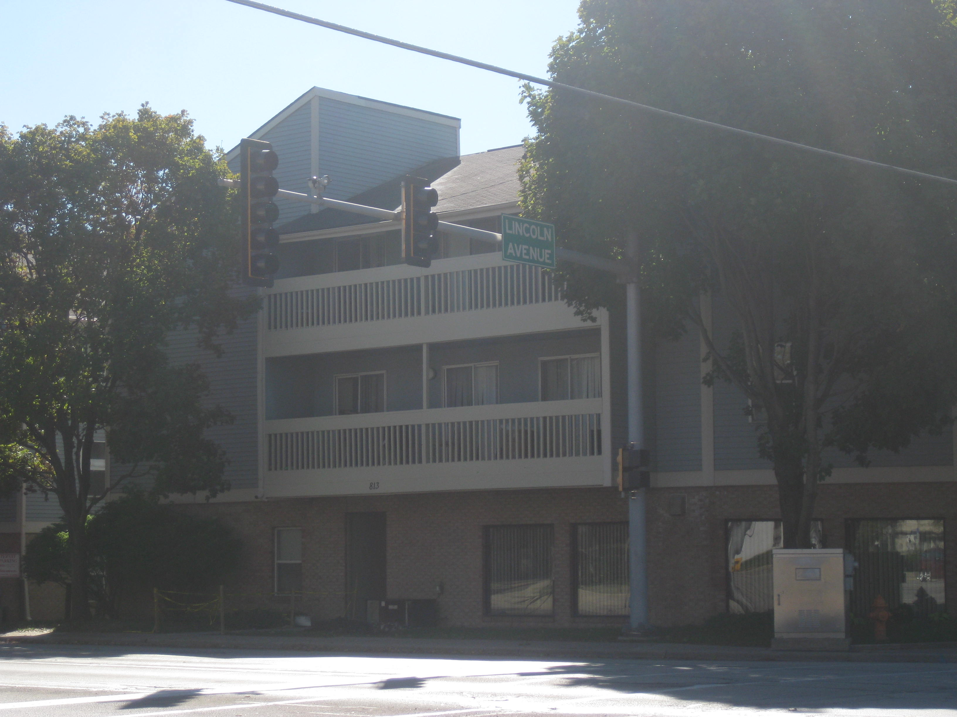

Slide 22
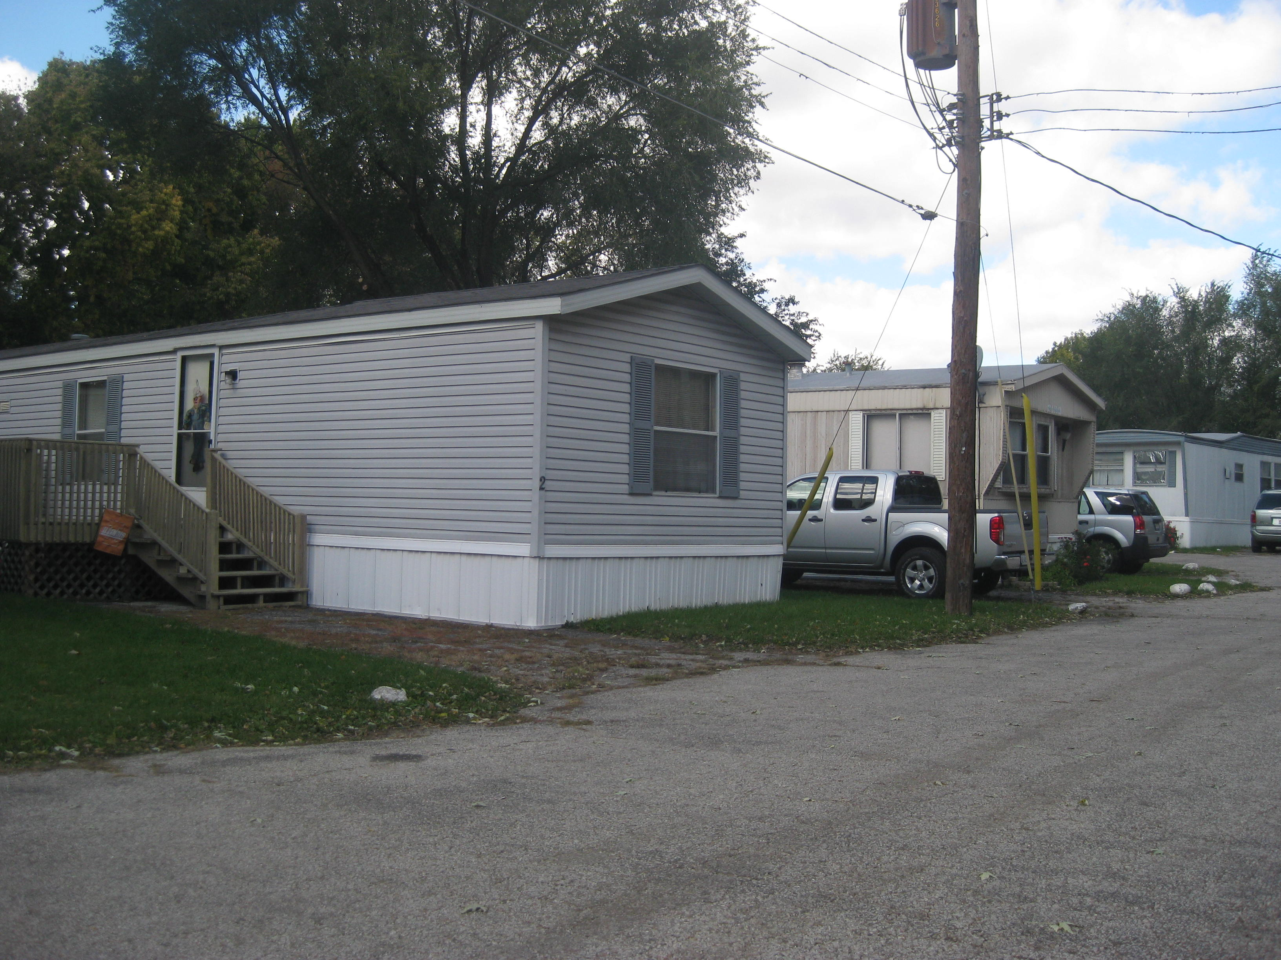

Slide 23
Schooling
Preschool to PhD all in one City
SchoolsWashington Early Childhood
Leal Elementary School
Martin Luther King Jr. Elementary
Prairie Elementary
Thomas Paine Elementary
Wiley Elementary
Yankee Ridge Elementary
Urbana Middle School
Urbana High School
Urbana Adult Education
U of I

Slide 24
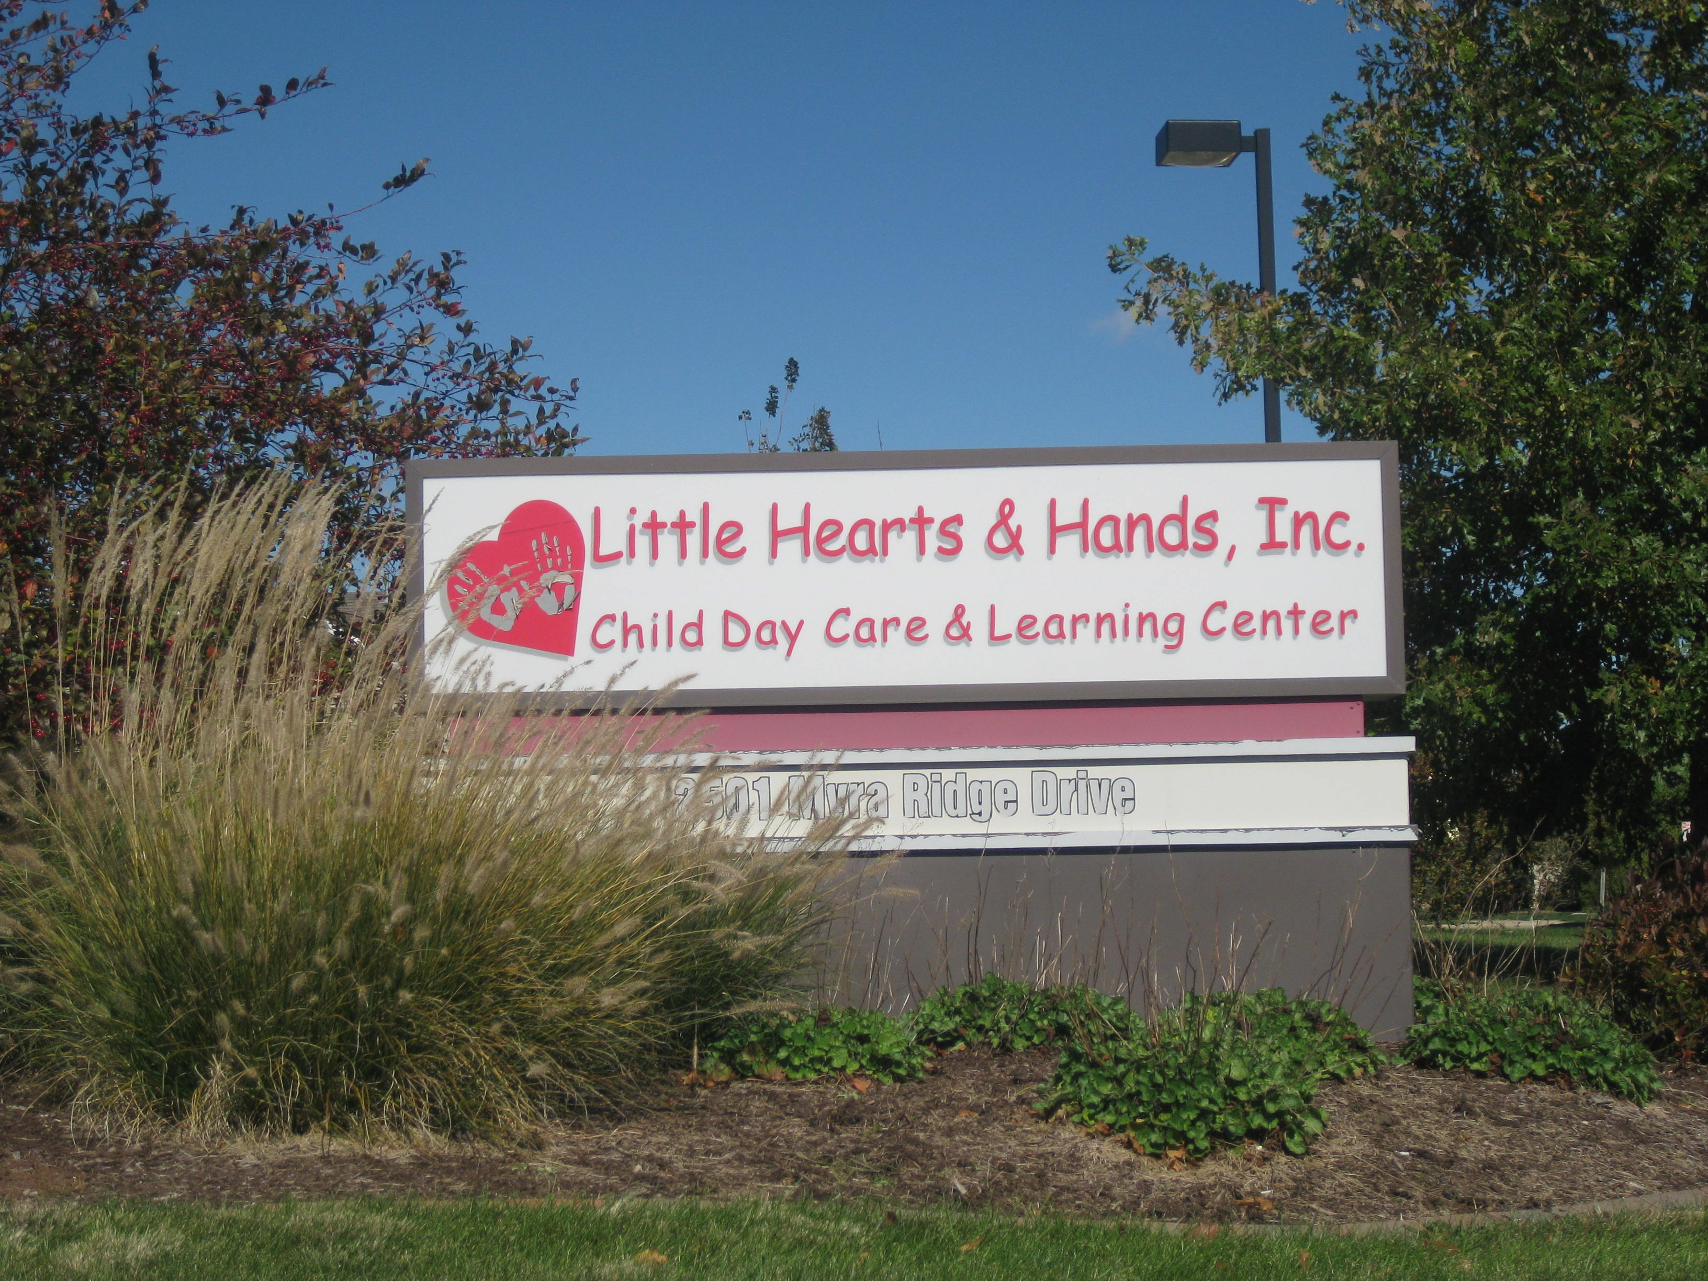

Slide 25
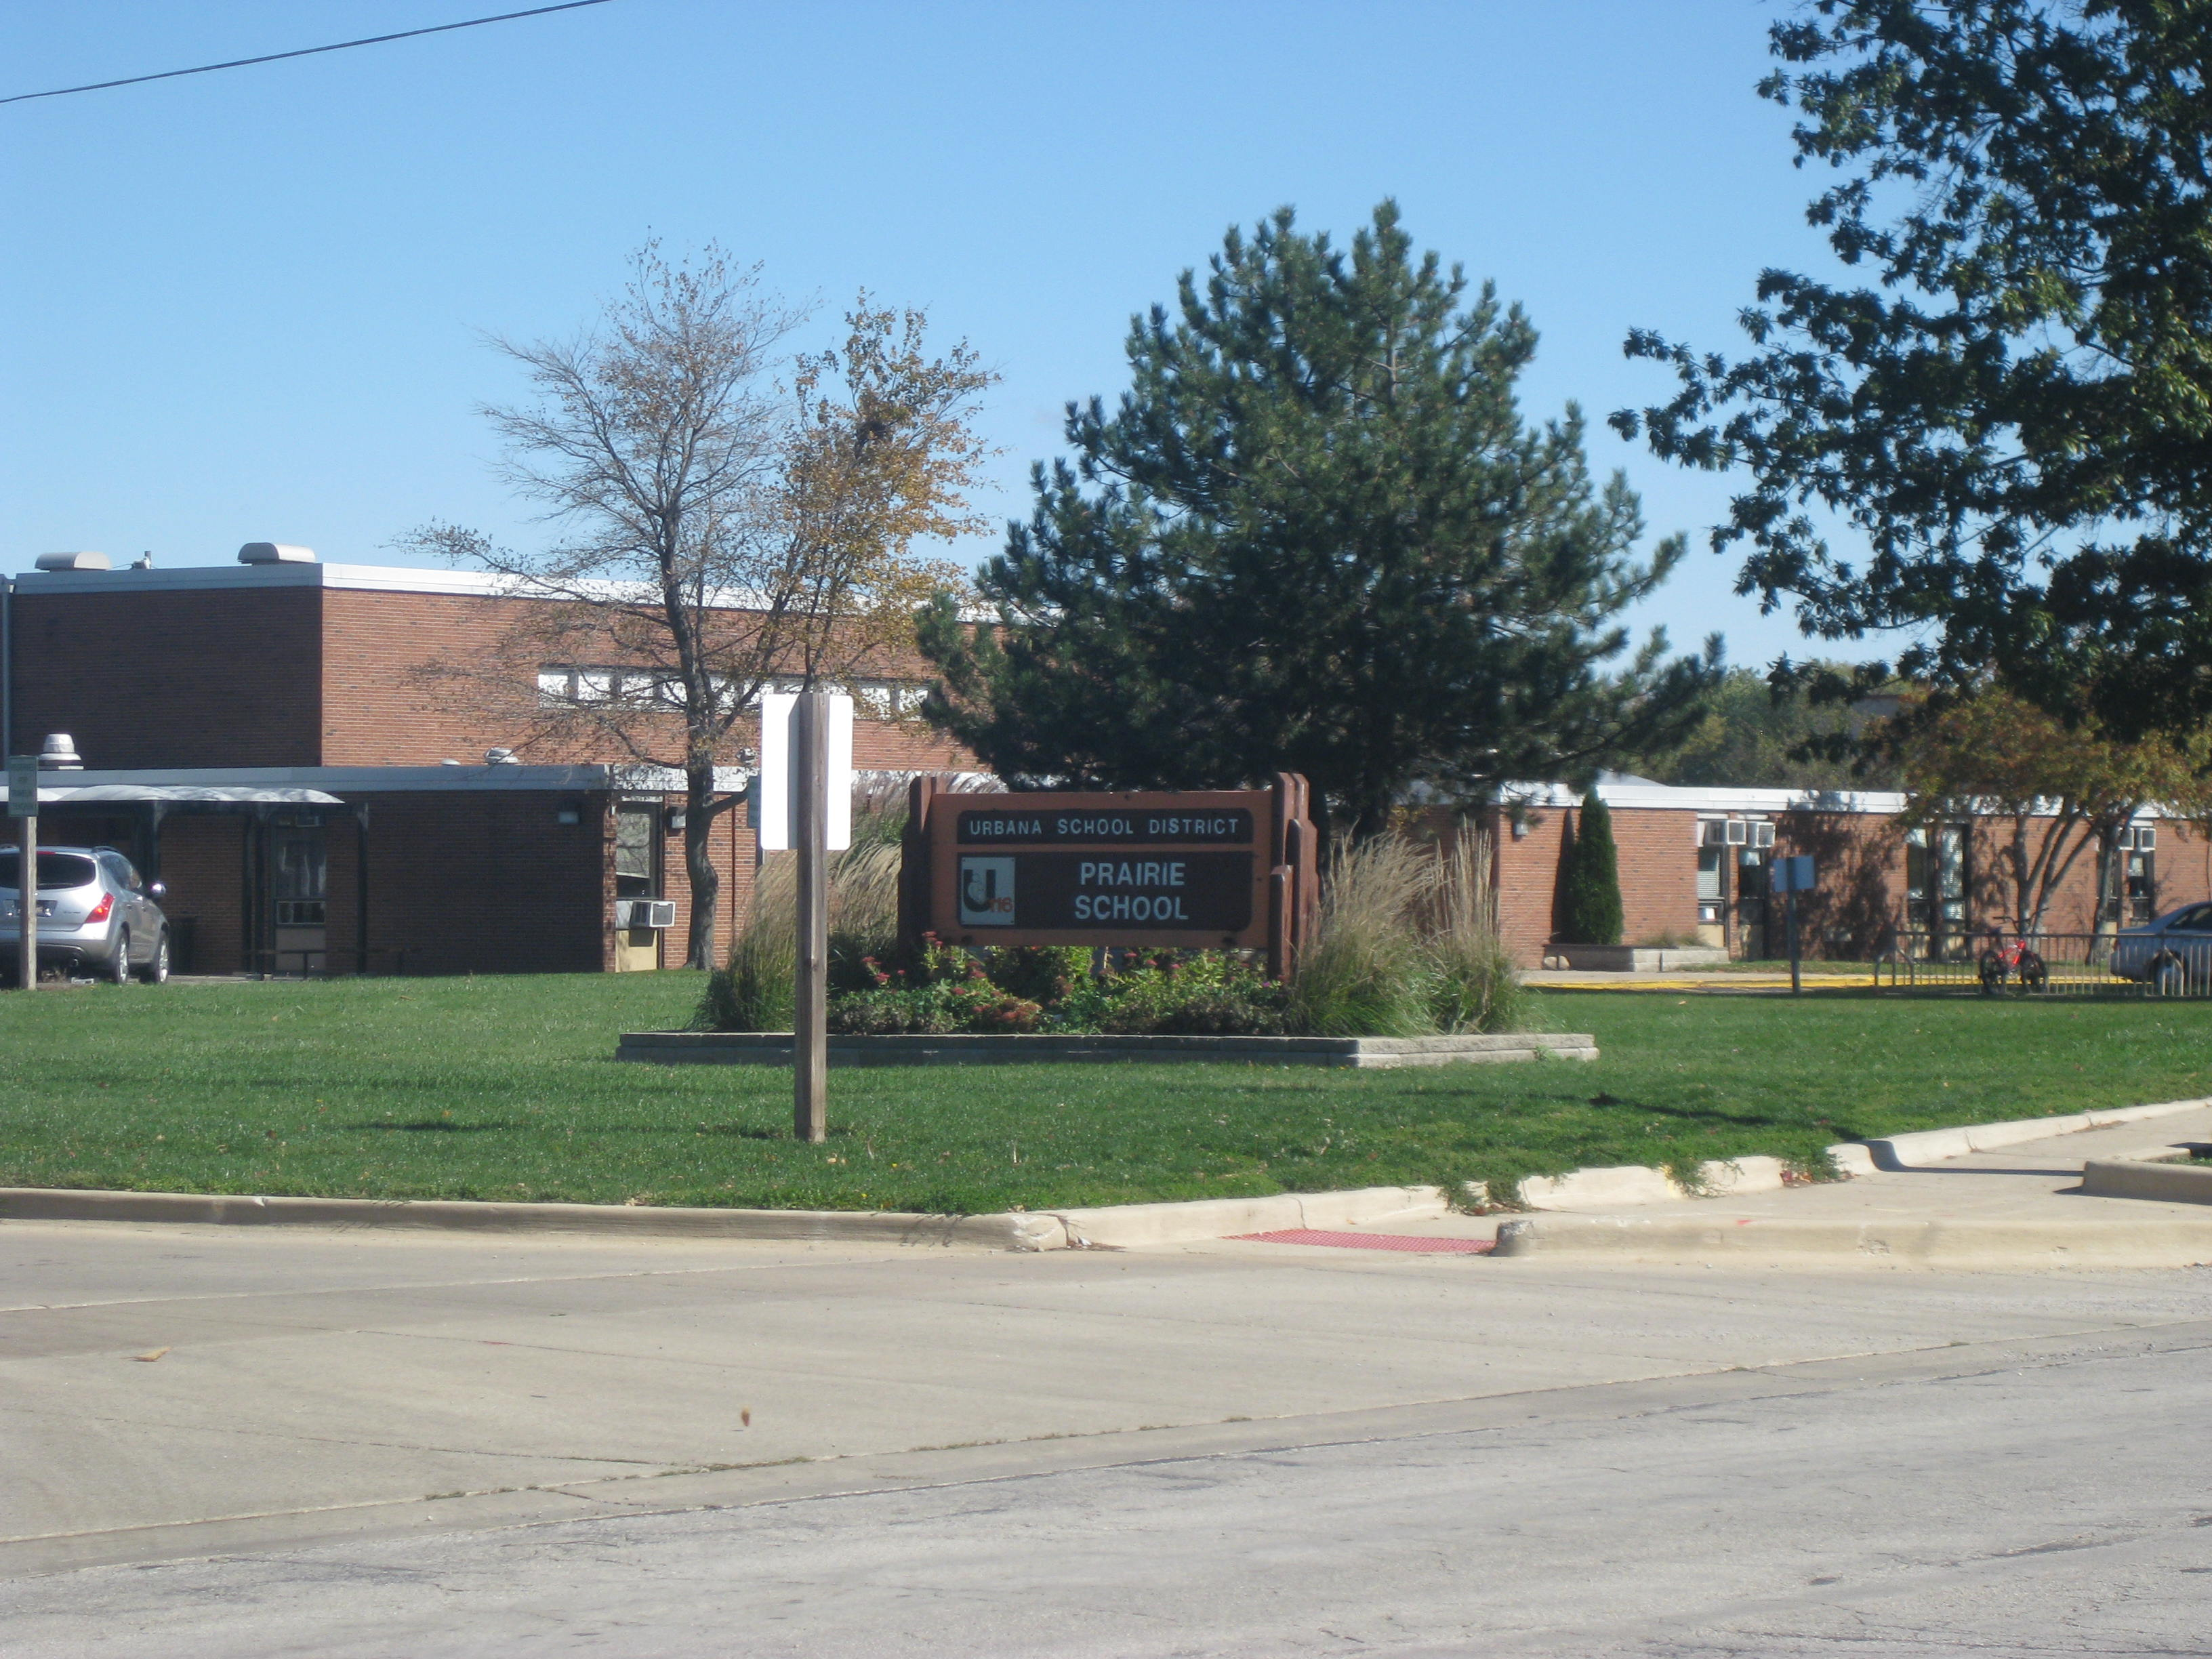

Slide 26
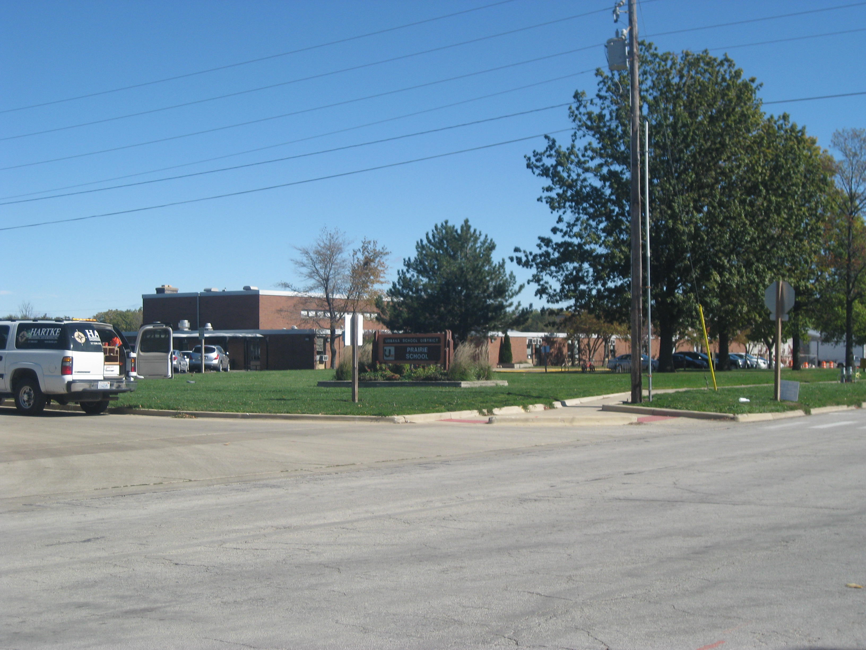

Slide 27
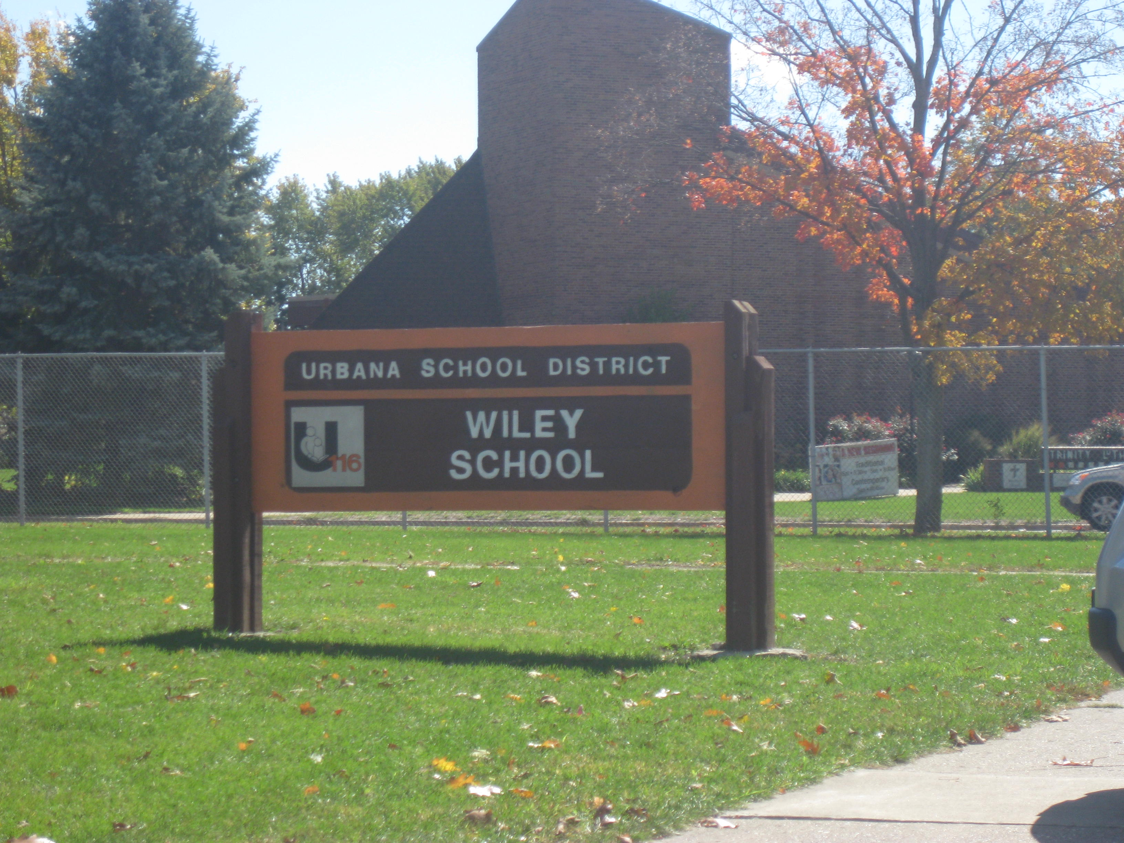

Slide 28
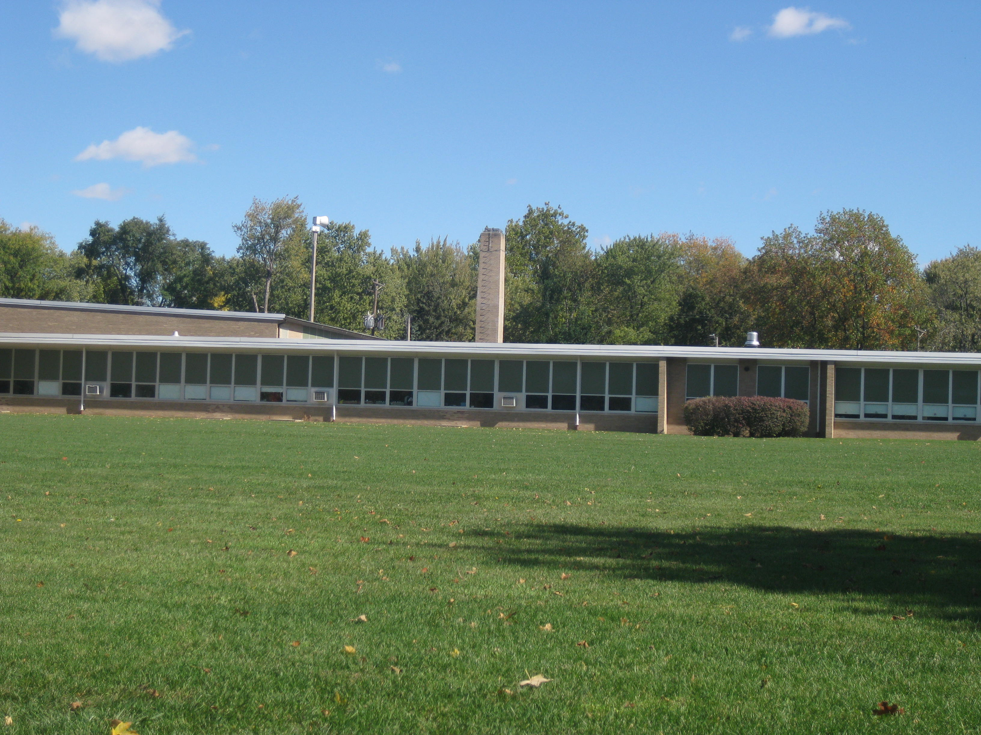

Slide 29
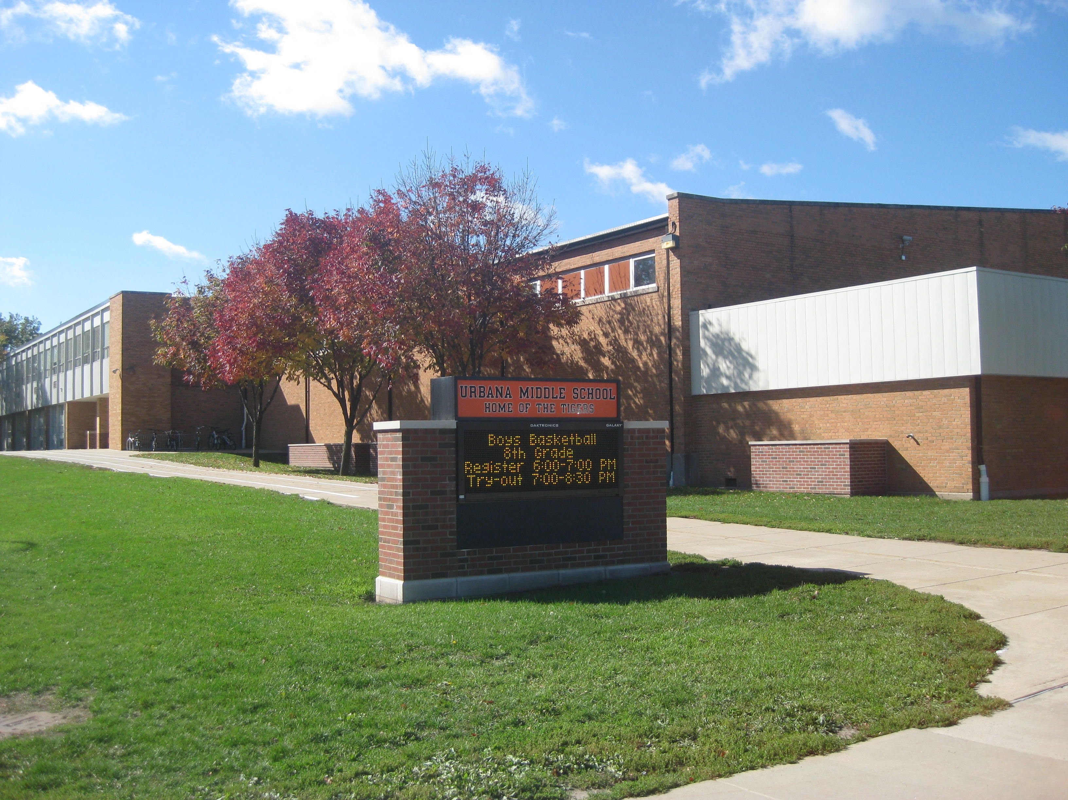

Slide 30
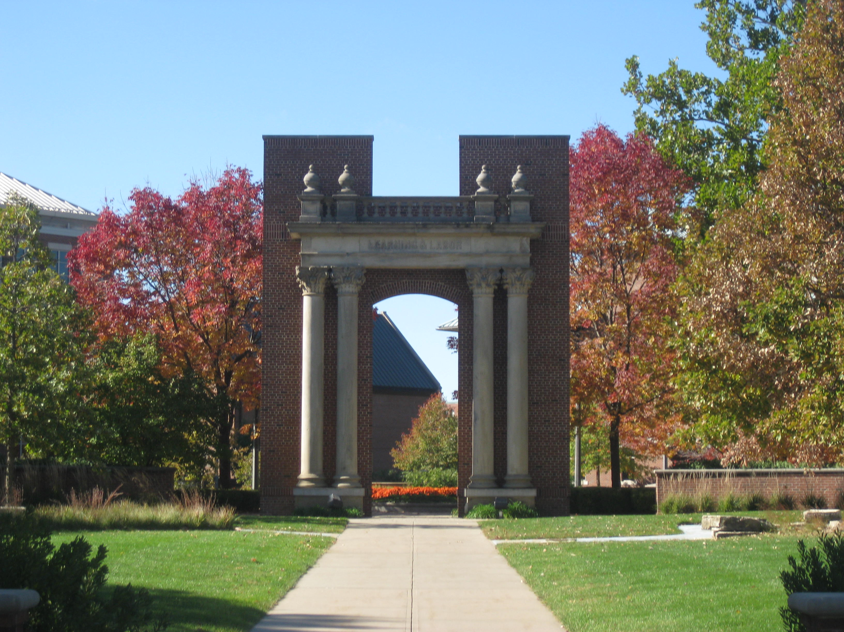

Slide 31
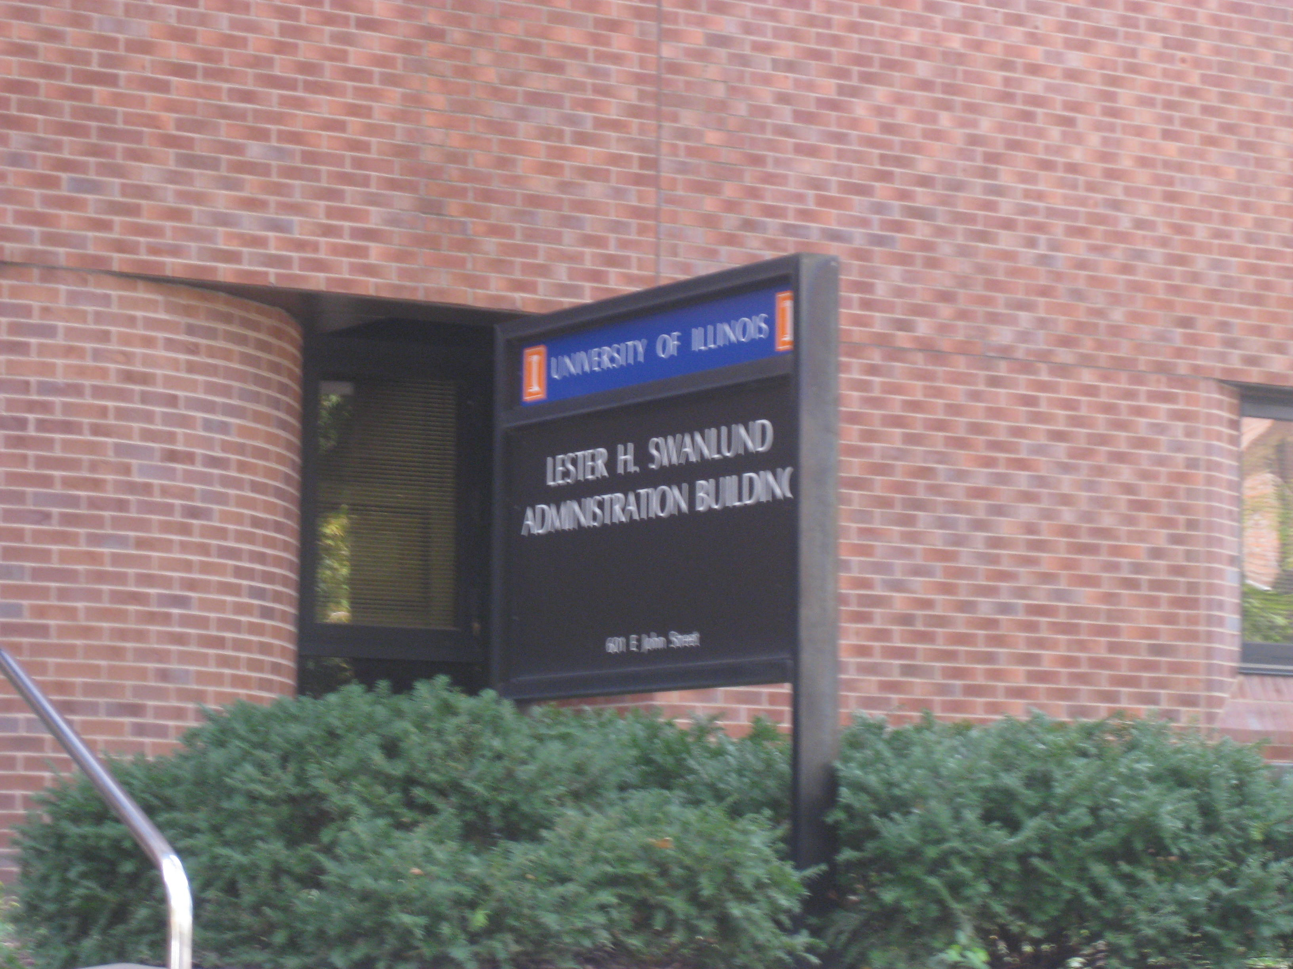

Slide 32
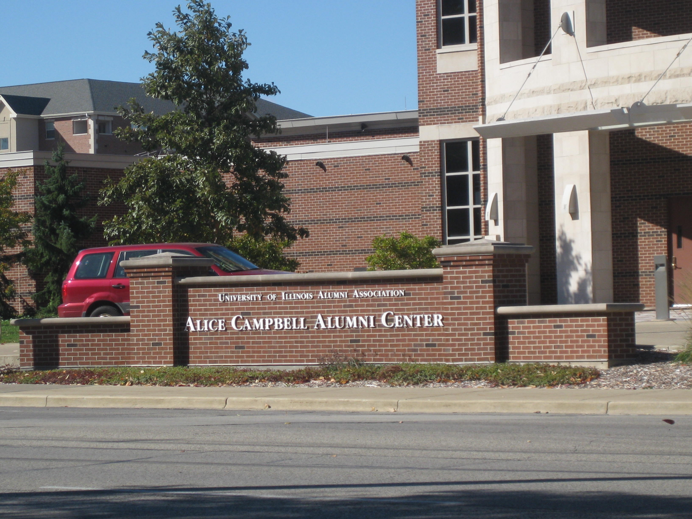

Slide 33
Healthcare
Two different hospitals to choose from

Slide 34
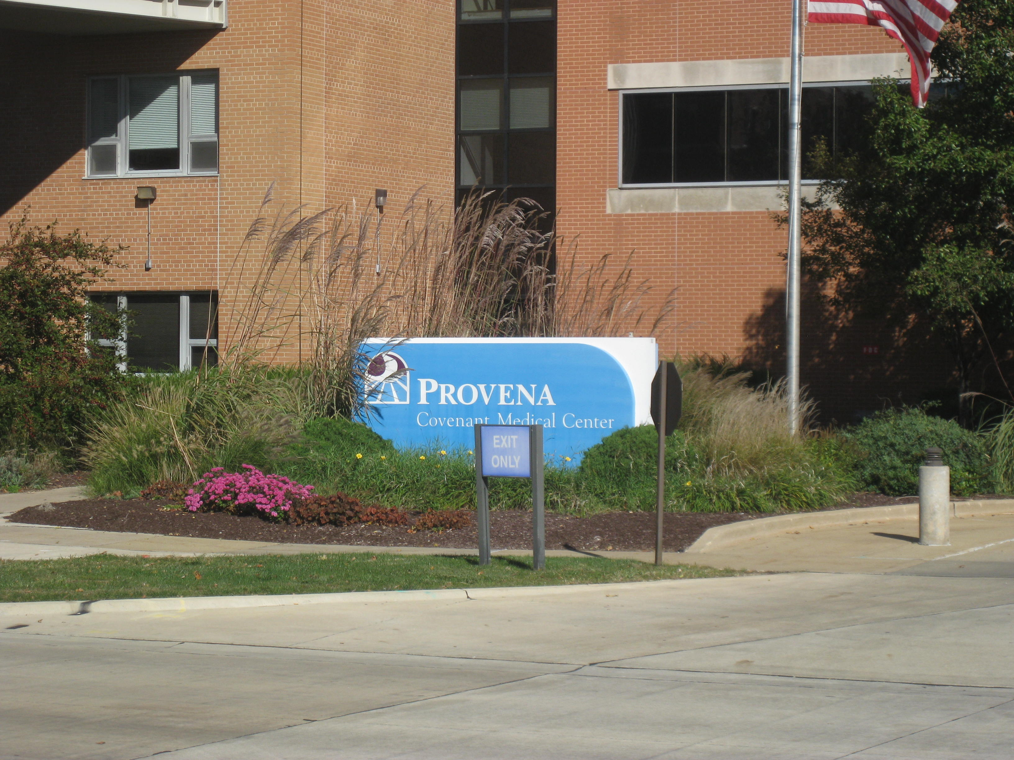

Slide 35
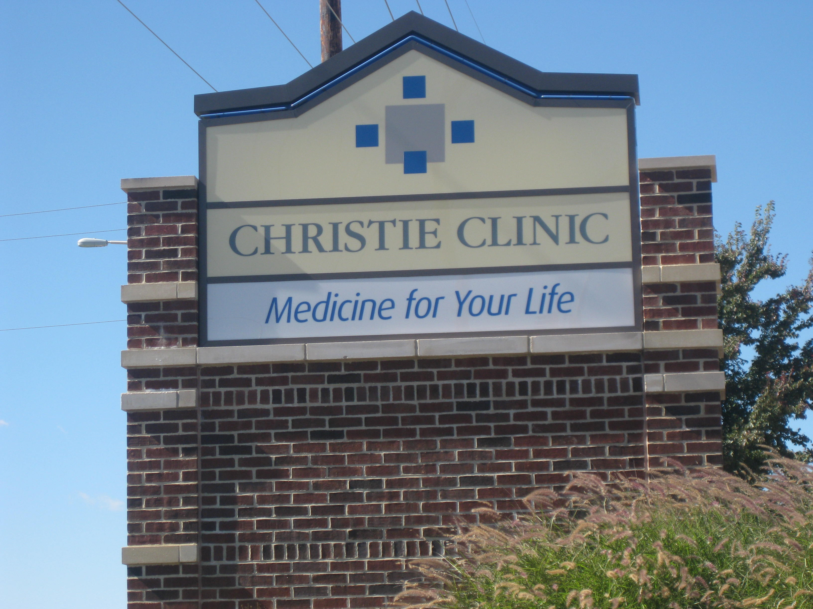

Slide 36
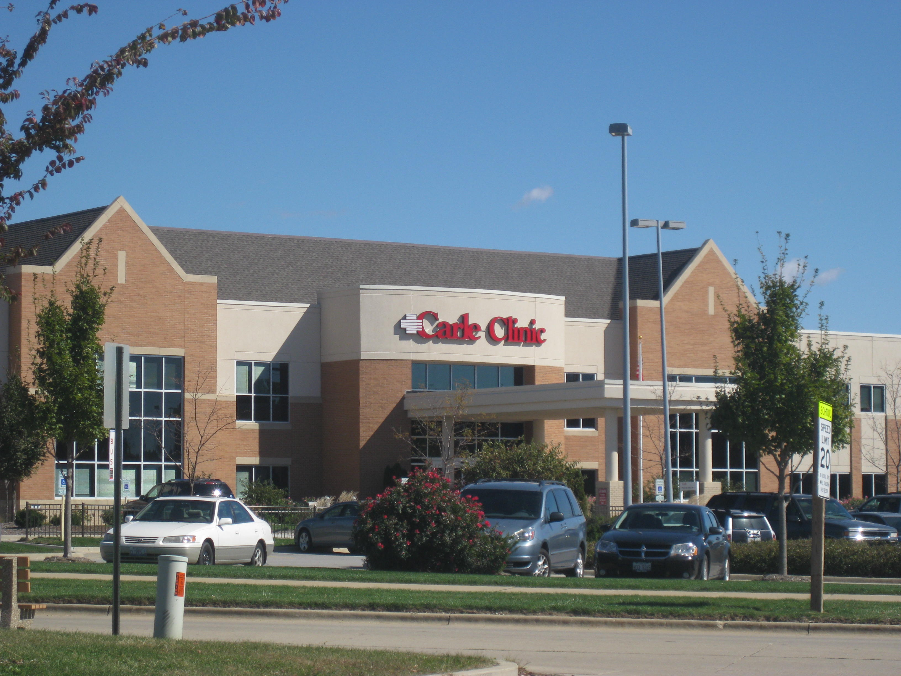

Slide 37
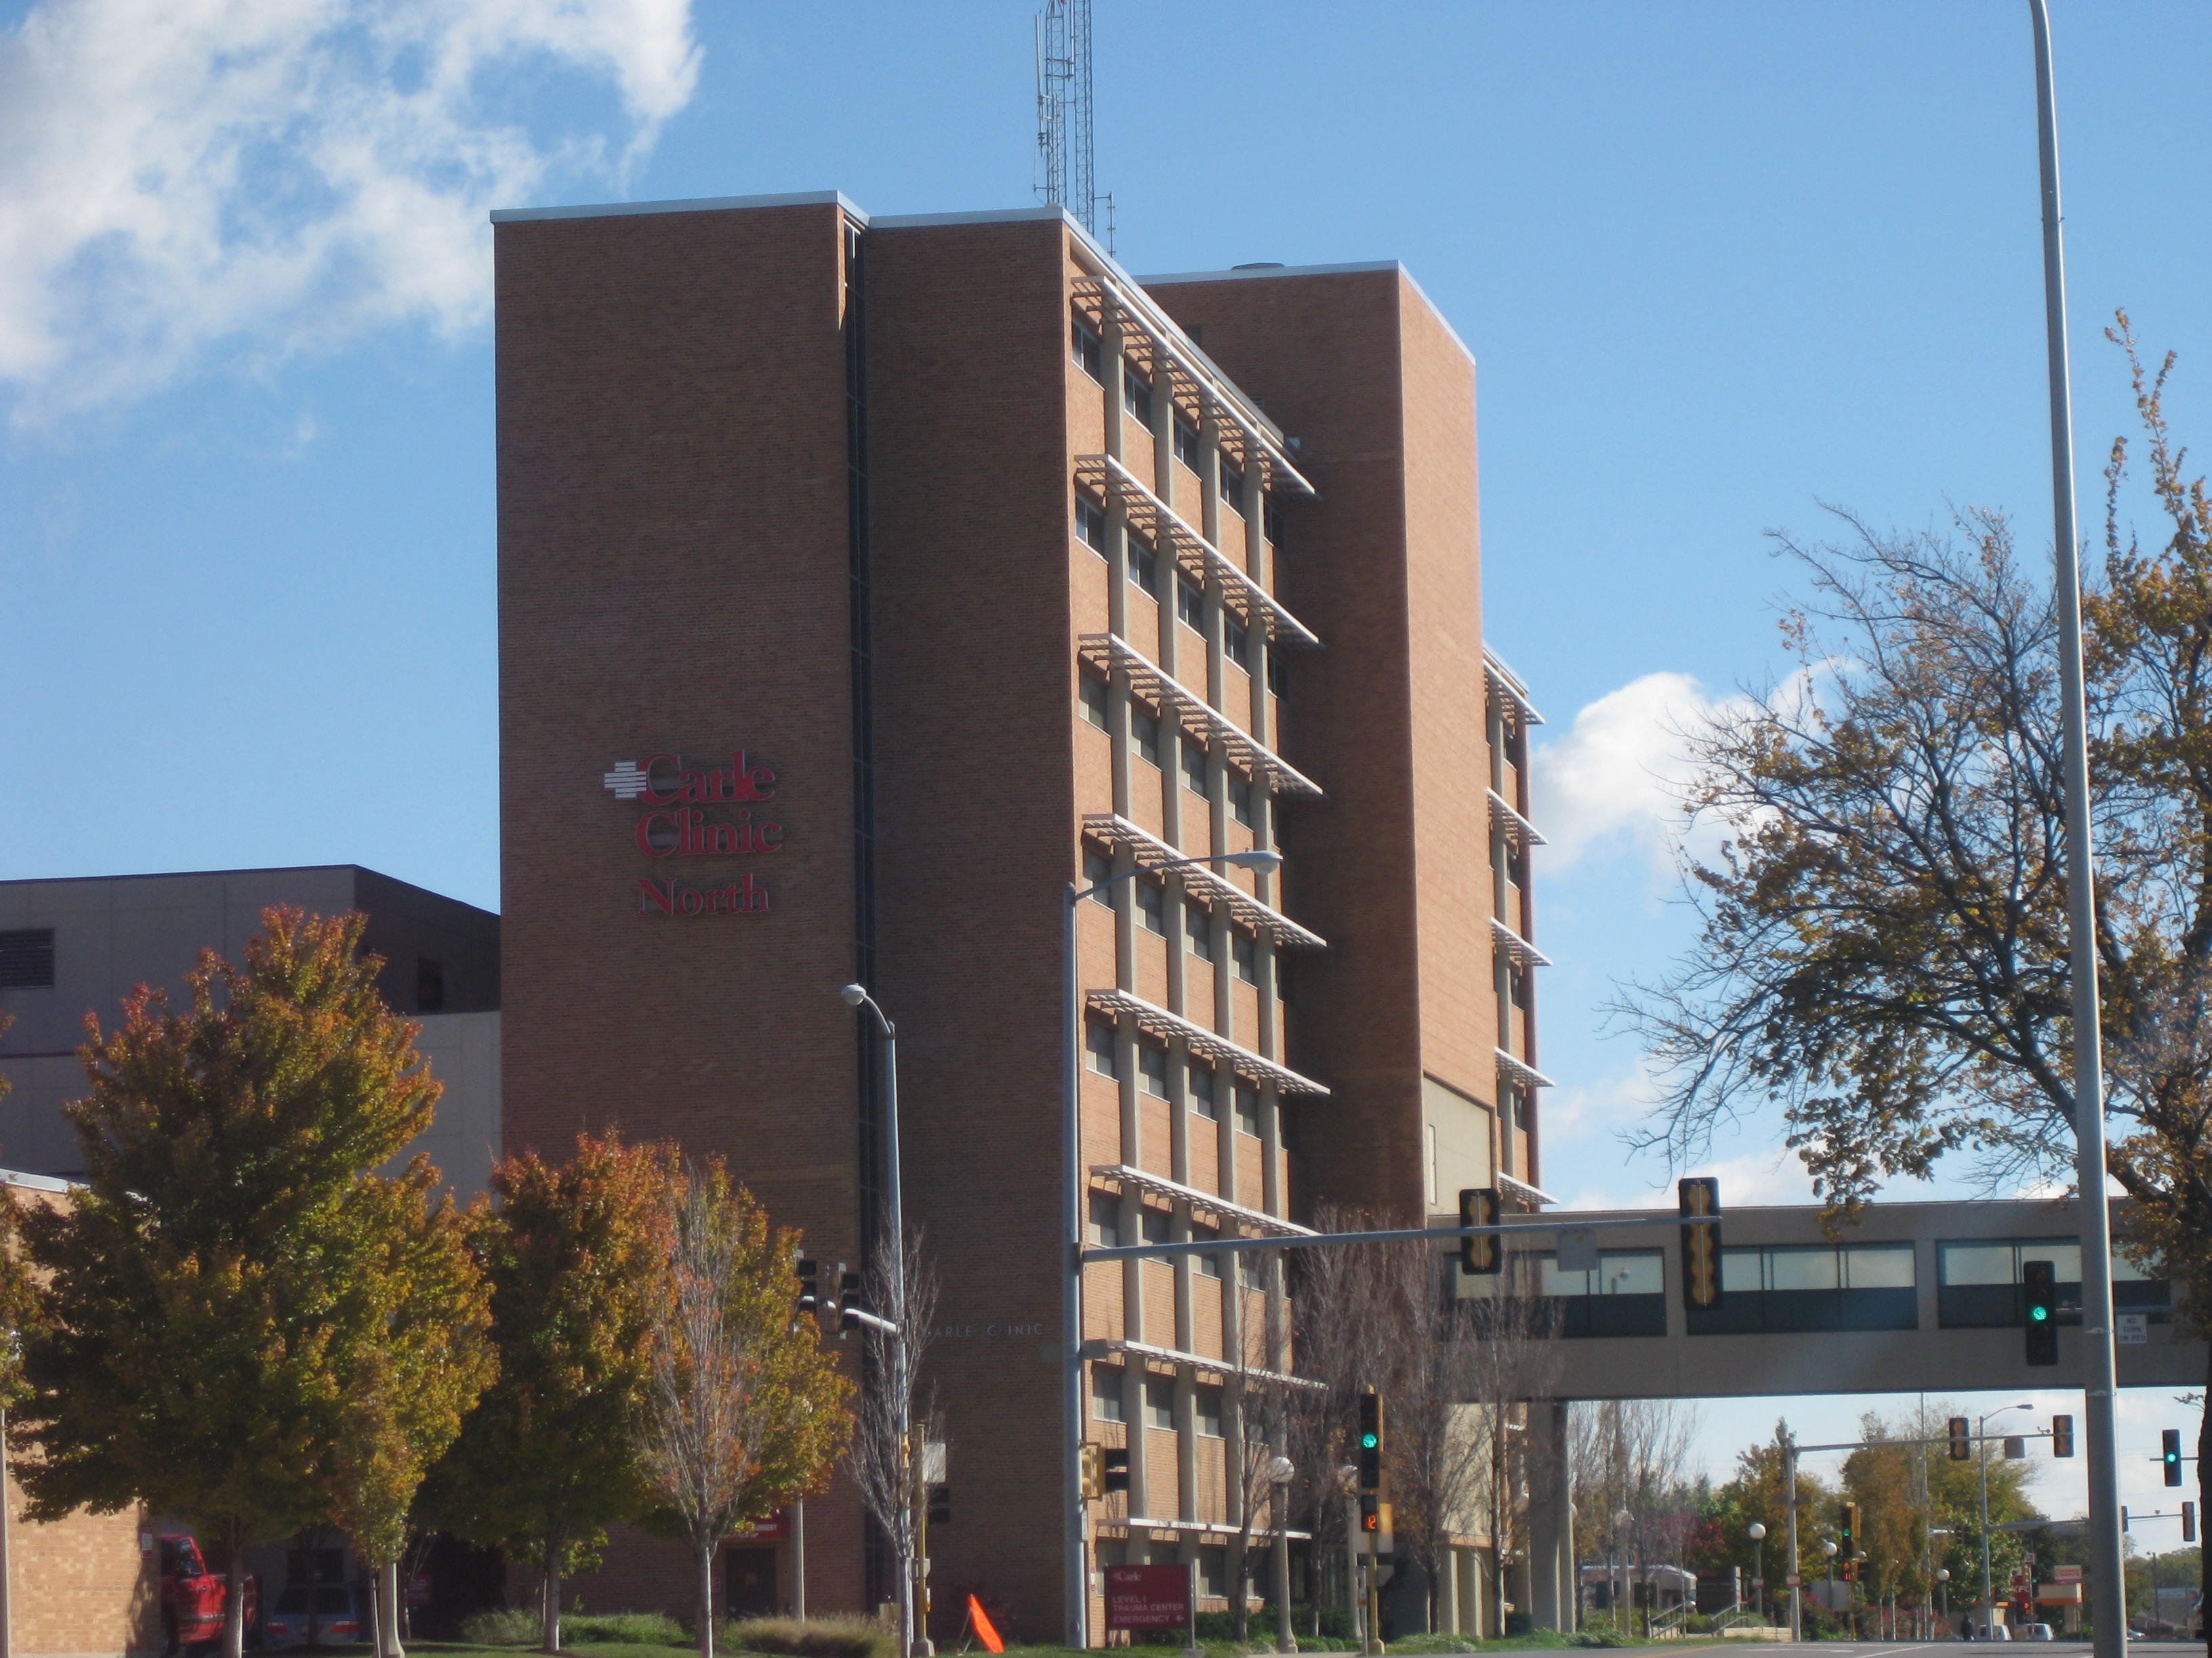

Slide 38
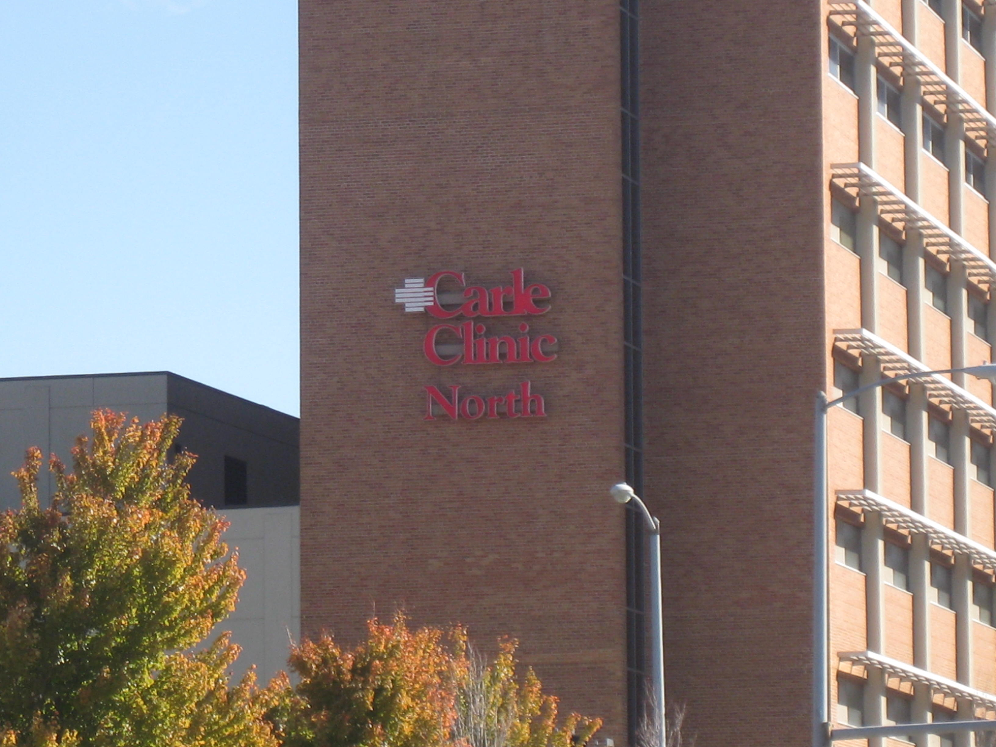

Slide 39
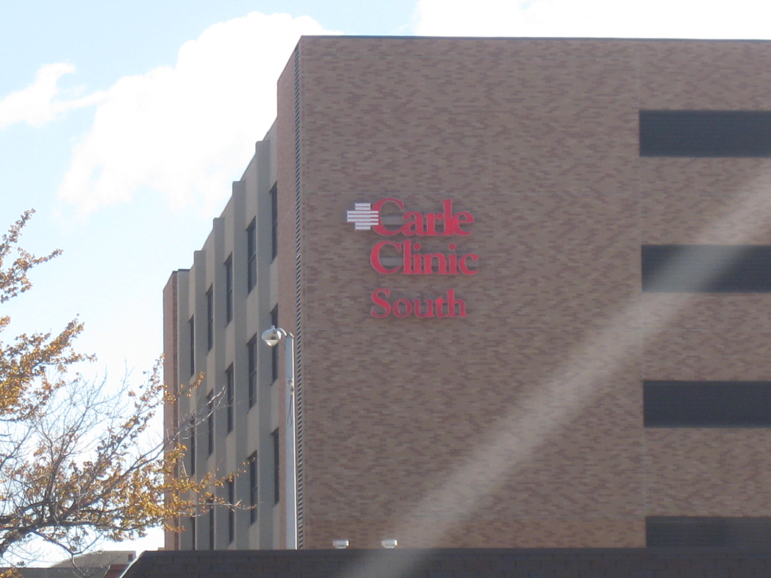

Slide 40
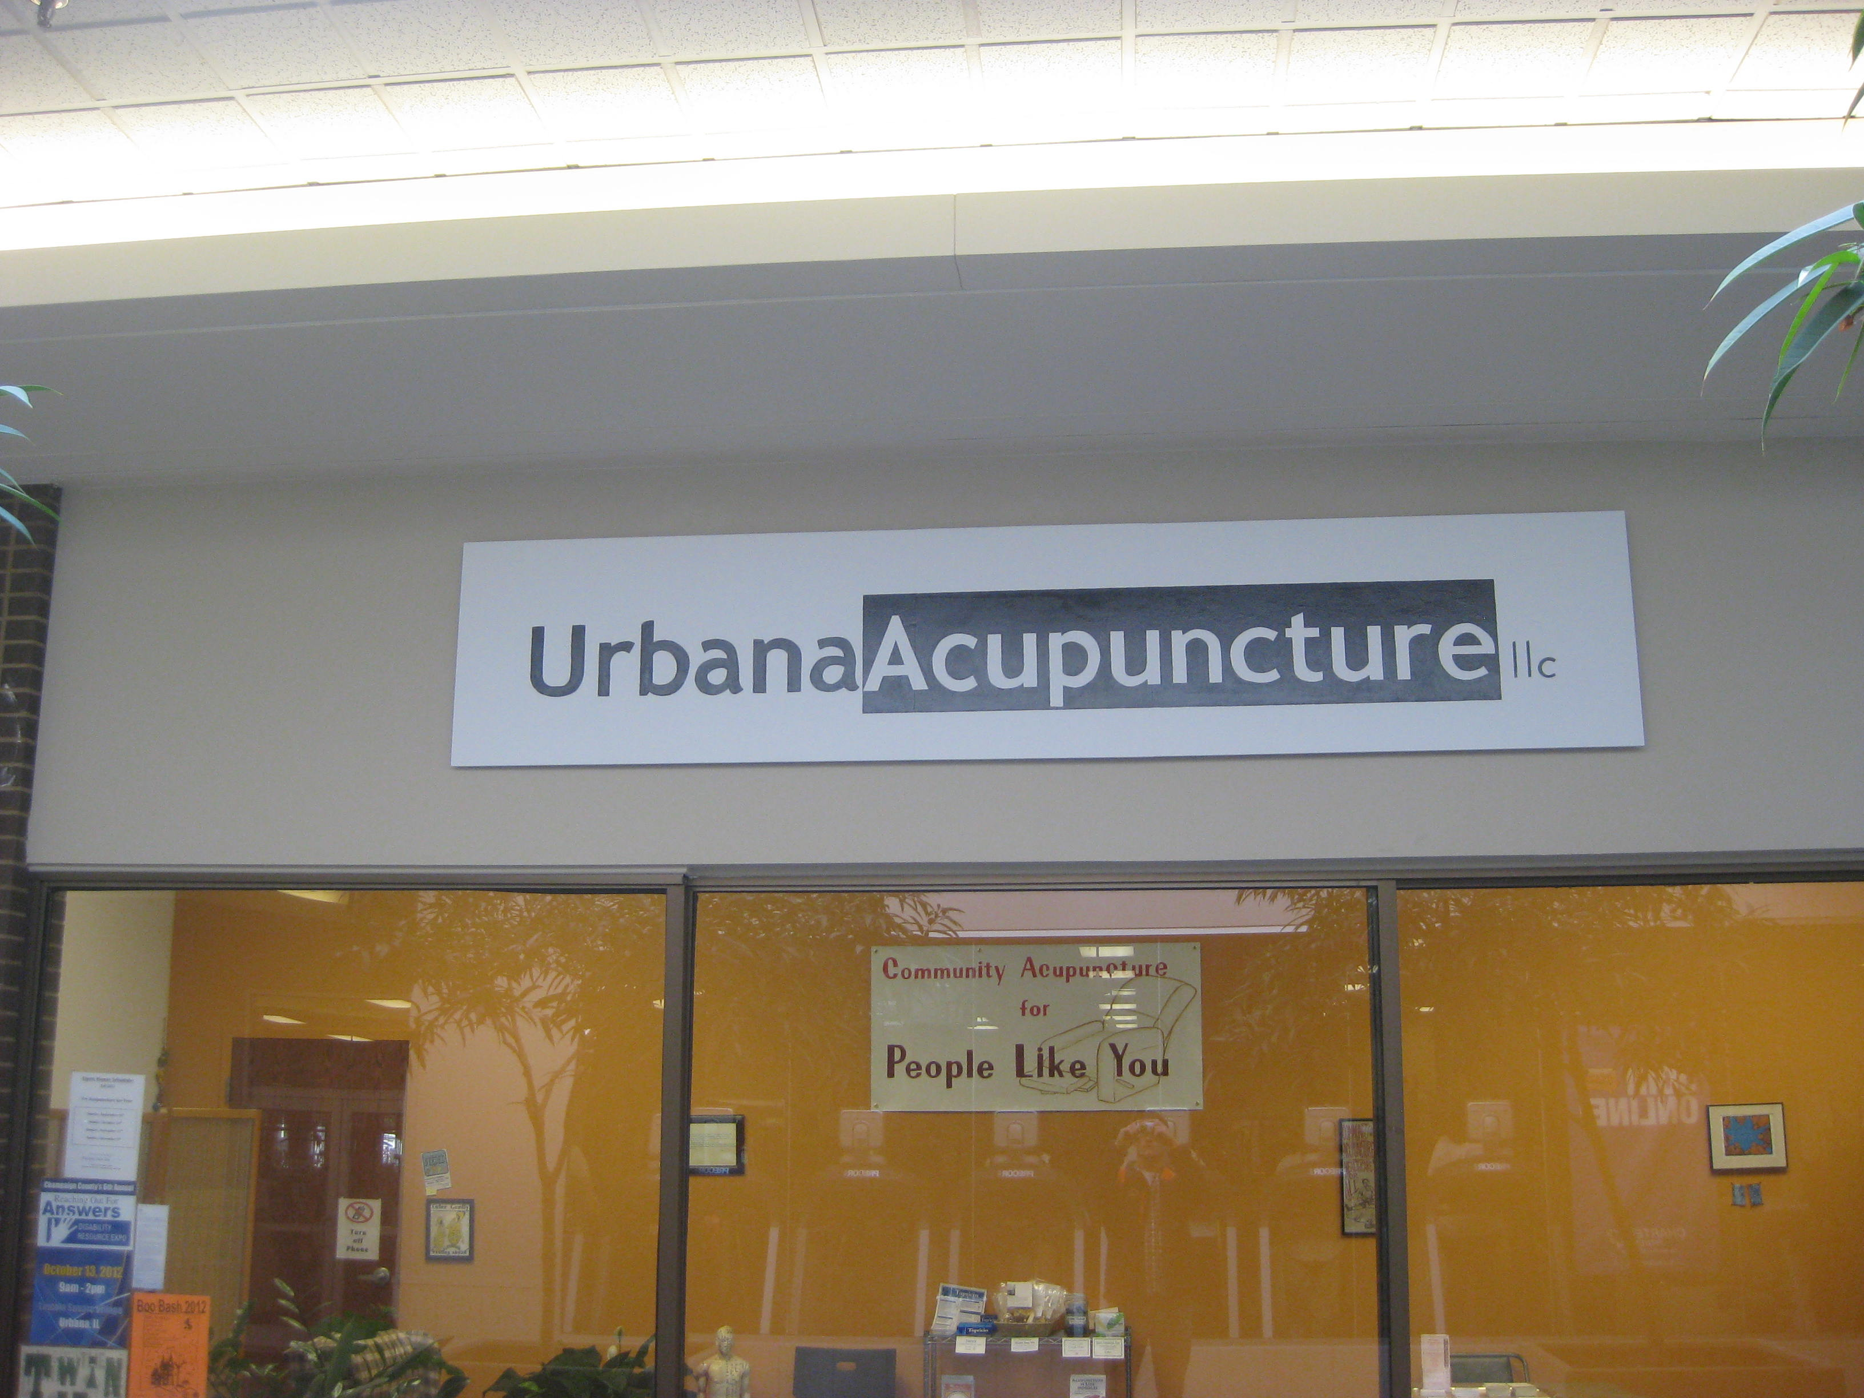

Slide 41
Grocery stores

Slide 42
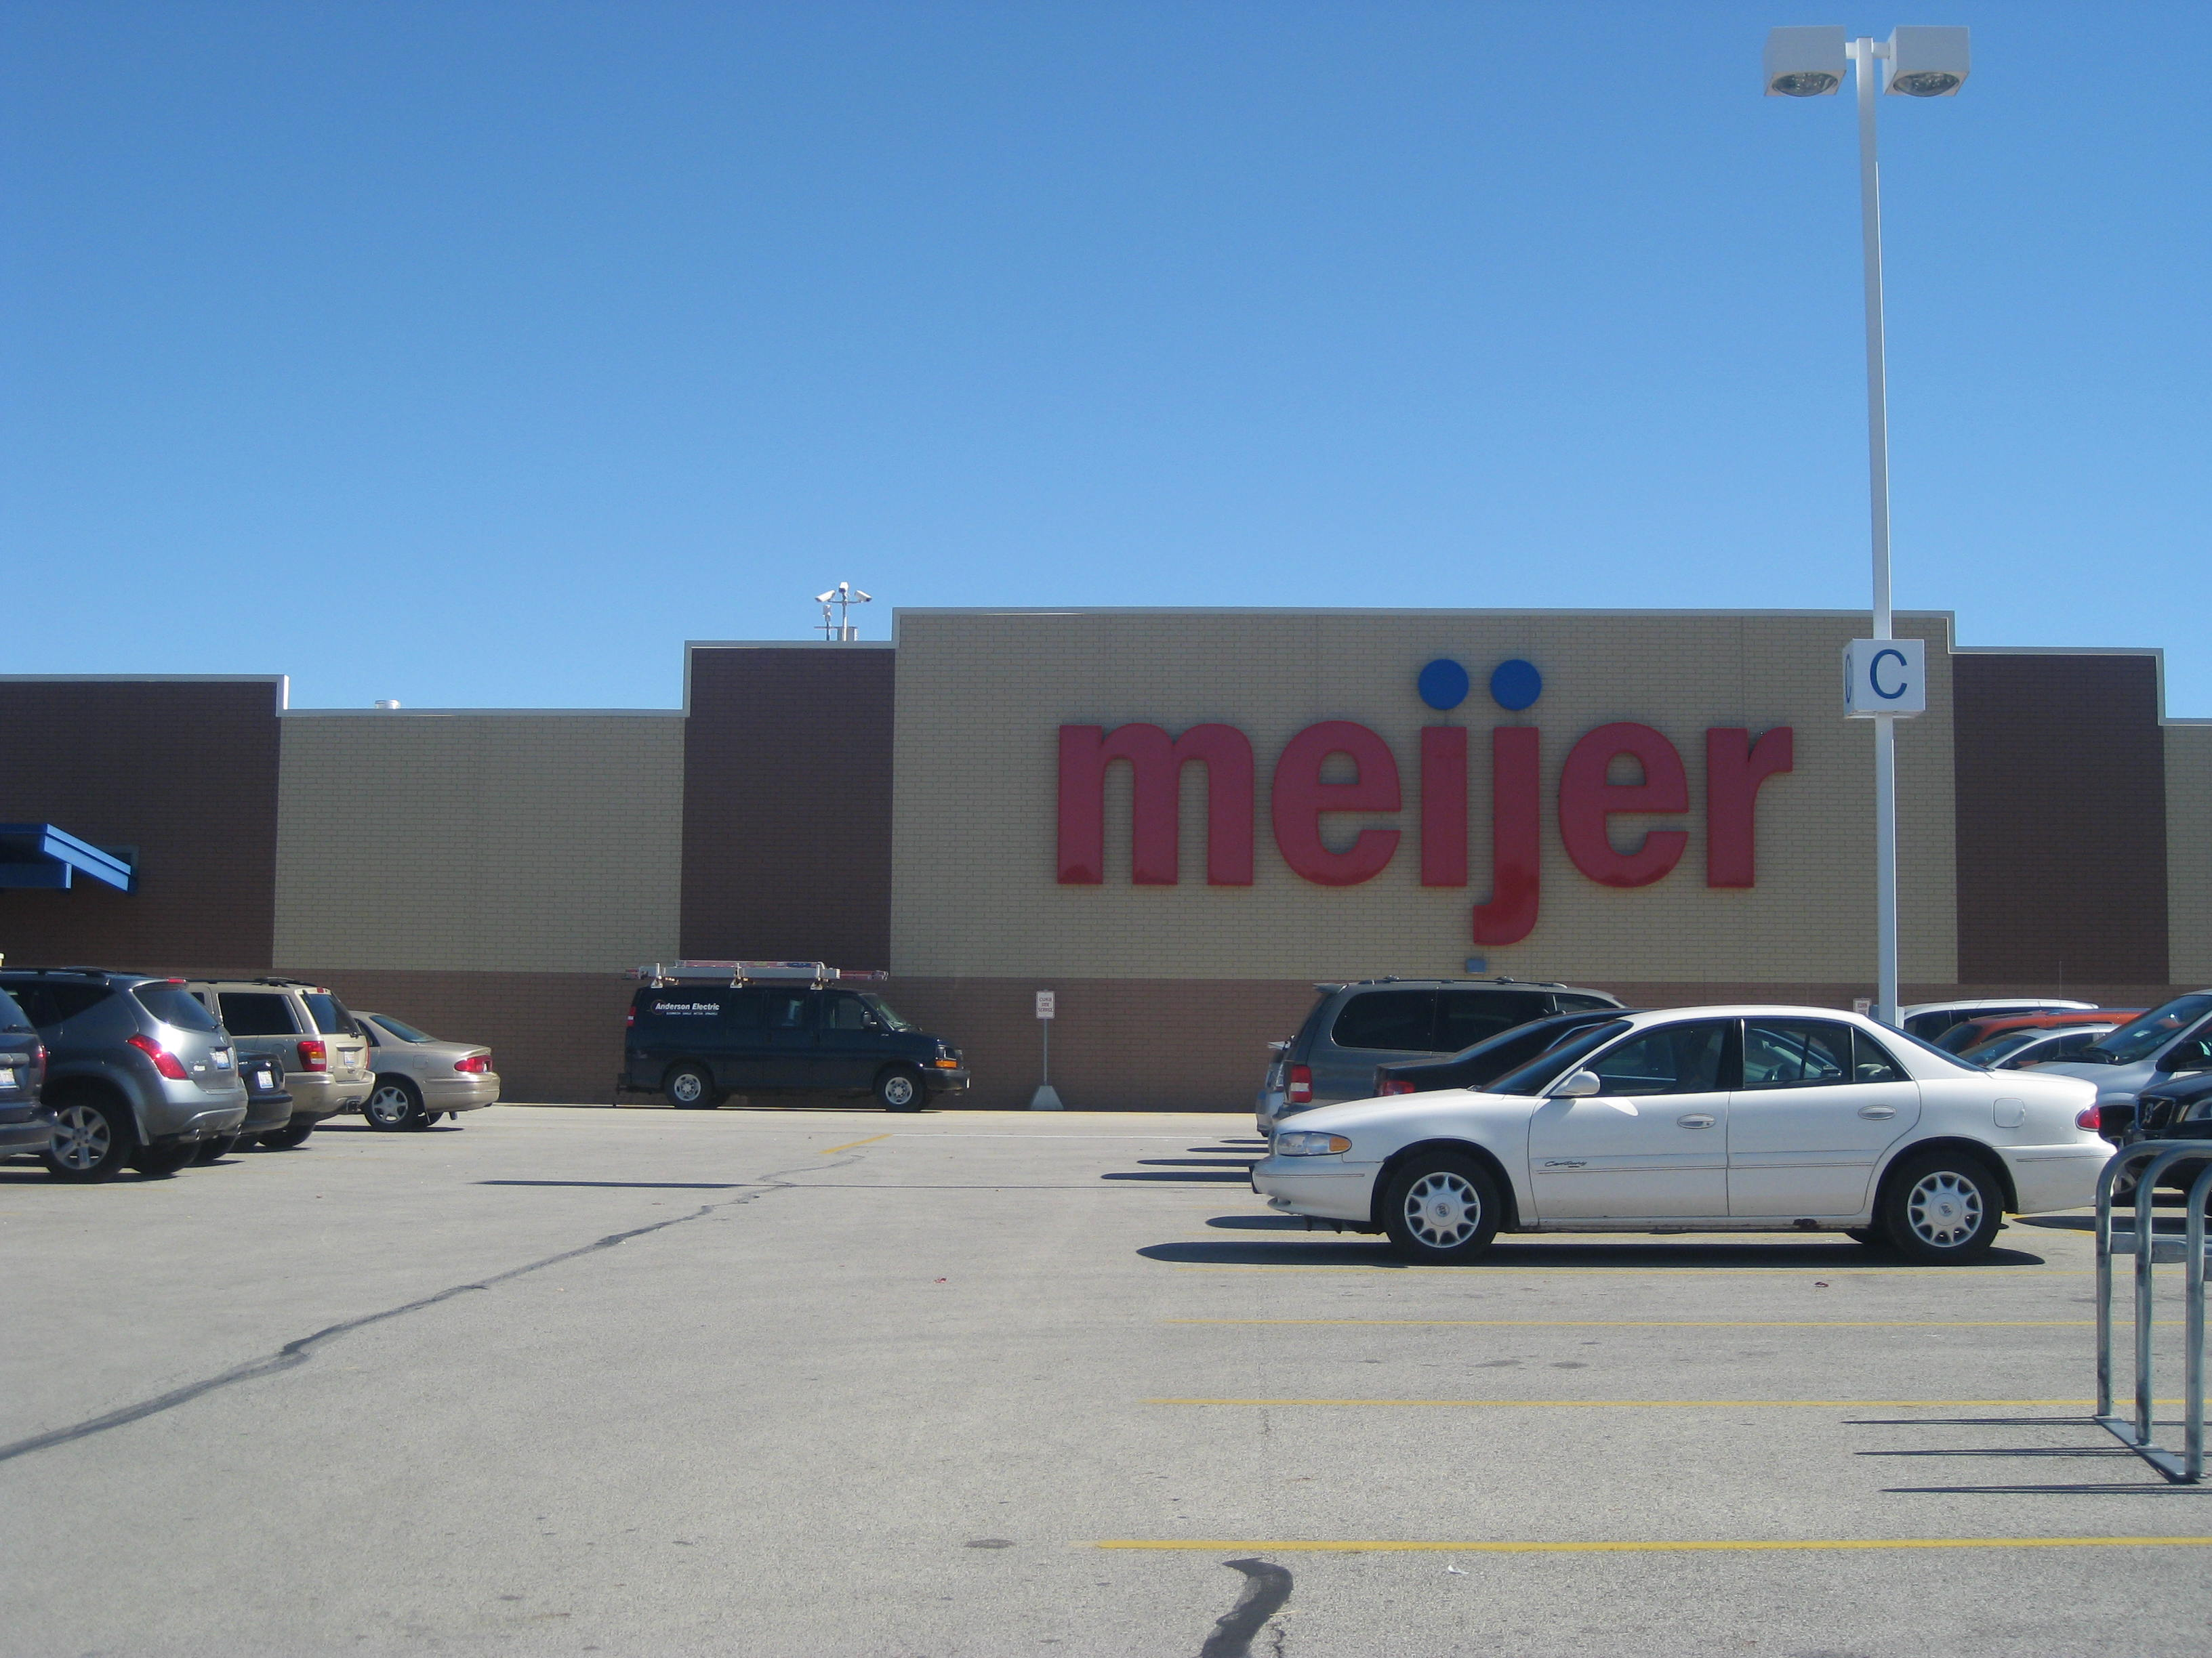

Slide 43
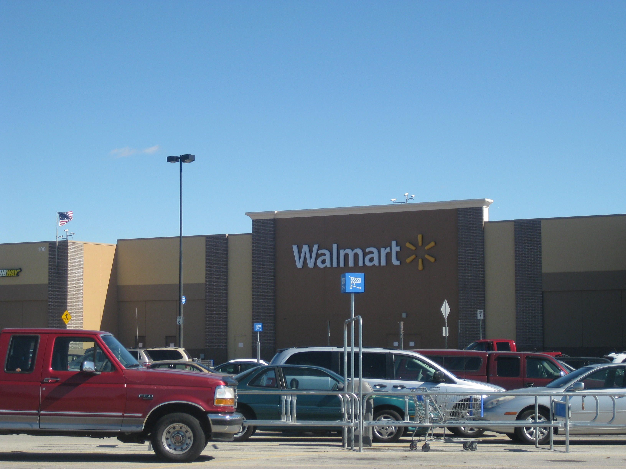

Slide 44
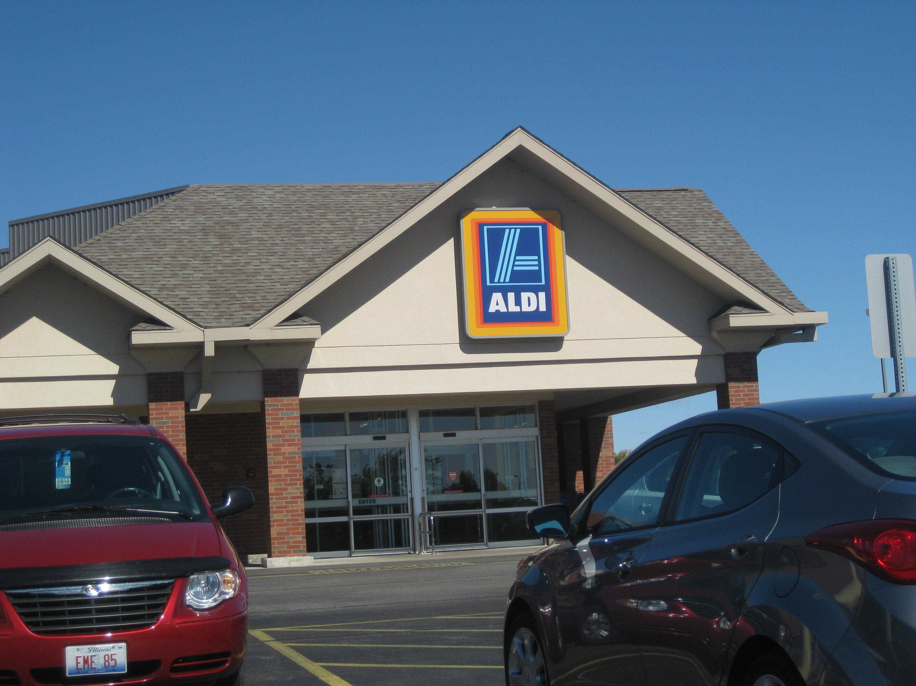

Slide 45
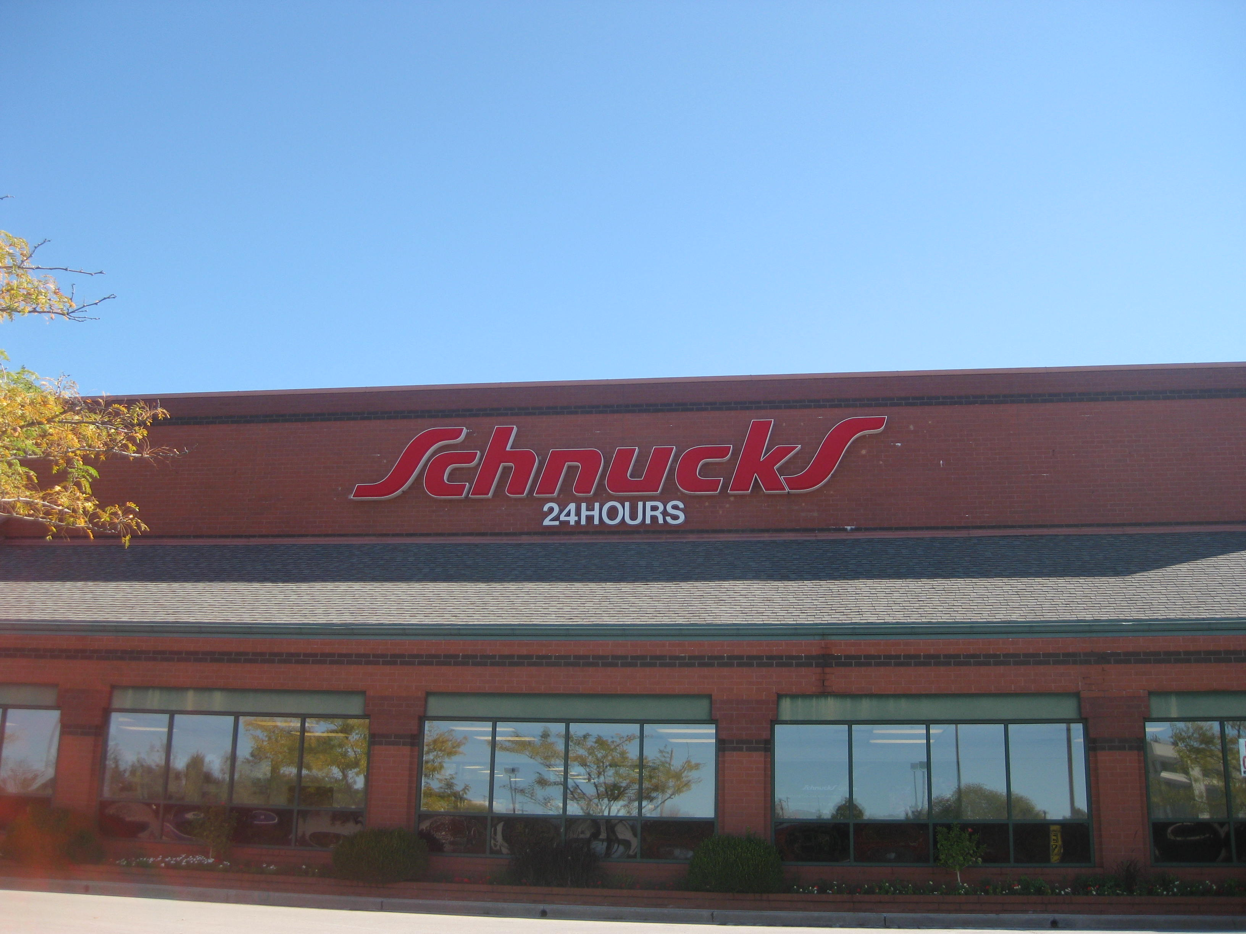

Slide 46
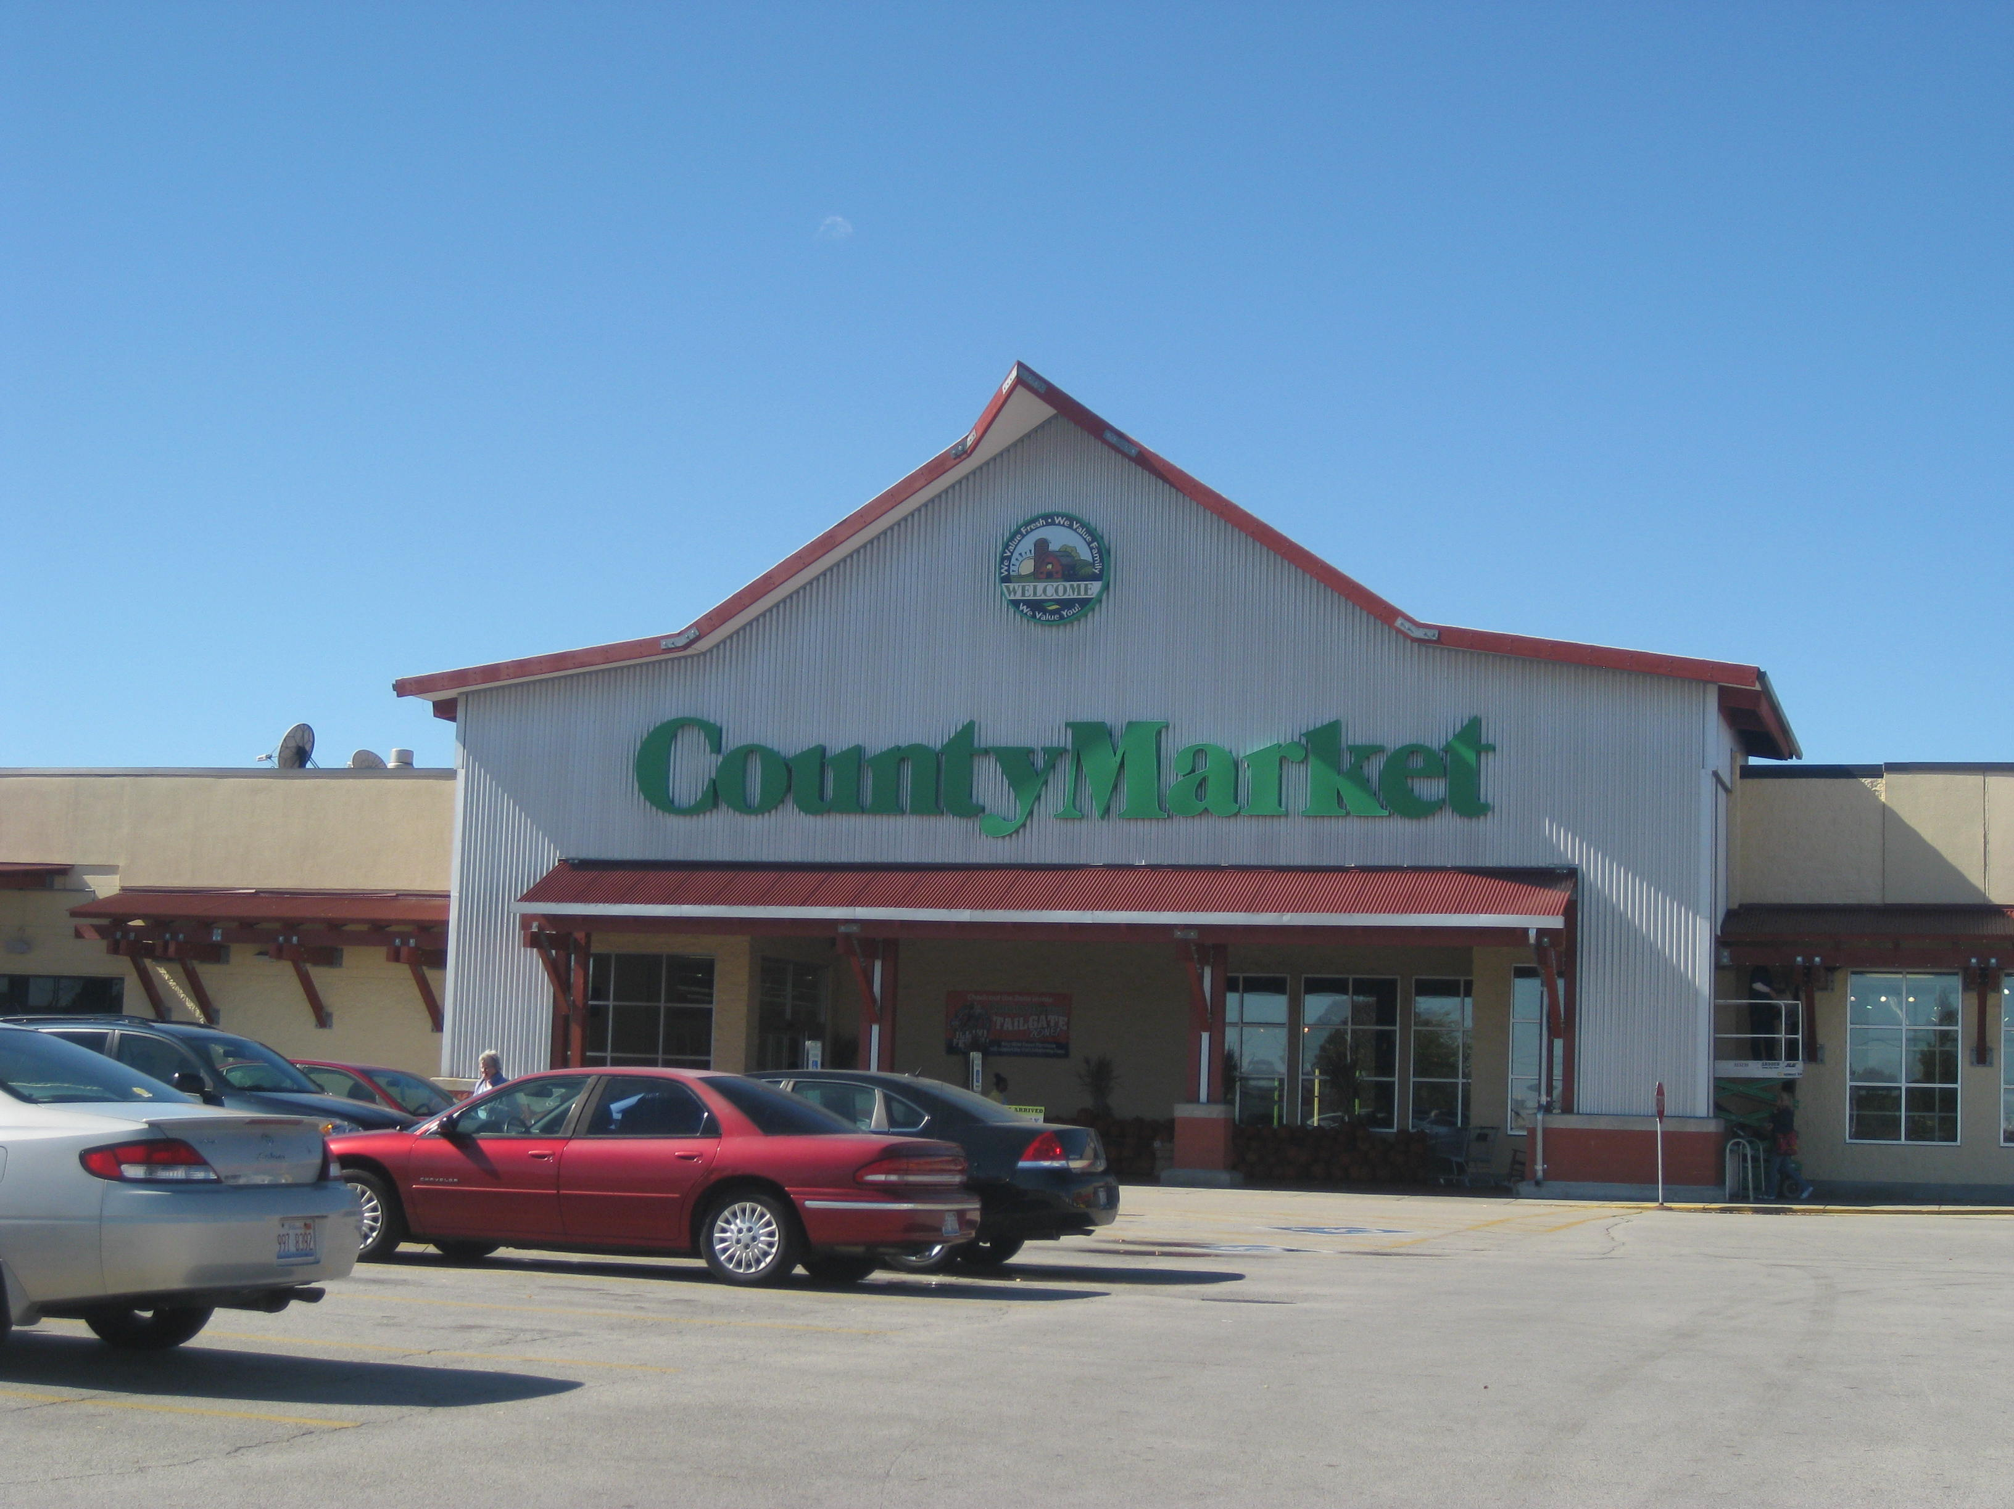

Slide 47
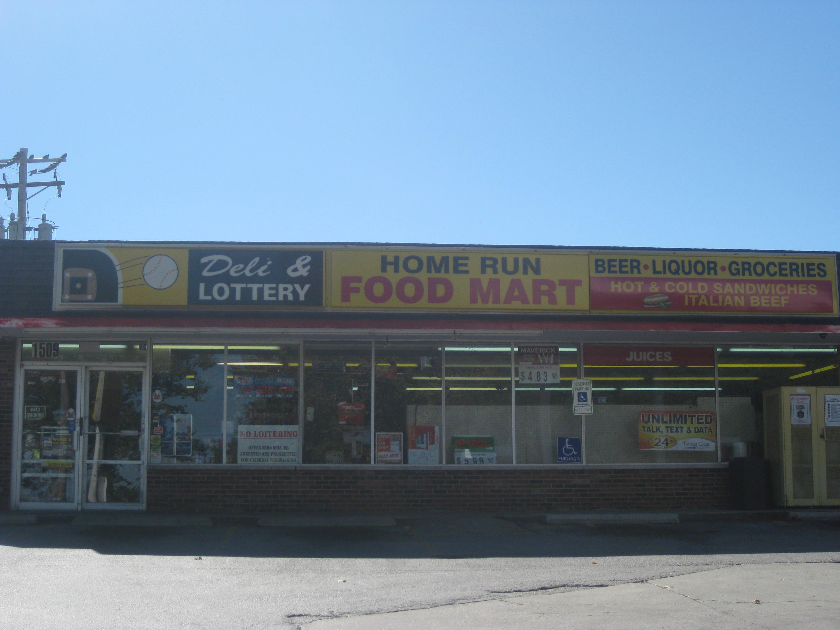

Slide 48
Businesses
Carle Foundation and University of Illinois are two of the biggest employers in the area

Slide 49
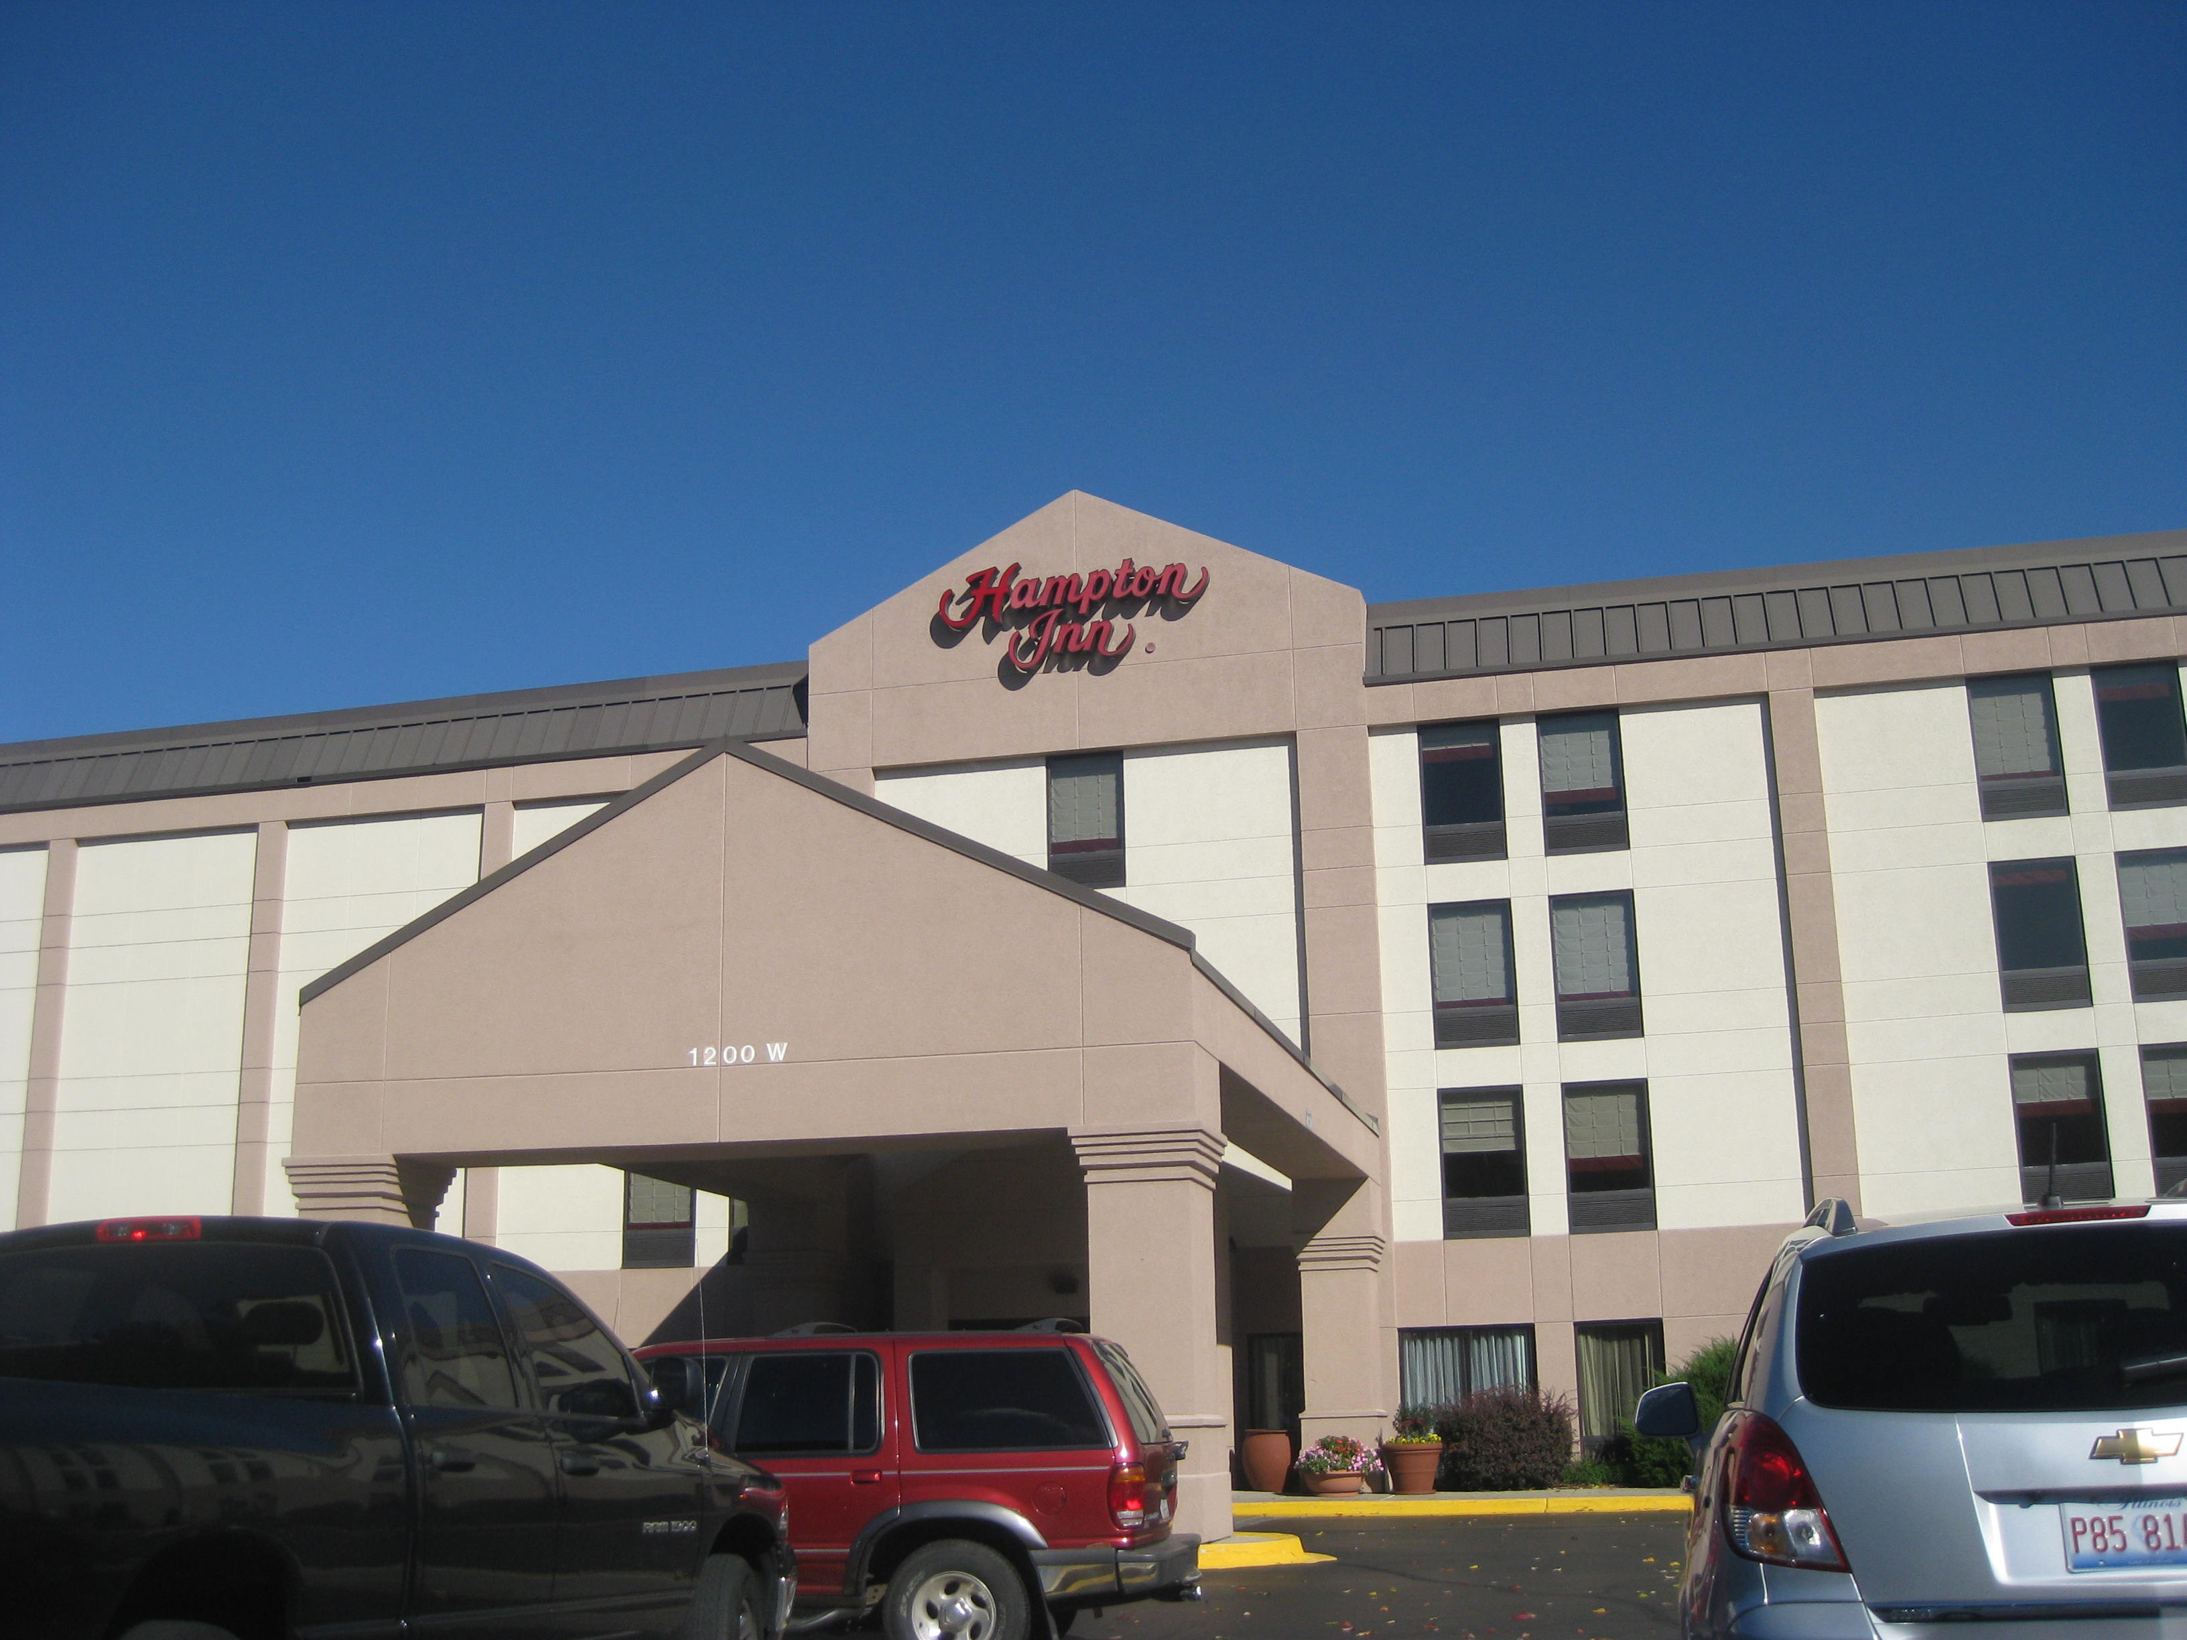
Urbana is home to many hotels and restaurants because the U of I Assembly Hall brings many visitors

Slide 50
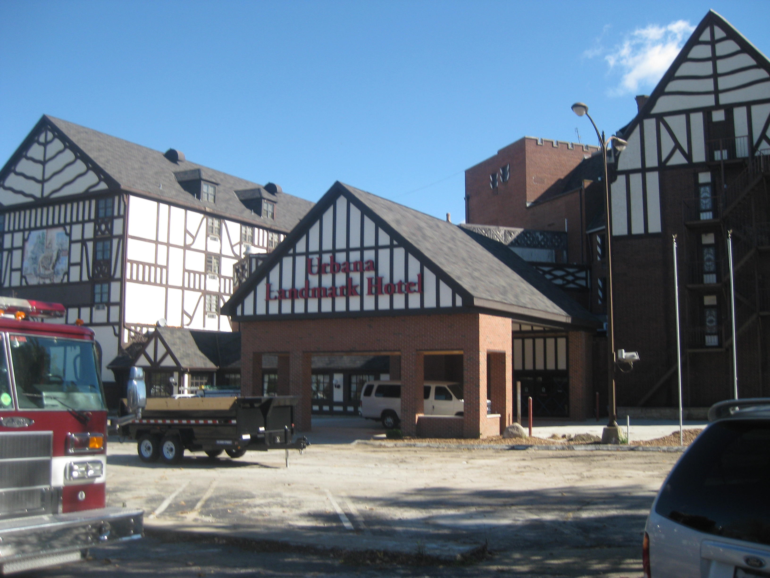

Slide 51
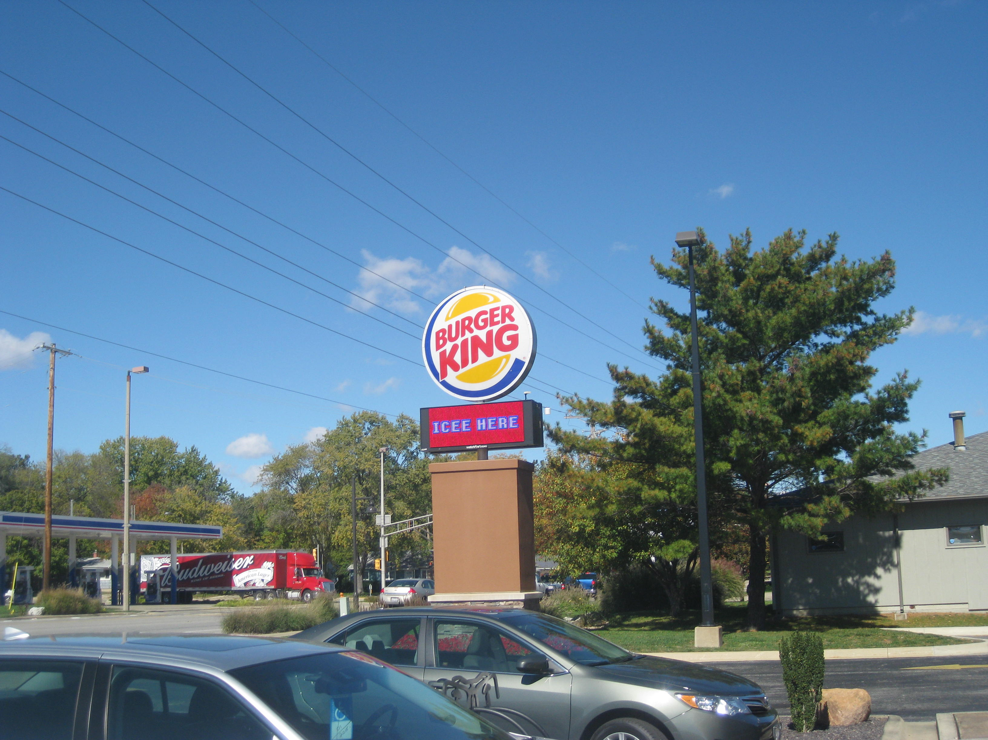

Slide 52
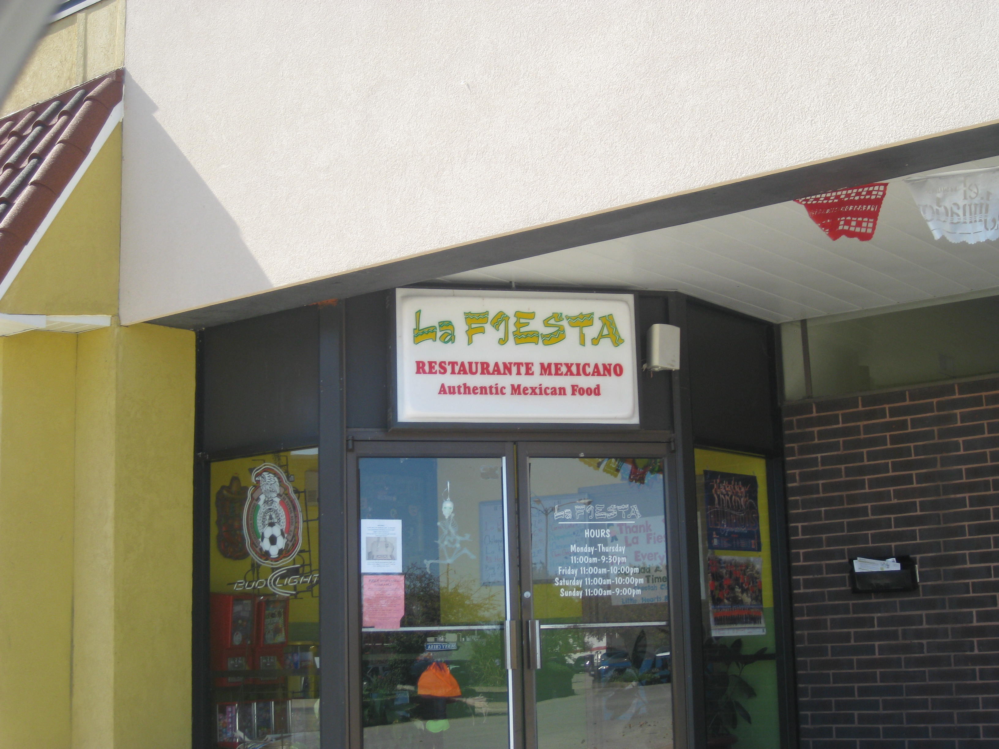

Slide 53
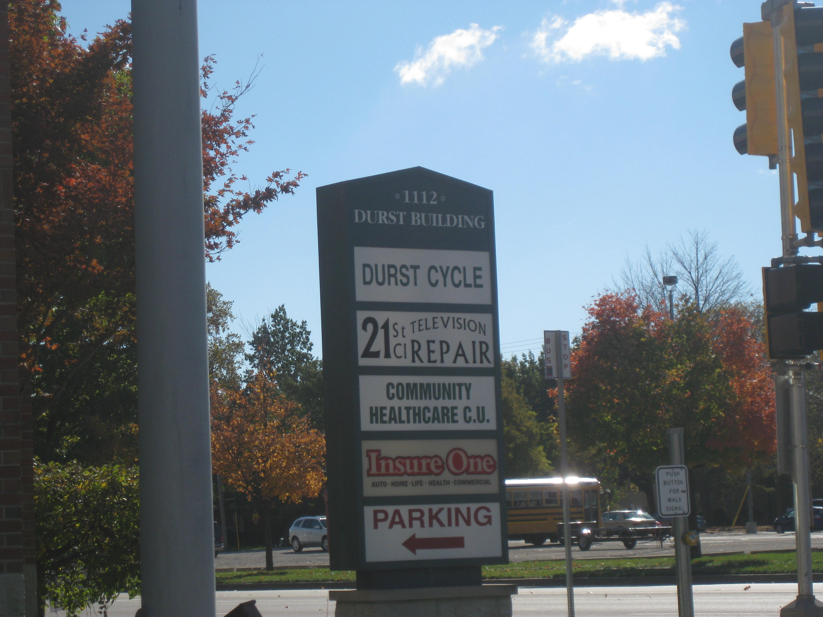

Slide 54
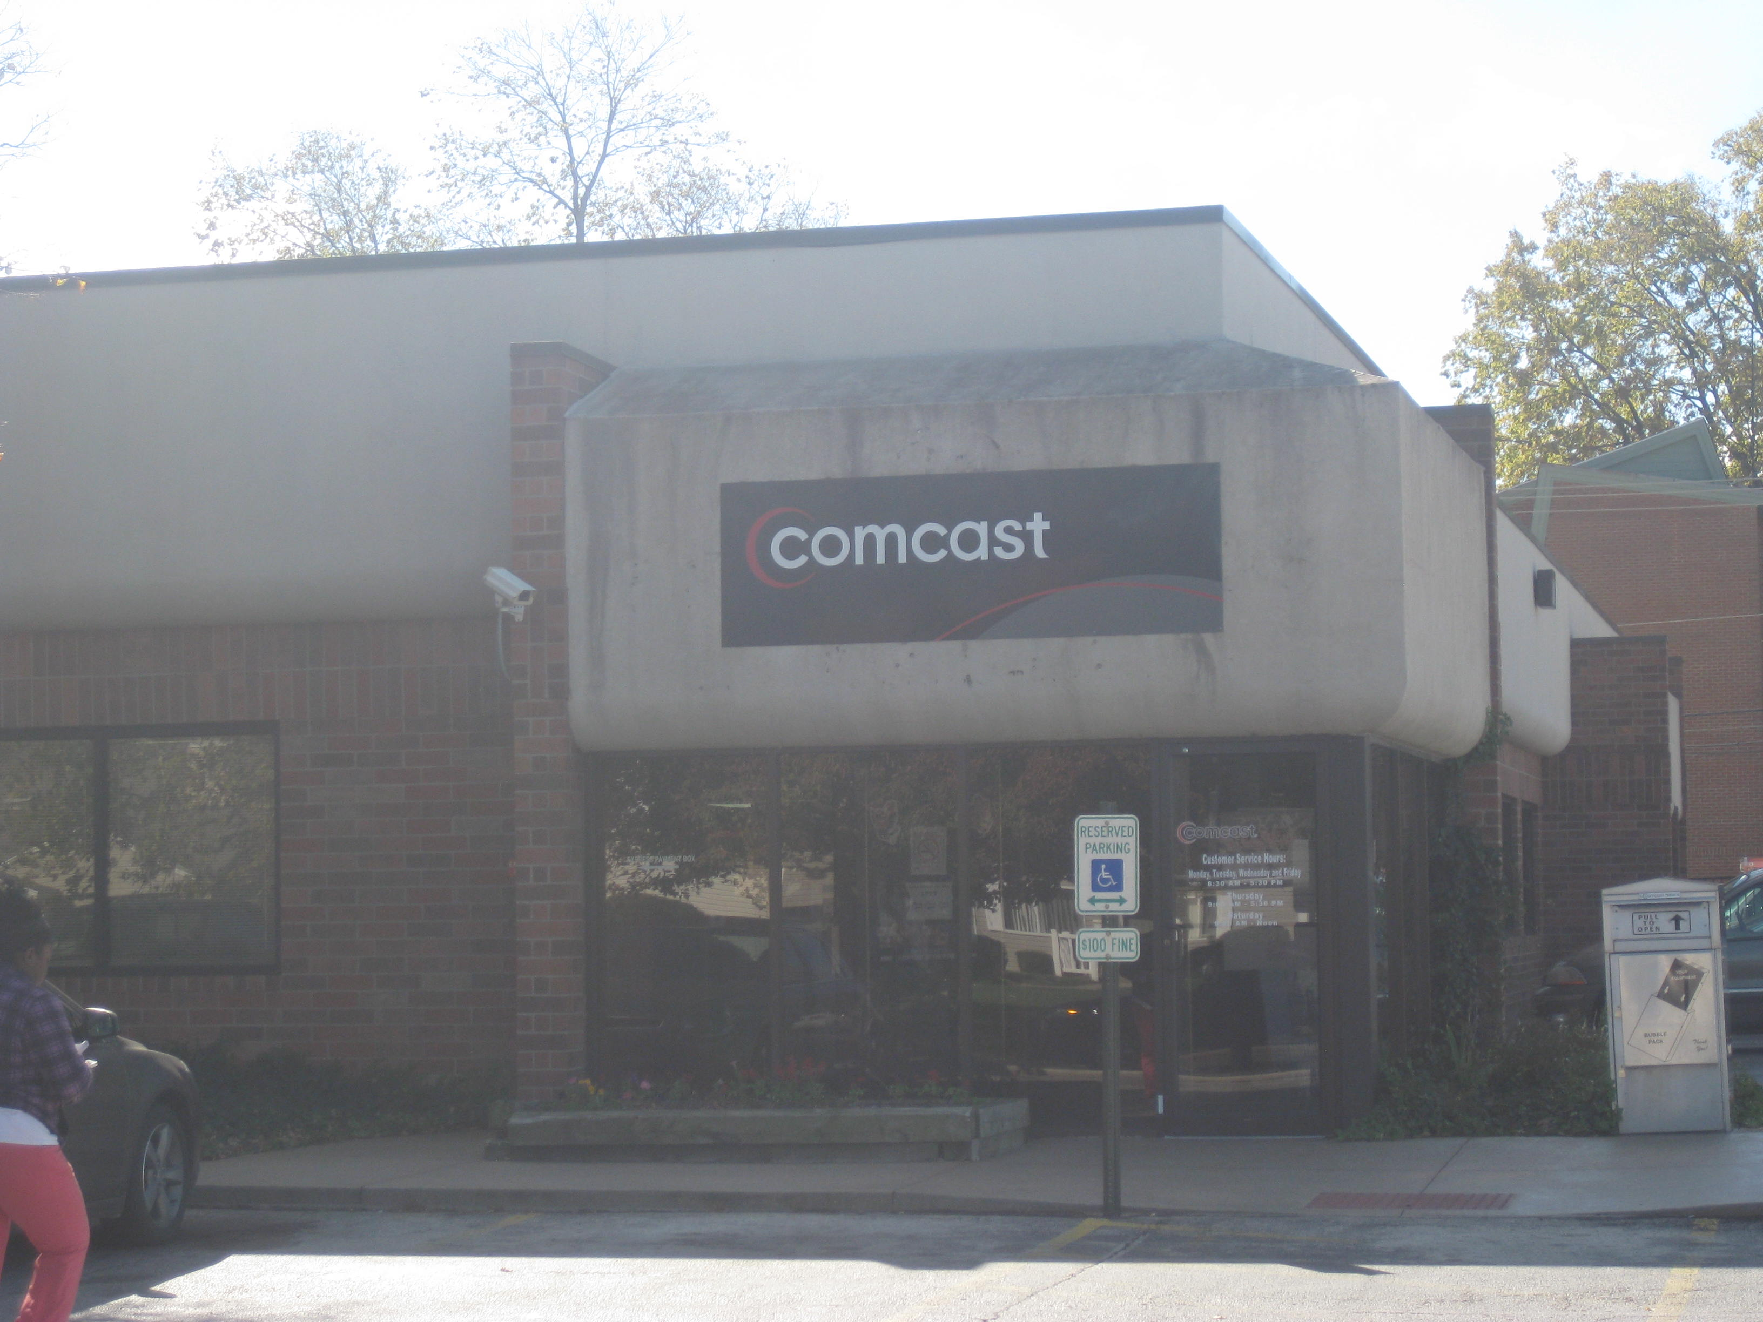

Slide 55
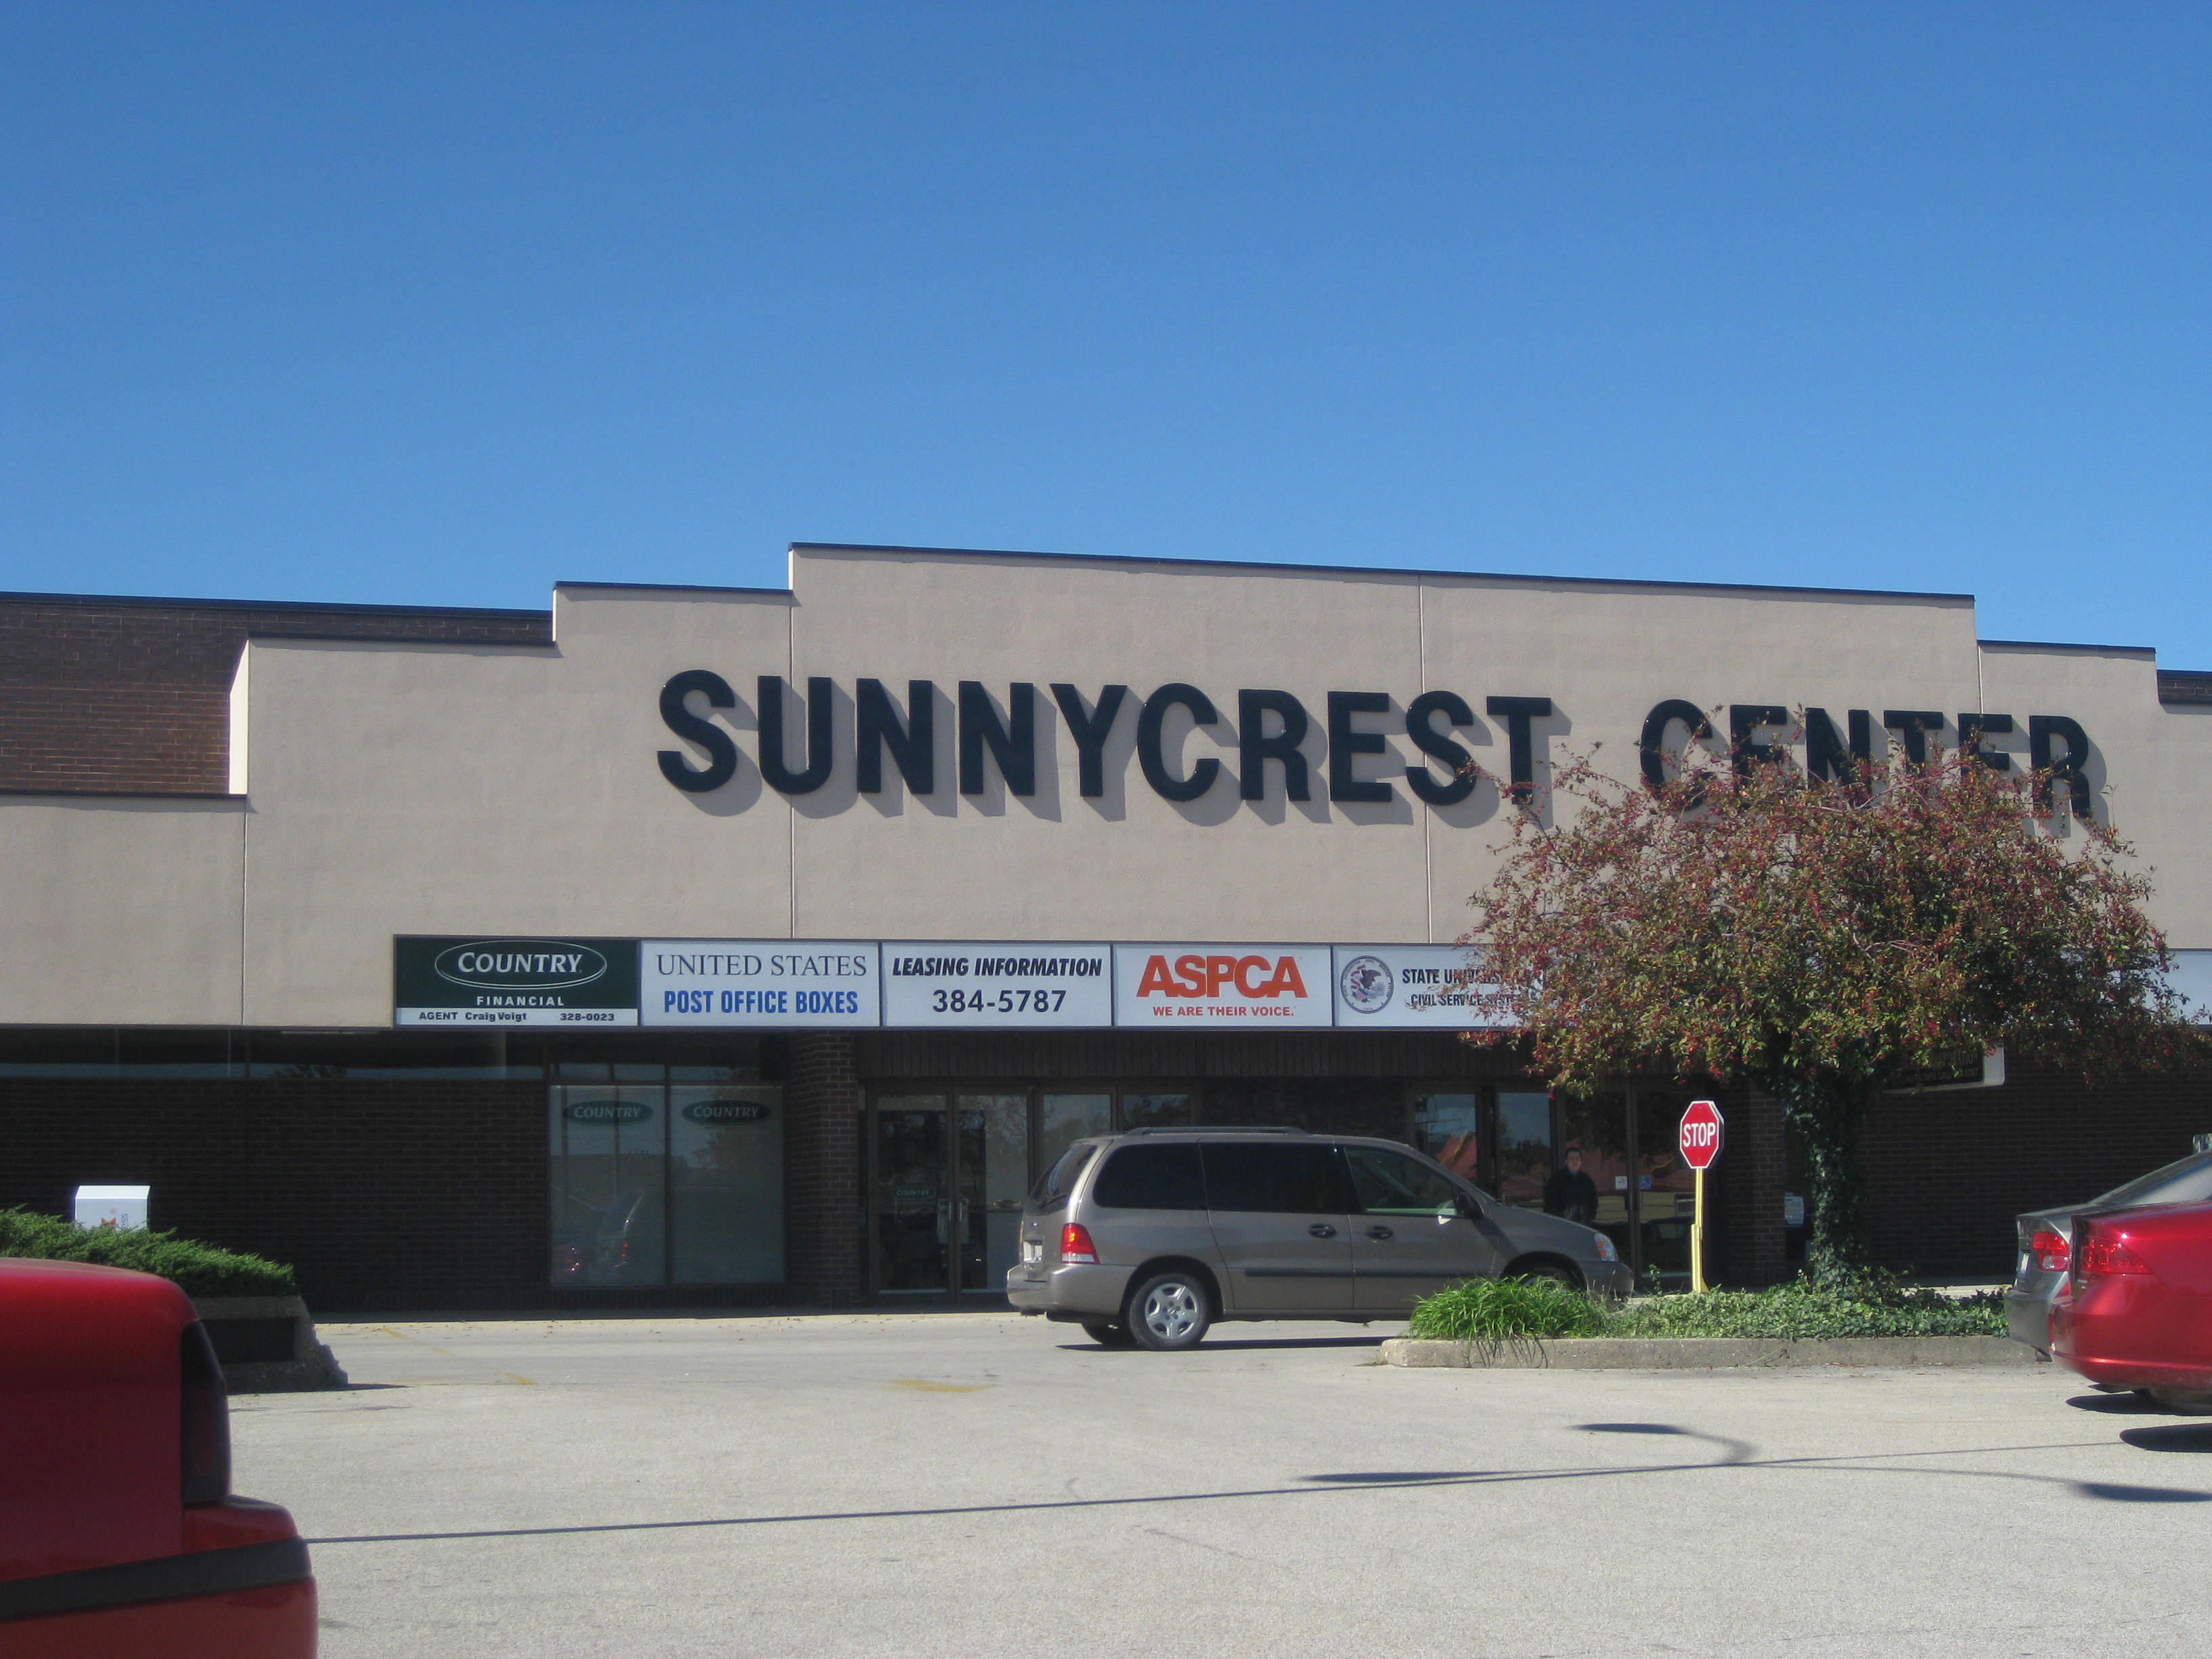

Slide 56
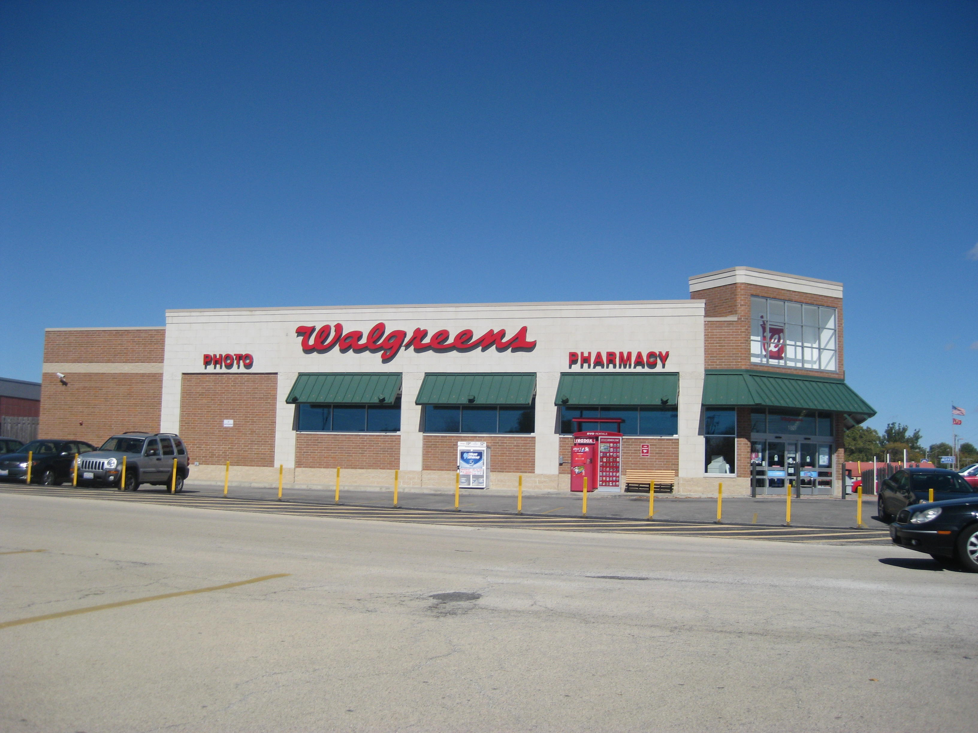

Slide 57
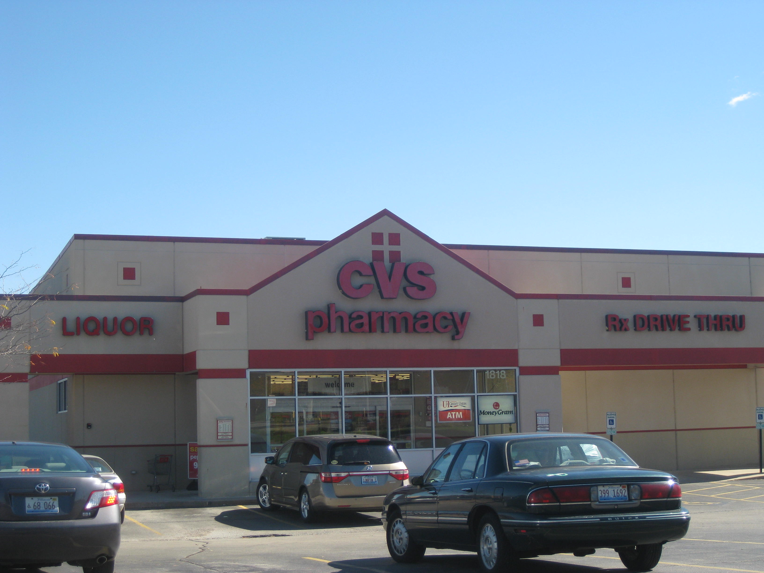

Slide 58
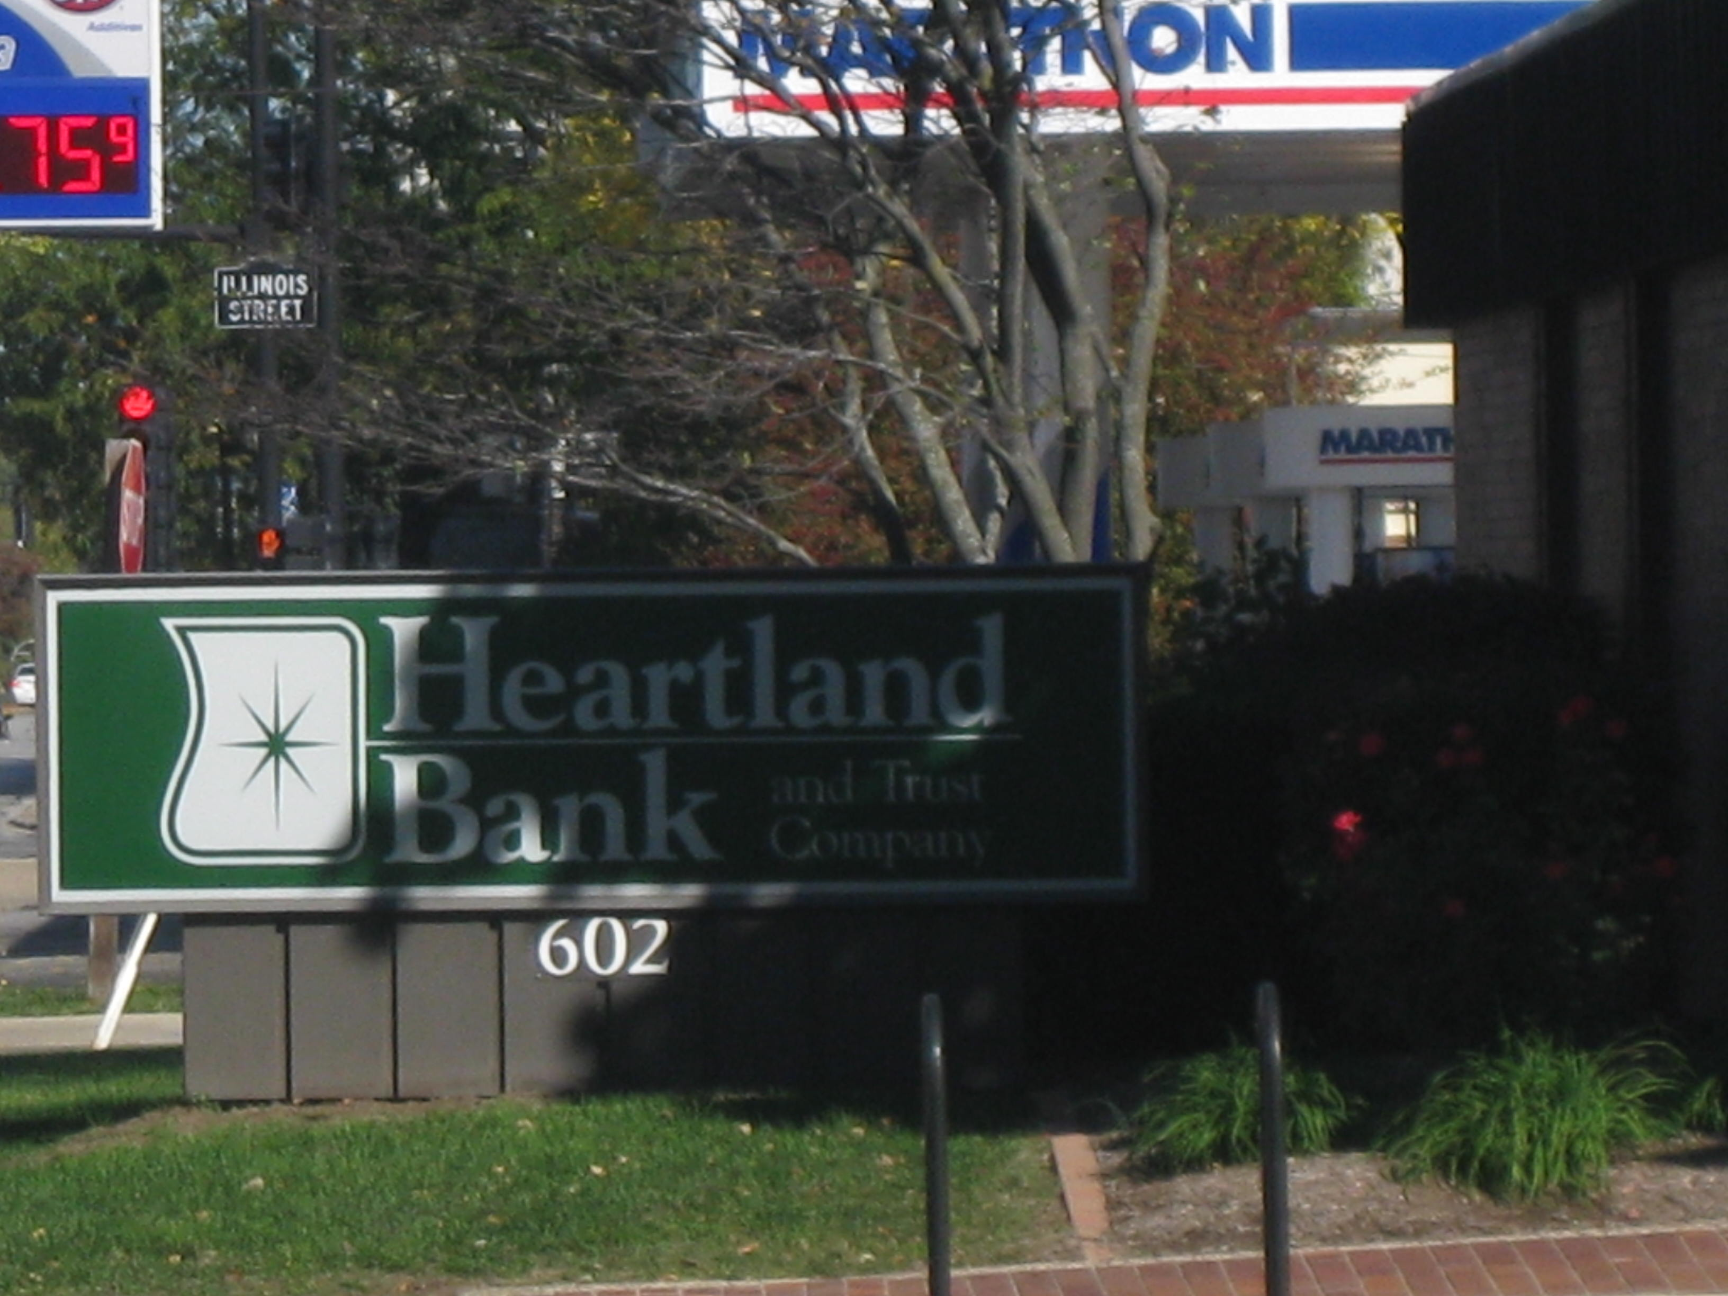
Urbana offers many banking options

Slide 60


Slide 61

Downtown Urbana

Slide 62


Slide 63


Slide 64


Slide 65


Slide 66
Government Services

Slide 67


Slide 69
Teaching kids fire safety at the local mall

Slide 80
Parks and Recreation

Slide 81


Slide 82


Slide 83


Slide 84


Slide 85


Slide 86


Slide 87


Slide 88


Slide 89

Adult Recreation

Slide 90


Slide 91
Transportation
Here to there and back again

Slide 92

Amtrak

Slide 93

Bus

Slide 94


Slide 95


Slide 96

A diverse faith population

Slide 97


Slide 98


Slide 99


Slide 100

Surrounded by corn

Slide 101


Slide 102
Urbana summary
Strengths
  U of I bring students from all over the world
  Culturally diverse
  Multiple health care facilities
  Close to major interstates
Weaknesses
  Poor public schools
  High rate of poverty

