Slide 1
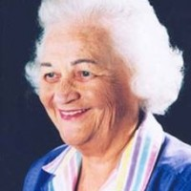
Imogene King
Abbi Palmer, Chelsea Owens,
Khoa Nguyen, Therese Pizzo,
Stephanie Redmon
N200 Theories and Issues in Nursing
5 October 2011

Slide 2
Biography of Imogene King
Born in West Point, Iowa on January 30th 1923.
Nursing theorist who is known for the development of the Goal Attainment Theory.
Earned her basic nursing education from St. John’s Hospital in St. Louis, Missouri, in 1945.
Began a course work toward a Bachelor of Science in Nursing education, which was received from St. Louis University in 1948.
Notes:
Imogene was born in 1923 and received a diploma from St. John’s Hospital. A couple years later she earned a BSN in 1948 and a MSN in 1957 from St Louis University. She was director of the Ohio State University, School of Nursing (1968-1972). King was an Associate Professor at Loyola University in Chicago as well as a professor at the University of South Florida . Until her death, she continued to speak at local, regional, national and international conferences and consulted with undergraduate and graduate students who were using her theory and developing theories from her Systems Framework.

Slide 3
Biography Continued
Published early forms of her theoretical work in 1971 called A Theory for Nursing: Systems, Concepts, Process, which contained her first claim to her nursing theory.
Framework viewed whole persons in their family and social contexts.
Retired in 1990
Died in December 2007 at the age of 84 years old.

Slide 4
How Theory Became Developed
Developed her theory of goal attainment during a time when nurses were striving to become professional practitioners (Fawcett, 2011, p.311)
Motivation for developing her conceptual framework was the need to select essential content for a new master’s degree program in nursing (Fawcett, 2011, p.311)
Notes:
Imogene King developed a goal attainment nursing theory. According to Fawcett, she was working with a faculty committee to develop a new master of science in nursing program and she was asked an in-depth question about the definition of ‘nursing act’. This is what really got Imogene King thinking and eventually had her thinking deep enough to develop her personal goal of attainment nursing theory. In 1964, King published her perception of the state of nursing and identified three major problems: lack of professional language, an antitheoretical bias, and the fact that the domain of nursing had not yet been identified. She also goes on to say that her initial thoughts were that the nursing acts represents actions, not interventions. She conducted a comprehensive review of nursing literature that revealed multiple concepts being discussed and from there she selected a few that represented broad conceptualizations of knowledge. This resulted in forming her initial conceptual framework of her goal attainment theory. She claims that learning the language of the systems helped her design her conceptual framework represented by three dynamic interacting systems (Fawcett, 2011, p.311)

Slide 5
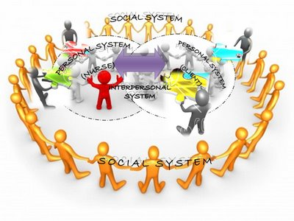
King’s Basic Concepts of Theory
Focus on persons, their interpersonal relationship, and social contexts with three interacting systems:
Personal
Interpersonal
Social
Notes:
According to Imogene King, there are three primary basic concepts to the theory of nursing. King states (King, 1981), “The whole concept contains three interrelated different system that have their own sub-concepts” (King, 1981). The three systems are personal systems, interpersonal systems, and social systems. King defines personal system as referring to the individual. He further defines interpersonal as involving individuals interacting with one another. Lastly, King states that social systems are related to groups of people within a community or society that shares common goals, interests and values.
According to King (King, 1981), “perception, self, body image, growth and development, time and space, are the important concepts in the personal system” (King, 1981).Based on King’s definition (King, 1981), “Interaction, transaction, communication, role and stress are the key concepts of the interpersonal system” (King, 1981). According to King’s theory (King, 1981), “the social system acts as a blue print for social interaction and relationship, set the foundation and rules of behavior and activity” (King, 1981).King’s theory of goal attainment consists of ten major key concepts. Imogene King lists, “Human interactions, perception, communication, role, stress, time, space growth, development, transactions as the ten concepts within the theory of goal attainment” (King, 1981, p. 142).

Slide 6
King’s Basic Concepts of Theory Continued
Personal System
Interpersonal
Social
Notes:
King’s concept of theory is goal attainment. There are three parts to this. One, personal system: The concepts within the personal systems and fundamental in understanding human being are perception, self, body image, growth and development, time, and space. Two, interpersonal: the concepts associated with interpersonal system are interaction, transaction, communication, role, and stress. And three, social: systems provide a framework for social interaction and relationship, and establish rules of behavior and courses of action. (King, 1981)

Slide 7
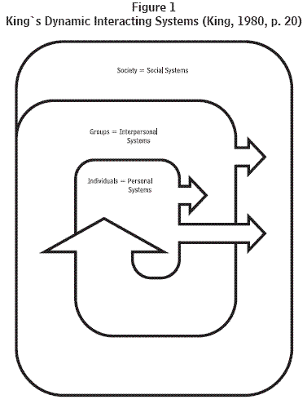
King’s Theory of Goal Attainment
10 MAJOR CONCEPTS
Human Interactions
Perception
Communication
Role
Stress
Time
Space
Growth
Development
Transactions
Notes:
There are ten major concepts of goal attainment. According to King (1981), they are as follows: Human interactions, perception, communication, role, stress, time, space, growth, development, and transactions.

Slide 8
Implementation of Person
Goal attainment
Simultaneous steps
Patient’s perceptions
Notes:
King’s focus on person is demonstrated in nursing practice. It allows the patient to participate with the nurse in actively stating desired goals and outcomes. It encourages to person to remain an individual and for the nurse to recognize the patient as one. The nurse needs to keep in mind what makes that person different and keep that person at the center of their care. The nurse is responsible for being knowledgeable about the patients beliefs and perceptions. Like the health continuum, King’s model is not linear. There are simultaneous steps all overlapping and taking place.

Slide 9
Interpersonal
Interactions between two people
Explore patient roles
Be aware of stresses in roles
Notes:
Interpersonal refers to the interaction between two or more people. This component of King’s model is seen in every day life. In nursing practice there are interactions between the nurse and the patient. The patient and their family. Nurse and doctor. Etc. It is the nurses responsibility to understand the different roles patients play in their families and daily lives. Roles differ by each patient and the difference in role will coincide with a difference in health care beliefs and practices. The different stressors in each role influence a patient’s decision making when concerning health care.

Slide 10
Social
Social contacts
Beliefs/practices
Cues that influence decision
Notes:
All people make social contacts. Whether it be at school, work, or group activities. People tend to stick with a group that shares the same values and practices. Based on a patient’s social contact, beliefs, or practices they will receive certain cues that influence the decisions they make. As nurses it is imperative to understand the patient’s social group and practices. This will help the nurse promote health while staying within the beliefs of the patient.

Slide 11
Interaction
Unique, All 3 levels
Verbal/nonverbal
Increase involvement
Effective nursing care; HEALTH
Notes:
Interaction of the patient and nurse is emphasized by King and is unique to her model. Communication can be both verbal and nonverbal. This model demonstrates the verbal and nonverbal communication that takes place between nurse and client. There is interaction on all 3 levels. The nurse interacts with or observes the patient interacting at all 3 levels; personal, interpersonal, and social. By participating in all levels, there is increased involvement on the nurse and the patient’s part. Furthermore, this promotes more effective nursing care. Nurses better understand the patients needs and expectations while involving them in their own planning and implementation. In doing so, the patient can achieve the ultimate goal, health.

Slide 12
Summary
King’s Goal Attainment Theory:
Focuses on;
The Personal
The Interpersonal
The Social
Personal – Identifies concepts that provide an understanding of individuals
Interpersonal – Interaction and transactions between two or more persons
Social – Presents concepts that consider social concepts
Putting the Theory to Practice – Goal Attainment for and by the patient
The model is not linear, however, several steps occurring simultaneously to identify the goals and ways to best attain them
Steps: Perception, Judgment, Action, Reaction, Interaction, Transaction

Slide 13
References
Chitty, K.K., & Black, B.P. (2011). The education of nurses. Professional nursing: Concepts & challenges (pp. 311-312). Maryland Heights, MO: Saunders Elsevier Inc.
Fawcett, J., RN, PhD. (Ed.) (2011). Nursing Science Quarterly. Imogene King, 14(4), 311-315.
King, I. M. (1981). A theory for nursing: Systems, concepts, process. New York: Wiley.
Williams, L. A. (2001). Imogene king’s interacting systems theory: Application in emergency and rural nursing. Online journal of rural nursing and health care, 2, 25-26.

