Slide 1
Madeleine Leininger
Presented
By
Ashley Reed
Kelly Shepard
Kaley Smith
Whitney Steigman
Shawna Storm
Lois Syse

Slide 2
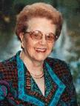
Madeleine Leininger
Madeline Leininger was born in Sutton, Nebraska in 1924.
She received her diploma of nursing at St. Anthony’s School of Nursing in Denver, Colorado
Completed her BS degree in biological science two years later from Benedictine College in Atchison, Kansas.
In 1954 she received her MSN from Catholic University in Washington, D.C
In 1965 she got her PhD in anthropology from the University of Washington in Seattle
Notes:
THE 5 BULLET POINTS IN THIS SLIDE NEED THEIR OWN CITATION.

Slide 3
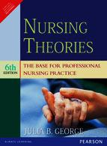
The theory of nursing is the best way nurses could provide care to their patients that were culturally congruent. (Chitty & Black, 2011)

Slide 4
Madeleine Leininger
How theory came to be developed

Slide 5

How theory came to be developed
Comes from the Latin and Greek work for “a viewing”
Traced back to Florence Nightingale
Most theories were developed in second half of the twentieth century
The work of developing theories is of nurse researches and scholars
Notes:
THE 4 BULLET POINTS IN THIS SLIDE NEED TO BE CITED.

Slide 6
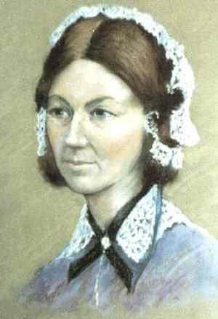
Developed Theories
Nightingale’s work represents the beginning of professional nursing as we know it today
Theory started as health, illness, and the nurse’s role in caring for patients
Beginning work came from the idea of assisting the individual sick or well and perform to your best ability
Notes:
THE THREE BULLET POINTS IN THIS SLIDE NEED TO BE CITED.

Slide 7
Description of Theory
Basic Concept

Slide 8
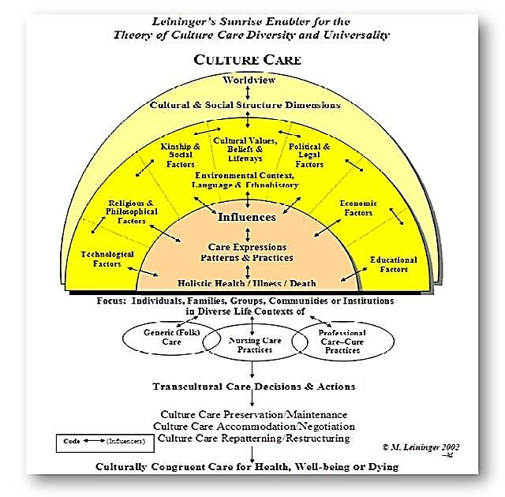
Culture Care
Leininger experienced during practice that children of different cultures had widely varying behaviors and needs (Chitty & Black, 2011, p. 316)
Lead to study of cultural differences and impact on health practices
Work lead to development of Culture Care Nursing
    Transcultural
Notes:
TWO BULLET POINTS AND THE ARTWORK ALL NEED TO BE CITED.

Slide 9
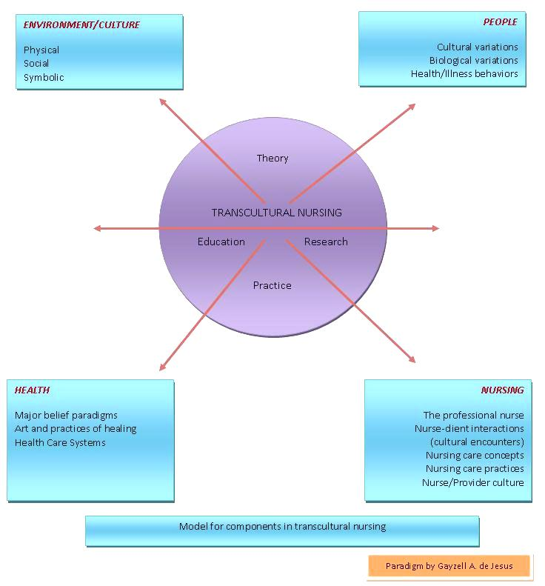
Culture Care cont…
Incorporates patient’s cultural health beliefs into care (Chitty & Black, 2011, p. 316)
Known as Transcultural Nursing
  Based on knowledge that is culturally defined, classified, and tested
  Used to make culturally congruent therapeutic decisions (Leininger's Theory of Nursing)
Notes:
TWO BULLET POINTS NEED TO BE CITED

Slide 10

Basic Concept
  Respecting cultures
  Recognizing importance to nursing care
  Co-participation of nurses and clients
  Provide care that is appropriate for each culturally unique patient (Chitty & Black, 2011)
Notes:
THREE BULLET POINTS NEED TO BE CITED.

Slide 11
Theory implementation on nursing practice
Transcultural Nursing

Slide 12
Transcultural Nursing
Developed by Madeline Leininger
  who found a relationship between cultural differences and health practices; her theory has influenced nursing today (Chitty & Black, 2011)
Transcultural nursing
  “a substantive area of study and practice focused on comparative cultural care (caring) values, beliefs, and practices of individuals or groups of similar or different cultures with the goal of providing culture-specific and universal nursing care practices in promoting health or well-being or to help people to face unfavorable human conditions, illness, or death in culturally meaningful ways” (Leininger, 1993).

Slide 13
Theory Implementation
Nursing Practice
Nursing Care
The theory is implemented in nursing practice today by those who can:
  understand that culture affects the client-nurse relationship
  ask the patient what their cultural practices and preferences are
  incorporates the client’s cultural beliefs and values into the plan of nursing care
  respect and appreciate the cultural diversity of the patient, and work to increase their knowledge of that culture to provide better care for the patient
  (Leininger, 1993)
  The core behind the development of Leninger’s theory was care
  A nurse must be able to recognize the importance of a patient’s culture and its relationship to nursing care
  “competent nursing care can only occur when client beliefs and values are thoughtfully and skillfully incorporated into nursing care plans” (Leininger, 1993).
Notes:
TWO BULLET POINTS IN THIS SLIDE NEED TO BE CITED.

Slide 14
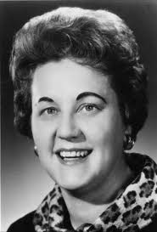
Leininger Goal
Leininger’s goal that nurses be able to provide culturally congruent, holistic care to patients (Leininger, 1993).
She stated that:
  nurses are able to provide culturally congruent care when together, the nurse and client can use care knowledge and skill to identify, plan, implement, and evaluate care that suites the client and his culture best (Leininger, 1993).
Transcultural nursing provides the patient with a plan that recognizes the values and beliefs of their culture, and is implemented to preserve and accommodate to their culture (Chitty & Black, 2011).

Slide 15
Summary of Theory
Contribution

Slide 16
Madeleine Leininger
A pioneer who shaped the way we plan and implement patient care while assessing a patients cultural needs along with their physical needs.
Responsible for the creation of Tran cultural Nursing Society, transcultural nursing conferences, newsletters and the Journal of Transpersonal Caring and the awarding of master’s degree in the specialty are known as transcultural nursing.
Madeleine Leininger’s work is seen as a theory rather than as a model of care.
Her work has been distributed as a theory rather than a concept model.
In order to be successful in the arena of transcultural nursing, you must understand that there is more to this than just being culturally aware of your surroundings. You must continue to be aware of your patient’s cultural needs and wants while formulating a patient care plan and during implementation.

Slide 17
Madeleine Leininger cont…
Utilizing culturally congruent nursing care is essential to providing exceptional and inoffensive patient care.
Being able to recognize your ignorance in a situation and either ask for help and guidance or bow out gracefully is the best care you can give for your patient.
Understanding your patient and their background will give you a greater sense of how you need to be a professional and exemplary example.
If you do not understand what needs your patient has or wants, ask someone who might have cared for them or ask their family how you can be of assistance.
Using your mistakes as a learning tool for the next patient is going to provide you with ongoing cultural education as well as learning from the mistakes of others.

Slide 18
References
Chitty, K. K., & Black, B. P. (2011). Nursing Theory: The Basis for Professional Nursing. Professional nursing: concepts & challenges (6th ed., p. 316). St. Louis, MI: Saunders Elsevier.
Leininger's Theory of Nursing: Cultural Care Diversity and Universality . (n.d.). Nursing Science Quarterly . Retrieved October 2, 2011, from http://nsq.sagepub.com/content/1/4/152.short

