Slide 1
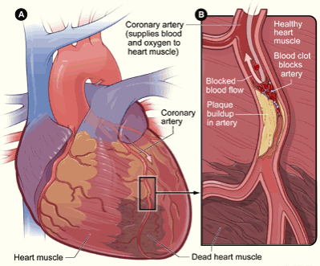
Care of MI patient at discharge.
Kelsey Draeger, Hannah Clark, Carolyn Horin, Bob Winkleman

Slide 2
Medications
Blood Thinners- help prevent blood clots from forming
clots can cause strokes, heart attacks and death
Aspirin- helps prevent heart problems
Prevents blood clots from forming
Nitroglycerin- (nitro) opens up the arteries to heart so heart gets more oxygen.
Cholesterol- decreases amount of plaque in blood

Slide 3
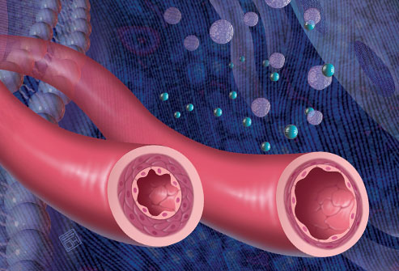
Calcium Channel Blockers-slow heartbeat, open up small blood vessels
Beta Blockers- help to maintain a steady and regular heartbeat
Aldosterone Antagonists- remove excess fluid from body, protects heart from more damage
Angiotensin-converting enzyme inhibitors-(ACE inhibitors) relax blood vessels so heart can get blood it needs

Slide 4
Safety
If patient is taking blood thinners- be aware of bleeding risks
Gums (brushing teeth)
Nose
Look for blood in urine and bowel movements
Don’t play contact sports
Use electric razor
Nitroglycerin- can cause headache, dizziness. Make sure to take it while sitting or lying down and get up slowly after taking it.

Slide 5
Self-Care Concerns
Don’t smoke – risk of vessel disease and MI
Diet- heart healthy, low in sodium, low in cholesterol, eat healthy fats : salmon, walnuts
Exercise as directed: as tolerated 30-60 minutes a day
Manage weight- losing can decrease risk of MI
Manage Stress level- can slow healing, and increase blood pressure
FOLLOW UP APPOINTMENTS WITHIN 14 DAYS.

Slide 6
References
http://youtu.be/V_1hxz8XxVk
Drugs.com. Myocardial Infarction: After You Leave. (3/21/2012). http://www.drugs.com/cg/myocardial-infarction-discharge-care.html

