Slide 1
Pediatric palliative care
By: Sandra Gutierrez
Required Readings: To Comfort Always: When a Child is Dying-Pediatric End of Life (Ch.8)

Slide 2
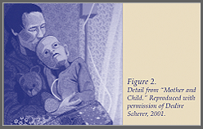
Reflection Activity
What do you feel when you look at this picture?

Slide 3

Introduction
Pediatric palliative care programs provide valuable services to children with life-limiting illnesses and their families that help to alleviate pain, manage symptoms, and provide psychosocial support.

Slide 4
Pediatric Palliative Care
Palliative care is to begin from time of diagnosis to the end of life.
The healthcare team includes: physicians, nurses, psychologists, child life specialists, and music/art therapists.
Palliative care services include:
management of pain (nausea, vomiting, and anxiety)
play therapy for the child and his/her siblings
sibling/parent counseling
music therapy
Emotional/spiritual support

Slide 5

Pediatric Palliative Care
Approximately 500,000 children cope with life-limiting illnesses in the U.S. per year.
Reimbursement policies for private and public health care organizations in the U.S. require a physician’s authorization to refer a child to pediatric palliative care.
Outside of the U.S., nurses often have as much referral authority as physicians in program.
NURSES PLAY A KEY ROLE IN THE PROCESS!

Slide 6


Pediatric Palliative Care

Slide 7
Differences between adult care and care of dying child
The age of the child affects the understanding of treatment, the disease process, and death.
Verbal skills are limited, making pain and symptom assessment and management difficult.
Many children receive more aggressive technological interventions in hope of prolonging life and finding a cure.
Parents must make the ultimate decisions on treatments, which can contradict what the patient wants.
Norlander,L. (2008). To comfort always. A nurse’s guide to end-of-life care. Indianapolis,IN. Sigma Theta Tau International.

Slide 8

Provisions for pediatric palliative care
One national barrier is the Medicare hospice reimbursement regulation that limits the provision of government subsidized hospice care to the final 6 months of life.
Florida was the first to develop a publicly funded palliative care program in 2005:
Partners in Care: Together for Kids
Children are enrolled in Medicaid or the State Children’s Health Insurance Program (SCHIP)
Serves children up to age 21
Nurses are required to attend an onsite training session

Slide 9
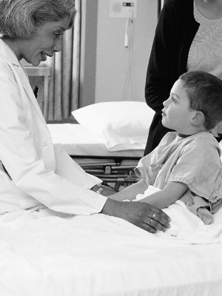
What to express……
Provide comfort for the child
Non-pharmacological treatment
Education to the patient and family
Providing information on support groups
Empathy
Respect
Privacy
Caring

Slide 10

Support for grieving parents
www.babieswithwings.com
www.pain-heartache-hope.com
http://www.smallestwingsofhope.faithweb.com/

Slide 11
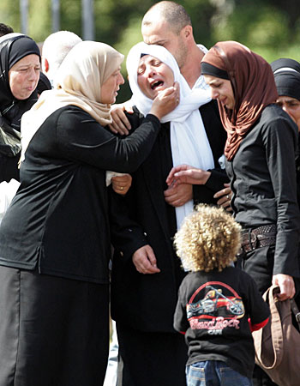
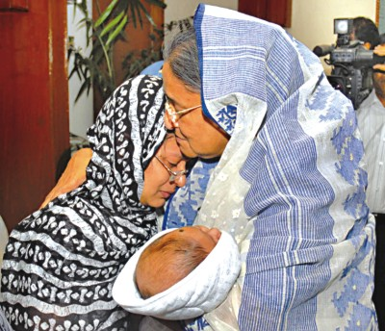
Quote
“I’m not suppose to bury my child, they are suppose to bury me. This isn’t how life is suppose to work.”
Learning Activity: http://www.pogo.ca/care/palliative-care/
-identify the steps and understand how to perform pediatric palliative care.

Slide 12
References
Huang, I., Shenkman, E., Madden, V., Vadaparampil, S., Quinn, G., & Knapp, C. (2010). Measuring quality of life in pediatric palliative care: challenges and potential solutions. Palliative Medicine, 24(2), 175-182. doi:10.1177/0269216309352418
Knapp, C., Madden, V., Curtis, C., Sloyer, P., Huang, I., Thompson, L., & Shenkman, E. (2008). Partners in Care: Together for Kids: Florida's model of pediatric palliative care. Journal of Palliative Medicine, 11(9), 1212- 1220. Retrieved from EBSCOhost
Knapp, C., Madden, V., Wang, H., Kassing, K., Curtis, C., Sloyer, P., & Shenkman, E. (2009). Effect of a pediatric palliative care program on nurses' referral preferences. Journal of Palliative Medicine, 12(12), 1131-1136. doi:10.1089/jpm.2009.0146
Norlander,L. (2008). To comfort always. A nurse’s guide to end- of-life care. Indianapolis,IN. Sigma Theta Tau International.

