Slide 1
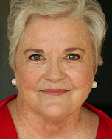
Patricia Benner
From Novice to expert
By:
Brittany Arrigoni
Hannah Clark
Charsie haygood

Slide 2
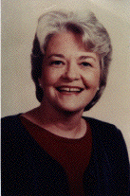
Early Life
Bachelor of Arts degree in nursing from Pasadena College in 1964
Master of Science in Medical-Surgical Nursing from the
University of California at San Francisco in 1970
Ph.D. from the University of California at Berkeley in 1982.

Slide 3
Working Career
Head Nurse of the Coronary Care Unit at the Kansas City General Hospital
Intensive Care Staff Nurse at the Stanford University Hospital and Medical Center
Research
  University of San Francisco researching intraprofessional consensus, assessment, and evaluation.

Slide 4
Dreyfus Model
Benner based her theory on this model
Developed from students to the nursing practice

Slide 5
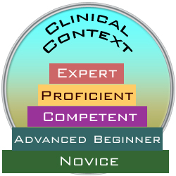
From Novice To Expert
Head of the AMICAE Project

Slide 6
Five Levels of Proficiency
Novice/beginner
Advanced beginner
Competent
Proficient
Expert

Slide 7
Differences Between the Levels
Clinical Scenario
How would a novice level nurse respond to the scenario?
How would an expert level nurse respond?

Slide 8
Practice Makes Perfect
Empirics
Ethics
Personal knowledge

Slide 9
What Does Benner’s Theory Mean to Nursing?
Novice to Advanced Beginner
  Start out as Novice, Graduate as Advance Beginner, back to Novice
Novice Nurse
  Focus on task at hand, lack critical thinking, prioritization, and determining interventions
Advanced Beginner Nurse
  Recognize recurring patterns of care, start making clinical judgment

Slide 10
Competent Nurse
  Organizes, plans, differentiates, and coordinates multiple tasks
Proficient Nurse
  See’s overall picture, speedy, flexible and understanding
Expert Nurse
  Quick to solve problems, intuition and critical thinking skills

Slide 11
Pattern recognition to advancement through stages
  Expert Nurses mentor other nurses
  Textbooks cannot teach mastery of skills, experience can
Transition Shock
  New Graduates “buddied” for 2 shifts, let go
  Mentoring builds knowledge and confidence
  Flexibility, efficacy, better patient care
Retirement
  Expert nurses leaving field
  Why does it matter to nursing?

Slide 12
What Does All This Mean To Nursing?
Lifelong Learning
  We never stop learning, and the more knowledge, and experience= better patient care
Importance of remembering where we started
  How difficult it was at first, how it felt
Implementing Mentoring
  Allows for sharing of knowledge, experience, and growth

Slide 13
Resources
http://currentnursing.com/nursing_theory/Patricia_Benner_From_Novice_to_Expert.html. From Novice to Expert. (september 2011)
Brown, C. & Dracup, K. (2004). From Novice to Expert to Mentor: Shaping The Future. AJCC Retrieved From: http://ajcc.aacnjournals.org/content/13/6/448.full
Hill,K. (2010). Improving Quality and Patient Safety by Retaining Nursing Expertise. OJIN Retrieved From: http://www.nursingworld.org/MainMenuCategories/ANAMarketplace/ANAPeriodicals/OJIN/TableofContents/Vol152010/No3-Sept-2010/Articles-Previously-Topic/Improving-Quality-and-Patient-Safety-.html
Duchscher,J. (2008). Transition Shock: The initial Stage of role adaptation for newly graduated Registered Nurses. JAN. Retrieved From: http://www.letthelearningbegin.com/documents/pdfs/shock.pdf

