Slide 2
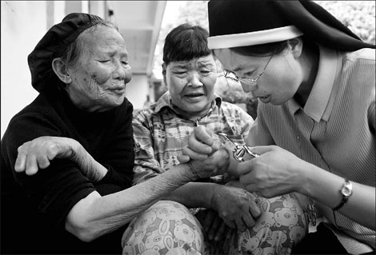
Who receives Palliative Care
Anyone affect physically or emotionally by a serious illness
Examples: Cancer, Heart disease, lung disease, RF, AIDS, Cystic fibrosis
Distress could be effect from treatments
Often pain and emotions are not under control
May need help understanding and coordinating
Leprosy Story
SOURCE:
United States Department of Health and Human Services. (2011). Palliative care: The relief you need when you’re experiencing the symptoms of a serious illness. Retrieved from
http://www.ninr.nih.gov/NR/rdonlyres/ 01CC45F1-048B468ABD9F3AB727A381D2/0/ NINR_PalliativeBrochure_Brochure_12_Layout_Version_508.pdf

Slide 3

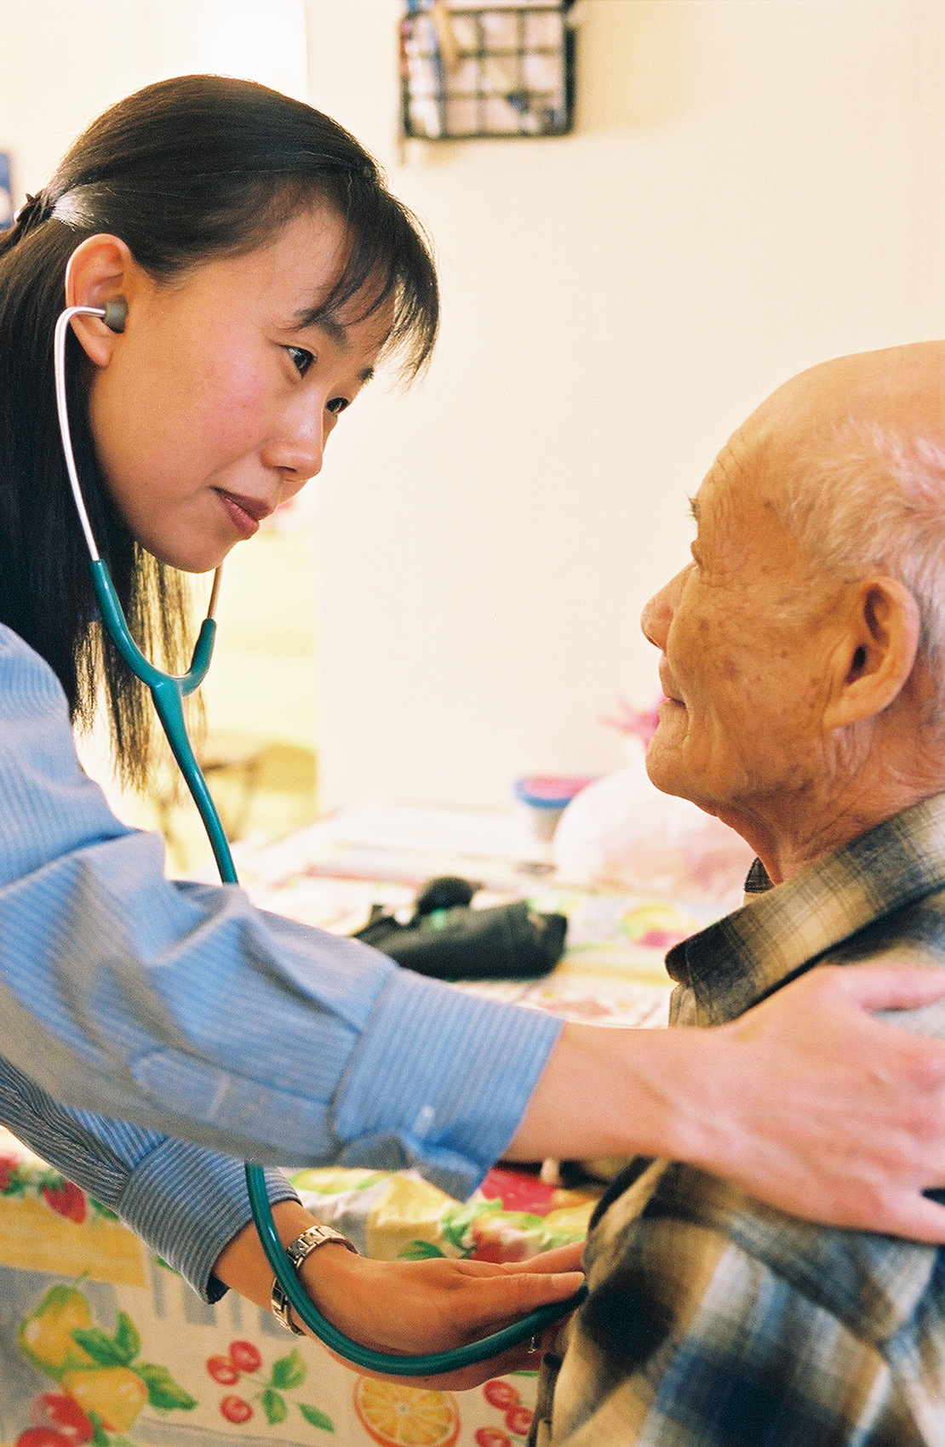

Palliative Care Team
A team approach
Doctors
Nurses
Social workers
Physical therapist
Nutritionist
Occupational therapist
Pharmacist
Counselors
Chaplains
Massage therapist
FAMILY!!!
Notes:
http://www.vnsny.org/system/assets/0000/2173/HospiceNurse1.original.jpg?1321477500

Slide 4
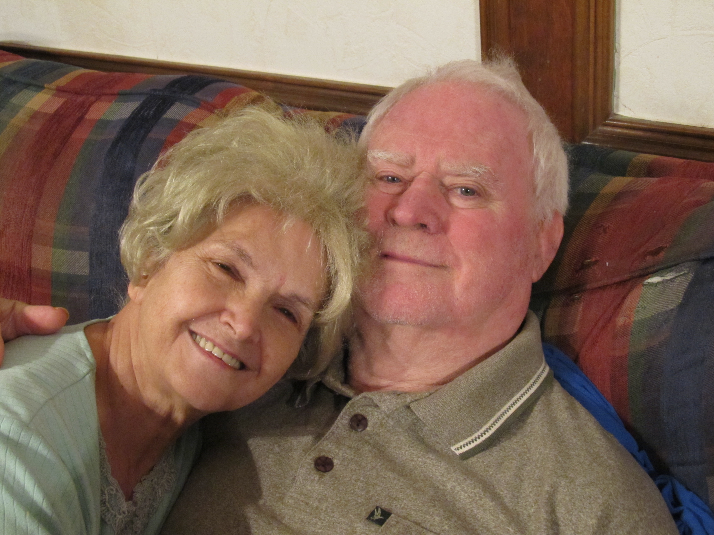
Palliative Care and Primary Care Givers
Provide most care in home
Need good communication: caregiver may know more
Can help with stress
Making decisions and goals
Benefits both parties
SOURCE
Wah, T. W., Doris, W. (2007). Care for the family in palliative care. HKSPM Newsletter, 1. Retrieved from http://www.fmshk.org/database/articles careforthefamilyinpalliativecaretsedmwhkspmnewsl.pdf
My Grandparents

Slide 5
SOURCES
Wah, T. W., Doris, W. (2007). Care for the family in palliative care. HKSPM Newsletter, 1. Retrieved from http://www.fmshk.org/databasearticlescareforthefamilyinpalliativecaretsedmwhkspmnewsl.pdf
United States Department of Health and Human Services. (2011). Palliative care:
The relief you need when you’re experiencing the symptoms of a serious
illness. Retrieved from http://www.ninr.nih.gov/NR/rdonlyres/01CC45F1-
048B468ABD9F3AB727A381D2/0/NINR_PalliativeBrochure_Brochure_12_Layout_Version_508.pdf

