Slide 1
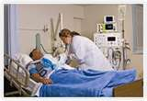

Palliative Care ICU
Palliative Care
RN306
Sheila Roth, RN
hartonmedicalcenter.com

Slide 2
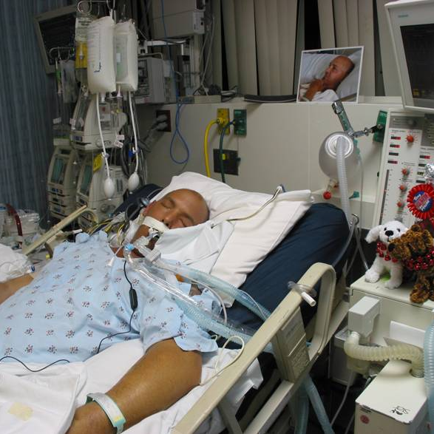
Goal of Intensive care medicine
Primary goal:
* To try to save a life
* Support and normalize the physiology of an acutely ill person
(Hawyrluck, 2007)
publicati...s.nih.gov/findingsmar07/otto_files/textmostly/slide9.html

Slide 3
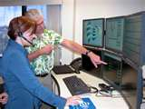
Remember… in the icu…
Care includes the patient and the family.
Promptly instruct patient and family:
  Several teams of healthcare professionals will be involved.
  Many teams may make communication challenging.
  Information may be described in different ways.
  Be sure to ask questions for clarity. (Hawyrluck, 2007)
bannerhealth.com

Slide 4
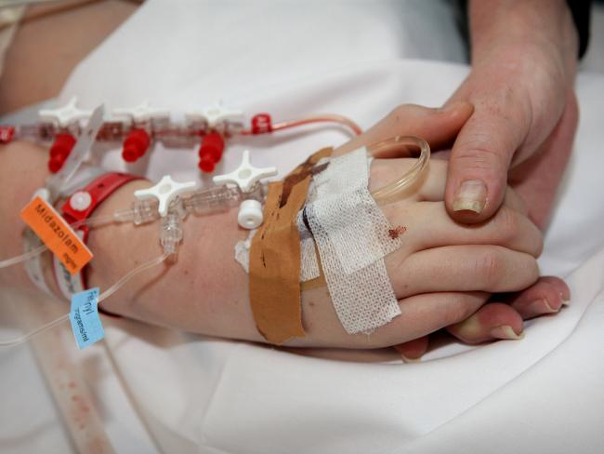
Remember…in the icu…(cont’d)
Families and patients should be informed:
  Course of illness will not be predictable.
  Focus on hope and survival
  Constant / consistent battle between life and death
  Tell the truth and reality of situation (Hawyrluck, 2007)
www.heraldsun.com.au/newsgallery-e...69?page=1

Slide 5
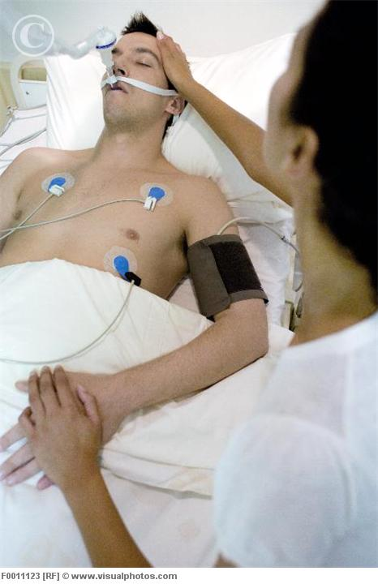
Nurses role
Nurses have obligation to:
  Demonstrate compassion while communicating
  Acknowledge patients life before illness/accident
  Talk honestly about severity of situation
  Explain emotions normal for patient / family
  Allow families time/understanding with decisions
  Allow patient to participate in decision making (Hawyrluck, 2007)
visualphotos.com

Slide 6

Nurses Role (cont’d)
Explain to the patient and family:
  Explain illness that brought patient to ICU
  Explain treatment and response to that point
  What life-sustaining interventions are available
  What interventions involve/ positive/negative outcomes
  Present and future goals of therapy (Hawyrluck, 2007)

Slide 7

Nurses role (cont’d)
Explain to the patient and family:
  Any alternatives with treatment therapy
  Likelihood of success
  Reasoning behind recommendations for future course treatment
  Include discussion withholding/withdrawing life-sustaining treatments (Hawyrluck, 2007)

Slide 8

Nurses role (cont’d)
Discuss goals both long and short term
Discuss decisions made affecting quality of life
Use goals to present options to patient and family
Explain treatments, risks/benefits clearly
Evaluate understanding of decisions made
Share families thoughts, plans, emotions / medical team
Continually assess symptoms and address quickly (Hawyrluck, 2007)

Slide 9

Family and surrogate decision makers
Anxiety and depression among family high
Distress affects decision makers ability to decide
Surrogates decision often made after family talk
Families require increased amounts of information
Families need main physician to guide decision
Bond established between main physician/family comfort
No bonding between MD/family → lack of caring (Hawyrluck, 2007)

Slide 10

Family and surrogate decision makers (cont’d)
Conflicts withhold/withdraw life-support common
Conflicts occur between family and medical team
Misunderstanding, forgetting, mix ups information→ explanations needed
Need reassurance pain and distressing symptoms alleviated
Facilitate communication among family members
Alleviate burden of decision making
Place decision making into group (Hawyrluck, 2007)

Slide 11

Caring for the family while letting the patient go
Withdrawing life-sustaining treatment…family
  Explain what is happening as it happens
  Explain how life-sustaining intervention will stop
  Explain other distress symptoms will be alleviated
  Family can help/ being with is necessary (Hawryluck, 2007)

Slide 12
healthcare team responsibilities during Withdrawal of support
Explain changes family will see in loved one
Reassure signs of discomfort will be alleviated
Changes are normal part of dying process
Reassure ICU team’s presence throughout dying process
Encourage questions and expression of fears
Provide emotional, psychological, spiritual support
Support family after death/ funeral arrangements (Hawyrluck, 2007)

Slide 13

Taking Care of you
To care for patients/care for self
Energy and compassion will ebb and flow
Step back and take breather
  Meditate
  Relax
  See spiritual council
  Journal
  Exercise (Norlander, 2008)

Slide 14
Taking care of you (cont’d)
Remember the good with each patient.
Give credit to self
Allow self to move on
Learn from the past
Lessons learned use for future patients
Laughter and joy effective medicine
Those dying are also living…laugh together (Norlander, 2008)

Slide 15
References
Hawryluck, L. (2007). Palliative care in the intensive care unit. In Palliative care: Core skills and clinical competencies (pp. 441- 457). Philadelphia, PA: Saunders Elsevier.
Yahoo (2011). Intensive Care Unit. Retrieved April 17, 2011, from http://images.search.yahoo/com/search/images
Norlander, L. (2008). To comfort always: A nurses guide to end-of- life care. Indianapolis, IN: Sigma Theta Tau International.

