Slide 1
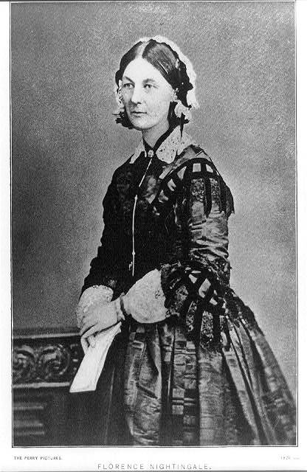
Origin of Evidence Based Practice Nursing
Florence Nightingale: Establishing the Cornerstone of Nursing
Lakeview College of Nursing
Arranged by:
Northen, Alicia
McMillan, Tenika
Roth, Sheila
Turner, Lori

Slide 2
Florence Nightingale
She was born May 12, 1820 in Florence, Italy to a family of wealthy means.
She had privileges afforded to her because of her background and family social status. She was highly intelligent and was tutored by her father on many subjects.
A woman of Nightingale’s social status was expected to marry and be an obedient wife. She refused to fit into that mold.

Slide 3
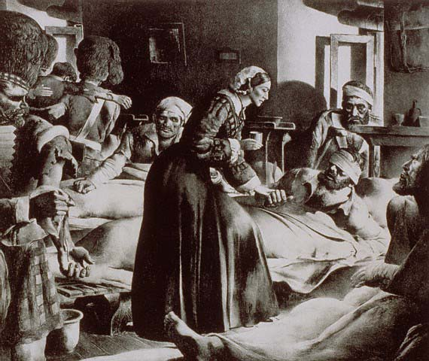
Florence Nightingale’s Origin of Nursing
Ms. Nightingale decided to become a
nurse at the age of 25. (Whyte, 2010, p18-22)
She attended the Institution of Kaiserwerth in
Germany. She spent 3 months observing the
deaconesses and was quite impressed with their
work efforts. (Fealy, 2010, p22)
From Keiserworth Germany she worked
as the head of the, “ Care of Sick Gentlewoman.”
(Macqueen, 2007)
She travelled to Turkey to work on the
Crimean War front in 1854 at the request of the
war minister, Sidney Herbert.

Slide 4
Florence Nightingale Origin of Nursing (con’t)
During the Crimean War, Nightingale found the hospital conditions to be dreadful. The hospital was overcrowded and filthy.
Nightingale was enlisted to develop better medical care for the wounded soldiers. Taking a group of 38 nurses, she set out to better the conditions.
Nightingale applied her philosophy of, ”…healing, not just caring for the sick, and this reflected a change in nursing practice which persists today.” (Payne, 2010, p8)

Slide 5
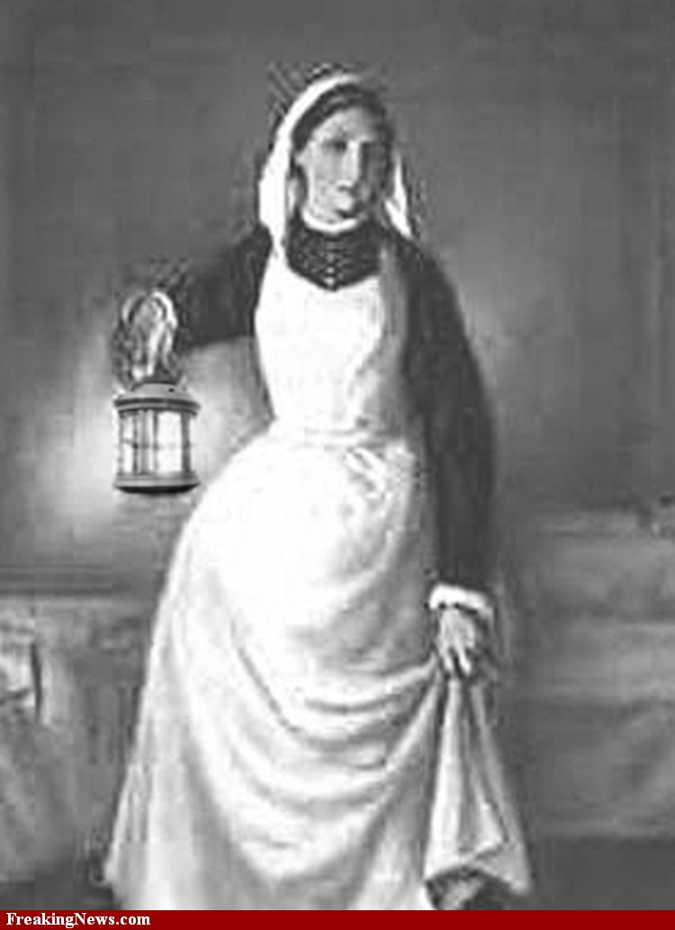
Ms. Nightingale’s philosophy:
Environment was essential in the recovery of her patients.
Environmental basics included clean air, clean water, clean linens, clean bodies, and sunlight.
She proposed separate institutions for the sick, the insane, the incurable, and children.
She was known for making rounds on the soldiers at night. She used a lantern when she made rounds thus being dubbed, “Lady of the Lamp.” (Payne, 2010, p8)

Slide 6
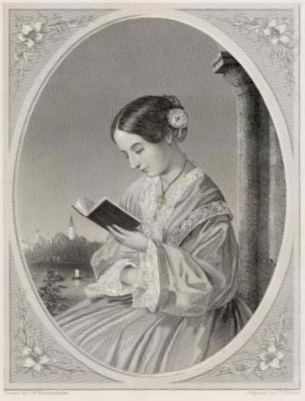
The Origin of Nightingale’s Principles
In the hospital, during the Crimean War, the death rate was first noted as being 33%. After Nightingale’s philosophy and principles were applied to the care of the soldiers; the death rate was decreased to 2%. (Gill & Gill, 2005, p1799-1805)
She instituted the hand washing rule for all nurses and physicians. She found this to promote infection control.
She recorded her observations of progresses and failures of patients. This process created statistical information which served as Evidence Based Practice.

Slide 7
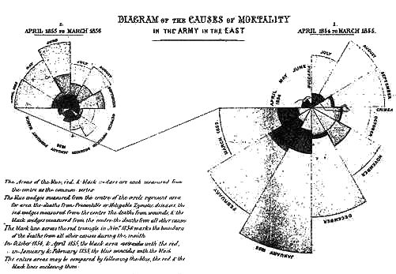
Evidence Based Practice
Through nightly observation, of the sickest soldiers, Nightingale recorded the progresses and failures of the nursing processes used. These outcomes became known as statistics.
Through research, education and positive outcomes, Ms. Nightingale established the groundwork for Evidence Based Practice.
According to Ms. Nightingale, “What you want are facts, not opinions…” (Monro, 2010, p 315-317)
She demanded excellence
and respect for and from
her nurses. She did not
settle for mediocrity.

Slide 8
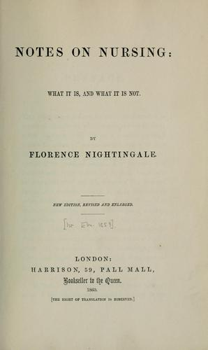
Nightingale the Teacher
Ms. Nightingale founded a training school for nurses at St. Thomas Hospital, where she attracted well-educated, dedicated women. (thefreedictionary.com)
She believed textbooks were inappropriate
for teaching the “handicraft” of nursing.
According to A. Attewell, Nightingale stated
that, "practitioners made the best teachers.”
(Attewell, 1998)
Ms. Nightingale also believed that once
a nurse had “learned to learn”, the process
should be continued beyond the formal
training. (Attewell, 1998)

Slide 9
Implementation of Nightingale’s Foundations in Modern Nursing
Today in healthcare facilities, patient outcomes are continually monitored.
Medical facilities are monitored by government agencies.
Nightingale’s principles are demonstrated today through the processes of hygiene, infection control, healing environment, and Evidence Based Practice monitoring.

Slide 10
Conclusion
Nightingale’s standards of education were pivotal in establishing the importance of education and continuing education today.
Through Nightingale’s collection of data, she learned valuable information in the prevention of infection through hand hygiene as well as the cleanliness of a patient’s environment.
Today’s nurses continue to expand upon the evidence based approach Nightingale provided through studies using statistics to prove theories of best nursing practices.
Florence Nightingale’s philosophy of Evidence Based Practice has changed the face of how society views nursing. It is now a highly respected profession.

Slide 11
References
Attewell, A. (1998). Florence nightingale. UNESCO, 28 (1),
http://www.ibe.unesco.org/publications/ThinkersPdf/nigthingalee.PDF .
Fealy, G.M. (2010). Lady with the lamp. World of Irish Nursing & Midwifery, 18(5), 22-23. Retrieved
by: CINAHL database.
Florence nightingale. (n.d.)
http://ww.solarnavigator.net/history/florence_nightingale.htm .
The free dictionary. (2010, September 14)
http://www.thefreedictionary.com/florence+nightingale .
Gill, C. J., Gill, G. C. (2005), Nightingale in Scutari: Her Legacy Reexamined., Infectious Disease Society
of America, 40(12), 1799-1805.
MacQueen, J.S., (2007), Florence Nightingale’s Nursing Practice., Nursing History Review, 1, 29-49.
Munro, D.L., (2010), “Lady With the Lamp” Illuminate Critical Care Today. American Journal of Critical
Care, 19(4), 315-317.
Payne, K. (2010). Science, healing, and courage: the Legacy of Florence Nightingale. Tennessee Nurse, 73(2), 8.
Retrieved by: http://www.tnaonline.org/tn-nurse-archive-articles.html .
Whyte, A., (2010), Relighting the Lamp. Nursing Standard, 24(18), 18-20.

