Slide 1
Dorothea Orem
By: Anna Barrera, Lisa Fresso, Peter Mbinglo, Chanelle Carley, Omololu Kafisanwo, Jamie Lowe
Notes:
Introduction
What we here to talk about today is Dorothea Orem theories. Although she has couple of theories out there we will be focusing on the Self-care Deficit Theory. But before we go into that, what is a nursing theory? A nursing theory is a combine knowledge that guides nursing practices (Kalisch, P. & Kalisch, B., 1986, pp. 180-183). First, we will talk about Dorothea Orem’s biography and achievements, then we will talk about how the theory came to be, the general theory of nursing, how the theory focused on the basic concepts of nursing; person, environment and health, and lastly how to promote and maintain self care.
Kalisch, P. & Kalisch, B. (1987). The changing image of the nurse (pp. 183-195). Menlo Park,
CA: Addison Wesley Publishing Company

Slide 2
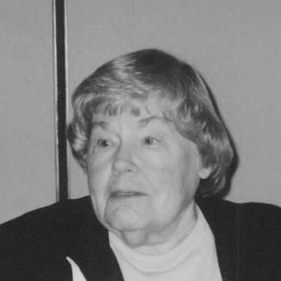
Born in Baltimore Maryland in 1914
Began nursing career at Providence Hospital Nursing in Washington D.C.
Received diploma of nursing in the early 1930s.
Received Bachelor of Science in Nursing Education and Master of Science in Nursing from The Catholic University of America (CUA) in 1939 and 1946, respectively.
http://studentnurselaura.wordpress.com/2009/09/21/662/
Notes:
Biographical information is from the following books:
Tomey, A., & Alligood, M. R. (2006). Dorothea E. Orem.Nursing theorists and their work (6th ed., pp. 267-287). St. Louis, MO: Mosby/Elsevier.
Fawcett, J. (2005). Orem's Self-Care Framework.Contemporary nursing knowledge: analysis and evaluation of nursing models and theories (2nd ed., pp. 223-294). Philadelphia, PA: F.A. Davis Co.

Slide 3
Achievements
1971-published the first edition of her book Nursing: Concepts of Practice
1980, 1985, and 1991, were the publications of the 2nd, 3rd, and 4th editions of her work.
Orem developed her definition of nursing practice in 1956
Held directorship of both the nursing school and department of nursing at Providence Hospital, Detroit from 1940 to 1949
Georgetown offered her honorary degree of Doctor of Science in 1976
Passed away on June 22,2007 shortly before 93rd birthday.
Her theory lives on to this day and it continues to be used in many nursing practices today.
Notes:
Basavanthappa, B. T. (2007). Orem's Self-care Theory. Nursing theories. New Delhi: Jaypee Brothers
Further developed her nursing concepts of self-care in her 1971 published “Nursing: Concepts of Practice”
The 2nd, 3rd, 4th editions of the work were published in 1980, 1985, 1991.
1st edition-focused on the individual.
2nd edition: was expanded to include multi person units (families, groups, and communities.)
3rd edition: presented Orem’s General Theory of Nursing as it’s constituted from the three related theoretical constructs: Self-care, deficit and nursing systems.
4th edition: her writing incorporates a greater emphasis on the child, groups, and society.
Honors and definition of nursing from the following books:
Tomey, A., & Alligood, M. R. (2006). Dorothea E. Orem.Nursing theorists and their work (6th ed., pp. 267-287). St. Louis, MO: Mosby/Elsevier.
Fawcett, J. (2005). Orem's Self-Care Framework.Contemporary nursing knowledge: analysis and evaluation of nursing models and theories (2nd ed., pp. 223-294). Philadelphia, PA: F.A. Davis Co.

Slide 4
Achievements
Received Doctor of Humane Letters from Illinois Wesleyan University in Bloomington, Illinois in 1988.
Catholic University of America Alumni Achievement Award for Nursing Theory (1980)
Completed the 6th edition of Nursing: Concepts of Practice that was published in Mosby (January 2001)
Notes:
Honors and last book completed of the 6th edition of Nursing: Concepts of Practice was just a development of the nursing theory and the relevance to nursing practice. (Basavanthappa, B. T. (2007). Orem's Self-care Theory. Nursing theories. New Delhi: Jaypee Brothers)

Slide 5
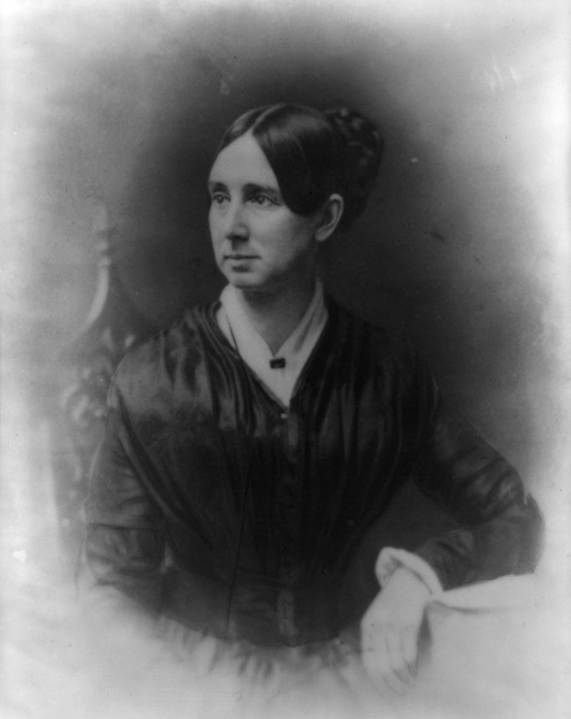
How the theory came to be
1949-1957: Nursing consultant at Division of Hospital and Institutional Services of Indiana State Board of Health
Goal: Upgrade the quality of nursing in general hospitals throughout the state
“Nursing involved both a mode of thinking and mode of communication” (Fawcett,2001,p.34).
newagedentists.com
Notes:
-Dorothea Orem had an extensive background in the profession of nursing and had many active years experience in different fields.
-Between the years 1949-1958 Dorothea worked as a nursing consultant at Division of Hospital and Institutional Services of Indiana State Board of Health. During this time she began to develop her own definition of nursing.
-She also developed a goal to upgrade the quality of nursing in general hospitals throughout the state, which became a beginning point for her theory.

Slide 6
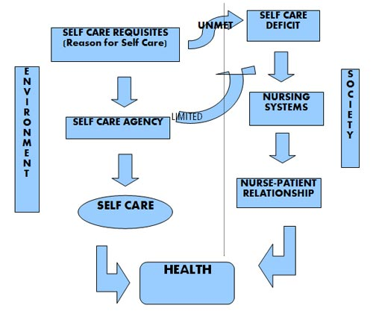
How the theory came to be
upoun207tfn.blogspot.com
Notes:
During the beggining stages of her theory she strove to find ways to try and solve current nursing issues.
-Some important questions she wanted answers to were, "What do nurses do and what should nurses do as practitioners of nursing," "Why do nurses do what they do?," and "What results from what nurses do as practitioners of nursing?"
-These questions created a basis for the development of her theory

Slide 7
Orem’s definition of Nursing
Nursing is the provision of self-care, which is therapeutic in sustaining life and health, in recovering from disease or injury, or coping with their effects.
Nursing is a service to people, not a derivative of medicine.
Nursing promotes the goal of patient self-care.
Notes:
Tomey, A., & Alligood, M. R. (2006). Dorothea E. Orem.Nursing theorists and their work (6th ed., pp. 267-287). St. Louis, MO: Mosby/Elsevier. Fawcett, J. (2005).
Orem's Self-Care Framework.Contemporary nursing knowledge: analysis and evaluation of nursing models and theories (2nd ed., pp. 223-294). Philadelphia, PA: F.A. Davis Co.

Slide 8
General theory of nursing
Comprised of three concepts:
1. Self-care :activities that the person can accomplish without assistance.
2. self- care deficit: ability does not allow for care to be completed independently.
3. nursing systems: assistance provided by nursing entity to accomplish self-care needs.
Notes:
Comprised of three concepts:
Self-care :activities that the person can accomplish without assistance.
Activities that the person can accomplish on their own without the assistance of others.
self- care deficit: ability does not allow for care to be completed independently.
When the need of the person does not meet the activities that the person requires to strive.
nursing systems: assistance provided by nursing entity to accomplish self-care needs.
The assistance that others provide to the person when the person is unable to care for themselves, i.e. a nurse.
Kozier, B., Erb,G.,& Blais, K. (1997). Professional nursing practice: Concepts and perspectives. Menlo Park, CA: Addison Wesley Longman

Slide 9
General theory of nursing
Self-Care
1.self- care- activities
2.self-care agency- person’s ability
self-care agent
dependent care agent
3.self-care requisites- needs
Universal requisites
Developmental requisites
Health deviation requisites
4.therapeutic self-care demand- steps needed to ensure adequate health.
Notes:
Self-Care
1.self- care- activities
2.self-care agency- person’s ability
self-care agent
dependent care agent
3.self-care requisites- needs
Universal requisites
Developmental requisites
Health deviation requisites
4.therapeutic self-care demand- steps needed to ensure adequate health.
Self-care are defined as activities that the person accomplish themselves.
The self-care agency is defined as the ability of the person. It can be divided into two entities. One is the self-care agent meaning the person themselves completing the activity that needs to be done. The second is the dependent care agent. An individual that provides assistance in the event that the person cannot complete the self-care that they required.
Self care requisites can be defined as needs. There a three different area of needs: Universal, developmental and health deviation. Universal needs are those needs that all individuals require. Those needs that are purported by Maslow’s Hierarchy of Needs. We all have the need for hygiene, food and shelter.
Developmental needs are those that are required for the development of the human at the stages of their life. Health deviation requisites can be referred to as the needs that the person has in the event that they encounter an illness that alter their health state and requires additional assistance.
Therapeutic self demand are the steps that the person takes to help ensure that they achieve adequate or quality health.
Kozier, B., Erb,G.,& Blais, K. (1997). Professional nursing practice: Concepts and perspectives. Menlo Park, CA: Addison Wesley Longman
Arnold, E. & Boggs, K. (2011).Interpersonal relationships: professional communication skills for nurses. St. Louis, MS: Elsevier Saunders.

Slide 10
General theory of nursing
Self-Care Deficit = need > ability
Affecting variables
Self-care agency
Therapeutic demands
5 Nursing Assisted Methods
Acting/doing for
Guiding
Teaching
Supporting
Enabling environment
Nursing system enacts nurses to:
Prescribe
Design
Provide
Three types of nursing systems
Wholly compensatory
Partly compensatory
Supportive- educative (developmental)
Notes:
Self-Care Deficit = need > ability
Affecting variables
Self-care agency
Therapeutic demands
5 Nursing Assisted Methods
Acting/doing for
Guiding
Teaching
Supporting
Enabling environment
Nursing system enacts nurses to:
Prescribe
Design
Provide
Three types of nursing systems
Wholly compensatory
Partly compensatory
Supportive- educative (developmental)
Self-care deficit is when the need exceeds the person’s ability. There are two variable that affect the self-care deficit: the self-care agency and therapeutic demands. Self-care agency is the person while therapeutic demands are the demands that the assisting person must or tries to provide to the person.
There are 5 ways that nurses can help the patient: acting/doing for, guiding, teaching, supporting and enabling environment. The assisting person can do the task for the person, guide them in the task. Teach the person the activity or need or support them and creating a therapeutic environment.
The nurse helps the patient also by prescribing through a possible nursing diagnosis. Design a care plan and provide help. There are three types of nursing systems: 1) wholly compensatory meaning that the person needs full assistance, 2) there is a sharing of the task between the patient and the person providing assistance, 3) supportive-educative means that the person is can complete or achieve the activity with the support of the assisting person.
Kozier, B., Erb,G.,& Blais, K. (1997). Professional nursing practice: Concepts and perspectives. Menlo Park, CA: Addison Wesley Longman

Slide 11
Orem's theory focused on person, health environment, & Nursing
Person:
Seen as an open system that is active
Masters his/her destinies
Health:
Absent of signs and symptoms of disease
Functional health – self care deficiency
Notes:
Person:
-Seen as an open system that is active.
Person receives, stores and exchange information. To Orem, a person is a whole unit that if functioning biologically and socially in unison. Orem viewed a person as having capacity for self knowledge and thus: (Hanucharunkul, 1989. pp. 366-367)
-Master of his/her destiny
A person has strength can made him/her a self care agent. Hence promote or initiate activities geared towards well being. (Hanucharunkul, 1989. pp. 367)
Health:
-Orem (1985). Defines health as “ a state of wholesome or integrity of human being” (Hanucharunkul, 1989. p. 367). That means functionally and structurally sound. This implies the absence of sign and symptoms of disease which is similar to medical diagnosis. She considers health functional and relates it to the physiological, psychological, interpersonal, and social aspect. (Hanucharunkul, 1989. pp. 367-368)
Health makes us human, thus as society in general and as nurses in particular, it is our responsibility to reduce self-care deficit by promoting self care at therapeutic level on a continuous bases to guarantee good health for all while taking the environment into consideration. (Hanucharunkul, 1989. pp. 367-368)
Reference:
Hanucharurnkul, S. (1989). Comparative analysis of Orem's and King's theories. Journal of Advanced Nursing, 14(5), 365-372. Retrieved from http://search.ebscohost.com/login.aspx?direct=true&db=rzh&AN=1989094611&site=ehost-live&scope=site

Slide 12
Orems theory focus
Environment:
Physical and psychosocial
Nurse – patient interaction
Nursing:
Provide services to its society
Focus is individual self care
Notes:
Environment
Chitty and Black (2011) – Environment is supra-system (p. 273).
-Physical and psychosocial
Motivate a person to attain set goals. It can equally force a change in behavior through adapting it or living a healthy lifestyle. It provides the medium for patient and nurse relationship formation. (Hanucharunkul, 1989. p. 368)
-Nurse patient interaction
The nurse encourages patients to set goals that are feasible and achieve them. The nurse helps in the development of person and thus builds a better nurse client relationship.
Nursing:
-provide care for its society
Double in action and assistance. Provide assistance with patients’ needs and goals. Promote patients as self care agent, formulate teaching for patients. (Hanucharunkul, 1989. p. 369)
-Focus is on individual care
Interventions are tailored to individual especially with self care deficits. With long term goals of promoting the patient’s individual self care. (Hanucharunkul, 1989. p. 369)
Reference
Chitty, K. K, & Black, P. B. (2011). Professional nursing concepts & challenges (6th Ed). Maryland Heights, MI: Saunders Elsevier.
Hanucharurnkul, S. (1989). Comparative analysis of Orem's and King's theories. Journal of Advanced Nursing, 14(5), 365-372. Retrieved from http://search.ebscohost.com/login.aspx?direct=true&db=rzh&AN=1989094611&site=ehost-live&scope=site

Slide 13
Nursing process for self care deficit
Step 1: Determine why a patient needs care (Assessment)
Step 2: Design a nursing system & plan the delivery of care (Planning and Interventions)
Step 3: Management of nursing systems (Initiating, and Controlling nursing actions)
Notes:
Nursing process for self care deficit
There are 3 steps in a nursing process for self-care deficit. Step 1 is determining what the patient need. This is the stage of assessment when you gather all information needed to plan a patient care. Information obtained can be subjective; what the patient or the patient’s family friends or relatives tells you. It can also be objective; what you feel, observe or measure. (Kalisch, P. & Kalisch, B, 1986, pp. 180-183). Step 2 is when you design a nursing system and plan the delivery of care. Designing a plan of care is putting into consideration all the information gathered and coming up with an effective care for the patient. Without a detailed plan of care, planning will be difficult and interventions may not be effective to achieve nursing goal. Step 3 is when you try to find out if your interventions are effective. This is when you evaluate the patient and determine if there is progress in the patient’s situation and if not, how you would change, increase or decrease your interventions. (pp. 183-185).
Kalisch, P. & Kalisch, B. (1987). The changing image of the nurse (p. 183-195). Menlo Park,
CA: Addison Wesley Publishing Company

Slide 14
Nursing process to maintain self care
To maintain a level of optimal health and wellness
Advocate
Redirect
Support Patient and overall
provide an environment conducive to therapeutic development.
Notes:
Nursing Process to maintain Self-care
Orem’s believes nurses should help in promoting and maintaining an optimal health care. And to achieve this, nurses need to advocate for patient and this can include referring the patient for further care after discharge. Redirecting is keeping in mind the patient’s personal beliefs or culture to modify the plan for long term goal so it can be acceptable and effective. (Kalisch, P. & Kalisch, B, 1986, pp. 186-190). Support patient by encouraging follow ups and educating and overall provide an environment conducive for therapeutic development by practicing safety techniques like hand washing to prevent infections
Kalisch, P. & Kalisch, B. (1987). The changing image of the nurse (pp. 183-195). Menlo Park,
CA: Addison Wesley Publishing Company

Slide 15
Summary
Orem’s practice of nursing
Orem’s Theories
Orem’s Contributions
How do we use Orem’s work today?
Notes:
Orem’s practice of nursing
-Orem had her BSN and MSN from the Catholic University of America
-She received many different awards and achievements
Orem’s Theories
-To improve nursing care Orem came up with the self-deficit theory
-This theory was designed to fulfill Orem’s definition as a whole
Orem’s Contributions’
-The theory is compromised of 3 concepts: 1)self-care 2) self-care deficit and 3)nursing systems, which then break down into subcategories
How do we use Orem’s work today?
-We use Orem’s theory today to decide how self-sufficient a patient may be, and then create a plan tailored to the individual patient’s needs/

Slide 16
References
Tomey, A., & Alligood, M. R. (2006). Dorothea E. Orem.Nursing theorists and their work (6th ed., pp. 267-287). St. Louis, MO: Mosby/Elsevier.
Fawcett, J. (2005). Orem's Self-Care Framework.Contemporary nursing knowledge: analysis and evaluation of nursing models and theories (2nd ed., pp. 223-294). Philadelphia, PA: F.A. Davis Co.
Kalisch, P. A. & Kalisch, B.J. (1987). The Changing Image of the Nurse. Menlo Park, CA: Addison-Wesley Publishing Company.
Kozier, B., Erb,G.,& Blais, K. (1997). Professional nursing practice: Concepts and perspectives. Menlo Park, CA: Addison Wesley Longman
Simmons, S. (1990). The Health-Promoting Self-Care System Model: directions for nursing research and practice. Journal of Advanced Nursing, 15(10), 1162-1166. Retrieved from EBSCOhost. http://search.ebscohost.com/login.aspx?direct=true&db=rzh&AN=1991122724&site=ehost-live&scope=site
Hanucharurnkul, S. (1989). Comparative analysis of Orem's and King's theories. Journal of Advanced Nursing, 14(5), 365-372. Retrieved from http://search.ebscohost.com/login.aspx?direct=true&db=rzh&AN=1989094611&site=ehost-live&scope=site
Fawcett, J. (2001). The nurse theorists: 21st century updates-Dorothea E. Orem (Nurs Sci Q 2001 14:34) Retrieved from Nursing Science Quarterly website: http://nsq.sagepub.com/content/14/1/34

