Slide 1
Placental Abruption
Jessica Key & Stephanie Gonzalez

Slide 2
Introduction
Placental Abruption is the premature separation of the placenta from the uterus during pregnancy (Leone et al., 2010).
Abruption is the most common cause of serious vaginal bleeding, occurring in 1 percent of pregnancies (Sakornbut, Leeman, & Fontaine, 2007).
It is a great contributor to fetal mortality and accounts for 15% of all perinatal deaths. Maternal mortality in the United States is uncommon, but morbidity is common (Davidson, London, & Ladewig, 2012).
Perinatal mortality associated with placental abruption is approximately 25% (Davidson, London, Ladewig, 2012).
Severe cases in which separation occurs to about 50% of placenta, infant mortality is 100% (Davidson, London, Ladewig, 2012).

Slide 3
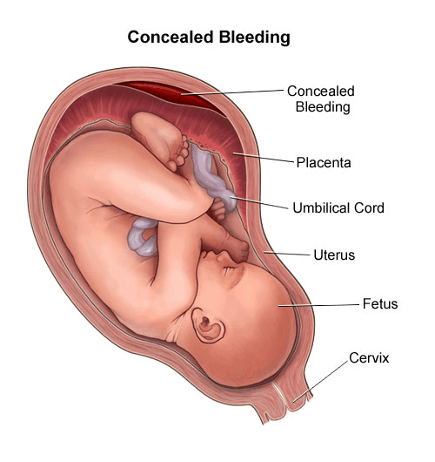
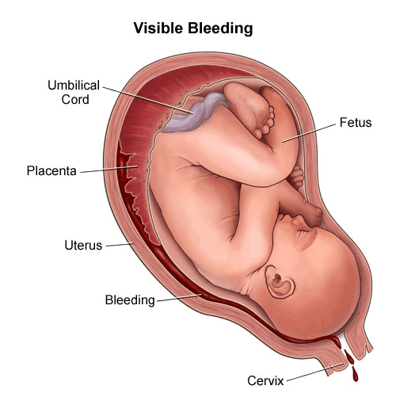
Concealed Bleeding and Visible Bleeding
(Bleeding in Pregnancy, 2013)

Slide 4
Grades of Placental Abruption
Grade 1 - small amount of vaginal bleeding, uterine contractions, no signs of fetal distress or low blood pressure in mother.
Grade 2 - mild to moderate amount of bleeding, uterine contractions, the fetal heart rate may shows signs of distress.
Grade 3 - moderate to severe bleeding or concealed bleeding, uterine contractions that do not relax (tetany), abdominal pain, low blood pressure, fetal death.

Slide 5
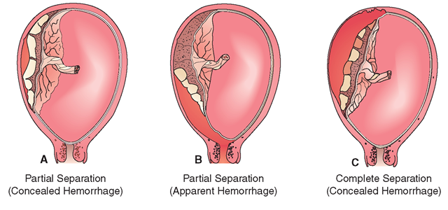
Different Levels of Separation
(High-risk pregnancy, 2013)

Slide 6
Etiology
To date, very little is known about the etiology of placental abruption (Leone et al., 2010).
Theories have been suggested relating its occurrence to decreased blood flow to the placenta during the last trimester (Davidson, Ladewig, & London, 2012).
Heritability is thought to be a factor for severe placental abruption. In a Norwegian population-study, the estimated heritability of severe abruptio placentae was 16%. The study found a two-fold recurrence risk for placental abruption among sisters (Rasmussen & Irgens, 2009).
Pregnancy trauma can cause placental abruption. A large study in the state of California showed that women who reported Intimate Partner Violence (IPV) during pregnancy were 5 times more likely to experience abruption. Other risks aside from trauma from IPV that increase the chance of abruption include drugs, stress, and hypertension. (Leone et al., 2010).
Placental abruption typically manifests as vaginal bleeding, uterine tenderness or back pain, and evidence of fetal distress (Sakornbut, Leeman, & Fontaine, 2007).

Slide 7
Risk Factors
Preeclampsia
Hypertension
Advanced maternal age
Smoking
Cocaine, or methamphetamine use
Trauma
Fibroids
Premature Rupture of Membranes (PROM)
Previous abruption
Select thrombophilias
Prior recurrent fetal loss
Short umbilical cord
Multiparity
Over-distension of the uterus
Fetal growth restriction
Multiple gestation
Caucasian or African American ethnicity

Slide 8
Treatment
Tocolysis may be used with corticosteroids in mild abruption before 34 weeks but otherwise, it is contraindicated (Sakornbut, Leeman, & Fontaine, 2007).
One trial demonstrated a reduction in the incidence of abruption with intrapartum treatment of preeclampsia using magnesium sulfate (Sakornbut, Leeman, & Fontaine, 2007).
Managing an abruption may require rapid cesarean delivery to prevent morbidity and mortality (Sakornbut, Leeman, & Fontaine, 2007).
The incidence of placental abruption may be decreased by cessation of tobacco, cocaine, or amphetamine use, and appropriate care for hypertensive disorders in pregnancy (Sakornbut, Leeman, & Fontaine, 2007).

Slide 9
Treatment for Moderate to Severe Abruption
Maintain the mother’s cardiovascular status and developing a plan for the birth of the fetus
Assess coagulation tests to monitor for disseminated intravascular coagulation (DIC)
Treat hypofibrinogenemia from DIC with intravenous infusion of cryoprecipitate or fresh frozen plasma
Emergency Cesarean birth if fetus is alive but experiencing distress. Vaginal birth may not be possible if Couvelaire uterus occurs. Emergency Cesarean also indicated to allow an immediate hysterectomy for severe hemorrhaging
Vaginal birth with a stillborn fetus is preferred unless hemorrhagic shock is uncontrollable
Combat hypovolemia with whole blood

Slide 10
Treatment for Moderate to Severe Abruption
IV lactated Ringer’s solution or a balanced salt solution is given through 16 or 18 gage cannula
Monitor central venous pressure (CVP) to evaluate IV fluid replacement
Start two venous lines if there is any evidence of hypovolemia
Monitor urine output, if it is below 30ml per hour treat with adequate fluid replacement
Keep hematocrit at 30% by administering packed red blood cells, whole blood, or both.

Slide 11
Consequences of Complication
Disseminated intravascular coagulation can result from the release of thromboplastin into the mother’s blood circulation when the placenta separates (Sakornbut, Leeman, & Fontaine, 2007).
Placental Abruption is a major contributor to fetal and maternal mortality (Leone et al., 2010).
The high fetal mortality is usually caused by preterm delivery. Maternal outcomes caused by placental abruption include major blood loss, disseminated intravascular coagulopathy, and renal failure (Leone et al., 2010).
Placental abruption accounts for 20–25% of antepartum hemorrhages (Prochazka et al., 2007).

Slide 12
Nursing Diagnoses
The #1 nursing diagnoses that would be assigned to this patient would be Risk for Deficient Fluid Volume related to hypovolemia secondary to excessive blood loss.
The #2 nursing diagnoses that would be assigned to this patient would be Ineffective Peripheral Tissue Perfusion related to blood loss secondary to uterine atony following birth.

Slide 13
Nursing Interventions for Risk for Deficient Fluid Volume
Weigh pads and chux, this will help determine the woman's amount of blood loss.
Monitor urinary output hourly and measure urine specific gravity, to assess for dehydration.
Assess mental status of patient, to ensure there is no excessive blood loss causing confusion.
Palpate bilateral peripheral pulses, skin color and temperature to help determine signs of hypovolemic shock.
(Davidson, Ladewig, & London, 2012)

Slide 14
Nursing Interventions for Ineffective Peripheral tissue Perfusion
Assess maternal vital signs to determine if an episode of bleeding has occurred.
Monitor fetal heart tones to detect signs of fetal hypoxia.
Assess fundal height to determine an approximate gestational age.
(Davidson, Ladewig, & London, 2012)

Slide 15
Conclusion
Placental Abruption is the separation of the placenta from the uterine wall before delivery of a fetus and the exact cause is unknown (Davidson, Ladewig, & London, 2012).
Chances of Placental Abruption occurring can be lowered by participating in preventative measures (Sakornbut, Leeman, & Fontaine, 2007).
Treatment is limited but medications focus on maintaining the mothers cardiovascular status while developing a plan to safely deliver the fetus (Davidson, Ladewig, & London, 2012).
Fetus can be delivered by cesarean section if moderate to severe abruption has occurred. If mild abruption occurs close to full term, vaginal delivery can be induced (Davidson, Ladewig, & London, 2012).

Slide 16
References
Bleeding in pregnancy/placenta previa /placental abruption. (2013). Retrieved from http://www.chop.edu/healthinfo/bleeding-in- pregnancy-placenta-previa-placental-abruption.html
Davidson, M., London, M., & Ladewig, P. (2012). Old's maternal- newborn nursing & women's health across the lifespan (9th ed.).
High-risk pregnancy and childbirth (maternal and newborn nursing) part 3. (n.d.). Retrieved March 16, 2013, from http://what-when how.com/nursing/high-risk-pregnancy-and-childbirth-maternal- and-newborn-nursing-part-3/
Leone, J. M., Lane, S. D., Koumans, E. H., DeMott, K., Wojtowycz, M. A., Jensen,J., & Aubry, R. H. (2010). Effects of intimate partner violence on pregnancy trauma and placental abruption. Journal of Women's Health, 19(8). http://dx.doi.org/10.1089/jwh.2009.1716

Slide 17
References
Prochazka, M., Lubusky, M., Slavik, L., Hrachovec, P., Kudela, M., & Lindqvist,P. G. (2007). Frequency of selected thrombophilias in women with placental abruption. Australian and New Zealand Journal of Obstetrics and Gynaecology, (47). Retrieved from EBSCOhost database.
Rasmussen, S., & Irgens, L. (2009). Occurrence of placental abruption in relatives. BJOG, (116). http://dx.doi.org/10.1111/j.1471-0528.2008.02064.x
Sakornbut, E., Leeman, L., & Fontaine, P. (2007). Late pregnancy bleeding. American Family Physician, 75(8). Retrieved from EBSCOhost database.

