Slide 1
Nutrition Labels

Slide 2
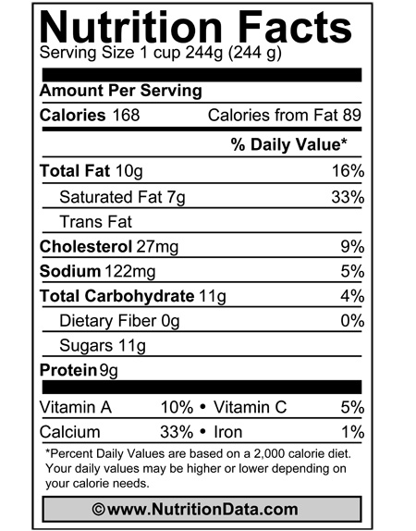
Serving Size= 1 cup
→

Slide 3
% Daily Value
→
→

Slide 4
Total Fat
-Saturated
-Unsaturated
-Trans Fat
→

Slide 5
Cholesterol
→

Slide 6
Sodium
→

Slide 7
Carbohydrates
-Sugar
-Fiber
-Starch
→

Slide 8
Protein
→

Slide 9
Vitamins!
→

