Slide 1
Nursing War veterns
By: Kara Thomas, Sydney Bailey, Simone Walker, Greg Cahill
With guest speaker: Betty Mosier

Slide 2
Post traumatic stress disorder (PTSD)
Triggered by an event that produces intense fear, helplessness or horror
Trouble coping with the traumatic event
Trouble adjusting to your life after a traumatic event
Symptoms usually start within 3 months of event
Notes:
Characterized by having trouble coping with a traumatic event You can see, learn about or experience the traumatizing event

Slide 3
PTSd
Symptoms may include
Flashbacks
Nightmares
Severe anxiety
Uncontrollable thoughts about the triggering event
Avoid activities you once enjoyed

Slide 4
PTSD
Veterans with PTSD are 2.8 times more likely to attempt suicide
VA provides suicide prevention program
1-800-273-talk
Hard to diagnose with conventional CT and MRI scans
Developing
Magnetoencephalography (MEG)
Diffusion tensor imaging (DTI)

Slide 5
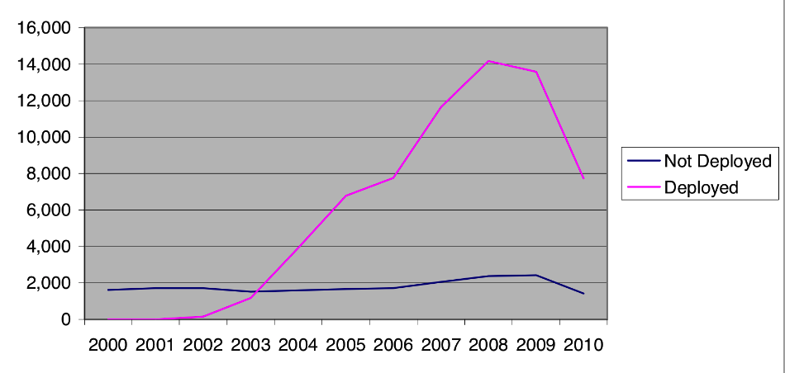
PTSD
Notes:
The more often a soldier is in combat or the more intense the fighting the more likely a soldier is to develop PTSD
As this chart demonstrates; deployed soldiers are more likely to develop PTSD than the soldiers who are not deployed.

Slide 6
Risk factors
Genetics
Family history of anxiety and depression
Life experiences
The amount and severity of trauma experienced throughout their life
Personality/ temperament
Brain regulation of chemicals and hormones in response to stress

Slide 7
PTSD treatment
The more quickly treatment starts the better the outcomes usually are
Counseling
Meditation
mantram
SSRI’s
Zoloft
Paxil
Exposure therapy
Virtual reality exposure therapy
Notes:
Benzodiazepines and tricyclic antidepressants were used to treat PTSD until the last decade when SSRI’s became more prevelant. Mantram therapy is repeating a sacrad, powerful word or phrase that has meaning to the individual soldier. Exposure therapy is exposing the patient to a traumatic memory until they learn to cope. VR exposure therapy is a newer treatment that exposes veterans with PTSD to traumatic memories using VR in a safe and secure place.

Slide 9
citation
Fischer, H. (2010). U.s. military casualty statistics: Operation new dawn, operation iraqi freedom, and operation enduring freedom (RS22452)Congressional research service.
Garske, G. (2011). Military-related ptsd: A focus on the symptomatology and treatment approaches. Journal of rehabilitation, 77(4), 31-36.
Mayo Clinic Staff. (2011, April 08). Mayo clinic. Retrieved from http://www.mayoclinic.com/health/post-traumatic-stress-disorder/ds00246/dsection=symptoms

