Slide 1
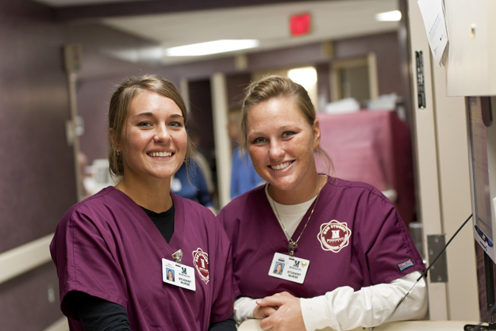
“Nurses Giving back”
Lakeview College of Nursing Legacy Project
Group Members: Ihechi Alilionwu, Dominique Davis ,Tearra Mcdade,Theresa Pollum & Lois Syse

Slide 2
Mission, Vision,& Values
“Mission”
To work with communities to eliminate poverty by promoting health wellness interventions and providing useful referrals of medical and employment opportunities.
“Vision”
To impact others in the community by using our talents and any resources available that may be useful to live a better life
“Values”
Awareness,Leadership,Compassion,Diversity,
Education and Love

Slide 3
Purpose
The goals of this Legacy projects is to
Inform the community that Poverty exists throughout Edgar & Coles County
Help those to learn of the resources available for those in need of Medical and Employment referrals
Promote Health & Wellness Interventions
Donate items of necessity for those in need of all ages

Slide 4
Activites Planned
“Health Screening Work”
“Lunch and Dinner Meal Deal”
“Guess Speakers(Dawn Thomason & Kory Stone) views of poverty & helpful interventions of how to overcome poverty throughout the world”
“Clothing Drive”

Slide 5

Sponsor Association
Aggregate: Low income families, Single parent households, homeless veterans and children
ministry featuring food, clothing and furniture to the community.
Purpose is to meet un-needs through multi-faceted, Christ centered outreach
Executive Director: Dawn Thomson
Location 206 North 6th Street , Charleston Il

