Slide 1
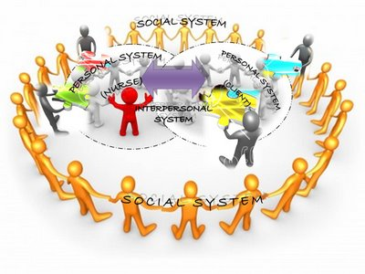
King’s Basic Concepts of Theory
Focus on persons, their interpersonal relationship, and social contexts with three interacting systems:
Personal – refer to the individual
Interpersonal – involve individuals interacting with one another
Social – related to groups of people within a community or society that shares common goals, interests, and values.

Slide 2
King’s Basic Concepts of Theory Continued
According to King..
Personal System – the concepts within the personal systems and fundamental in understanding human being are perception, self, body image, growth and development, time, and space.
Interpersonal – the concepts associated with interpersonal system are interaction, transaction, communication, role, and stress.
Social – Social systems provide a framework for social interaction and relationship, and establish rules of behavior and courses of action.

Slide 3
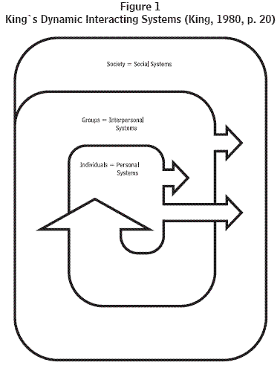
King’s Theory of Goal Attainment
10 Major Concepts
Human Interactions
Perception
Communication
Role
Stress
Time
Space
Growth
Development
Transactions

Slide 4
Reference
King, I. M. (1981). A theory for nursing: Systems, concepts, process. New York: Wiley.
Williams, L. A. (2001). Imogene king’s interacting systems theory: Application in emergency and rural nursing. Online journal of rural nursing and health care, 2, 25-26

