Slide 1
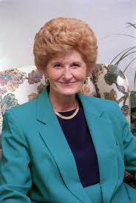
Nola pender
Health Promotion Model

Slide 2
Nola Penders
Born in Lansing, Michigan in 1941.
Only child of parents who advocated for the education of women
She became interested in nursing while visiting a hospitalized aunt at age 7.

Slide 3
Education
1962: Nursing diploma from the School of Nursing at West Suburban Hospital in Oak Park, IL
1964: BSN from Michigan State University
1965: MA in Human Growth & Development from Michigan State University
1969: Ph.D in Psychology and Education from Northwestern
At present, she is Professor Emerita at the University of Michigan School of Nursing

Slide 4
the health promotion model
Quality of life can be greatly improved by preventing health problems before they occur
Focus on positive sources of motivation to change and promote healthy behaviors
Version two of the Health Promotion Model focuses on behavior specific influences that have more predictive power than general influences
Framework for nurses to council individuals and families to adopt healthy behaviors

Slide 5
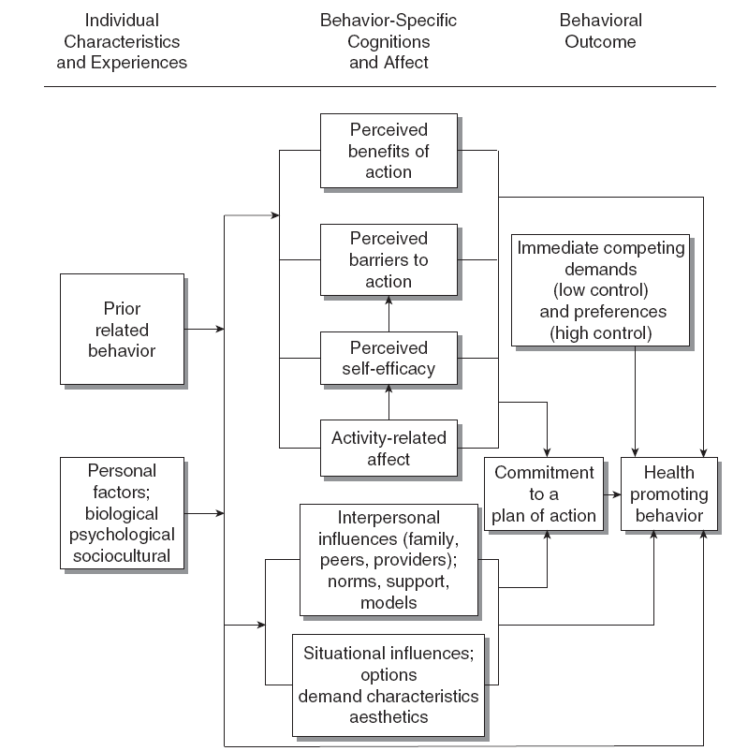

Slide 6
How does theory impact direct patient care?
Providing student nurses and nurses with behavioral counseling skills is an important part of health promotion education.

Slide 7
What does this theory mean for nursing?
Health promotion model is taught in community health and health promotion and illness prevention courses at the graduate and undergraduate levels in most nursing programs
Nurses can use HPM as a framework to counsel individuals and families to adopt healthy behaviors.
New computer technologies can be used during the conduct assessments and interventions to specific individuals.

Slide 8
Contd.
Health promotion counseling guidelines can be developed for an entire institution.
Health promotion system can be put into place that focus on HPM variables
We should probably mention the variables somewhere in the prev slide.

Slide 9
references
Finkleman, A., & Kenner, C. (2010). Professional nursing concepts: Competencies for quality leadership (2nd ed.). Burlington, MA: Jones & Bartlett.
Pender, N. (2011). Health promotion model: Frequent questions. In Deep blue. Retrieved November 16, 2012, from University of Michigan website: http://hdl.handle.net/2027.42/85352
Sitzman, K., Eichelberger, L. (2004) Understanding the work of nurse theorists : A creative beginning Sudbury, MA: Jones & Bartlett.
Walker, S., Sechrist, K., & Pender, N. (1995). Health promotion model - instruments to measure health promoting lifestyle: Health-promoting lifestyle profile [HPLP II] (Adult Version). In Deep blue. Retrieved November 16, 2012, from University of Michigan website: http://hdl.handle.net/2027.42/85349

