Slide 1

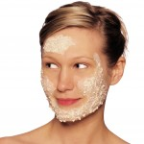
Dove, 2011.
Scrumptious Tidbits, 2011.
“The key to beautiful skin is taking care of it.”

Slide 2
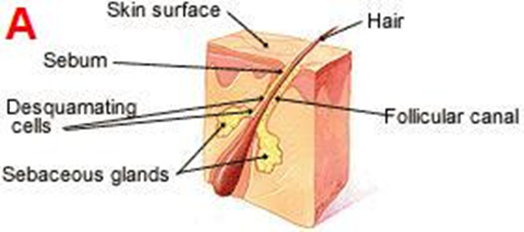
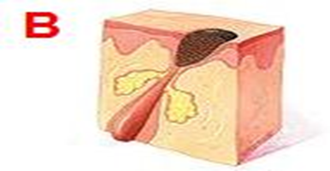
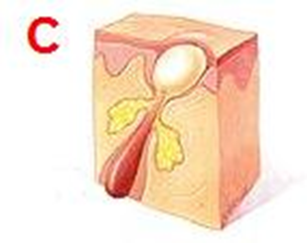
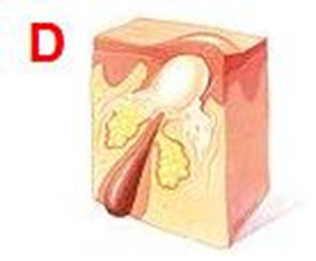
TYPES OF ACNE (WebMD)
FORMATION OF ACNE
BLACKHEADS
WHITEHEADS
PAPULES AND PUSTULES

Slide 3

Causes of Skin Damage (Derrick, n.d.):
Sun Exposure:
#1 Causes of damage to skin
Causes brown spots, aging, skin cancer—e.g., melanoma
Smoking:
Second leading cause of skin damage
Skin appears wrinkly like a squashed paper bag.
Nicotine constricts blood vessels and decreases the flow of oxygen to the skin.
Pulling and rubbing skin
Don’t forget to moisturize.
Moisturizing can improve the appearance of lines by temporarily plumping them up
Sporadically taking care of skin
Should cleanse the face every night not only to avoid clogged pores, but also to wash away all the pollution your skin has been prone to.

Slide 4
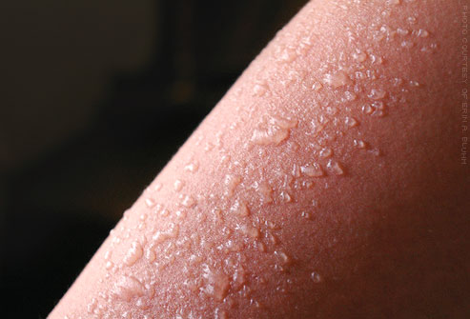
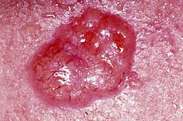
Wikipedia, 2011.
“Is the tan really worth the risk?”
Sunburn Home Remedies, 2011.

Slide 5
“A Rainbow is only as beautiful, as the colors it is composed of.”
Arika Kay
Brittany
Staci
Jessica
Samantha
Sammi Jo

