Slide 1
Chapter 21
Drugs for Parkinson’s Disease

Slide 2
Parkinson’s Disease
Parkinson’s disease (PD) is a neurodegenerative disorder of the extrapyramidal system associated with disruption of neurotransmission within the striatum.
Parkinson’s disease is characterized by dyskinesias and akinesia.
Proper function of the striatum requires a balance between the neurotransmitters dopamine and acetylcholine (ACh).
Imbalance between dopamine and ACh results from degeneration of the neurons that supply dopamine to the striatum.

Slide 3
Parkinson’s Disease (cont’d)
Dyskinesias of Parkinson’s disease are
Tremor at rest
Rigidity
Postural instability
Bradykinesia

Slide 4
Parkinson’s Disease (cont’d)
Therapeutic goals:
Improve patient’s ability to carry out activities of daily life
Drug selection and dosages are determined by extent to which PD interferes with work, dressing, eating, bathing, etc.

Slide 5
Drug Therapy for Parkinson’s Disease
Two major categories
Dopaminergic agents
By far the most commonly used for PD
Promote activation of dopamine receptors
Levodopa [Dopar]
Anticholinergic agents
Prevent activation of cholinergic receptors
Benztropine [Cogentin]

Slide 6
Dopaminergic Agents
Mechanisms of action
Levodopa: Promotes dopamine synthesis
Dopamine agonists: Stimulate dopamine receptors directly
Selegiline: Inhibits dopamine breakdown
Amantadine: Promotes dopamine release
COMT inhibitors: Enhance effects of levodopa by blocking its degradation

Slide 7
Anticholinergic Agents
Mechanism of action
Blockade of muscarinic receptors in the striatum

Slide 8
Drug Therapy for Parkinson’s Disease
Levodopa (drug holidays recommended)
Levodopa/carbidopa
Dopamine agonists:
Pramipexole [Mirapex]
Entacapone [Comtan]
Amantadine [Symmetrel]
Selegiline [Eldepryl, Carbex]

Slide 9
Chapter 22
Alzheimer’s Disease

Slide 10
Pathophysiology
Degeneration of neurons
Reduced cholinergic transmission
Beta-amyloid and neuritic plaques
Neurofibrillary tangles and tau
Apolipoprotein E4 (apoE4)
Endoplasmic reticulum-associated binding protein
Homocysteine

Slide 11
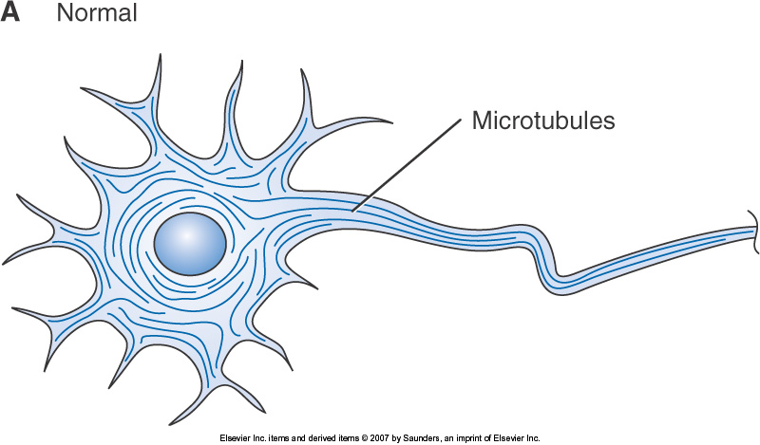
Figure 22-1A Histologic changes in Alzheimer's disease.

Slide 12
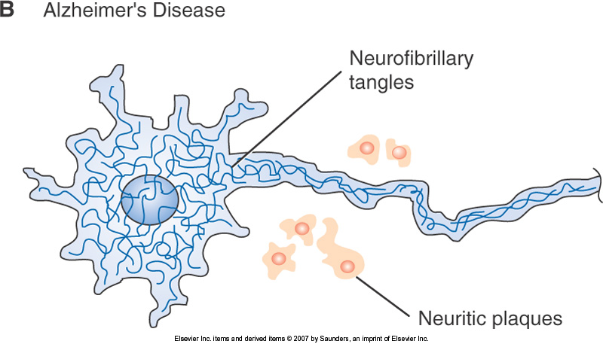
Figure 22-1B Histologic changes in Alzheimer's disease.

Slide 13
Risk Factors
Major risk factors
Advancing age
Family history
Possible risk factors
Female
Head injury
Low educational level
Production of apoE4
High levels of homocysteine
Nicotine in cigarette smoke

Slide 14
Symptoms
Memory loss
Confusion
Disoriented
Impaired judgment
Personality changes
Difficulty with self-care
Behavior problems (wandering, pacing, agitation, screaming)
Inability to recognize family members
Inability to communicate

Slide 15
Drug Therapy
Cholinesterase inhibitors
Indicated for mild to moderate Alzheimer’s disease (AD)
Prevent breakdown of ACh
Help to slow progression of disease
Adverse effects
Cholinergic side effects
GI
Dizziness
Headache
Bronchoconstriction
Liver injury (tacrine)

Slide 16
Drug Therapy (cont’d)
Memantine
First drug in a new class, the NMDA receptor antagonists
Indicated for moderate to severe AD
Better tolerated than cholinesterase inhibitors
Adverse Effects
Dizziness
Headache
Confusion
Constipation

Slide 17
Other Treatments
Vitamin E
Selegiline
NSAIDs
Estrogen
Ginkgo biloba
Drugs for neuropsychiatric disorders

Slide 18
Chapter 23
Drugs for Multiple Sclerosis

Slide 19
Multiple Sclerosis
Multiple sclerosis (MS) is a chronic, inflammatory, autoimmune disorder that damages the myelin sheath of neurons in the CNS.
MS causes a wide variety of sensory and motor deficits.
Most patients experience periods of acute clinical exacerbations (relapses) alternating with periods or complete or partial recovery (remissions).
Over time, symptoms usually grow progressively worse.

Slide 20
Signs and Symptoms of MS
Symptoms vary depending on where CNS demyelination occurs and the size of the region of demyelination
Paresthesias
Muscle or motor problems
Visual impairment
Bladder and bowel symptoms
Sexual dysfunction
Disabling fatigue
Emotional lability
Depression

Slide 21
Subtypes of MS
Relapsing-remitting MS
Secondary progressive MS
Primary progressive MS
Progressive-relapsing MS

Slide 22
Drug Therapy for MS
Disease-modifying therapy
Treating an acute episode (relapse)
Drug therapy of symptoms

Slide 23
Disease Modifying Drugs I: Immunomodulators
Four immunomodulators currently available
Recommended for all patients with relapsing-remitting MS and with secondary progressive MS experiencing acute exacerbations
Decrease relapse rate about 30%
Self-injected

Slide 24
Interferon Beta
Interferon is a naturally occurring glycoprotein with antiviral, antiproliferative, and immunodulatory actions.
Therapeutic use:
Reduces the frequency and severity of attacks
Reduces the number and size of MRI detectable lesions
Delays progression of disability

Slide 25
Interferon Beta (cont’d)
Adverse effects and drug interactions
Flu-like reactions
Hepatotoxicity
Myelosuppression
Injection-site reactions
Depression
Drug interactions
Preparation, dosage, and administration
Dispensed as single-use syringes and vials

Slide 26
Glatiramer Acetate
Therapeutic use
For long-term therapy of relapsing-remitting MS
Description and mechanism
Protects myelin by inhibiting immune response to myelin basic protein
Adverse effects
Well tolerated

Slide 27
Disease Modifying Drugs II: Immunosuppressants
Only one approved by the FDA—mitoxantrone
More toxic than immunomodulators
Produces greater suppression of immune function

Slide 28
Mitoxantrone
Therapeutic use
Decreases neurologic disability and clinical relapses
Mechanism of action
Binds with DNA and inhibits topoisomerase
Adverse effects and drug interactions
Myelosuppression
Cardiotoxicity
Fetal harm

Slide 29
Mitoxantrone
Monitoring summary
Perform complete blood counts at baseline and prior to each dose
Perform liver function tests at baseline and prior to each dose
Perform a pregnancy test prior to each dose
Determine LVEF:
Prior to the first dose
Prior to all doses once the cumulative dose has been reached
Whenever signs of CHF develop

Slide 30
Symptom Management
Bladder dysfunction
Bowel dysfunction
Fatigue
Depression
Spasticity
Sexual dysfunction
Neuropathic pain
Ataxia and tremor
Cognitive dysfunction
Dizziness and vertigo

Slide 31
Chapter 24
Drugs for Epilepsy

Slide 32
Definition of Epilepsy
Group of disorders characterized by excessive excitability of neurons in the CNS

Slide 33
Seizures: Types
Partial (focal) seizures
– Simple partial
– Complex partial
– Secondarily generalized
Generalized seizures
Tonic-clonic (grand mal)
– Absence (petit mal)
– Atonic
– Myoclonic
– Status epilepticus (SE)
– Febrile

Slide 34
Antiepileptic Drugs
Effects
Suppress discharge of neurons within a seizure focus
Suppress propagation of seizure activity from the focus to other areas of the brain
Mechanisms of action:
Suppression of sodium influx
Suppression of calcium influx
Antagonism of glutamate
Potentiation of GABA

Slide 35
Epilepsy: Therapeutic Considerations
Treatment goal and treatment options
Neurosurgery (best success rate)
Vagal nerve stimulation
Ketogenic diet
Diagnosis and drug selection
Drug evaluation

Slide 36
Epilepsy: Therapeutic Considerations (cont’d)
Monitoring plasma drug levels
Promoting patient adherence
Withdrawing antiepileptic drugs

Slide 37
Classification of Antiepileptic Drugs Two major categories:
Traditional antiepileptic drugs (AEDs)
Phenytoin, carbamazepine, valproic acid, and others
Newer AEDs
Oxcarbazepine
gabapentin

Slide 38
Phenytoin [Dilantin]
Partial and tonic-clonic seizures
Mechanism of action: selective inhibition of sodium channels
Varied oral absorption
Half-life: 8 to 60 hours

Slide 39
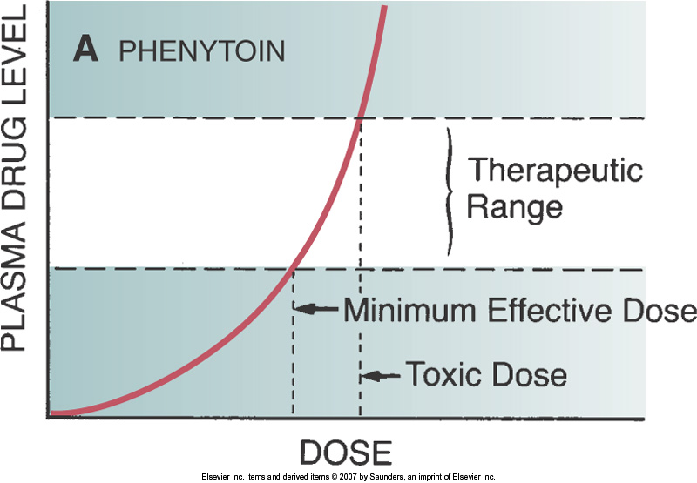
Figure 24-1A Relationship between dose and plasma level for phenytoin compared with most other drugs.

Slide 40
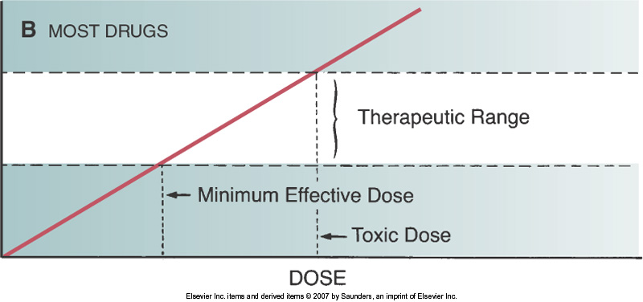
Figure 24-1B Relationship between dose and plasma level for phenytoin compared with most other drugs.

Slide 41
Phenytoin (cont’d)
Adverse effects
Nystagmus
Sedation
Ataxia
Diplopia
Cognitive impairment
Gingival hyperplasia
Skin rash
Effects in pregnancy
Cardiovascular effects

Slide 42
Phenytoin (cont’d)
Drug interactions
Decreases the effects of oral contraceptives, warfarin, and glucocorticoids
Increases levels of diazepam, isoniazid, cimetidine, alcohol, valproic acid

Slide 43
Carbamazepine [Tegretol]
Uses
Epilepsy
Bipolar disorder
Trigeminal and glossopharyngeal neuralgias
Adverse effects
Neurologic effects: nystagmus, ataxia
Hematologic effects: leukopenia, anemia, thrombocytopenia
– Birth defects
Hypo-osmolarity
Dermatologic effects: rash, photosensitivity reactions

Slide 44
Valproic Acid [Depakene, Depakote, Depacon]
Uses
Seizure disorders
Bipolar disorder
Migraine
Adverse effects
GI effects
Hepatotoxicity: liver failure
Pancreatitis
Teratogenic effects

