Slide 1
The Cesarean Section Epidemic
Stacey Johansen, Jenna Kreke, Lindsay Rhodes, & Robert Winkelman
Lakeview College of Nursing
N305 – Nursing of the Childbearing Family
November 27, 2012

Slide 2
Introduction
Reasons
Risks
Rates in the U.S.
Demographics
Reasons for high rates
Guidelines from national organizations
Nursing implications

Slide 3
Reasons for a C-Section: Medical

Slide 4
Reasons for a C-Section: Non-Medical

Slide 5
Risks for a C-Section: Mother

Slide 6
Risks for a C-Section: Baby

Slide 7
C-Section Rates in the U.S.
1965 – 4.5%
1996 – 20.7%
2006 – 31.1%
2009 – Over 34%
That’s more than 1 in 3 mothers!

Slide 8
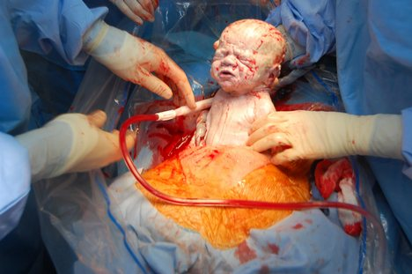
Demographics of C-Sections
Women of higher socioeconomic status are much more likely to have a C-Section than women of lower incomes.

Slide 9
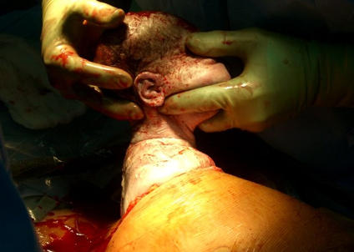
Reasons for High Rates
Myths
Not enhancing women’s own ability
Side effects of labor
Not getting a choice
Casual attitudes about surgery
Lack of awareness
Provider efficiency

Slide 10
Vaginal Birth after Cesarean

Slide 11
Induction

Slide 12
Timing of C-Section

Slide 13
National Organizations on C-Sections

Slide 14
Nursing Implications

Slide 15
Conclusion

Slide 16
Questions

Slide 17
References
Childbirth Connection. What Every Pregnant Woman Should Know About Cesarean Section, 2nd ed. New York: Childbirth Connection, December 2006. Available at http://www.childbirthconnection.org/cesareanbooklet/
Hamilton BE, Martin JA, Ventura SJ. Births: preliminary data for 2010. Natl Vital Stat Rep 2011;60(2):1-25. Available at www.cdc.gov/nchs/data/nvsr/nvsr60/nvsr60_02.pdf
Bielanko, M. (2011). C-sections on demand: “labor shouldn’t be viewed as a rite of passage into motherhood”. Being Pregnant. Retrieved from: http://blogs.babble.com/being-pregnant/2011/11/10/c-sections-on-demand-labor-shouldnt-be-viewed-as-a-rite-of-passage-into-motherhood/

