Slide 1
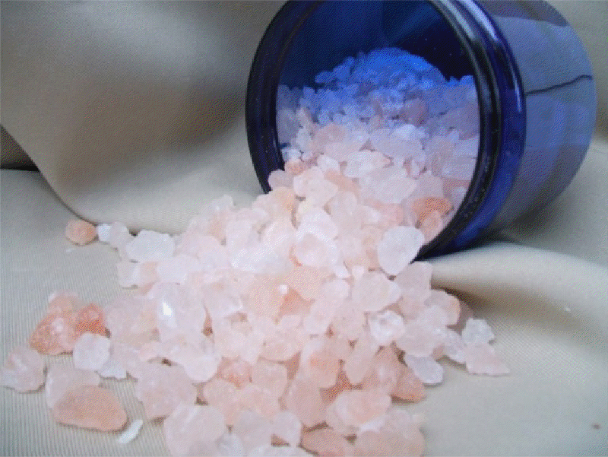
Bath salts
GROUP 6
Carol Ann Cheetham Dwight Hardin
Aubrie Lalich Gretchen Olmsted
Brooke Wickman

Slide 2
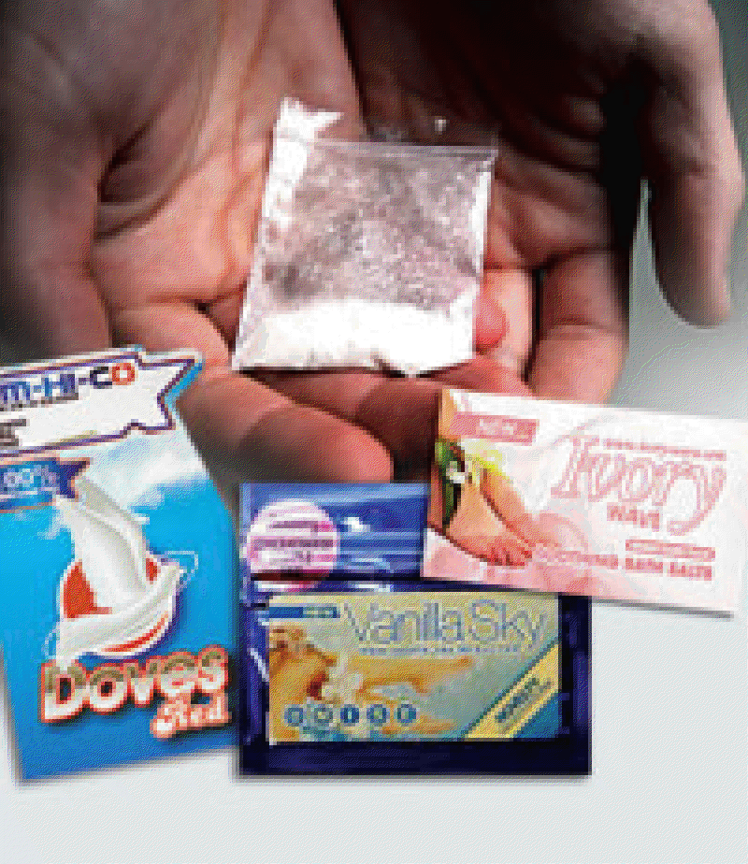
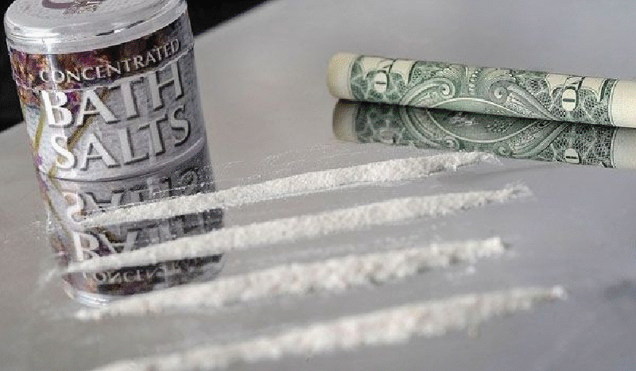
What are bath salts?
It is a synthetic stimulant powder that contains amphetamine-like chemicals; including mephedrone, which may have a high risk for overdose.
It is sold under the brand names blizzard, blue silk, charge+, ivory snow, ivory wave, ocean burst, pure ivory, purple wave, snow leopard, stardust, vanilla sky, white dove, white knight, white lightening
Bath Salts are new and some of the contents unknown, using it in any way is highly dangerous.
Bath salts are illegal in a several U.S. states, as well as Canada, Australia, and Great Britain.

Slide 3
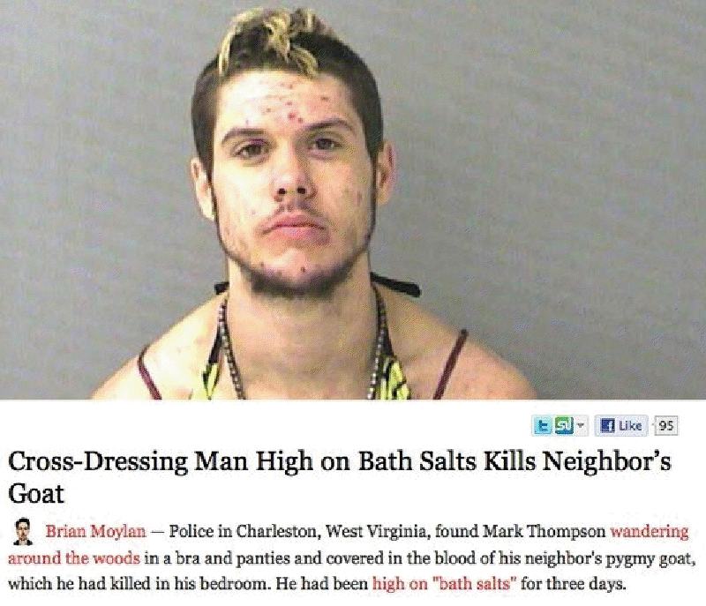
Risks?
Between January and February 2011, there were over 250 calls to U.S. poison centers related to bath salts.
Well over 236 calls in all of 2010
Full risks and effects are unknown
Rehabs are receiving referrals from psychiatric hospitals to treat those addicted to bath salts
Those who take bath salts have committed horrible acts of violence against themselves and others
  Believing demons, monsters and aliens are out to get them

Slide 4
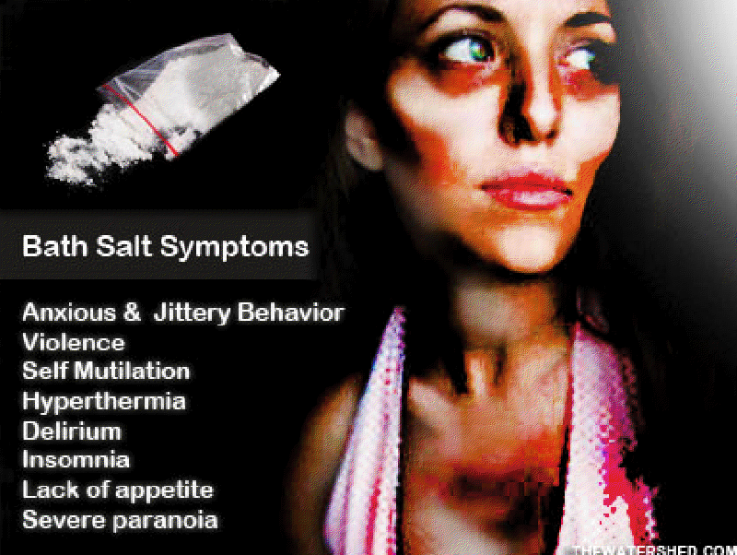
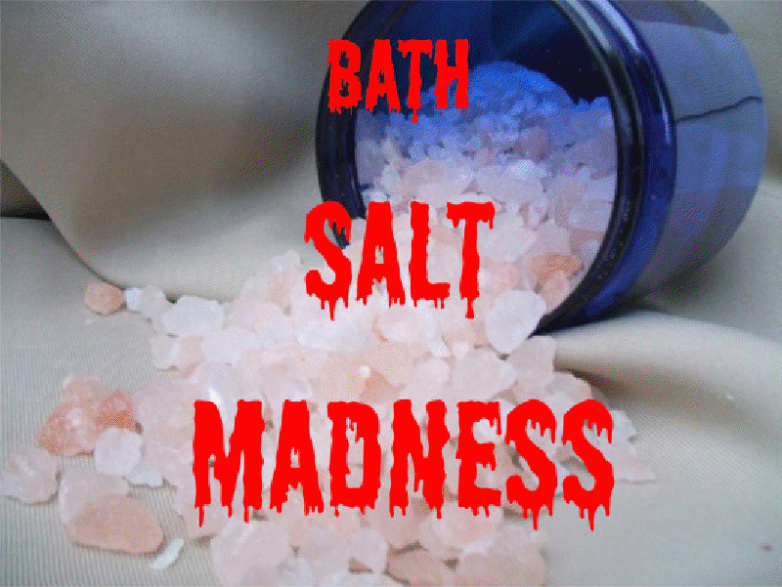
Effects
Rapid heart rate
  Hypertension
  Chest pain
  Stroke
  Heart attack
Nose bleed
Sweating
Nausea
Confusion
Psychosis
Aggression
Agitation
Seizures
Vomiting
http://www.ebaumsworld.com/video/watch/82310574/

Slide 5
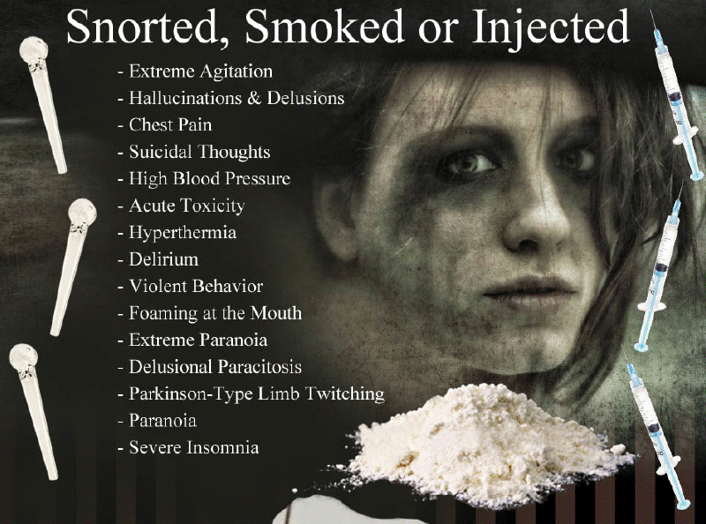
Long-term effects
Bath salts are relatively new so long term effects are unknown
They have similarities to methamphetamine
Long-term use can lead to:
    Emotional and physical crashing
    Depression/anxiety
    Intense cravings for the drug

Slide 6
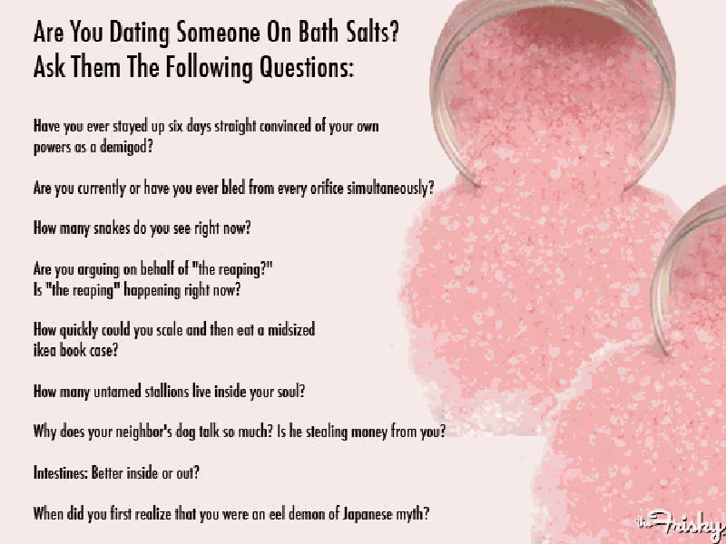
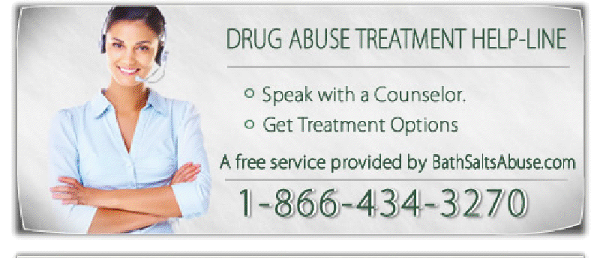
Recovery
Rehab is essential
Even months after last use, addicts can still feel cravings, agitation, and paranoia
Effects can last beyond typical 30-day stay
May need stay in transitional living facility
Use of 12-step program
Rehab is first step
Addiction to bath salts is just as serious as cocaine, meth, and other stimulants

