Slide 1
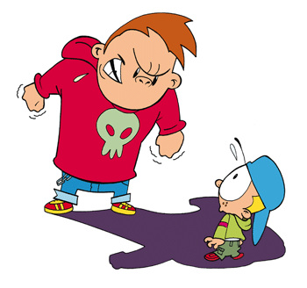
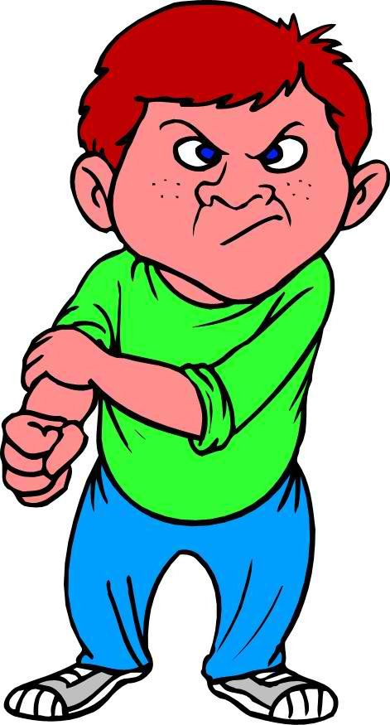
Bullying

Slide 2

Overview
What is Bullying?
Where can bullies be found?
What can be done to stop bullying?
What are the long term consequences of being bullied?

Slide 3
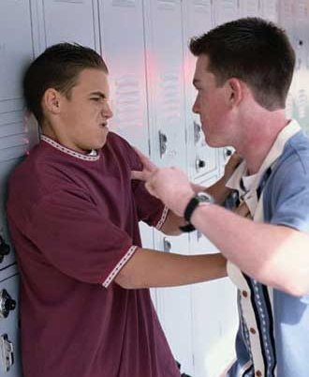
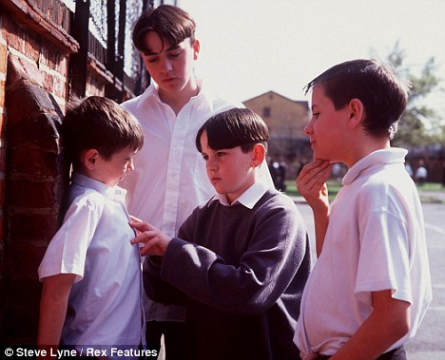
What is Bullying?
Bullying can be defined as repeated and
systematic harassment and attacks on others
Bullying can be perpetrated by individuals or
groups

Slide 4
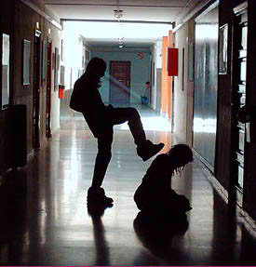

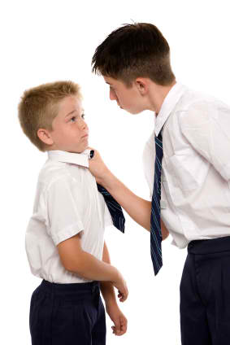

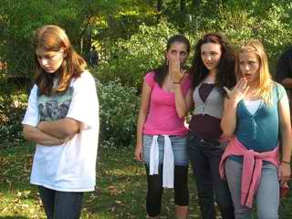
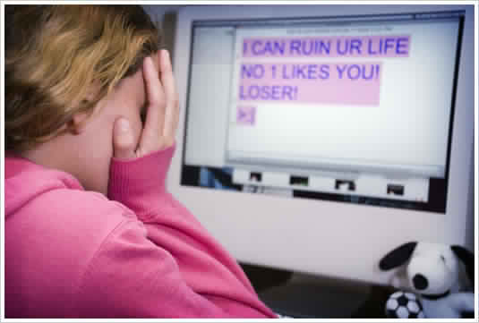
Types of Bullying
Physical Violence and Attacks
Verbal Taunts, Name Calling and Put-Downs
Threats and intimidation
Stealing of Money and Possessions
Exclusion from the Peer Group
Cyber Bullying

Slide 5


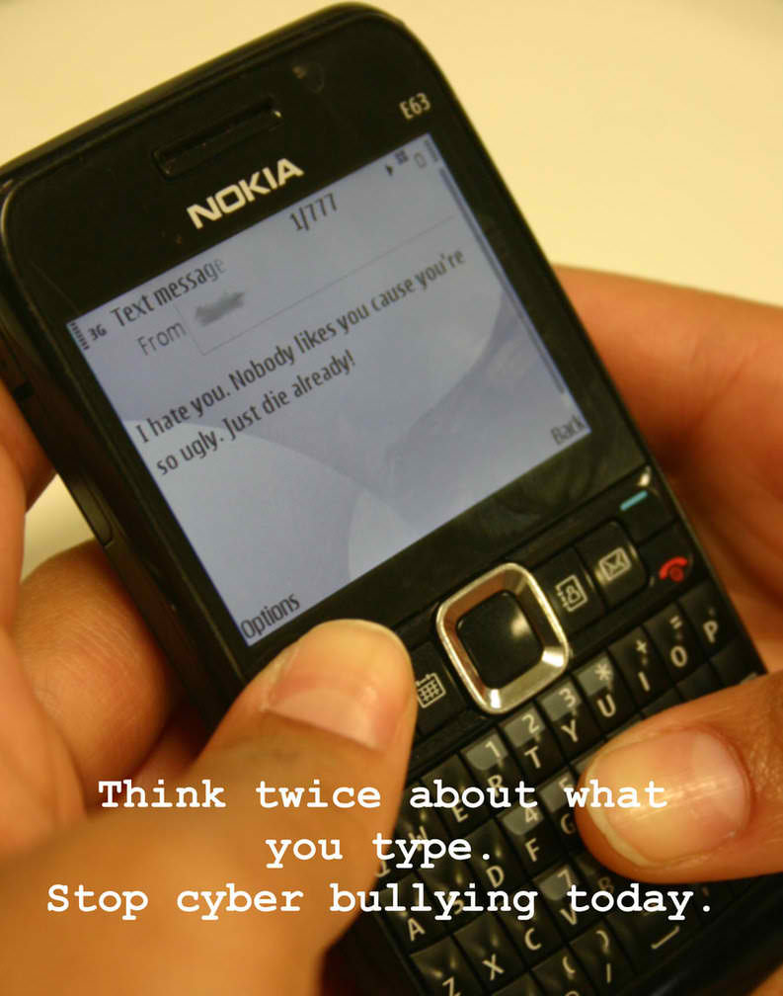


Where can bullies be Found?

Slide 6


What Can YOU do to stop bullying?
Tell the Bully to stop!!
Talk with someone you trust. You are not to blame for being bullied
Ask for help!! Do not be afraid to ask an authority figure to intervene between you and the bully

Slide 7
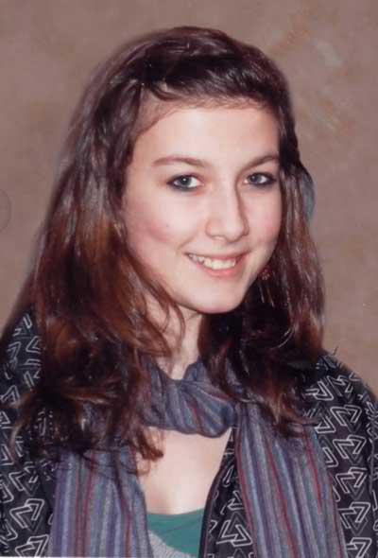
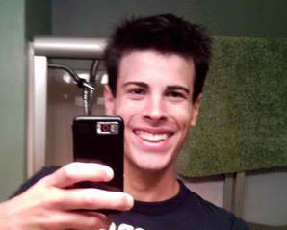


Lance Lundston
Died January 18, 2011 by suicide from bullying because he was gay
Phoebe Prince
Died January 14, 2010 by suicide from cyber bullying
Hope Witsell
Died September 2009 by suicide from bullying from “sexting”

