Slide 1
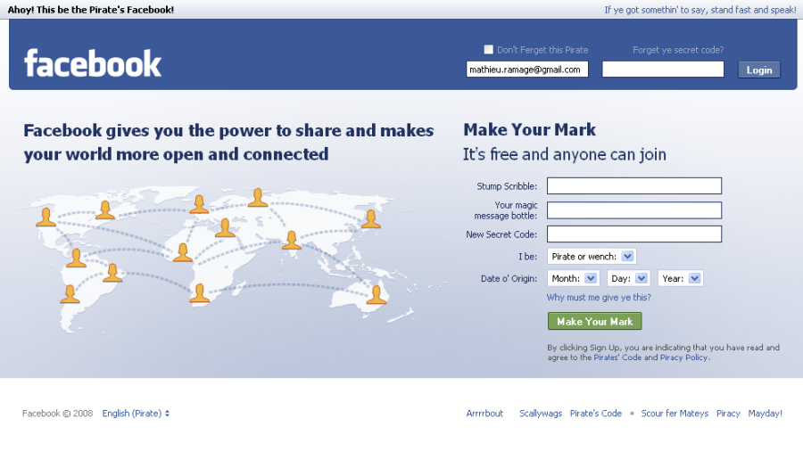
Internet Safety
Created by: Jessica, Karianne, Nicole, Sarah, Suzanne, and Yvonne

Slide 2
Adolescent Online Posting
Social networking sites have millions of people logging in every day to create profiles, post pictures, and share information.
Facebook (Worldwide)
Twitter (Worldwide)
Myspace (Mainly North America)
Youtube (Worldwide)

Slide 3


Slide 4
Objectives for Presentation
Identify what information is appropriate to post.
Identify what information is not appropriate to post.
Have a general idea of the safety precautions and risks that are involved in joining a social networking site.

Slide 5
Internet Dangers
"Cyber bullying" is when a child, preteen or teen is tormented, threatened, harassed, humiliated, embarrassed or otherwise targeted by another child, preteen or teen using the Internet, interactive and digital technologies or mobile phones
Profiles and chat rooms give others easy access to private information that when publicized and gotten into the wrong hands, may harm the individual
Those especially at risk are children, adolescents, and teens

Slide 6
Statistics
8 percent of teens have admitted to meeting someone they had only met online in person while 16 percent admitted to considering meeting someone they had only communicated with online.
52 percent of teens have given out personal information including photos and physical descriptions of themselves to someone they don't know while online.

Slide 7
Statistics
69 percent of teens receive personal messages online on a regular basis from people they do not know.
14 percent of sophomores, juniors, and seniors in high school admit to accepting an invitation to meet a stranger in person that they had met online and 14 percent admit to inviting strangers to come meet them in person.
One in eight adolescents and teens age 8 to 18 have discovered that someone they had met and communicated with online was an adult pretending to be younger.

Slide 8

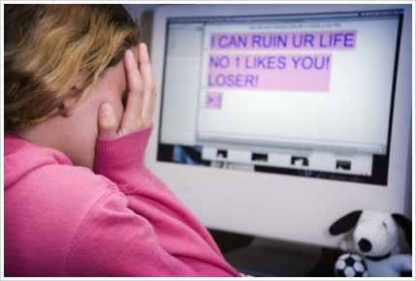

Slide 9
Do’s of Internet Usage
Use the internet for help with schoolwork- there is a vast amount of knowledge to be found
Keep in touch with pen pals- be careful talking to strangers- tell a trusted adult immediately if something makes you uncomfortable
Be careful with personal information
Respect the privacy of others
Follow your parent’s rules regarding internet usage
Make sure you completely log out of any site you get on to
Install antivirus software
If you are using a chat room stay on public monitored and friendly chat rooms
Practice honesty and politeness to peers!

Slide 10
Top 10 things you should not share on the internet
Top 10 things you should not share on the internet:
Anything you do not want shared
Password hints
Password
Personal finance information
Address/phone number
Photos of your kids
Company information
Linking sites
Social plans
Personal conversation

Slide 11
Links
http://www.youtube.com/watch?v=ieRE_wyheRg
http://www.youtube.com/watch?v=yZgpmuz2MQc
http://www.youtube.com/watch?v=aa6Vxc4cB2w

Slide 12

Conclusion
The Children's Online Privacy Protection Act (COPPA), was created to help protect kids online.
Profiles may have limited viewers and privacy- know how to work them
Always lookout for the signs of internet dangers
Anything suspicious should be reported or refrain from talking to the person/persons

Slide 13
References
Bryant, C. W. (2010). Top 10 things you should not share on your social network. Retrieved from The
discovery Company:How stuff works website: http://computer.howstuffworks.com/internet/
social-networking/information/10-things-you-should-not-share-on-social-networks1.htm
Cyber bullying . (2008, May 28). Retrieved from http://www.youtube.com/watch?v=yZgpmuz2MQc
Cyber bullying . (n.d.). Retrieved from http://www.google.com/images?um=1&hl=en&biw=1280&bih=642&tbs=isch%3A1&sa=1&qbe r+bullying&aq=f&aqi=&aql=&oq=&gs_rfai=
Couric, K. (Photographer). (2007). Notebook: cyber bullying (cbs news) . [Web]. Retrieved from http://www.youtube.com/watch?v=aa6Vxc4cB2w
Internet safety . (n.d.). Retrieved from http://kidshealth.org/parent/positive/family/net_safety.html

Slide 14
References
Online Sexual Predators. (n.d.). Retrieved from Enough is Enough: Making the
Internet Safer for Children and Families website: http://enough.org/
inside.php?id=2UXKJWRY8#6
Stop cyber bullying . (n.d.). Retrieved from Bryant, C. W. (2010). Top 10 things you should not share on your social network. Retrieved from The discovery Company:How stuff works website: http://computer.howstuffworks.com/internet/ social-networking/information/10-things-you- should-not-share-on-social-networks1.htm
Internet Safer for Children and Families website: http://enough.org/inside.php?id=2UXKJWRY8#6
WDTNTV, Initials. (Producer). (2010). Internet safety for teenagers. [Web]. Retrieved from http://www.youtube.com/watch?v=ieRE_wyheRg
What is your teen posting online?. (2009). Retrieved from http://www.focusas.com/online-posing.html

