Slide 1
Sexually Transmitted Diseases
Abdul Alli-Balogun
Rachel Davis
Kaitlin Fleischman
Christina Grider
Sara Janes
Danielle Stafford
Ijeoma Uzoaru

Slide 2
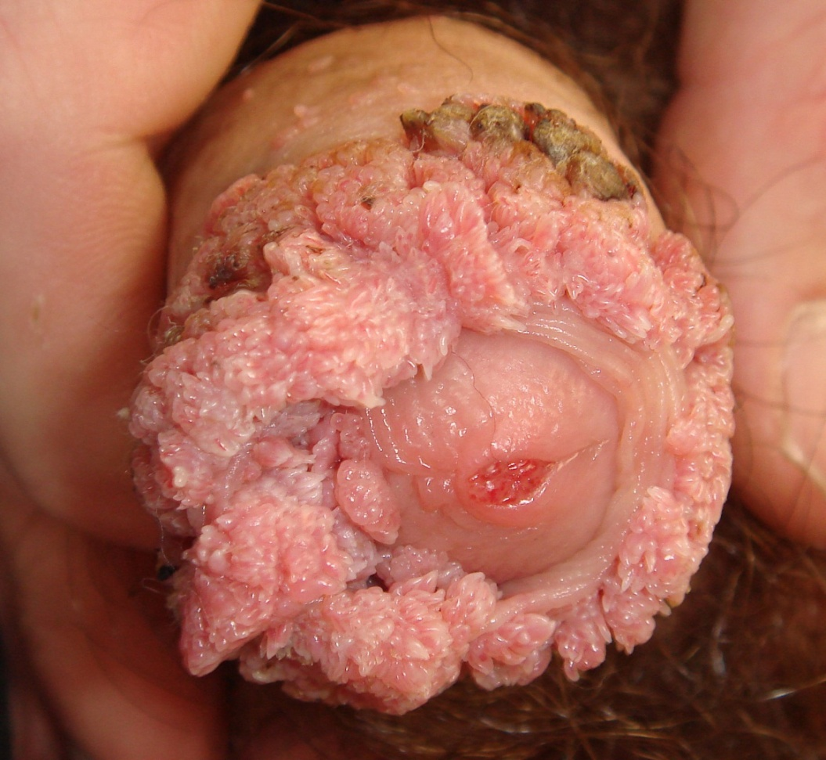
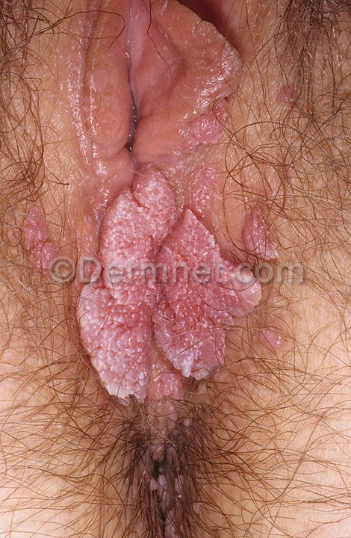
Any idea what kind of STD/STI this is?
http://dermatlas.med.jhmi.edu/derm/result.cfm?Diagnosis=-1449379264

Slide 3
Genital Warts and HPV What are they?
Genital warts are soft wart-like growths on the genitals
Genital warts are caused by a virus called human papilloma virus (HPV), but not all HPV infections lead to Genital Warts
Genital warts are a type of sexually transmitted disease (STD), also called a sexually transmitted infection (STI).

Slide 4
Genital Warts and HPV Symptoms
Genital warts are raised, flesh-colored lesions on the genitals, anus, or surrounding skin
They may appear as cauliflower-like growths around the anus or genitals
Abnormal vaginal bleeding (not associated with a menstrual period) after sexual intercourse
Increased dampness or moisture in the area of the growths
Itching of the penis, scrotum, anal area, or vulva
Increased vaginal discharge
Often there are no symptoms

Slide 5
Genital Warts and HPV Treatment
Genital Warts must be treated by a doctor
-Do NOT use over the counter medications to treat these warts
Your doctor will either apply a skin treatment or prescribe a medication that you apply at home
Women who have ever had genital warts or have had partners who have ever had genital warts should have a Pap smear at least once a year
HPV can lead to changes in cell function in the cervix, and commonly be the cause of abnormal results of a Pap smear. If a Pap comes back abnormal, typically a colposcopy is recommended

Slide 6
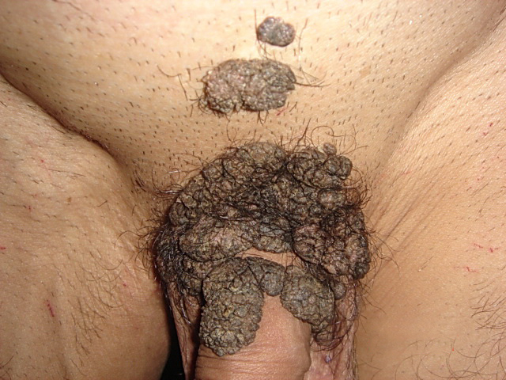
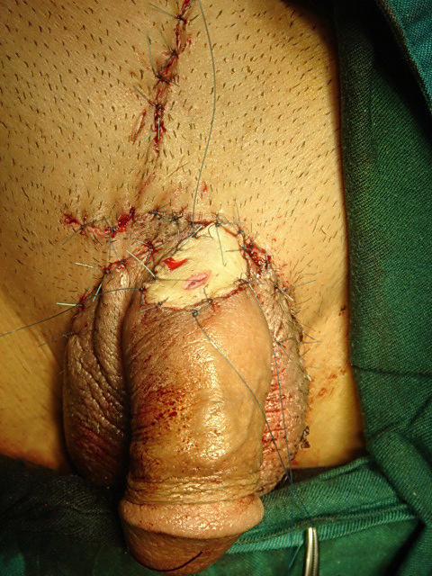
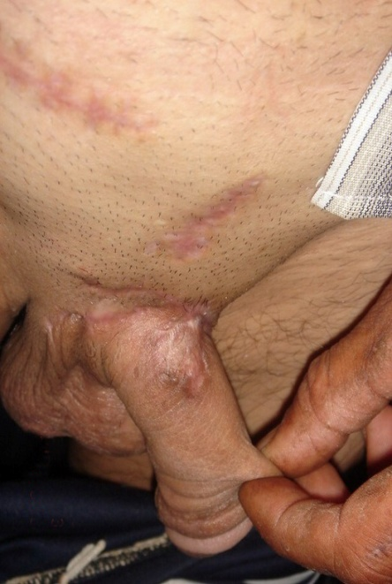
Genital Warts and HPV Treatment - Continued
Surgical treatment include: Cyrosurgery, Electrocauterization, Laser Therapy or Cutting them out
http://dermatlas.med.jhmi.edu/derm/result.cfm?Diagnosis=-1449379264

Slide 7
Genital Warts and HPV Prognosis
With proper treatment, genital wart outbreaks usually can be controlled. However, the warts frequently reappear after treatment. Even after you have been treated for HPV, you may still infect others.

Slide 8
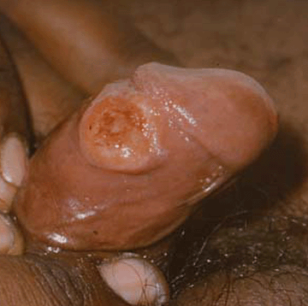
Any idea what kind of STD/STI this is?
http://qwickstep.com/search/syphilis-chancres.html

Slide 9
Syphilis What is it?
A sexually transmitted infection caused by the bacterium Treponema pallidum
It is passed via direct contact with a syphilis sore (chancre)
Typically transmission occurs from sores in persons in the primary or secondary stage (when a rash or sores are present)
However, sores can be unrecognizable at this stage, and transmission can happen without either person knowing there is an infection
Passed through vaginal, anal, or oral sex
Pregnant mothers (infected with syphilis) can pass this disease on to their unborn child

Slide 10
Syphilis Symptoms
Chancres are typically present on:
External genitals
Vagina
Anus
Rectum
Can occur on lips and in the mouth

Slide 11
Syphilis Treatment
Diagnosis
Blood tests (the body produces syphilis antibodies after the infection occurs, and these are found from the test)
Treatment
Single IM shot of penicillin can cure someone who has been infected for less than a year
More doses are required to treat a person infected for more than a year
If allergic to penicillin, other antibiotics can be utilized

Slide 12
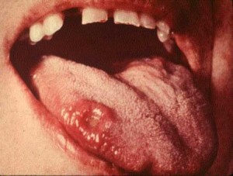
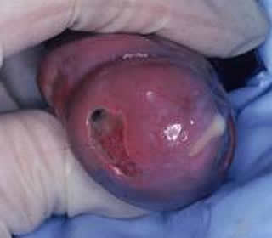
Any idea what kind of STD/STI this is?
http://e-mergencycontraception.com/tag/chlamydia-symptoms/
http://qwickstep.com/search/gonorrhea.html

Slide 13
Chlamydia and Gonorrhea What are they?
Chlamydia is caused by bacterium Chlamydia trachomatis, it is the most frequently reported bacterial STD in the United States
Gonorrhea is caused by bacterium Neisseria gonorrhoeae, most commonly reported in teens, young adults and the African American population

Slide 14
Chlamydia and Gonorrhea Symptoms
Most people with Chlamydia never exhibit symptoms and generally Gonorrhea exhibits mild symptoms
For both Chlamydia and Gonorrhea, in men the urethra is the main site of infection, pain or discharge may be present
For both Chlamydia and Gonorrhea, in women the cervix is the main site of infection, pain during sexual intercourse, abdominal pain, discharge or vaginal irritation may be present

Slide 15
Chlamydia and Gonorrhea Treatment
Chlamydia is usually treated with a single dose of azithromycin , or a week long dose (twice daily) of doxycycline
Gonorrhea is usually treated with antibiotics, though there are several strains of antibiotic-resistant forms of Gonorrhea
Many people with Gonorrhea also have Chlamydia, so usually one antibiotic is given to treat both

Slide 16
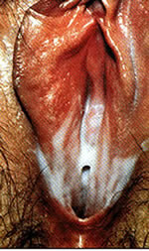
Any idea what kind of STD/STI this is?
http://www.palmbeachurgentcare.net/STDs.html

Slide 17
Trichomoniasis What is it?
Trichomoniasis is found worldwide. In the United States, the highest number of cases are seen in women between age 16 and 35. Trichomonas vaginalis is spread through penis-to-vagina intercourse or vulva-to-vulva contact with an infected partner. The parasite cannot survive in the mouth or rectum.
The disease can affect both men and women, but the symptoms differ between the two groups. The infection usually does not cause symptoms in men and goes away on its own in a few weeks.

Slide 18
Trichomoniasis Symptoms
Women:
Discomfort with intercourse
Itching of the inner thighs
Vaginal discharge (thin, greenish-yellow, frothy or foamy)
Vaginal itching
Vulvar itching or swelling of the labia
Vaginal odor (foul or strong smell)
Men:
Burning after urination or ejaculation
Itching of urethra
Slight discharge from urethra
Occasionally, some men with trichomoniasis may develop prostatitis or epididymitis from the infection

Slide 19
Trichomoniasis Treatment
The antibiotic metronidazole is commonly used to cure the infection. An alternative drug is called Tinidazole You should not drink alcohol while taking the medicine and for 48 hours afterwards. Doing so can cause severe nausea and vomiting.
Avoid sexual intercourse until treatment has been completed. Sexual partners should be treated at the same time, even if they have no symptoms.

Slide 20
Trichomoniasis Prognosis
With treatment the prognosis is excellent, left untreated it can increase the susceptibility of a woman being infected with HIV if exposed to the virus

Slide 21
HIV/AIDS What is it?
The CDC estimates that over one million people are living in the U.S. with HIV and 20% of those are unaware that they are infected
HIV is a retrovirus that impacts the vital organs of the immune system, especially the CD4+ T Helper Cells which have the primary function of fighting infection
Women are more susceptible to HIV infections, though twice as many men currently have HIV compared to women

Slide 22
HIV/AIDS Symptoms
Initially HIV may be asymptomatic, this may last for years
When symptomatic, the first symptoms noted are upper respiratory tract infections
Then diarrhea lasting over a month may be reported along with pulmonary tuberculosis
HIV is called AIDS when the viral process progresses to include symptoms like toxoplasmosis of the brain, candidiasis of the esophagus, trachea, bronchi or lungs and Kaposi’s sarcoma
These symptoms appear when the CD4+ T Helper Cells depletion reaches a certain low point

Slide 23
HIV/AIDS Treatment
Antiretroviral drugs are most commonly prescribed to people with HIV/AIDS, these drugs are used to slow the replication process of the HIV virus
Antiretroviral drugs often have many adverse side effects, such as osteoporosis, nephropathy, cancers, neurocognitive disorders, and cardiovascular diseases

Slide 24
HIV/AIDS Prognosis
HIV/AIDS is not curable, but with treatment patients have an estimated life expectancy of about 20 years after diagnosis, just 10 years ago the life expectancy was 9-11 years
HIV can be spread even when patient is on antiretroviral and symptoms are not apparent

Slide 25
Risk Factors Associated with STDs and STIs
Multiple sexual partners
Not knowing if someone you had sex with had STDs
Early age when you start to be sexually active
Tobacco and alcohol use
Stress and other viral infections at the same time at sexual intercourse

Slide 26
Prevention of STDs and STIs
All STDs and STIs are preventable either through abstinence or practicing safe sex
In sexually active people, condoms are the most effective form of protection against STDs and STIs, though they are not 100% effective
Condoms provide some protection against skin contact STDs, though STDs, like HPV and genital warts, can be present in the skin not covered by a condom
Birth control methods such as oral contraceptives, diaphragms, IUDs and sterility are not effective against STDs and STIs
Oral and anal sex can have the same infection rate as vaginal sex

Slide 27
References
Chlamydia – CDC fact sheet. (2010). Retrieved October 24, 2010 from http://www.cdc.gov/std/chlamydia/stdfact-chlamydia.htm
Gonorrhea – CDC fact sheet. (2010). Retrieved October 24, 2010 from http://www.cdc.gov/std/gonorrhea/STDFact-gonorrhea.htm
Google Health – genital warts.(n.d.). Retrieved October 16, 2010 from https://health.google.com/health/ref/Genital+warts
HIV/AIDS – CDC fact sheet (2010). Retrieved October 16, 2010 from: http://www.cdc.gov/hiv/resources/factsheets/
Syphilis – CDC fact sheet. (2010). Retrieved October 16, 2010 from: http://www.cdc.gov/std/Syphilis/STDFact-Syphilis.htm
Trichomoniasis – CDC fact sheet. (2010). Retrieved October 16, 2010 from: http://www.cdc.gov/std/trichomonas/stdfact-trichomoniasis.htm

